Slide 1
Callbacks
Very many actions in Javascript involve initiating an action and passing a function that will be called when the action completes – This is a Call-back
function
Example shows tying
Javascript functions
to button ‘events’
<!button with a call-back function !>
<h1> Buttons and Call-Backs</h1>
<button onclick="myfunction()">
Go On!</button>
<script>
function myfunction() {alert('you pressed my button')}</script>
<button
onclick='test = () => {confirm("Thats pushing it")}; test()’>
Try again</button>'

Slide 2
Callbacks, Pomises and Async.. Await
Good video: https://www.youtube.com/watch?v=gB-OmN1egV8

Slide 3
AJAX
If a browser-based Javascript program needed to get information from a server – the primary way to do this was a page-refresh
Very cumbersome for many type of application e.g. moving around on Google maps
Cured with a Javascript object called XMLHttpRequest object – which allowed a script to asynchronously pull other pages at any time
First implemented by Microsoft in 1999, but not universally deployed until 2002
Spawned a class of Internet Application called “Asynchronous Javascript and XML (AJAX)”
Used by Gmail(2004), Google Maps(2005)

Slide 4
Modules in Browser Javascript
In a browser, a loaded HTML file can contain many independent <script> elements
These get loaded in order into a single global scope
Tools have emerged (Webpack) to take programs developed as separate modules and pack them into a single HTML with <script>s

Slide 5
Modules in Node.js
circle.js
const PI = 3.14159265359;
function area(radius) {
return (radius ** 2) * PI;
}
function circumference(radius) {
return 2 * radius * PI;
module.exports ={ PI: PI,
area : area,
circumference:
circumference};
Each .js file becomes a module
Each file can explicitly decide what to export by adding it to their module.exports array
The consumer module can import all of the exports using the ‘require’ function
This does not work in the browser
  Multiple scripts can be used, but they are all in global scope
  There are tools (like browserify) that will transpile this into a single <script> for a browser
An ECMAscript standard module interface is coming
main.js
let circle = require(‘./circle.js’);
const r = 3;
console.log(`Circle with radius %d has
area: %d and circumference %d’,
r, circle.area(r), circle.circumference(r));

Slide 6
Package Managers - NPM
package.json
{
"name": "newproj",
"version": "1.0.0",
"description": "This is a new project just to see what happens",
"main": "index.js",
"scripts": {
"test": "echo \"Error: no test specified\" && exit 1"
},
"keywords": [
"initial",
"npm",
"example"
],
"author": "Prof. Donal O'Mahony",
"license": "UNLICENSED",
"dependencies": {
"express": "^4.17.1"
}
}
The proliferation of modules led to the development of an online repository and package managers to build and resolve dependency graphs – The most popular of these is the Node Package Manager (NPM)
npm init -create package.json and ask for details
npm install express - fetch ‘express’ package and all its dependencies
npm notice created a lockfile as package-lock.json. You should commit this file.
npm WARN newproj@1.0.0 No repository field.
+ express@4.17.1
added 50 packages from 37 contributors and audited 126 packages in 5.945s
found 0 vulnerabilities

Slide 7
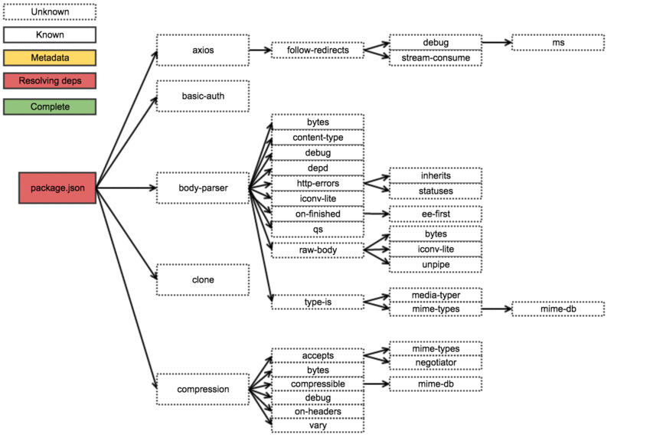
NPM installs the package and all of its dependencies
Can be version controlled – exact or >

Slide 8
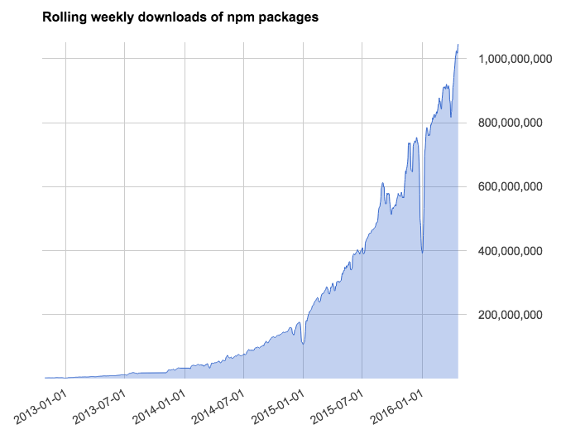
NPM Public registry
Run by a commercial company called NPM Inc (since 2014)
Had > 350,000 packages by 2017!
Has become the primary evolution path for the Javascript Ecosystem
Modules are (mostly) unvetted
Can lead to security vulnerabilities and Software Bloat

Slide 9
Callback pattern
Used extensively for Asynchronous coding – or “doing something useful while a slow thing is underway”
Dosomethingslow ( function callmewhenyouarefinished)
Do other useful things while the slow thing is happening
console.log(“First Thing”);
setTimeout( () => { console.log(“Finished”)}, 5000);
console.log(“Second Thing”);
First Thing
Second Thing
Finished - 5 seconds later

Slide 10
Simple Express Example
Express is a very common framework for building web-based applications that uses callbacks extensively
const express = require('express')
const app = express()
const port = 3000
app.get('/', (req, res) => res.send('Hello World!'))
app.listen(port, () => console.log(`Example app listening on port ${port}!`))
app.listen(3000,cb1)
App
app.get(‘/’,cb2)
GET /
(req,res)
Port
3000
Hello World
cb2
res.send(‘Hello

Slide 11
Promises..Promises
https://hackernoon.com/understanding-promises-in-javascript-13d99df067c1
Javascript runs a single-threaded event loop
Current code runs until it blocks – then other events in the queue get scheduled
Call-backs are one way to implement asynchrony – Promises build upon this

Slide 12
Example of Promise…then…catch
Taken from https://developer.mozilla.org/en-US/docs/Web/JavaScript/Guide/Using_promises
Doing sequential operations using callbacks results in an ugly pyramid of code
… ‘Callback hell’
doSomething(function(result) {
doSomethingElse(result, function(newResult) {
doThirdThing(newResult, function(finalResult) {
console.log('Got the final result: ' + finalResult);
}, failureCallback);
}, failureCallback);
}, failureCallback);

Slide 13
What is a Promise (new in ES6;EC2015) ?
Creating a Promise
The executor function is a function that contains (usually blocking) actions that will get done eventually
A promise is either: pending, fulfilled or rejected
Executor Function:
  Take two arguments: both functions (resolve, reject) – The executor should get the job done – then call either resolve() or reject() to reflect the result in the promise – these function can pass on data if required
When you call “new Promise”.. The executor is called immediately.. When it blocks (or completes) control returns to “p = new Promise…..”
let p = new Promise ( <executor function> )

Slide 14
Using the Promise
Generally you put something into an executor function which might take a while
There are often things you want to get done after the promise’s work is finished (the promise is fulfilled or rejected) e.g. process data fetched from a website
You can queue these up in a chain of processing tasks using .then syntax
When the promise if resolved, then if fulfilled, onFulfilled is called …
The .then call also returns a promise on which a second .then can be invoked
Also
promise.then ( onFulfilled, onRejected)
.catch (onRejected) // essentially a synonym for .then(null, onRejected)
.finally (onSettled) // calls onSettled regardless of whether the promise is fulfilled or rejected

Slide 15
Using the Promise…
var p2 = new Promise(function(resolve, reject) {
resolve(1);
});
p2.then(function(value) {
console.log(value); // 1
return value + 1;
}).then(function(value) {
console.log(value + ' - A synchronous value works');
});
p2.then(function(value) {
console.log(value); // 1
});
///What does this print????
The value passed to resolve(..data) gets passed to onFulfilled or onRejected
.then returns a promise with a new value based on what it returns
So data can be passed through ‘layers’ of processing actions
Notes:
Code examples prints
1
2 A synchronous value works
1 Because this is starting with the original promise which still has a value of 1

