Slide 1




Browser Evolution
Mosaic developed by NCSA (Marc Andreesen & Eric Bina) for Windows in 1993 (3 years after WorldWideWeb)
Andreesen teamed up with Jim Clark (SGI founder) to form Netscape and released Navigator in 1994 – free for non-commercial use
May, 1995: Bill Gates sends his “Internet Tidal Wave” memo to MS staff
Microsoft released Internet Explorer in Aug,1995 – free and bundled with windows – quickly became dominant
Browser Wars began – IE won!
[ Visualization of Browser Wars: https://www.youtube.com/watch?v=es9DNe0l0Qo
Netscape became Mozilla which later gave birth to Chrome

Slide 2
Scripting in the Browser
Netscape’s Brendan Eich (now CEO Brave) was given 10 days to produce a scripting language for Navigator – Released LiveScript in Dec’95 - >called Javascript in Dec’95 release – rumour was he wanted to use Scheme – but he dismisses this.
In August’96 Microsoft put VBScript into Internet Explorer – modelled on Visual Basic – The engine also included Jscript – based on Netscape’s Javascript
Numerous incompatibilities arose during Browser Wars

Slide 3
Scripting in the Browser…
Nov’86 Netscape submitted Javascript to ECMA which released ECMAScript in June ‘97
ES2(1998), ES3(1999), ES4 was controversial, EC5..EC2015(ES6), EC2016 – Currently on EC2017
Language is evolving (being enlarged!) all the time
https://hackernoon.com/how-it-feels-to-learn-javascript-in-2016-d3a717dd577f
Microsoft released TypeScript in 2012 – but typing/classes have not settled yet
Check http://node.green to get a sense of how changes propagate in Node

Slide 4
Javascript Basics
Syntax of language: blocks, variables similar to Java but basic language is dynamically typed
Can use ‘Strict’ mode to force all variables to be declared
No input-output as part of the language – rather Javascript runs in a ‘Host Environment’ with Objects (host specific) available to:
  Get and Put output text, results, colours, sounds etc
  Events and Actions that Javascript can ‘Hook on to’

Slide 5
Simple Javascript Program running in Node.JS
Syntax similar to Java
Console object allows text string to be
logged and will appear on screen
Everything is dynamically typed with no
checking
“use strict”; makes sure every variable is
declared
"use strict";
console.log("Watch while i count to 10");
let i=0;
while (i<= 10)
{ console.log("Counting %d", i);
i++}
console.log('finished');

Slide 6
Similar Program running in a browser
<html>
<head>Page used to execute simple script</head>
<body>
<H1>I'm Busy - check my console</H1>
</body></h1>
</html>
<script>
"use strict";
console.log("Watch while i count to 10");
let i=0;
while (i<= 10)
{ console.log("Counting %d", i);
i++}
console.log('finished');
window.open(); //open new tab
</script>
JS can be mixed with HTML enclosed
with <script> tags
In this host, Javascript can use objects
to access:
  The browser windows, frames, tabs
  The debug console
  It also has Read/Write access to the
  Document Object Model (DOM) which
  completely controls what is shown to the
  user and How it is presented

Slide 7
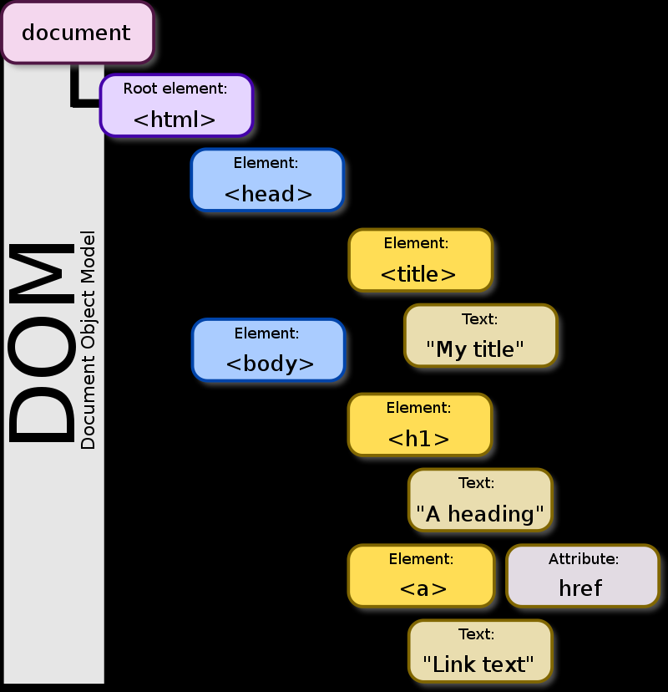
The Document Object Model
First appeared during the Browser Wars in Microsoft
IE (1996) to allow ‘client-side’ interactivity
In 1997 Netscape Navigator 4.0 has Dynamic HTML
W3C produced a DOM level 1 standard in 1998 – still
issuing standards based on WHATWG snapshots
When a browser loads a document (HTML/XML) it builds a tree in the object ‘document’ and then ‘renders’ it
Javascript has full access to add/change elements in this and react to events from it
The jQuery library built on this in 2006 – other frameworks built on to of that again

Slide 8
DOM Example
<!DOCTYPE html>
<html>
<body>
<p id="p1">
This is a text.
This is a text.
This is a text.
</p>
<input type="button" value="Hide text"
onclick="document.getElementById('p1').style.visibility='hidden'">
<input type="button" value="Show text"
onclick="document.getElementById('p1').style.visibility='visible'">
</body>
</html>

Slide 9
Defining functions in Javascript
// different ways to define and pass
// functions
function f1add(x,y) { return x+y }
f2add = function (x,y) {return x+y }
f3add = (x,y) => { return x+y;} // fat arrow
console.log("1 and 2 is "+ f1add(1,2) )
console.log("2 and 3 is "+ f2add(2,3) )
console.log("3 and 4 is "+ f3add(3,4) )
Functions are first-class objects in javascript
  They can be assigned to variables and passed
  and returned from functions
The fat-arrow syntax ‘=>’ reflects how
frequently
anonymous functions are used
2nd example show .forEach – which
takes a fn as arg and applies it
to all elements of an array
var array1 = ['a', 'b', 'c’];
array1.forEach(function(element) { console.log(element);});
// expected output: "a“
// expected output: "b“
// expected output: "c"

