Slide 1
CS4400 Internet Applications
Prof. Donal O’Mahony

Slide 2
Course Outline
What is an Internet Application and how have these evolved?
Key Technologies: Javascript, Node Package Managers
Execution Environment: Client Side (Browser) and Server
Using Node.JS, NPM and support tools
Cloud Computing Architectures –SaaS, IaaS, PaaS, Serverless Computing
Web Frameworks: Angular, React and Vue – The Model-View-Controller paradigm
A simple Cloud-based Internet Application
Database Services
Load Balancing
Scaling & Monitoring
Introduction to Containers
Serverless Computing
Characteristics & Enabling Technologies for Web 3.0

Slide 3
Course Assessment – Current Thoughts
Write a simple Node.js based REST server using local computing environment
Deploy a web service on AWS Virtual Machine – with a Vue Front-end
Either a Container-based deployment or a Serverless deployment or both
Deployment Strategy Essay – How would I best implement….

Slide 4
Large-Scale Computing Application pre 1990 e.g. Airline Flight Booking
Mainframe
Powerful CPU
Applications
Processes
VM?
Databases
10s of thousands of
terminals
Hierarchy of Terminal
Controllers
Scale-UP every
3 years or so

Slide 5
Large Scale Computing Application in 2020s e.g. Search
Cloud Computing Facility with
Up to 500,000 servers
Hierarchy of
Data Center Switches
Rack-mounted
Servers
Applications
Databases
Billions of PCs,
phones, IoT, Cars
Often running Browsers
VMs, Containers
Microservices
Cell base-stations, Wi-Fi
Switches, Routers, Middle-boxes,
Caches
Apps scale-OUT/in
constantly

Slide 6
What is an Internet Application?
Something that interacts with a user through an Internet Browser – that ‘Does Something’
Gmail
Google Maps
Ryanair Flight Booking

Slide 7
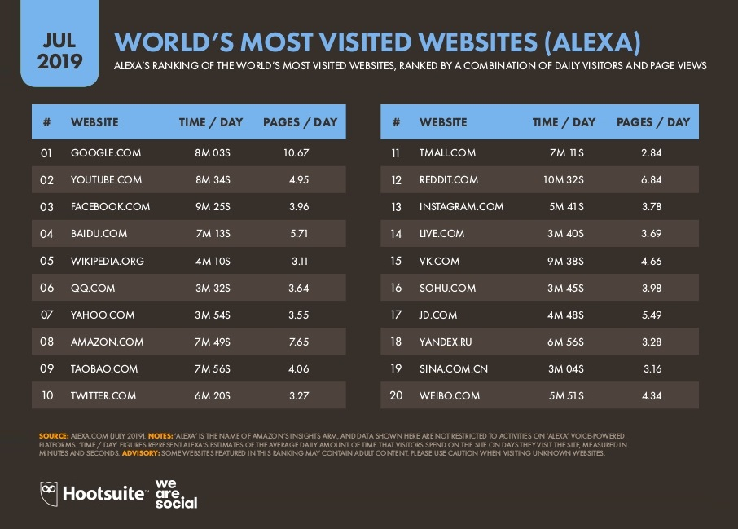

Slide 8
How did we get here?
Started with the WWW – aimed at browsing Hypertext Documents across the Internet
TCP/IP around since 1974 – first link to Ireland - TCD (June, 1991)
Internet penetration was primarily to Universities
  Main application was Email, telnet, (anonymous) ftp etc
Could find useful data on other Internet sites (software, papers etc) and retrieve it using FTP
Hardest part was to discover it what out there – and where?
  RESOURCE DISCOVERY
Users at the time (early 1990s) were using a mix of Terminals, PCs (with and without Windows (1985), Mac (1984), X-windows (early 1980s)

Slide 9
The World Wide Web
One of the efforts at “Resource Discovery” involved an international group including Tim Berners-Lee at CERN
In December, 1990, They came up with:
  HTML – a stripped down version of the Standard Generalized Markup Language (SGML)
  HTTP
  A prototype web-server (CERN httpd)
  A WorldWideWeb client (Web Editor) that ran on a NeXT cube workstation
  Later – Line Mode Browser
Experience recreated at:
https://worldwideweb.cern.ch/
Key Point: The WWW was designed for LOOKING at Hypertext Documents

Slide 10
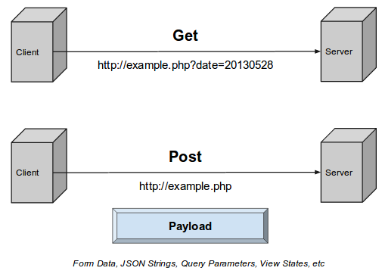
Simple HTTP exchanges

Slide 11
Concept of the Web as the Universal Program Interface
People wanted to use the web for navigating more complex data than static HTML files.. Culminated in web applications like Hotmail (1996)
Could do this by building logic into the WebServer (Client Side) or the WebBrowser (Server Side) or BOTH
Web Browser
Netscape, IE,…..
Web Server
Netscape Enterprise
Microsoft IIS
Apache (1995)
Or Custom Software
Get/Put HTML
Content

Slide 12
Making the Web Browser do Clever Things
Early Hypertext was aimed at representing the ‘Structure’ of the Document – not the presentation
The browser was in charge of rendering the doc – possibly with ‘hints’ in the HTML e.g. <i>Text to be put in Italics</i>
Later this changed with ‘Styles’ and Cascading Style Sheets (CSS)

Slide 13
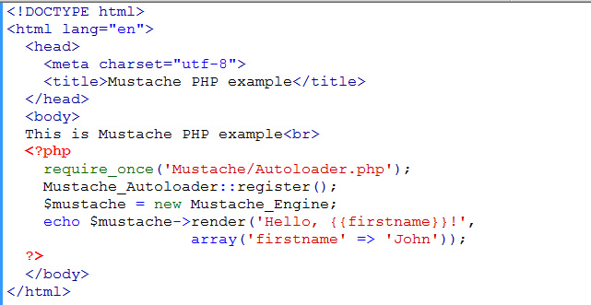
Selection of Server-Side Technologies
Common Gateway Interface – CGI-Bin (NCSA, 1993)
  GET and Post caused programs/scripts (in Perl, C…) to be executed which consumed the GET and Post parms and generated HTML for the response
Personal Home Page – PHP (OpenSrc, 1994/5-)
  Used the CGI-BIN in conjunction
  with server-side scripts mixed
  with the HTML to generate
  Dynamic HTML pages
Ruby on Rails (OpenSrc, 2005)
Node.JS (OpenSrc, 2009) –
Javascript

