Slide 2
Running Time Performance analysis
Techniques until now:
Experimental
Approximate running time using cost models
counting execution of operations or lines of code.
under some assumptions
only some operations count
cost of each operation = 1 time unit
Tilde notation: T(n) ~ (5/3)n²
Today:
Asymptotic Running Time: Θ/O/Ω-notation
Examples: insertionSort & binarySearch

Slide 3
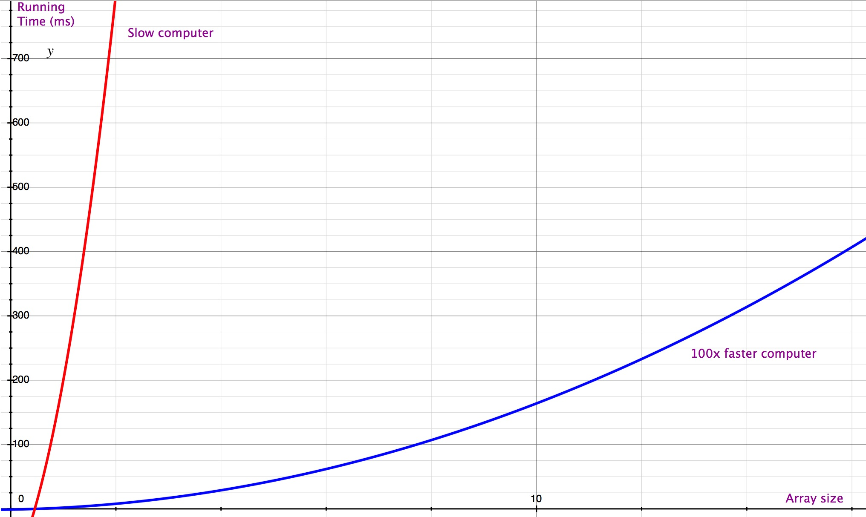
How fast is T(n) = (3/2)n² + (3/2)n - 1 ?
Fast computer vs. Slow computer

Slide 4
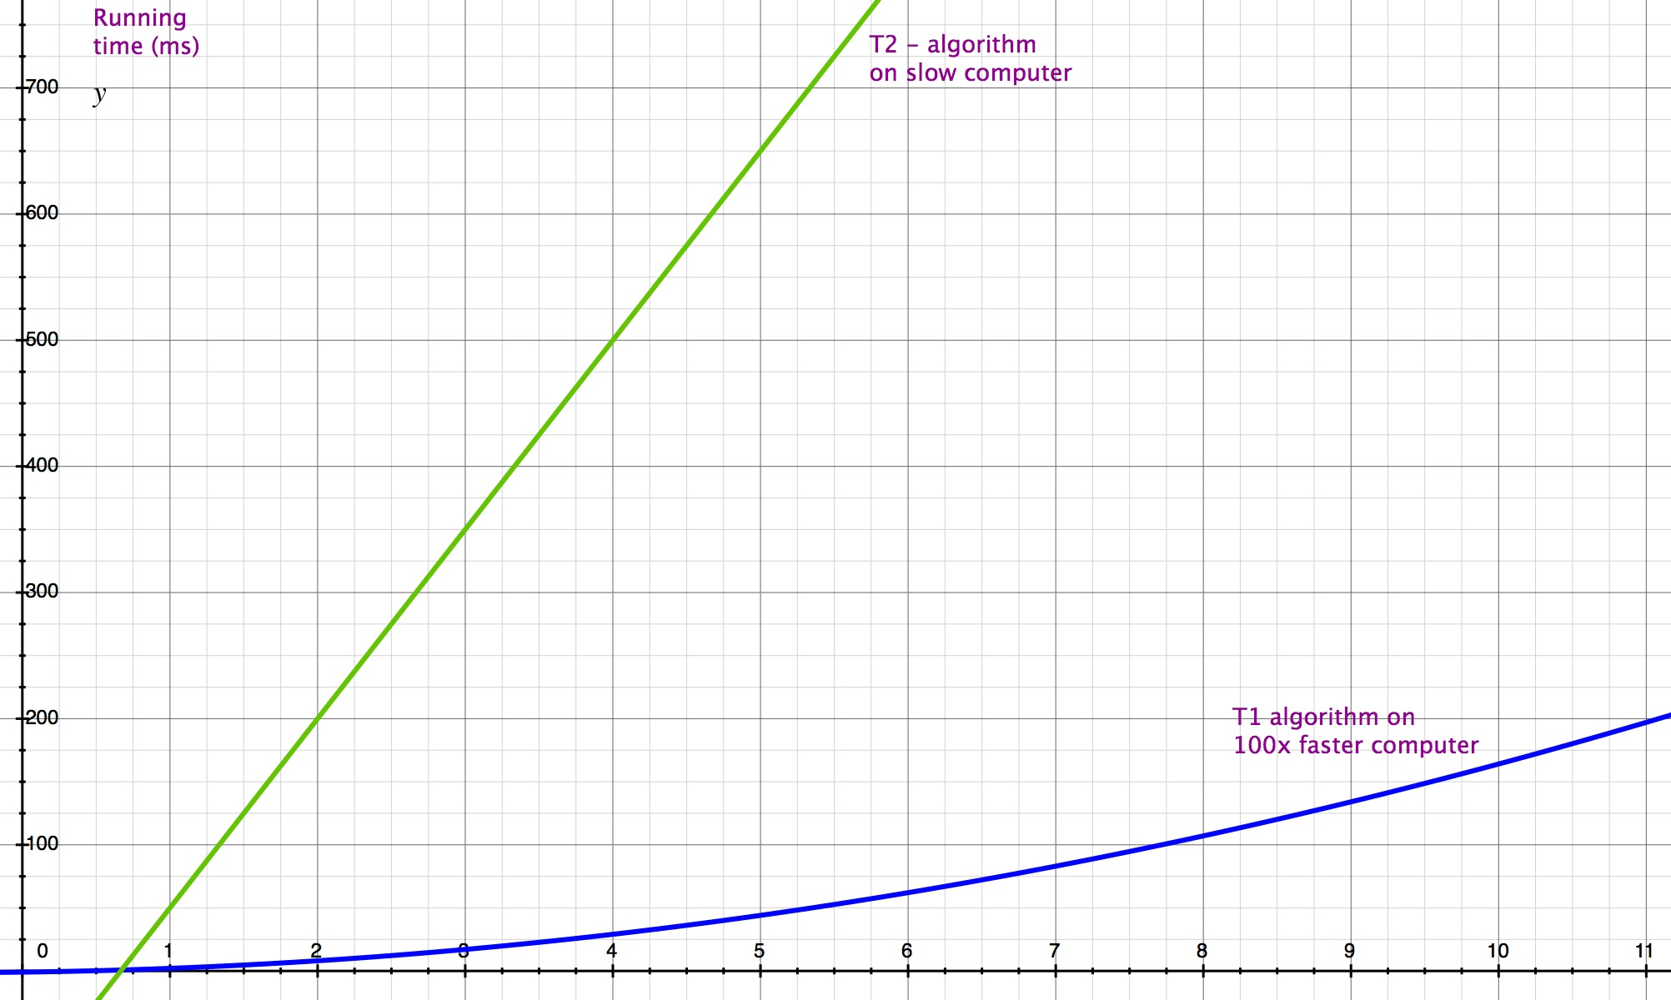
T1(n) = (3/2)n² + (3/2)n - 1 T2(n) = (3/2)n - 1
Fast Computer vs. Smart Programmer

Slide 5
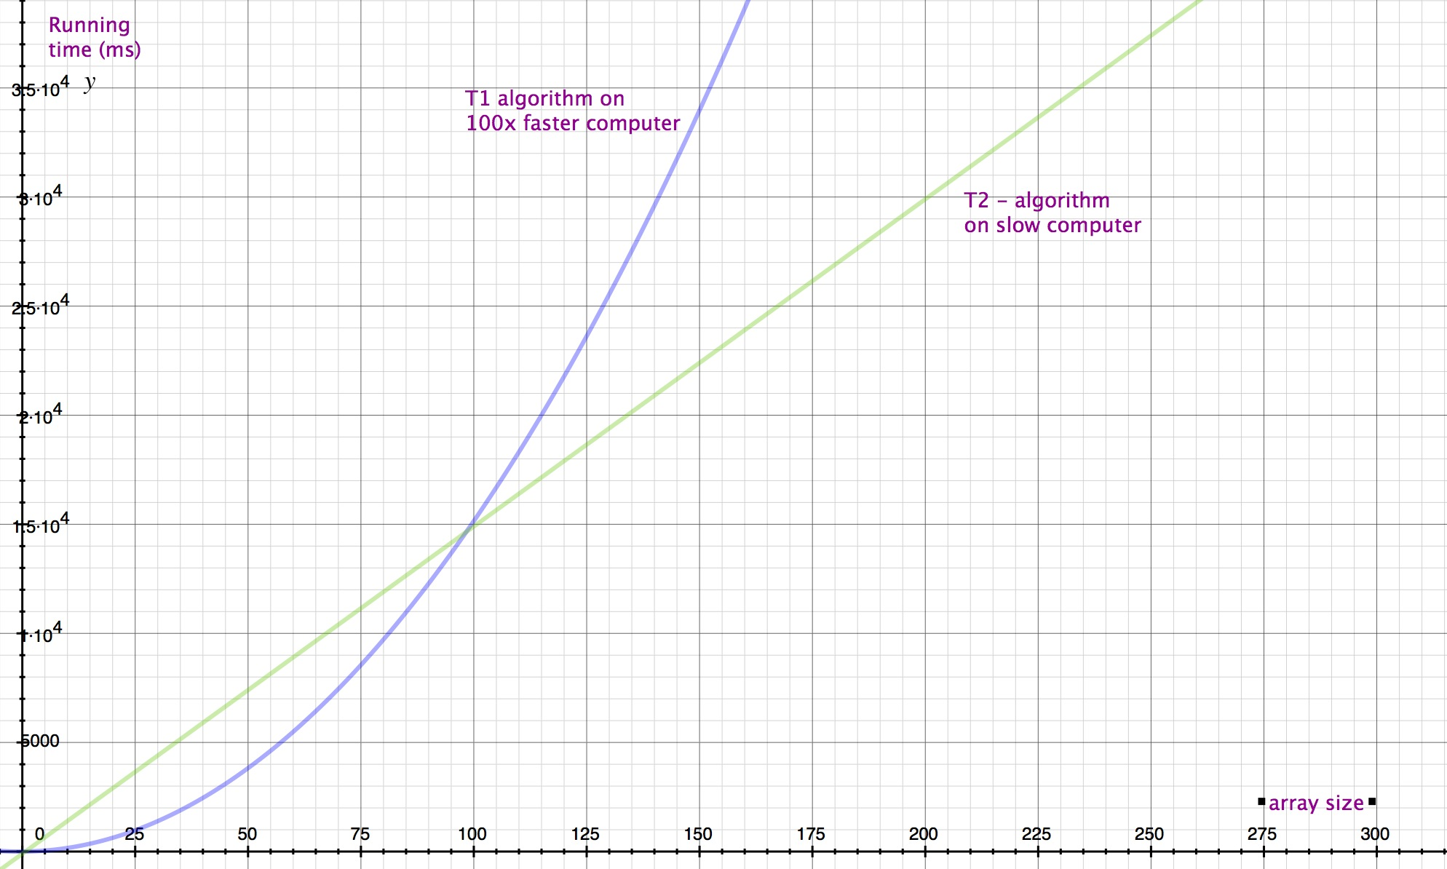
T1(n) = (3/2)n² + (3/2)n - 1 T2(n) = (3/2)n - 1
Fast Computer vs Smart Programmer (rematch!)

Slide 6
A smart programmer with a better algorithm always beats a fast computer with a worst algorithm for sufficiently large inputs.

Slide 7
At large enough input sizes only the rate of growth of an algorithm’s running time matters.
That’s why we dropped the lower-order terms in the approximate tilde notation:
When T(n) = (3/2)n² + (3/2)n -1
we write: T(n) ~ (3/2)n²
However: to calculate (3/2)n² we need to first calculate (3/2)n² + (3/2)n -1
It is not possible to calculate the coefficient 3/2 without the complete polynomials.

Slide 8
Worst Case
cost no of times
for (j = 1; j<A.length; j++) {
//shift A[j] into the sorted A[0..j-1]
i=j-1
while i>=0 and A[i]>A[i+1] { 1 2+…+n
swap A[i], A[i+1] 1 1+…+(n-1)
i=i-1
}}
return A
In the worst case the array is in reverse sorted order.
T(n) = Σ_{i=2..n}(i) + Σ_{i=1..n-1}(i) = Σ_{i=1..n}(i) - 1 + Σ_{i=1..n-1}(i)
= (n(n+1)/2 - 1) + 2n(n-1)/2
~ (5/2)n²

Slide 9
Simpler approach
It turns out that even the coefficient of the highest order term of polynomials is not all that important for large enough inputs.
This leads us to Asymptotic running time:
T(n) = Θ(n²)
We calculate directly the growth function
Even with such a simplification, we can compare algorithms to discover the best ones
Sometimes constants matter in the real-world performance of algorithms, but in many cases we can ignore them.
We can write the asymptotic running time of best/worst/average case

Slide 10
Important Growth Functions
From better to worse:
Function f Name
1 constant
log n logarithmic
n linear
n.log n
n² quadratic
n³ cubic
…
2^{n} exponential
...

Slide 11
Important Growth Functions
From better to worse:
Function f Name
1 constant
log n logarithmic
n linear
n.log n
n² quadratic
n³ cubic
…
2^{n} exponential
...
The first 4 are practically fast
(most commercial programs run in such Θ-time)
Anything less than exponential
is theoretically fast (P vs NP)

Slide 12
Important Growth Functions
From better to worse:
Function f Name Problem size solved in mins (today)
1 constant any
log n logarithmic any
n linear billions
n.log n hundreds of millions
n² quadratic tens of thousands
n³ cubic thousands
…
2^{n} exponential 100
...

Slide 13
What programs have these running times?
With experience we can recognise patterns in code with known running time

Slide 14
Θ(1)
Any fixed number of basic operations.
assignments
int i = 5
memory access
A[5]
fixed number of combinations of the above
swap A[i], A[j] (3 array accesses & 3 assignments)
any other basic command
But not:
array initialisation
int A[] = new int[n] (Θ(n))

Slide 15
Θ(n)
Pattern of code: loops where each iteration decreases the problem size by a constant factor
for(j=1; j<n; j++){ …<constant cost operations>… }
Problem: iterate from 1 … n
Initial problem size: n
each iteration decreases problem size by 1.
k=n;
while(k>0){ …<constant cost operations>… ; k=k-100; }
Problem: iterate from n … 1
Initial problem size: n
each iteration decreases problem size by 100.

Slide 16
Θ(log n)
Pattern of code: loops where each iteration divides the problem size by a constant
j=n;
while(j>=0){…<constant cost operations>…; j=j/2}
Problem: iterate from n … 0
Initial problem size: n
each iteration divides problem size by 2.

Slide 18
Asymptotic Running Time Θ(f(n))
It has useful operations:
Simplify: replace multiplicative constants with 1
Θ(2) = Θ(1)
Θ(10n²) = Θ(n²)
Θ(log₃₀₀ n ) = Θ(log₂ n)
Always use the simplest possible functions

Slide 19
Asymptotic Running Time Θ(f(n))
It has useful operations:
Addition: keep only highest factor
Θ(1) + Θ(1) = Θ(1)
Θ(n) + Θ(n²) = Θ(n²)
Θ(n³) + Θ(n³) = Θ(n³)
Θ(n^{2.}log n) + Θ(n²) = Θ(n^{2.}log n)

Slide 20
Asymptotic Running Time Θ(f(n))
It has useful operations:
Multiplication: multiply inner functions
Θ(n) × Θ(n²) = Θ(n³)
Θ(n) × Θ(log n) = Θ(n.log n)
Θ(1) × Θ(log n) = Θ(log n)

Slide 21
Asymptotic Running Time Θ(f(n))
It has useful operations:
Simplify: replace multiplicative constants with 1
Θ(2) = Θ(1)
Θ(10n²) = Θ(n²)
Θ(log₂₀₀(n)) = Θ(log₂(n))
Addition: keep only highest factor
Θ(1) + Θ(1) = Θ(1)
Θ(n) + Θ(n²) = Θ(n²)
Θ(n³) + Θ(n³) = Θ(n³)
Θ(n²log(n)) + Θ(n²) = Θ(n²log(n))
Multiplication: multiply inner functions
Θ(n) × Θ(n²) = Θ(n³)
Θ(n) × Θ(log n) = Θ(n.log n)
Θ(n^{2.}log n) + Θ(n²) = Θ(n^{2.}log n)
The above are because of the following general theorems:
Θ(f(n)) + Θ(g(n)) = Θ(g(n)) if Θ(f(n)) ≤ Θ(g(n))
Θ(f(n)) × Θ(g(n)) = Θ(f(n) × g(n))
If f(n) = Θ(g(n)) and g(n) = Θ(h(n)) then f(n) = Θ(h(n))

Slide 22
How to calculate Asymptotic running times?
First decide what case you want to calculate
Worst case input ← usually
Best case input
Average case input
Then add up costs of each operation multiplied with number of times called
As we did with the precise/approximate running times
but use asymptotic notation
take advantage of the simple addition and multiplication operations

Slide 23
InsertionSort – asymptotic worst-case analysis
cost No of times
for j = 1 to A.length {
//shift A[j] into the sorted A[0..j-1]
i=j-1
while i>=0 and A[i]>A[i+1] {
swap A[i], A[i+1]
i=i-1
}}
return A

Slide 24
InsertionSort – asymptotic worst-case analysis
cost No of times
for j = 1 to A.length { Θ(1)
//shift A[j] into the sorted A[0..j-1]
i=j-1 Θ(1)
while i>=0 and A[i]>A[i+1] { Θ(1)
swap A[i], A[i+1] Θ(1)
i=i-1 Θ(1)
}}
return A Θ(1)

Slide 25
InsertionSort – asymptotic worst-case analysis
cost No of times
for j = 1 to A.length { Θ(1) Θ(Ν)
//shift A[j] into the sorted A[0..j-1]
i=j-1 Θ(1) Θ(Ν)
while i>=0 and A[i]>A[i+1] { Θ(1)
swap A[i], A[i+1] Θ(1)
i=i-1 Θ(1)
}}
return A Θ(1)

Slide 26
InsertionSort – asymptotic worst-case analysis
cost No of times
for j = 1 to A.length { Θ(1) Θ(Ν)
//shift A[j] into the sorted A[0..j-1]
i=j-1 Θ(1) Θ(Ν)
while i>=0 and A[i]>A[i+1] { Θ(1) Θ(Ν)xΘ(Ν)
swap A[i], A[i+1] Θ(1)
i=i-1 Θ(1)
}}
return A Θ(1)

Slide 27
InsertionSort – asymptotic worst-case analysis
cost No of times
for j = 1 to A.length { Θ(1) Θ(Ν)
//shift A[j] into the sorted A[0..j-1]
i=j-1 Θ(1) Θ(Ν)
while i>=0 and A[i]>A[i+1] { Θ(1) Θ(Ν)xΘ(Ν)
swap A[i], A[i+1] Θ(1) Θ(Ν²)
i=i-1 Θ(1) Θ(Ν²)
}}
return A Θ(1) Θ(1)

Slide 28
InsertionSort – asymptotic worst-case analysis
cost No of times
for j = 1 to A.length { Θ(1) Θ(Ν)
//shift A[j] into the sorted A[0..j-1]
i=j-1 Θ(1) Θ(Ν)
while i>=0 and A[i]>A[i+1] { Θ(1) Θ(Ν)xΘ(Ν)
swap A[i], A[i+1] Θ(1) Θ(Ν²)
i=i-1 Θ(1) Θ(Ν²)
}}
return A Θ(1) Θ(1)
T(n) = Θ(1) x Θ(Ν) + Θ(1) x Θ(Ν) + Θ(1) x Θ(Ν²) + Θ(1) x Θ(Ν²) + Θ(1) x Θ(Ν²) + Θ(1) x Θ(1)

Slide 29
InsertionSort – asymptotic worst-case analysis
cost No of times
for j = 1 to A.length { Θ(1) Θ(Ν)
//shift A[j] into the sorted A[0..j-1]
i=j-1 Θ(1) Θ(Ν)
while i>=0 and A[i]>A[i+1] { Θ(1) Θ(Ν)xΘ(Ν)
swap A[i], A[i+1] Θ(1) Θ(Ν²)
i=i-1 Θ(1) Θ(Ν²)
}}
return A Θ(1) Θ(1)
T(n) = Θ(1) x Θ(Ν) + Θ(1) x Θ(Ν) + Θ(1) x Θ(Ν²) + Θ(1) x Θ(Ν²) + Θ(1) x Θ(Ν²) + Θ(1) x Θ(1)
= Θ(Ν) + Θ(Ν) + Θ(Ν²) + Θ(Ν²) + Θ(Ν²) + Θ(1)
= Θ(Ν²)

Slide 30
One more example: BinarySeach
Specification:
Input: array a[0..n-1], integer key
Input property: a is sorted
Output: integer pos
Output property: if key==a[i] then pos==I

Slide 31
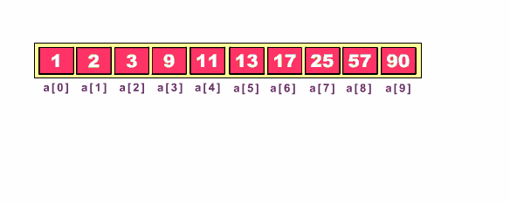
BinarySearch – worst case asymptotic running time
Cost No of times
lo = 0, hi = a.length-1
while (lo <= hi) {
int mid = lo + (hi - lo) / 2
if (key < a[mid]) then hi = mid - 1
else if (key > a[mid]) then lo = mid + 1
else return mid
}
return -1

Slide 32
BinarySearch – worst case asymptotic running time
Cost No of times
lo = 0, hi = a.length-1 Θ(1) Θ(1)
while (lo <= hi) { Θ(1) Θ(log n)
int mid = lo + (hi - lo) / 2 Θ(1) Θ(log n)
if (key < a[mid]) then hi = mid – 1 Θ(1) Θ(log n)
else if (key > a[mid]) then lo = mid + 1 Θ(1) Θ(log n)
else return mid Θ(1) Θ(log n)
}
return -1 Θ(1) Θ(1)
T(n) = Θ(log n)

Slide 34
Cost No of times
Θ(1) Θ(1)
Θ(1) Θ(N)
Θ(N) Θ(N)
Θ(1) Θ(N)
Θ(1) Θ(1)

Slide 35
Examples (comparisons)
Θ(n log n) =?= Θ(n)

Slide 36
Examples (comparisons)
Θ(n log n) > Θ(n)
Θ(n² + 3n – 1) =?= Θ(n²)

Slide 37
Examples (comparisons)
Θ(n log n) > Θ(n)
Θ(n² + 3n – 1) = Θ(n²)

Slide 38
Examples (comparisons)
Θ(n log n) > Θ(n)
Θ(n² + 3n – 1) = Θ(n²)
Θ(1) =?= Θ(10)
Θ(5n) =?= Θ(n²)
Θ(n³ + log(n)) =?= Θ(100n³ + log(n))
Write all of the above in order, writing = or < between them

Slide 39
Examples (comparisons)
MyAlgorithm has an asymptotic worst case running time:
T(N) = O(Ν² lgN)
Does that mean:
T(N) = O(Ν³)?
T(N) = O(Ν²)?
T(N) = Ω(Ν)?
T(N) = Ω(Ν³)?
T(N) = Θ(Ν² lgN)?

Slide 40
Examples (comparisons)
MyAlgorithm has an asymptotic worst case running time:
T(N) = O(Ν² lgN)
Does that mean:
T(N) = O(Ν³)? YES
T(N) = O(Ν²)? NO
T(N) = Ω(Ν)? NO
T(N) = Ω(Ν³)? NO
T(N) = Θ(Ν² lgN)? NO

Slide 41
Examples (comparisons)
MyAlgorithm has an asymptotic worst case running time:
T(N) = Ω(Ν² lgN)
Does that mean :
T(N) = O(Ν³)?
T(N) = O(Ν²)?
T(N) = Ω(Ν)?
T(N) = Ω(Ν³)?
T(N) = Θ(Ν² lgN)?

Slide 42
Examples (comparisons)
MyAlgorithm has an asymptotic worst case running time:
T(N) = Ω(Ν² lgN)
Does that mean:
T(N) = O(Ν³)? NO
T(N) = O(Ν²)? NO
T(N) = Ω(Ν)? YES
T(N) = Ω(Ν³)? NO
T(N) = Θ(Ν² lgN)? NO

Slide 43
Examples (comparisons)
MyAlgorithm has an asymptotic worst case running time:
T(N) = Θ(Ν² lgN)
Does that mean:
T(N) = O(Ν³)?
T(N) = O(Ν²)?
T(N) = Ω(Ν)?
T(N) = Ω(Ν³)?

Slide 44
Examples (comparisons)
MyAlgorithm has an asymptotic worst case running time:
T(N) = Θ(Ν² lgN)
Does that mean:
T(N) = O(Ν³)? Yes
T(N) = O(Ν²)? NO
T(N) = Ω(Ν)? YES
T(N) = Ω(Ν³)? NO
*Because the above means MyAlgorithm is both O(N² lgN) and
Ω(N² lgN).

