Slide 1
A whistle-stop tour of some parallel architectures that are used in practice
David Gregg
Department of Computer Science
University of Dublin, Trinity College

Slide 2
Parallel Architectures
Wide range of parallel architectures
  Many in use
  Many more have been proposed
Same ideas emerge again and again
  But Moore’s law means that the components change that we build parallel computers from
  So the trade-offs between approaches change

Slide 3
Levels of parallelism
Different parallel architectures exploit parallelism at different levels
  Coarse or fine grain
  Different types of synchronization
Trend towards architectures that exploit multiple types and levels of parallelism

Slide 4
E.g. 1: STI Cell B/E
Cell Broadband Engine is a processor developed by Sony, Toshiba and IBM
Most celebrated use is in Playstation 3
  Good graphics, physics, etc.
Also used in IBM Cell clusters for HPC
  Computing values of options
Also used in Toshiba consumer electronics

Slide 5
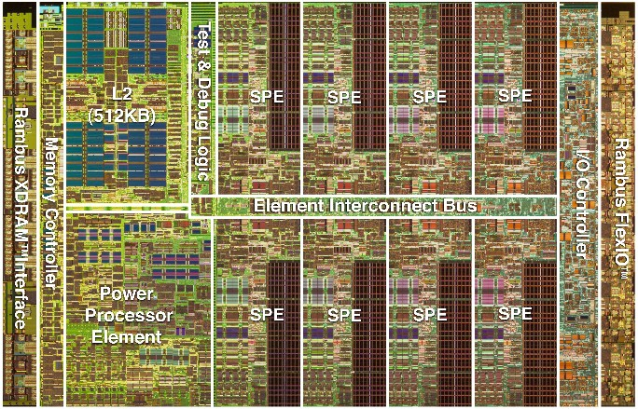
Cell B/E

Slide 6
E.g. 2: Myriad X
Myriad X is an embedded accelerator processor from Movidius-Intel
Used in drones, headsets, phones
  Image processing, deep neural networks
Two simple controller cores
12 VLIW vector cores
  Shared on-chip memory
Dedicated hardware accelerators
  Image processing, AI

Slide 7
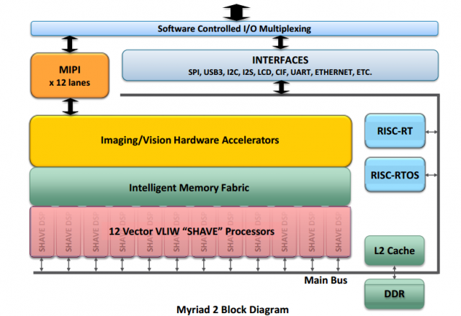
Movidius Myriad X

Slide 8
Flynn’s Taxonomy
Prof. Mike Flynn’s famous taxonomy of parallel computers
  Single instruction stream, single data stream
    E.g. VLIW, found in Cell BE
  Single instruction stream, multiple data streams
    E.g. Vector SIMD, found in Cell BE
  Multiple instruction streams, multiple data streams
    E.g. Multiple parallel cores, found in Cell BE
  Multiple instruction streams, single data stream
    Unusual, sometimes found in safety-critical systems
    Texas Instruments Hercules processors

Slide 9
Flynn’s Taxonomy
It is quite difficult to fit many parallel architectures into Flynn’s taxonomy
  It attempted to describe different types of parallel architectures in 1966
  It’s not entirely clear where some architectures fit
    E.g. instruction level parallel
    E.g. fine-grain speculative multithreading
Most important distinction is between SIMD and MIMD
  These terms are used a lot

Slide 10
Instruction level parallelism
Attempt to execute multiple machine instructions from the same instruction stream in parallel
Two major approaches
  Deep pipelining (super-pipelining)
    Production line of instructions
    Overhead at each pipeline stage so very deep pipelining has lots of overhead
  Multiple instruction pipelines
    “Superscalar”
    Complex hardware or compiler

Slide 11
Instruction level parallelism
Finding parallel instructions, either…
  Get the compiler to find the parallelism
    VLIW, in-order superscalar
  Get the hardware to find independent instructions in the running program
    Out-of-order superscalar
Cell B/E
  Main processor core is superscalar
  Accelerator cores are VLIW
Myriad X
  Accelerator cores are VLIW

Slide 12
Instruction level parallelism
Cell B/E
  Main processor core is superscalar
  Accelerator cores are VLIW
Myriad X

Slide 13
Vector Computers
Most machine instructions operate on a single value at a time
Vector computers operate on an array of data with a single instruction
Many parallel computing problems operate on large arrays of data
Vector computers were some of the earliest and most successful parallel computers
  E.g. many supercomputers designed by Seymour Cray

Slide 14
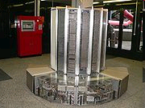
Vector Computers
Cray 1
    glass panels allow viewer to “see more” Cray

Slide 15
Vector Computers
Vector instructions are a form of SIMD
  very popular on modern computers
  Accelerate multimedia, games, scientific, graphics apps
Vector sizes are smallish
  E.g. 16 bytes, four floats – SSE, Neon
  Intel AVX uses 32 bytes
  Intel AVX-512 uses 64 bytes
Vector SIMD used in Cell BE, where all SPE instructions are SIMD

Slide 16
Multithreaded Computers
Pipelined computers spend a lot of their time stalled
  Cache misses, branch mispredictions, long-latency instructions
  Multi-threaded computers attempt to cover the cost of stalls by running multiple threads on the same processor core
  Require very fast switching between threads
    Separate register set for each thread

Slide 17
Multithreaded Computers
Three major approaches
  Switch to a different thread every cycle
  Switch thread on a major stall
  Use OOO superscalar hardware to mix instructions from different threads together (aka simultaneous multithreading)
Big problem is software
  Programmer must divide code into threads
Multithreading is used in Cell main core

Slide 18
Multi-core computers
Power wall, ILP wall and memory wall pushed architecture designers to put multiple cores on a single chip
Two major approaches
  Shared memory multi-core
  Distributed memory multi-core
Shared memory is usually easier to program, but
  hardware does not scale well
  shared memory needs cache consistency
Big problem is dividing software into threads
Cell BE has distributed memory SPEs, but SPEs can also access global memory shared by PPE

Slide 19
Shared memory multiprocessors
Shared memory multiprocessors are parallel computers where there are multiple processors sharing a single memory
Main approaches
  Symmetric multiprocessors
  Non-uniform memory access (NUMA)
    Usually a distributed shared memory
Big problem is software
IBM Cell Blades allow two Cell processors on the same board to share memory

Slide 20
Distributed memory multicomputers
A system of communicating processors, each with their own memory
Distributed memory systems scale extremely well
  The hardware is simple
Huge variety of configurations
  ring, star, tree, hypercube, mesh
Programming is arguably even more difficult than for shared memory machines
  Always need to move data explicitly to where it is needed
The Cell processor provides 8 SPEs, which each have their own local memory, and are connected in a ring topology

Slide 21
Clusters
A group of loosely coupled computers that work closely and can be viewed as a single machine
Multiple stand-alone machines connected by a network
Clusters are a form of distributed memory multicomputers
  But may support a virtual shared memory using software
  E.g PVM (parallel virtual machine)
Classic example is the Beowulf Cluster, made from standard PCs, running Linux or Free BSD, connected by ethernet

Slide 22
Clusters
Most big supercomputers these days are clusters
  It’s usually cheaper to build large machines out of thousands of cheap PCs
Cell BE is used in IBM Cell clusters
Clusters of Playstation 3 machines running Linux are also being used as cheap supercomputers

Slide 23
Graphics Processing Units (GPU)
Emergence of GPUs is a major recent development in computer architecture
GPUs have very large amounts of parallelism on a single chip
  vector processing units
  multithreaded processing units
  multiple cores
GPUs originally aimed at graphics rendering
  Very large memory bandwidth
    But high memory latency
  Lots of low-precision floating point units
GPUs implement graphics pipeline directly
  Generality was once very limited, but is getting better with each new generation of GPU

Slide 24
Graphics Processing Units (GPU)
GPUs are increasingly programmable
Trend towards using GPUs for more “general purpose” computation (GPGPU)
  But mapping general purpose applications to GPU architecture is challenging
  Only certain types of apps run well on GPU
Special languages are popular for GPGPU
  E.g. CUDA, OpenCL

Slide 25
Field Programmable Gate Arrays
Gate array
  There is an array of gates that can be used to implement hardware circuits
Field programmable
  The array can be configured (programmed) at any time “in the field”.
FPGAs can exploit parallelism at many levels
  Special purpose processing units
    E.g. bit twiddling operations
  Fine grain parallelism
    Circuit is clocked, so very fine grain synchronization is possible
  Coarse grain parallelism
    FPGA can implement any parallel architecture that fits on the chip

Slide 26
Field Programmable Gate Arrays
FPGAs are commonly used to implement special-purpose parallel architectures
  E.g. Systolic arrays

Slide 27
Low Power Parallel Processors
Several big changes in computing
  (Exact categories and times very debatable)
  Giant computer room with single user – 1950s
  Mainframe computers with hundreds of users – 1960s
  Minicomputer with dozens of users – 1970s
  Microcomputer with single user – 1980s
  Networks and microcomputer servers – 1990s
  Continuous network connection – 2000s
  Mobile internet devices – 2010s

Slide 28
Low Power Parallel Processors
Power and energy are extremely important for mobile computing
  Trend towards mobile devices, mobile phones, wearable computing, internet of things
  Battery life depends directly on energy consumption
  Devices that consume very little energy can really add up if you have dozens or hundreds of them
Parallelism is alternative to faster clock
  Dynamic power is Capacitance * Frequency * Voltage²
  Significant increase in clock normally requires increase in voltage

Slide 29
Low Power Parallel Processors
Low power multicore processors
  Often trade software complexity for hardware complexity
    Many are VLIW processors
    Instruction-level parallelism under software control
    Complicated compilers
  On-chip scratchpad memory instead of caches
    Caches need logic to find cache line
    Cache line tags, comparators, replacement logic, etc.
    Scratch-pad memory is fully under software control
    Data transfers using so-called directed memory access (DMA)
    More complicated compilers, software
  Cores do not share on-chip memory
    Programmer must manage each core’s scratchpad memory
    Explicit movement of data between cores

