Slide 1
Multiprocessor Architectures
David Gregg
Department of Computer Science
University of Dublin, Trinity College

Slide 2
Multiprocessors
Machines with multiple processors are what we often think of when we talk of parallel computing
Multiple processors cooperate and communicate to solve problems fast
Multiple processor architecture consists of
  Individual processor computer architecture
  Communication architecture

Slide 3
All kinds of everything
Two kinds of physical memory organization:
Physically centralized memory
  Allows only a few dozen processor chips
Physically distributed memory
  Larger number chips and cores
  Simpler hardware
  More memory bandwidth
  More variable memory latency
    Latency depends heavily on distance to memory

Slide 4
Centralized vs. distributed memory
Scale
P
P
P
1
n
P
n
1
€
$
$
$
Mem
Mem
Inter
connection network
Inter
connection network
Mem
Mem
Centralized Memory
Distributed Memory

Slide 5
More kinds of everything
Two logical views of memory
  Logically shared memory
  Logically distributed memory
Logical view does not have to follow physical implementation
  Logically shared memory can be implemented on top of a physically distributed memory
    Often with hardware support
  Logically distributed memory can be built on top of a physically centralized memory

Slide 6
Logical view of memory
Logically shared memory programming model
  communication between processors uses shared variables and locks
  e.g. OpenMP, pthreads, Java threads
Logically distributed memory
  communication between processors uses message passing
  e.g. MPI, Occam

Slide 7
UMA versus NUMA
Shared memory may be physically centralized or physically distributed
Physically centralized
  All processors have equal access to memory
  Symmetric multiprocessor model
  Uniform memory access (UMA) costs
  Scales to a few dozen processors
  Cost increases rapidly as number of processors increases

Slide 8
UMA versus NUMA (contd.)
Physically distributed shared memory
  Each processor has its own local memory
  Cost of accessing local memory is low
  But address space is shared, so each processor can access any memory in system
  Accessing memories of other processors has higher cost than local memory
  Some memories may be very distant
  Non-uniform memory access (NUMA) costs

Slide 9
Summary
Four main categories of multiprocessor
  Physically centralized logically shared memory
    UMA, symmetric multiprocessor
  Physically distributed logically shared
    NUMA
  Physically distributed logically distributed memory
    Message passing parallel machines
    Most supercomputers today
  Physically centralized logically distributed memory
    No specific machines designed to do this
    Significant cost of building a centralized memory
    But programming in languages with message passing model is not unknown on SMP machines.

Slide 10
Symmetric Multiprocessors (SMP)
Most common type of parallel machines
  Physically centralized memory
  Logically shared address space
Local caches are used to reduce bus traffic to the central memory
Programming is relatively simple
  Parallel threads sharing memory
  Memory access costs uniform
  Need to avoid cache misses, like sequential programming

Slide 11
SMP Multi-core
Symmetric multi-processing is the most common model for multi-core processors
Multi-core is a relatively new term
  Previous name was always chip multiprocessor (CMP)
Multiple cores on a single chip, sharing a single external memory
  with caches to reduce memory traffic

Slide 12
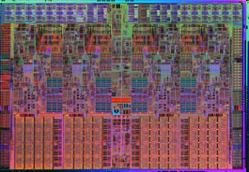
E.g. Intel i7 Processor

Slide 13
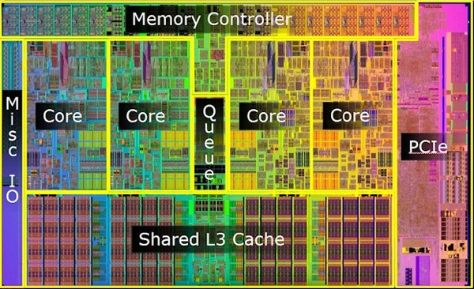
E.g. Intel i7 Processor

Slide 14
E.g. Intel i7 Processor
Family of processors, we consider one example
Four cores per chip
  Each core has own L1 and L2 cache
    4 X 256K
  Single shared L3 cache
    8MB
External bus from L3 cache to external memory

Slide 15
Other SMP Multi-cores
Another common pattern is to reuse configurations from chips with fewer cores
E.g. Dual-core processors
  Popular to take a dual-core processor and replicate it on a chip
  E.g. Four cores
  Each has its own L1 cache
  Each pair has a shared L2 cache
  L2 caches connected to memory

Slide 16
SMP Multi-cores
SMP multi-cores scale pretty well but they may not scale forever
Immediate issue: cache coherency
  Cache coherency is much simpler on a single chip than between chips
  But it is still complex and doesn’t scale well
  In the medium to long term we may see more multi-core processors that do not share all their memory
    E.g. Cell B/E or Movidius Myriad; but how do we program these?

Slide 17
SMP Multi-cores
Immediate issue: memory bandwidth
  As the number of cores rises, the amount of memory bandwidth needed will also rise
    Moore’s law means that number of cores can double every 18-24 months (at least in the medium term)
    But number of pins is limited
  Experimental architectures put pins through chip to stacked memory
  Latency can be traded for bandwidth
  Bigger on-chip caches
    Caches may be much larger and much slower in future
    Possible move to placing processor in memory?

Slide 18
Multi-chip SMP
Traditional type of SMP machine
More difficult to build than multi-core
  Running wires within a chip is cheap
  Running wires between chips is expensive
Caches are essential to lower bus traffic
Must provide hardware to ensure that caches and memory are consistent (cache coherency)
  Expensive across multiple chips
Must provide a hardware mechanism to support process synchronization

Slide 19
Multi-chip SMP
Processor
Processor
Processor
Cache
Cache
Cache
Single Bus
Memory
I/O

Slide 20
Multi-chip SMP
Whether the SMP is single or multiple chip, the programming model is the same
But performance trade-offs may be different
  Communication may be much more expensive in multi-chip SMP
  A multi-chip SMP machine may have more total memory bandwidth

