Slide 1
Network Connected Multiprocessors
[Adapted from Computer Organization and Design, Patterson & Hennessy]
Notes:
Other handouts
To handout next time

Slide 2
Communication in Network Connected Multi’s
Shared memory model and hardware
  hardware designers have to provide coherent caches and process synchronization primitive
  lower communication overhead
  harder to overlap computation with communication
  more efficient to use an address to remote data when demanded rather than to send for it in case it might be used (such a machine has distributed shared memory (DSM))
Distributed memory model and hardware
  Explicit communication via sends and receives
  simplest solution for hardware designers
  higher communication overhead
  easier to overlap computation with communication
  easier for the programmer to optimize communication

Slide 3
Interconnection Network Performance Metrics
Network cost
  number of switches
  number of (bidirectional) links on a switch to connect to the network (plus one link to connect to the processor)
  width in bits per link, length of link
Network bandwidth (NB) – represents the best case
  bandwidth of each link * number of links
Bisection bandwidth (BB) – represents the worst case
  divide the machine in two parts, each with half the nodes and sum the bandwidth of the links that cross the dividing line
Other interconnection network (IN) performance issues
  latency on an unloaded network to send and receive messages
  throughput – maximum # of messages transmitted per unit time
  # routing hops worst case, congestion control and delay

Slide 4
Bus Interconnection Network
Bidirectional
network switch
Processor
node
N processors, 1 switch ( ), 1 link (the bus)
Only 1 simultaneous transfer at a time
  Network bandwidth = link (bus) bandwidth * 1
  Bisection bandwidth = link (bus) bandwidth * 1

Slide 5
Ring Interconnection Network
N processors, N switches, 2 links/switch, N links
N simultaneous transfers
  Network bandwidth = link bandwidth * N
  Bisection bandwidth = link bandwidth * 2
If a link is as fast as a bus, the ring is only twice as fast as a bus in the worst case, but is N times faster in the best case

Slide 6
Fully Connected Interconnection Network (IN)
N processors, N switches, N-1 links/switch, (N*(N-1))/2 links
N simultaneous transfers
  Network bandwidth = link bandwidth * (N*(N-1))/2
  Bisection bandwidth = link bandwidth * (N/2)²
Notes:
Easy way to explain the BB: Half of the nodes (which is to say, N/2) each connect to the other N/2 nodes. Since you've got (N/2) nodes, each with (N/2) links, there are (N/2)^2 links crossing the bisection. Hence, (N/2)^2

Slide 7
Crossbar (Xbar) Connected Interconnect Net
N processors, N² switches (unidirectional),2 links/switch, N² links
N simultaneous transfers
  Network bandwidth = link bandwidth * N
  Bisection bandwidth = link bandwidth * N/2
Notes:
The crossbar can support any combination of messages between processors. Note: Remind students that the crossbar, unlike the others, doesn't have a 1-to-1 correlation between switches and processors. Hence, the usual calculation of "# of links * link bandwidth" doesn't apply here. Instead, you simply recognize that there are only N nodes, each with one input and one output, for a best case communication of Link Bandwidth * # Nodes

Slide 8
2D and 3D Mesh/Torus Connected Interconnect
N processors, N switches, 2, 3, 4 (2D torus) or 6 (3D torus) links/switch, 4N/2 links or 6N/2 links
N simultaneous transfers
  NB = link bandwidth * 4N or link bandwidth * 6N
  BB = link bandwidth * 2 N^{1/2} or link bandwidth * 2 N^{2/3}

Slide 9
Hypercube (Binary N-cube) Connected Interconnect
2-cube
3-cube
N processors, N switches, logN links/switch, (Nlog₂N)/2 links
N simultaneous transfers
  Network bandwidth = link bandwidth * (N log N)/2
  Bisection bandwidth = link bandwidth * N/2

Slide 10
Fat Tree
Trees are good structures. In computer science we use them all the time. Suppose we wanted to make a tree network.
A
B
C
D
Any time A wants to send to C, it ties up the upper links, so that B can't send to D.
  The bisection bandwidth on a tree is poor: 1 link, at all times
The solution is to 'thicken' the upper links.
  More links as the tree gets thicker increases the bisection
Rather than design a bunch of N-port switches, use pairs
Notes:
Important point: Fat trees are /fantastic/ at multicast and large-scale message distribution. Wonderful for one-to-many messages, as the tree can propogate them down, saving much bandwidth. Especially helpful for timing specific things (same time of arrival in unloaded network) and other such group messages.

Slide 11
Fat Tree Interconnection Network
N processors, log(N-1)*logN switches, 2 up + 4 down = 6 links/switch, N*logN links
N simultaneous transfers
  Network bandwidth = link bandwidth * NlogN
  Bisection bandwidth = link bandwidth * 4
Notes:
The CM5 fat tree switches had four downward connections and two or four upward connections.
Greg note: I don't like this diagram much at all. So I just drew a new one on the board, and explained it with a previous step. See the next slide for a rough attempt at what I did.

Slide 12
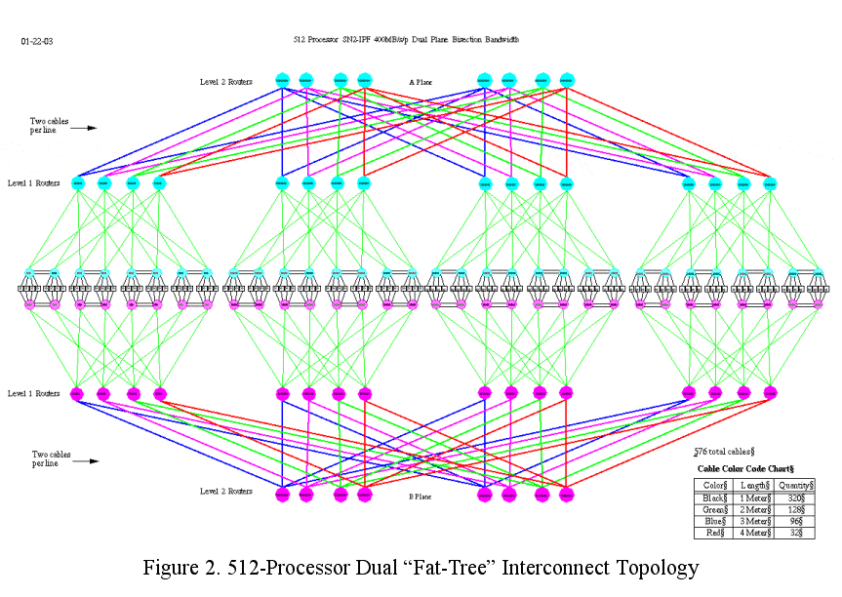
SGI NUMAlink Fat Tree
www.embedded-computing.com/articles/woodacre

Slide 13
Interconnection Network Comparison
For a 64 processor system
 | Bus | Ring | 2D Torus | 6-cube | Fully connected
Network bandwidth | 1 | N | 4N | 3N
Bisection bandwidth | 1 | 2 | Root N
Total # of Switches | 1
Links per switch
Total # of links | 1 | N | 4N | 3N
Notes:
For class handout

Slide 14
Interconnection Network Comparison
For a 64 processor system
 | Bus | Ring | 2D Torus | 6-cube | Fully connected
Network bandwidth | 1
Bisection bandwidth | 1
Total # of switches | 1
Links per switch
Total # of links (bidi) | 1
64
2
64
2+1
64+64
256
16
64
4+1
128+64
192
32
64
6+7
192+64
2016
1024
64
63+1
2016+64
Notes:
For lecture
What about a 3D torus – 4 x 4 x 4 = 64: links per switch = 6, total # of switches = 64, NB = 384/2, BB = 32

Slide 15
Network Connected Multiprocessors
 | Proc | Proc Speed | # Proc | IN Topology | BW/link (MB/sec)
SGI Origin | R16000 |  | 128 | fat tree | 800
Cray 3TE | Alpha 21164 | 300MHz | 2,048 | 3D torus | 600
Intel ASCI Red | Intel | 333MHz | 9,632 | mesh | 800
IBM ASCI White | Power3 | 375MHz | 8,192 | multistage Omega | 500
NEC ES | SX-5 | 500MHz | 640*8 | 640-xbar | 16000
NASA Columbia | Intel Itanium2 | 1.5GHz | 512*20 | fat tree, Infiniband
IBM BlueGene/L | Power PC 440 | 0.7GHz | 65,536*2 | 3D torus, fat tree, barrier
Notes:
ASCI white has 16 processors per chip (those are probably mesh connected)
The Columbia machine is 20 Infiniband connected SGI clusters of 512 fat tree interconnected processors

Slide 16
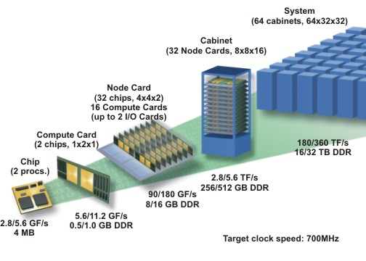
IBM BlueGene
 | 512-node proto | BlueGene/L
Peak Perf | 1.0 / 2.0 TFlops/s | 180 / 360 TFlops/s
Memory Size | 128 GByte | 16 / 32 TByte
Foot Print | 9 sq feet | 2500 sq feet
Total Power | 9 KW | 1.5 MW
# Processors | 512 dual proc | 65,536 dual proc
Networks | 3D Torus, Tree, Barrier | 3D Torus, Tree, Barrier
Torus BW | 3 B/cycle | 3 B/cycle
Notes:
Two PowerPC 440s cores per chip – 2 PEs, 2 chips per computer card – 4 PEs, 16 compute cards per node card – 64 PEs, 32 node cards per cabinet – 2048 PEs, 64 cabinets per system – 131,072 PEs

