Slide 1
Lec 3 – Memory Hierarchy Review
Based on slides by David Patterson
Notes:
CS252 S05

Slide 2
Since 1980, CPU has outpaced DRAM ...
Q. How do architects address this gap?
A. Put smaller, faster “cache” memories between CPU and DRAM.
Create a “memory hierarchy”.
Performance
(1/latency)
CPU
60% per yr
2X in 1.5 yrs
1000
CPU
100
Gap grew 50% per year
10
DRAM
9% per yr
2X in 10 yrs
DRAM
1980
1990
2000
Year

Slide 3

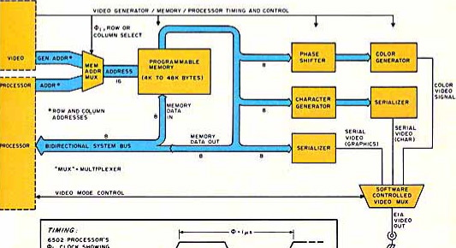
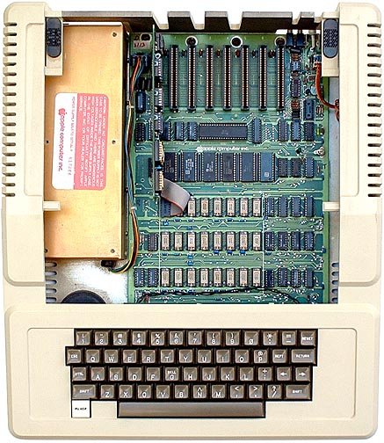


1977: DRAM faster than microprocessors
Apple ][ (1977)
CPU: 1000 ns
DRAM: 400 ns
Steve
Wozniak
Steve Jobs

Slide 4
Levels of the Memory Hierarchy
Capacity
Access Time
Cost
Upper Level
Staging
Xfer Unit
faster
CPU Registers
100s Bytes
<10s ns
Registers
Instr. Operands
prog./compiler
1-8 bytes
Cache
K Bytes
10-100 ns
1-0.1 cents/bit
Cache
Blocks
cache cntl
8-128 bytes
Main Memory
M Bytes
200ns- 500ns
$.0001-.00001 cents /bit
Memory
Pages
OS
512-4K bytes
Disk
G Bytes, 10 ms
(10,000,000 ns)
10 - 10 cents/bit
Disk
-5
-6
Files
user/operator
Mbytes
Tape
infinite
sec-min
10
Larger
Tape
Lower Level
-8
Notes:
CS252 S05

Slide 5
The Principle of Locality
The Principle of Locality:
  Program access a relatively small portion of the address space at any instant of time.
Two Different Types of Locality:
  Temporal Locality (Locality in Time): If an item is referenced, it will tend to be referenced again soon (e.g., loops, reuse)
  Spatial Locality (Locality in Space): If an item is referenced, items whose addresses are close by tend to be referenced soon
  (e.g., straightline code, array access)
Last 15 years, HW relied on locality for speed
Locality is a property of programs which is exploited in machine design.
Notes:
CS252 S05
The principle of locality states that programs access a relatively small portion of the address space at any instant of time.
This is kind of like in real life, we all have a lot of friends. But at any given time most of us can only keep in touch with a small group of them.
There are two different types of locality: Temporal and Spatial. Temporal locality is the locality in time which says if an item is referenced, it will tend to be referenced again soon.
This is like saying if you just talk to one of your friends, it is likely that you will talk to him or her again soon.
This makes sense. For example, if you just have lunch with a friend, you may say, let’s go to the ball game this Sunday. So you will talk to him again soon.
Spatial locality is the locality in space. It says if an item is referenced, items whose addresses are close by tend to be referenced soon.
Once again, using our analogy. We can usually divide our friends into groups. Like friends from high school, friends from work, friends from home.
Let’s say you just talk to one of your friends from high school and she may say something like: “So did you hear so and so just won the lottery.”
You probably will say NO, I better give him a call and find out more.
So this is an example of spatial locality. You just talked to a friend from your high school days. As a result, you end up talking to another high school friend. Or at least in this case, you hope he still remember you are his friend.
+3 = 10 min. (X:50)

Slide 6
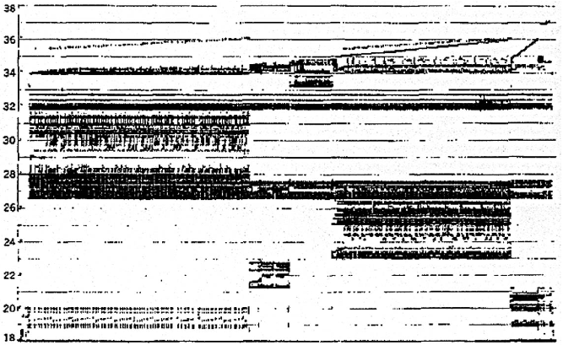
Programs with locality cache well ...
Bad locality behavior
Temporal
Locality
Memory Address (one dot per access)
Spatial
Locality
Time
Donald J. Hatfield, Jeanette Gerald: Program Restructuring for Virtual Memory. IBM Systems Journal 10(3): 168-192 (1971)

Slide 7
Memory Hierarchy: Terminology
Hit: data appears in some block in the upper level (example: Block X)
  Hit Rate: the fraction of memory access found in the upper level
  Hit Time: Time to access the upper level which consists of
    RAM access time + Time to determine hit/miss
Miss: data needs to be retrieve from a block in the lower level (Block Y)
  Miss Rate = 1 - (Hit Rate)
  Miss Penalty: Time to replace a block in the upper level +
    Time to deliver the block the processor
Hit Time << Miss Penalty (500 instructions on 21264!)
Lower Level
Memory
To Processor
Upper Level
Memory
Block X
From Processor
Block Y
Notes:
CS252 S05
A HIT is when the data the processor wants to access is found in the upper level (Blk X).
The fraction of the memory access that are HIT is defined as HIT rate.
HIT Time is the time to access the Upper Level where the data is found (X). It consists of:
(a) Time to access this level.
(b) AND the time to determine if this is a Hit or Miss.
If the data the processor wants cannot be found in the Upper level. Then we have a miss and we need to retrieve the data (Blk Y) from the lower level.
By definition (definition of Hit: Fraction), the miss rate is just 1 minus the hit rate.
This miss penalty also consists of two parts:
(a) The time it takes to replace a block (Blk Y to BlkX) in the upper level.
(b) And then the time it takes to deliver this new block to the processor.
It is very important that your Hit Time to be much much smaller than your miss penalty. Otherwise, there will be no reason to build a memory hierarchy.
+2 = 14 min. (X:54)

Slide 8
Cache Measures
Hit rate: fraction found in that level
  So high that usually talk about Miss rate
  Miss rate fallacy: as MIPS to CPU performance,
  miss rate to average memory access time in memory
Average memory-access time
= Hit time + Miss rate x Miss penalty
(ns or clocks)
Miss penalty: time to replace a block from lower level, including time to replace in CPU
  access time: time to lower level
  = f(latency to lower level)
  transfer time: time to transfer block
  =f(BW between upper & lower levels)

Slide 9
Types of Cache Miss – the 3 C’s
Compulsory Misses
  The first time a piece of memory is used, it is not in the cache
  No choice but to load used memory at least once
Capacity Misses
  The size of the cache is limited
  Once the cache is full, you must kick out something to load something else
Conflict Misses
  Most caches are not fully associative
  Cache lines get swapped out even if cache is not full
  If two regions of memory are mapped to the same cache line, then they conflict
Coherency Misses
  Cache invalidation due to cache coherency
  Data is written by another core or processor

Slide 10
So why should the programmer care?
Cache misses can have a huge impact on program performance
  L1 hit costs maybe two cycles
  Main memory access costs maybe 400 cycles
  Two orders of magnitude
We can’t understand the performance of a program that accesses any significant amount of data without considering cache misses.

Slide 11
What can the programmer do?
Sometimes there isn’t much that can be done
  Data access patterns are difficult to change
But programmer decisions can have a huge impact on performance
  Design of data structures
  Order of access of data structures by the code
Quite simple changes to the algorithms and/or data structures can have a very large impact on cache misses

Slide 12
Data structures
How can we design data structures to reduce cache misses?
Make data structures more compact
  E.g. use smaller data sizes or pack bits to reduce size
Separate “hot” and “cold” data
  Some parts of a data structure may be used much more than others. For example, some fields of a structure may be used on every access, whereas others are used only occasionally.
  Consider whether to use structures of arrays rather than arrays of structures.
  This may require very large changes to your program

Slide 13
Data structures
Collapse linked data structures
  Linked lists can have terrible locality, because each element can be anywhere in memory.
  Replacing linked lists with arrays usually improves locality because (at least in C/C++) arrays are contiguous in memory
  Linked lists are not always a good replacement for arrays, so consider hybrid data structures.
  E.g. linked lists where each element is a short array of values.
Other linked structures can also be collapsed
  Consider replacing binary trees with BTrees, etc.
  Standard libraries should do more of this

Slide 14
Data access patterns
In many cases it is not feasible to change the data structures
Instead change order of access
E.g. matrix by vector multiplication
for ( i = 0; i < N; i++ ) {
y[i] = 0;
for ( j = 0; j < N; j++ ) {
y[i] = y[i] + x[j] *A[i][j];
}
}

Slide 15
Programs and the cache
For some types of programs the a cache-efficient version can be as much as five times faster than a regular version.
  E.g. Matrix multiplication
When you start to work with multiple cores, considering the cache becomes even more important.
Different cores may compete for space within shared caches. L1 and L2 caches are usually private to the core. L3 is usually shared among all cores.

