Slide 1
CS3014: Concurrent Systems
Static & Dynamic Instruction Scheduling
Slides originally developed by Drew Hilton, Amir Roth, Milo Martin and Joe Devietti at University of Pennsylvania

Slide 2
Instruction Scheduling & Limitations

Slide 3
Instruction Scheduling
Scheduling: act of finding independent instructions
“Static” done at compile time by the compiler (software)
“Dynamic” done at runtime by the processor (hardware)
Why schedule code?
Scalar pipelines: fill in load-to-use delay slots to improve CPI
Superscalar: place independent instructions together
As above, load-to-use delay slots
Allow multiple-issue decode logic to let them execute at the same time

Slide 4
Dynamic (Execution-time) Instruction Scheduling

Slide 5
Can Hardware Overcome These Limits?
Dynamically-scheduled processors
Also called “out-of-order” processors
Hardware re-schedules instructions…
…within a sliding window of instructions
As with pipelining and superscalar, ISA unchanged
Same hardware/software interface, appearance of in-order
Increases scheduling scope
Does loop unrolling transparently!
Uses branch prediction to “unroll” branches
Examples:
Pentium Pro/II/III (3-wide), Core 2 (4-wide), Alpha 21264 (4-wide), MIPS R10000 (4-wide), Power5 (5-wide)
Notes:
Pentium Pro appeared in 1995

Slide 6
Example: In-Order Limitations #1
 | 0 | 1 | 2 | 3 | 4 | 5 | 6 | 7 | 8 | 9 | 10 | 11 | 12
Ld [r1] ➜ r2 | F | D | X | M₁ | M₂ | W
add r2 + r3 ➜ r4 | F | D | d* | d* | d* | X | M₁ | M₂ | W
xor r4 ^ r5 ➜ r6 |  | F | D | d* | d* | d* | X | M₁ | M₂ | W
ld [r7] ➜ r4 |  | F | D | p* | p* | p* | X | M₁ | M₂ | W
In-order pipeline, three-cycle load-use penalty, 2-wide
Why not the following?
 | 0 | 1 | 2 | 3 | 4 | 5 | 6 | 7 | 8 | 9 | 10 | 11 | 12
Ld [r1] ➜ r2 | F | D | X | M₁ | M₂ | W
add r2 + r3 ➜ r4 | F | D | d* | d* | d* | X | M₁ | M₂ | W
xor r4 ^ r5 ➜ r6 |  | F | D | d* | d* | d* | X | M₁ | M₂ | W
ld [r7] ➜ r4 |  | F | D | X | M₁ | M₂ | W
Notes:
OoO register writes, but different kind of dependence

Slide 7
Example: In-Order Limitations #2
 | 0 | 1 | 2 | 3 | 4 | 5 | 6 | 7 | 8 | 9 | 10 | 11 | 12
Ld [p1] ➜ p2 | F | D | X | M₁ | M₂ | W
add p2 + p3 ➜ p4 | F | D | d* | d* | d* | X | M₁ | M₂ | W
xor p4 ^ p5 ➜ p6 |  | F | D | d* | d* | d* | X | M₁ | M₂ | W
ld [p7] ➜ p8 |  | F | D | p* | p* | p* | X | M₁ | M₂ | W
In-order pipeline, three-cycle load-use penalty, 2-wide
Why not the following?:
 | 0 | 1 | 2 | 3 | 4 | 5 | 6 | 7 | 8 | 9 | 10 | 11 | 12
Ld [p1] ➜ p2 | F | D | X | M₁ | M₂ | W
add p2 + p3 ➜ p4 | F | D | d* | d* | d* | X | M₁ | M₂ | W
xor p4 ^ p5 ➜ p6 |  | F | D | d* | d* | d* | X | M₁ | M₂ | W
ld [p7] ➜ p8 |  | F | D | X | M₁ | M₂ | W

Slide 8
Out-of-Order to the Rescue
 | 0 | 1 | 2 | 3 | 4 | 5 | 6 | 7 | 8 | 9 | 10 | 11 | 12
Ld [p1] ➜ p2 | F | Di | I | RR | X | M₁ | M₂ | W | C
add p2 + p3 ➜ p4 | F | Di |  |  |  | I | RR | X | W | C
xor p4 ^ p5 ➜ p6 |  | F | Di |  |  |  | I | RR | X | W | C
ld [p7] ➜ p8 |  | F | Di | I | RR | X | M₁ | M₂ | W |  | C
“Dynamic scheduling” done by the hardware
Still 2-wide superscalar, but now out-of-order, too
Allows instructions to issue when dependences are ready
Longer pipeline
In-order front end: Fetch, “Dispatch”
Out-of-order execution core:
“Issue”, “RegisterRead”, Execute, Memory, Writeback
In-order retirement: “Commit”
Notes:
didn’t save any cycles, but we are setup for more ILP

Slide 9
Out-of-Order Pipeline
Buffer of instructions
Decode
Rename
Dispatch
Commit
Fetch
Reg-read
Writeback
Execute
Issue
In-order front end
Out-of-order execution
In-order commit

Slide 10
Out-of-Order Execution
Also called “Dynamic scheduling”
Done by the hardware on-the-fly during execution
Looks at a “window” of instructions waiting to execute
Each cycle, picks the next ready instruction(s)
Two steps to enable out-of-order execution:
Step #1: Register renaming – to avoid “false” dependencies
Step #2: Dynamically schedule – to enforce “true” dependencies
Key to understanding out-of-order execution:
Data dependencies

Slide 11
Dependence types
RAW (Read After Write) = “true dependence” (true)
mul r0 * r1 ➜ r2
…
add r2 + r3 ➜ r4
WAW (Write After Write) = “output dependence” (false)
mul r0 * r1➜ r2
…
add r1 + r3 ➜ r2
WAR (Write After Read) = “anti-dependence” (false)
mul r0 * r1 ➜ r2
…
add r3 + r4 ➜ r1
WAW & WAR are “false”, Can be totally eliminated by “renaming”
Notes:
what about RAR?

Slide 12
Step #1: Register Renaming
To eliminate register conflicts/hazards
“Architected” vs “Physical” registers – level of indirection
Names: r1,r2,r3
Locations: p1,p2,p3,p4,p5,p6,p7
Original mapping: r1→p1, r2→p2, r3→p3, p4–p7 are “available”
Renaming – conceptually write each register once
Removes false dependences
Leaves true dependences intact!
When to reuse a physical register? After overwriting instruction is complete
MapTable |  |  |  | FreeList |  | Original insns |  | Renamed insns
r1 | r2 | r3
p1 | p2 | p3 |  | p4,p5,p6,p7 |  | add r2,r3➜r1 |  | add p2,p3➜p4
p4 | p2 | p3 |  | p5,p6,p7 |  | sub r2,r1➜r3 |  | sub p2,p4➜p5
p4 | p2 | p5 |  | p6,p7 |  | mul r2,r3➜r3 |  | mul p2,p5➜p6
p4 | p2 | p6 |  | p7 |  | div r1,4➜r1 |  | div p4,4➜p7
Time
Notes:
What can we free after this code executes? p4

Slide 13
Out-of-order Pipeline
Buffer of instructions
Decode
Rename
Dispatch
Commit
Fetch
Reg-read
Writeback
Execute
Issue
In-order front end
Out-of-order execution
Have unique register names
Now put into out-of-order execution structures
In-order commit

Slide 14
Step #2: Dynamic Scheduling
add p2,p3➜p4
sub p2,p4➜p5
mul p2,p5➜p6
div p4,4➜p7
regfile
I$
insn buffer
D$
B
P
D
S
Ready Table
P2 | P3 | P4 | P5 | P6 | P7
Yes | Yes
Yes | Yes | Yes
Yes | Yes | Yes | Yes |  | Yes
Yes | Yes | Yes | Yes | Yes | Yes
add p2,p3➜p4
and
Time
sub p2,p4➜p5
div p4,4➜p7
mul p2,p5➜p6
Instructions fetch/decoded/renamed into Instruction Buffer
Also called “instruction window” or “instruction scheduler”
Instructions (conceptually) check ready bits every cycle
Execute oldest “ready” instruction, set output as “ready”
Notes:
How do we know when an insn is ready to execute? it’s inputs are ready
Why execute the *oldest* ready insn?

Slide 15
Dynamic Scheduling/Issue Algorithm
Data structures:
Ready table[phys_reg] ➔ yes/no (part of “issue queue”)
Algorithm at “issue” stage (prior to read registers):
foreach instruction:
if table[insn.phys_input1] == ready && table[insn.phys_input2] == ready then
insn is “ready”
select the oldest “ready” instruction
table[insn.phys_output] = ready
Multiple-cycle instructions? (such as loads)
For an instruction with latency of N, set “ready” bit N-1 cycles in future

Slide 16
Register Renaming

Slide 17
Register Renaming Algorithm (Simplified)
Two key data structures:
maptable[architectural_reg] ➔ physical_reg
Free list: allocate (new) & free registers (implemented as a queue)
ignore freeing of registers for now
Algorithm: at “decode” stage for each instruction:
Rewrites instruction with “physical” registers (rather than “architectural” registers
insn.phys_input1 = maptable[insn.arch_input1]
insn.phys_input2 = maptable[insn.arch_input2]
new_reg = new_phys_reg()
maptable[insn.arch_output] = new_reg
insn.phys_output = new_reg
Notes:
don’t worry about free-ing registers

Slide 18
Renaming example
xor r1 ^ r2 ➜ r3
add r3 + r4 ➜ r4
sub r5 - r2 ➜ r3
addi r3 + 1 ➜ r1
r1
p1
p6
r2
p2
p7
r3
p3
p8
r4
p4
p9
r5
p5
p10
Map table
Free-list

Slide 19
Renaming example
xor r1 ^ r2 ➜ r3
add r3 + r4 ➜ r4
sub r5 - r2 ➜ r3
addi r3 + 1 ➜ r1
xor p1 ^ p2 ➜
r1
p1
p6
r2
p2
p7
r3
p3
p8
r4
p4
p9
r5
p5
p10
Map table
Free-list

Slide 20
Renaming example
xor r1 ^ r2 ➜ r3
add r3 + r4 ➜ r4
sub r5 - r2 ➜ r3
addi r3 + 1 ➜ r1
xor p1 ^ p2 ➜ p6
r1
p1
p6
r2
p2
p7
r3
p3
p8
r4
p4
p9
r5
p5
p10
Map table
Free-list

Slide 21
Renaming example
xor r1 ^ r2 ➜ r3
add r3 + r4 ➜ r4
sub r5 - r2 ➜ r3
addi r3 + 1 ➜ r1
xor p1 ^ p2 ➜ p6
r1
p1
r2
p2
p7
r3
p6
p8
r4
p4
p9
r5
p5
p10
Map table
Free-list
Notes:
why do we update the map table here?

Slide 22
Renaming example
xor r1 ^ r2 ➜ r3
add r3 + r4 ➜ r4
sub r5 - r2 ➜ r3
addi r3 + 1 ➜ r1
xor p1 ^ p2 ➜ p6
add p6 + p4 ➜
r1
p1
r2
p2
p7
r3
p6
p8
r4
p4
p9
r5
p5
p10
Map table
Free-list

Slide 23
Renaming example
xor r1 ^ r2 ➜ r3
add r3 + r4 ➜ r4
sub r5 - r2 ➜ r3
addi r3 + 1 ➜ r1
xor p1 ^ p2 ➜ p6
add p6 + p4 ➜ p7
r1
p1
r2
p2
p7
r3
p6
p8
r4
p4
p9
r5
p5
p10
Map table
Free-list

Slide 24
Renaming example
xor r1 ^ r2 ➜ r3
add r3 + r4 ➜ r4
sub r5 - r2 ➜ r3
addi r3 + 1 ➜ r1
xor p1 ^ p2 ➜ p6
add p6 + p4 ➜ p7
r1
p1
r2
p2
r3
p6
p8
r4
p7
p9
r5
p5
p10
Map table
Free-list

Slide 25
Renaming example
xor r1 ^ r2 ➜ r3
add r3 + r4 ➜ r4
sub r5 - r2 ➜ r3
addi r3 + 1 ➜ r1
xor p1 ^ p2 ➜ p6
add p6 + p4 ➜ p7
sub p5 - p2 ➜
r1
p1
r2
p2
r3
p6
p8
r4
p7
p9
r5
p5
p10
Map table
Free-list

Slide 26
Renaming example
xor r1 ^ r2 ➜ r3
add r3 + r4 ➜ r4
sub r5 - r2 ➜ r3
addi r3 + 1 ➜ r1
xor p1 ^ p2 ➜ p6
add p6 + p4 ➜ p7
sub p5 - p2 ➜ p8
r1
p1
r2
p2
r3
p6
p8
r4
p7
p9
r5
p5
p10
Map table
Free-list

Slide 27
Renaming example
xor r1 ^ r2 ➜ r3
add r3 + r4 ➜ r4
sub r5 - r2 ➜ r3
addi r3 + 1 ➜ r1
xor p1 ^ p2 ➜ p6
add p6 + p4 ➜ p7
sub p5 - p2 ➜ p8
r1
p1
r2
p2
r3
p8
r4
p7
p9
r5
p5
p10
Map table
Free-list

Slide 28
Renaming example
xor r1 ^ r2 ➜ r3
add r3 + r4 ➜ r4
sub r5 - r2 ➜ r3
addi r3 + 1 ➜ r1
xor p1 ^ p2 ➜ p6
add p6 + p4 ➜ p7
sub p5 - p2 ➜ p8
addi p8 + 1 ➜
r1
p1
r2
p2
r3
p8
r4
p7
p9
r5
p5
p10
Map table
Free-list

Slide 29
Renaming example
xor r1 ^ r2 ➜ r3
add r3 + r4 ➜ r4
sub r5 - r2 ➜ r3
addi r3 + 1 ➜ r1
xor p1 ^ p2 ➜ p6
add p6 + p4 ➜ p7
sub p5 - p2 ➜ p8
addi p8 + 1 ➜ p9
r1
p1
r2
p2
r3
p8
r4
p7
p9
r5
p5
p10
Map table
Free-list

Slide 30
Renaming example
xor r1 ^ r2 ➜ r3
add r3 + r4 ➜ r4
sub r5 - r2 ➜ r3
addi r3 + 1 ➜ r1
xor p1 ^ p2 ➜ p6
add p6 + p4 ➜ p7
sub p5 - p2 ➜ p8
addi p8 + 1 ➜ p9
r1
p9
r2
p2
r3
p8
r4
p7
r5
p5
p10
Map table
Free-list

Slide 31
Out-of-order Pipeline
Buffer of instructions
(reorder buffer)
Decode
Rename
Dispatch
Commit
Fetch
Reg-read
Writeback
Execute
Issue
Have unique register names
Now put into out-of-order execution structures

Slide 32
Dynamic Instruction Scheduling Mechanisms

Slide 33
Dispatch
Put renamed instructions into out-of-order structures
Re-order buffer (ROB)
Holds instructions from Fetch through Commit
Issue Queue
Central piece of scheduling logic
Holds instructions from Dispatch through Issue
Tracks ready inputs
Physical register names + ready bit
“AND” the bits to tell if ready
Insn
Inp1
R
Inp2
R
Dst
Bday
Ready?
Notes:
Why Birthday instead of Age?

Slide 34
Dispatch Steps
Allocate Issue Queue (IQ) slot
Full? Stall
Read ready bits of inputs
1-bit per physical reg
Clear ready bit of output in table
Instruction has not produced value yet
Write data into Issue Queue (IQ) slot

Slide 35
Dispatch Example
xor p1 ^ p2 ➜ p6
add p6 + p4 ➜ p7
sub p5 - p2 ➜ p8
addi p8 + 1 ➜ p9
Ready bits
p1 y
p2 y
p3 y
Issue Queue
p4 y
Insn
Inp1
R
Inp2
R
Dst
Bday
p5 y
p6 y
p7 y
p8 y
p9 y

Slide 36
Dispatch Example
xor p1 ^ p2 ➜ p6
add p6 + p4 ➜ p7
sub p5 - p2 ➜ p8
addi p8 + 1 ➜ p9
Ready bits
p1 y
p2 y
p3 y
Issue Queue
p4 y
Insn
Inp1
R
Inp2
R
Dst
Bday
p5 y
xor
p1
y
p2
y
p6
0
p6 n
p7 y
p8 y
p9 y

Slide 37
Dispatch Example
xor p1 ^ p2 ➜ p6
add p6 + p4 ➜ p7
sub p5 - p2 ➜ p8
addi p8 + 1 ➜ p9
Ready bits
p1 y
p2 y
p3 y
Issue Queue
p4 y
Insn
Inp1
R
Inp2
R
Dst
Bday
p5 y
xor
p1
y
p2
y
p6
0
p6 n
add
p6
n
p4
y
p7
1
p7 n
p8 y
p9 y

Slide 38
Dispatch Example
xor p1 ^ p2 ➜ p6
add p6 + p4 ➜ p7
sub p5 - p2 ➜ p8
addi p8 + 1 ➜ p9
Ready bits
p1 y
p2 y
p3 y
Issue Queue
p4 y
Insn
Inp1
R
Inp2
R
Dst
Bday
p5 y
xor
p1
y
p2
y
p6
0
p6 n
add
p6
n
p4
y
p7
1
p7 n
sub
p5
y
p2
y
p8
2
p8 n
p9 y

Slide 39
Dispatch Example
xor p1 ^ p2 ➜ p6
add p6 + p4 ➜ p7
sub p5 - p2 ➜ p8
addi p8 + 1 ➜ p9
Ready bits
p1 y
p2 y
p3 y
Issue Queue
p4 y
Insn
Inp1
R
Inp2
R
Dst
Bday
p5 y
xor
p1
y
p2
y
p6
0
p6 n
add
p6
n
p4
y
p7
1
p7 n
sub
p5
y
p2
y
p8
2
p8 n
addi
p8
n
---
y
p9
3
p9 n

Slide 40
Out-of-order pipeline
Execution (out-of-order) stages
Select ready instructions
Send for execution
Wakeup dependents
Reg-read
Writeback
Issue
Execute

Slide 41
Dynamic Scheduling/Issue Algorithm
Data structures:
Ready table[phys_reg] ➔ yes/no (part of issue queue)
Algorithm at “schedule” stage (prior to read registers):
foreach instruction:
if table[insn.phys_input1] == ready && table[insn.phys_input2] == ready then
insn is “ready”
select the oldest “ready” instruction
table[insn.phys_output] = ready

Slide 42
Issue = Select + Wakeup
Select oldest of “ready” instructions
“xor” is the oldest ready instruction below
“xor” and “sub” are the two oldest ready instructions below
Note: may have resource constraints: i.e. load/store/floating point
Insn
Inp1
R
Inp2
R
Dst
Bday
xor
p1
y
p2
y
p6
0
Ready!
add
p6
n
p4
y
p7
1
sub
p5
y
p2
y
p8
2
Ready!
addi
p8
n
---
y
p9
3

Slide 43
Issue = Select + Wakeup
Wakeup dependent instructions
Search for destination (Dst) in inputs & set “ready” bit
Implemented with a special memory array circuit called a Content Addressable Memory (CAM)
Also update ready-bit table for future instructions
For multi-cycle operations (loads, floating point)
Wakeup deferred a few cycles
Include checks to avoid structural hazards
Ready bits
p1 y
Insn
Inp1
R
Inp2
R
Dst
Bday
p2 y
xor
p1
y
p2
y
p6
0
p3 y
add
p6
y
p4
y
p7
1
p4 y
sub
p5
y
p2
y
p8
2
p5 y
addi
p8
y
---
y
p9
3
p6 y
p7 n
p8 y
p9 n

Slide 44
Note: Content Addressable Memory
A content addressable memory (CAM) is indexed by the content of each location, not by the address
Sometimes known as associative memory
It compares an input “key” against a table of keys, and returns the location of the key in the table
In software this might be implemented with a hash table
Hardware hash table is also possible, but potentially slow
To search all locations in a single cycle
You need to be able to compare the search key to all keys in the table simultaneously
This requires a *lot* of hardware
Fast CAMs are very hardware expensive
If you need to be able to do multiple searches in the same cycle, the hardware requirements are even greater

Slide 45
Issue
Select/Wakeup one cycle
Dependent instructions execute on back-to-back cycles
Next cycle: add/addi are ready:
Issued instructions are removed from issue queue
Free up space for subsequent instructions
Insn
Inp1
R
Inp2
R
Dst
Bday
add
p6
y
p4
y
p7
1
addi
p8
y
---
y
p9
3

Slide 46
OOO execution (2-wide)
p1 7
p2 3
p3 4
xor RDY
add
sub RDY
addi
p4 9
p5 6
p6 0
p7 0
p8 0
p9 0

Slide 47
OOO execution (2-wide)
p1 7
p2 3
xor p1^ p2 ➜ p6
p3 4
add RDY
addi RDY
p4 9
p5 6
p6 0
p7 0
sub p5 - p2 ➜ p8
p8 0
p9 0

Slide 48
OOO execution (2-wide)
p1 7
p2 3
xor 7^ 3 ➜ p6
add p6 +p4 ➜p7
p3 4
p4 9
p5 6
p6 0
p7 0
addi p8 +1 ➜ p9
sub 6 - 3 ➜ p8
p8 0
p9 0
Notes:
add depends on xor, addi depends on sub

Slide 49
OOO execution (2-wide)
p1 7
p2 3
4 ➜ p6
add p6 + 9 ➜ p7
p3 4
p4 9
p5 6
p6 0
p7 0
addi p8 +1 ➜ p9
3 ➜ p8
p8 0
p9 0
Notes:
use MX bypass

Slide 50
OOO execution (2-wide)
p1 7
p2 3
13 ➜ p7
p3 4
p4 9
p5 6
p6 4
p7 0
p8 3
4 ➜ p9
p9 0

Slide 51
OOO execution (2-wide)
p1 7
p2 3
p3 4
p4 9
p5 6
p6 4
p7 13
p8 3
p9 4

Slide 52
OOO execution (2-wide)
Note similarity
to in-order
p1 7
p2 3
p3 4
p4 9
p5 6
p6 4
p7 13
p8 3
p9 4

Slide 53
Renaming Revisited

Slide 54
Re-order Buffer (ROB)
ROB entry holds all info for recovery/commit
All instructions & in order
Architectural register names, physical register names, insn type
Not removed until very last thing (“commit”)
Operation
Fetch: insert at tail (if full, stall)
Commit: remove from head (if not yet done, stall)
Purpose: tracking for in-order commit
Maintain appearance of in-order execution
Needed to support:
Misprediction recovery
Freeing of physical registers

Slide 55
Renaming revisited
Track (or “log”) the “overwritten register” in ROB
Free this register at commit
Also used to restore the map table on “recovery”
Used for branch misprediction recovery

Slide 56
Dynamic Scheduling Example

Slide 57
Dynamic Scheduling Example
The following slides are a detailed but concrete example
Yet, it contains enough detail to be overwhelming
Try not to worry about the details
Focus on the big picture:
Hardware can reorder instructions
to extract instruction-level parallelism

Slide 58
Recall: Motivating Example
 | 0 | 1 | 2 | 3 | 4 | 5 | 6 | 7 | 8 | 9 | 10 | 11 | 12
ld [p1] ➜ p2 | F | Di | I | RR | X | M₁ | M₂ | W | C
add p2 + p3 ➜ p4 | F | Di |  |  |  | I | RR | X | W | C
xor p4 ^ p5 ➜ p6 |  | F | Di |  |  |  | I | RR | X | W | C
ld [p7] ➜ p8 |  | F | Di | I | RR | X | M₁ | M₂ | W |  | C
How would this execution occur cycle-by-cycle?
Execution latencies assumed in this example:
Loads have two-cycle load-to-use penalty
Three cycle total execution latency
All other instructions have single-cycle execution latency
“Issue queue”: hold all waiting (un-executed) instructions
Holds ready/not-ready status
Faster than looking up in ready table each cycle

Slide 59
Out-of-Order Pipeline – Cycle 0
 | 0 | 1 | 2 | 3 | 4 | 5 | 6 | 7 | 8 | 9 | 10 | 11 | 12
ld [r1] ➜ r2 | F
add r2 + r3 ➜ r4 | F
xor r4 ^ r5 ➜ r6
ld [r7] ➜ r4
Map Table
r1 | p8
r2 | p7
r3 | p6
r4 | p5
r5 | p4
r6 | p3
r7 | p2
r8 | p1
Ready Table
p1 | yes
p2 | yes
p3 | yes
p4 | yes
p5 | yes
p6 | yes
p7 | yes
p8 | yes
p9 | ---
p10 | ---
p11 | ---
p12 | ---
Reorder Buffer
Insn | To Free | Done?
ld |  | no
add |  | no
Issue Queue
Insn | Src1 | R? | Src2 | R? | Dest | Bdy

Slide 60
Out-of-Order Pipeline – Cycle 1a
 | 0 | 1 | 2 | 3 | 4 | 5 | 6 | 7 | 8 | 9 | 10 | 11 | 12
ld [r1] ➜ r2 | F | Di
add r2 + r3 ➜ r4 | F
xor r4 ^ r5 ➜ r6
ld [r7] ➜ r4
Map Table
r1 | p8
r2 | p9
r3 | p6
r4 | p5
r5 | p4
r6 | p3
r7 | p2
r8 | p1
Ready Table
p1 | yes
p2 | yes
p3 | yes
p4 | yes
p5 | yes
p6 | yes
p7 | yes
p8 | yes
p9 | no
p10 | ---
p11 | ---
p12 | ---
Reorder Buffer
Insn | To Free | Done?
ld | p7 | no
add |  | no
Issue Queue
Insn | Src1 | R? | Src2 | R? | Dest | Bdy
ld | p8 | yes | --- | yes | p9 | 0
Notes:
Di(spatch) includes decode and rename

Slide 61
Out-of-Order Pipeline – Cycle 1b
 | 0 | 1 | 2 | 3 | 4 | 5 | 6 | 7 | 8 | 9 | 10 | 11 | 12
ld [r1] ➜ r2 | F | Di
add r2 + r3 ➜ r4 | F | Di
xor r4 ^ r5 ➜ r6
ld [r7] ➜ r4
Map Table
r1 | p8
r2 | p9
r3 | p6
r4 | p10
r5 | p4
r6 | p3
r7 | p2
r8 | p1
Ready Table
p1 | yes
p2 | yes
p3 | yes
p4 | yes
p5 | yes
p6 | yes
p7 | yes
p8 | yes
p9 | no
p10 | no
p11 | ---
p12 | ---
Reorder Buffer
Insn | To Free | Done?
ld | p7 | no
add | p5 | no
Issue Queue
Insn | Src1 | R? | Src2 | R? | Dest | Bdy
ld | p8 | yes | --- | yes | p9 | 0
add | p9 | no | p6 | yes | p10 | 1

Slide 62
Out-of-Order Pipeline – Cycle 1c
 | 0 | 1 | 2 | 3 | 4 | 5 | 6 | 7 | 8 | 9 | 10 | 11 | 12
ld [r1] ➜ r2 | F | Di
add r2 + r3 ➜ r4 | F | Di
xor r4 ^ r5 ➜ r6 |  | F
ld [r7] ➜ r4 |  | F
Map Table
r1 | p8
r2 | p9
r3 | p6
r4 | p10
r5 | p4
r6 | p3
r7 | p2
r8 | p1
Ready Table
p1 | yes
p2 | yes
p3 | yes
p4 | yes
p5 | yes
p6 | yes
p7 | yes
p8 | yes
p9 | no
p10 | no
p11 | ---
p12 | ---
Reorder Buffer
Insn | To Free | Done?
ld | p7 | no
add | p5 | no
xor |  | no
ld |  | no
Issue Queue
Insn | Src1 | R? | Src2 | R? | Dest | Bdy
ld | p8 | yes | --- | yes | p9 | 0
add | p9 | no | p6 | yes | p10 | 1

Slide 63
Out-of-Order Pipeline – Cycle 2a
 | 0 | 1 | 2 | 3 | 4 | 5 | 6 | 7 | 8 | 9 | 10 | 11 | 12
ld [r1] ➜ r2 | F | Di | I
add r2 + r3 ➜ r4 | F | Di
xor r4 ^ r5 ➜ r6 |  | F
ld [r7] ➜ r4 |  | F
Map Table
r1 | p8
r2 | p9
r3 | p6
r4 | p10
r5 | p4
r6 | p3
r7 | p2
r8 | p1
Ready Table
p1 | yes
p2 | yes
p3 | yes
p4 | yes
p5 | yes
p6 | yes
p7 | yes
p8 | yes
p9 | no
p10 | no
p11 | ---
p12 | ---
Reorder Buffer
Insn | To Free | Done?
ld | p7 | no
add | p5 | no
xor |  | no
ld |  | no
Issue Queue
Insn | Src1 | R? | Src2 | R? | Dest | Bdy
ld | p8 | yes | --- | yes | p9 | 0
add | p9 | no | p6 | yes | p10 | 1

Slide 64
Out-of-Order Pipeline – Cycle 2b
 | 0 | 1 | 2 | 3 | 4 | 5 | 6 | 7 | 8 | 9 | 10 | 11 | 12
ld [r1] ➜ r2 | F | Di | I
add r2 + r3 ➜ r4 | F | Di
xor r4 ^ r5 ➜ r6 |  | F | Di
ld [r7] ➜ r4 |  | F
Map Table
r1 | p8
r2 | p9
r3 | p6
r4 | p10
r5 | p4
r6 | p11
r7 | p2
r8 | p1
Ready Table
p1 | yes
p2 | yes
p3 | yes
p4 | yes
p5 | yes
p6 | yes
p7 | yes
p8 | yes
p9 | no
p10 | no
p11 | no
p12 | ---
Reorder Buffer
Insn | To Free | Done?
ld | p7 | no
add | p5 | no
xor | p3 | no
ld |  | no
Issue Queue
Insn | Src1 | R? | Src2 | R? | Dest | Bdy
ld | p8 | yes | --- | yes | p9 | 0
add | p9 | no | p6 | yes | p10 | 1
xor | p10 | no | p4 | yes | p11 | 2

Slide 65
Out-of-Order Pipeline – Cycle 2c
 | 0 | 1 | 2 | 3 | 4 | 5 | 6 | 7 | 8 | 9 | 10 | 11 | 12
ld [r1] ➜ r2 | F | Di | I
add r2 + r3 ➜ r4 | F | Di
xor r4 ^ r5 ➜ r6 |  | F | Di
ld [r7] ➜ r4 |  | F | Di
Map Table
r1 | p8
r2 | p9
r3 | p6
r4 | p12
r5 | p4
r6 | p11
r7 | p2
r8 | p1
Ready Table
p1 | yes
p2 | yes
p3 | yes
p4 | yes
p5 | yes
p6 | yes
p7 | yes
p8 | yes
p9 | no
p10 | no
p11 | no
p12 | no
Reorder Buffer
Insn | To Free | Done?
ld | p7 | no
add | p5 | no
xor | p3 | no
ld | p10 | no
Issue Queue
Insn | Src1 | R? | Src2 | R? | Dest | Bdy
ld | p8 | yes | --- | yes | p9 | 0
add | p9 | no | p6 | yes | p10 | 1
xor | p10 | no | p4 | yes | p11 | 2
ld | p2 | yes | --- | yes | p12 | 3

Slide 66
Out-of-Order Pipeline – Cycle 3
 | 0 | 1 | 2 | 3 | 4 | 5 | 6 | 7 | 8 | 9 | 10 | 11 | 12
ld [r1] ➜ r2 | F | Di | I | RR
add r2 + r3 ➜ r4 | F | Di
xor r4 ^ r5 ➜ r6 |  | F | Di
ld [r7] ➜ r4 |  | F | Di | I
Map Table
r1 | p8
r2 | p9
r3 | p6
r4 | p12
r5 | p4
r6 | p11
r7 | p2
r8 | p1
Ready Table
p1 | yes
p2 | yes
p3 | yes
p4 | yes
p5 | yes
p6 | yes
p7 | yes
p8 | yes
p9 | no
p10 | no
p11 | no
p12 | no
Reorder Buffer
Insn | To Free | Done?
ld | p7 | no
add | p5 | no
xor | p3 | no
ld | p10 | no
Issue Queue
Insn | Src1 | R? | Src2 | R? | Dest | Bdy
ld | p8 | yes | --- | yes | p9 | 0
add | p9 | no | p6 | yes | p10 | 1
xor | p10 | no | p4 | yes | p11 | 2
ld | p2 | yes | --- | yes | p12 | 3

Slide 67
Out-of-Order Pipeline – Cycle 4
 | 0 | 1 | 2 | 3 | 4 | 5 | 6 | 7 | 8 | 9 | 10 | 11 | 12
ld [r1] ➜ r2 | F | Di | I | RR | X
add r2 + r3 ➜ r4 | F | Di
xor r4 ^ r5 ➜ r6 |  | F | Di
ld [r7] ➜ r4 |  | F | Di | I | RR
Map Table
r1 | p8
r2 | p9
r3 | p6
r4 | p12
r5 | p4
r6 | p11
r7 | p2
r8 | p1
Ready Table
p1 | yes
p2 | yes
p3 | yes
p4 | yes
p5 | yes
p6 | yes
p7 | yes
p8 | yes
p9 | yes
p10 | no
p11 | no
p12 | no
Reorder Buffer
Insn | To Free | Done?
ld | p7 | no
add | p5 | no
xor | p3 | no
ld | p10 | no
Issue Queue
Insn | Src1 | R? | Src2 | R? | Dest | Bdy
ld | p8 | yes | --- | yes | p9 | 0
add | p9 | yes | p6 | yes | p10 | 1
xor | p10 | no | p4 | yes | p11 | 2
ld | p2 | yes | --- | yes | p12 | 3

Slide 68
Out-of-Order Pipeline – Cycle 5a
 | 0 | 1 | 2 | 3 | 4 | 5 | 6 | 7 | 8 | 9 | 10 | 11 | 12
ld [r1] ➜ r2 | F | Di | I | RR | X | M₁
add r2 + r3 ➜ r4 | F | Di |  |  |  | I
xor r4 ^ r5 ➜ r6 |  | F | Di
ld [r7] ➜ r4 |  | F | Di | I | RR | X
Map Table
r1 | p8
r2 | p9
r3 | p6
r4 | p12
r5 | p4
r6 | p11
r7 | p2
r8 | p1
Ready Table
p1 | yes
p2 | yes
p3 | yes
p4 | yes
p5 | yes
p6 | yes
p7 | yes
p8 | yes
p9 | yes
p10 | yes
p11 | no
p12 | no
Reorder Buffer
Insn | To Free | Done?
ld | p7 | no
add | p5 | no
xor | p3 | no
ld | p10 | no
Issue Queue
Insn | Src1 | R? | Src2 | R? | Dest | Bdy
ld | p8 | yes | --- | yes | p9 | 0
add | p9 | yes | p6 | yes | p10 | 1
xor | p10 | yes | p4 | yes | p11 | 2
ld | p2 | yes | --- | yes | p12 | 3

Slide 69
Out-of-Order Pipeline – Cycle 5b
 | 0 | 1 | 2 | 3 | 4 | 5 | 6 | 7 | 8 | 9 | 10 | 11 | 12
ld [r1] ➜ r2 | F | Di | I | RR | X | M₁
add r2 + r3 ➜ r4 | F | Di |  |  |  | I
xor r4 ^ r5 ➜ r6 |  | F | Di
ld [r7] ➜ r4 |  | F | Di | I | RR | X
Map Table
r1 | p8
r2 | p9
r3 | p6
r4 | p12
r5 | p4
r6 | p11
r7 | p2
r8 | p1
Ready Table
p1 | yes
p2 | yes
p3 | yes
p4 | yes
p5 | yes
p6 | yes
p7 | yes
p8 | yes
p9 | yes
p10 | yes
p11 | no
p12 | yes
Reorder Buffer
Insn | To Free | Done?
ld | p7 | no
add | p5 | no
xor | p3 | no
ld | p10 | no
Issue Queue
Insn | Src1 | R? | Src2 | R? | Dest | Bdy
ld | p8 | yes | --- | yes | p9 | 0
add | p9 | yes | p6 | yes | p10 | 1
xor | p10 | yes | p4 | yes | p11 | 2
ld | p2 | yes | --- | yes | p12 | 3

Slide 70
Out-of-Order Pipeline – Cycle 6
 | 0 | 1 | 2 | 3 | 4 | 5 | 6 | 7 | 8 | 9 | 10 | 11 | 12
ld [r1] ➜ r2 | F | Di | I | RR | X | M₁ | M₂
add r2 + r3 ➜ r4 | F | Di |  |  |  | I | RR
xor r4 ^ r5 ➜ r6 |  | F | Di |  |  |  | I
ld [r7] ➜ r4 |  | F | Di | I | RR | X | M₁
Map Table
r1 | p8
r2 | p9
r3 | p6
r4 | p12
r5 | p4
r6 | p11
r7 | p2
r8 | p1
Ready Table
p1 | yes
p2 | yes
p3 | yes
p4 | yes
p5 | yes
p6 | yes
p7 | yes
p8 | yes
p9 | yes
p10 | yes
p11 | yes
p12 | yes
Reorder Buffer
Insn | To Free | Done?
ld | p7 | no
add | p5 | no
xor | p3 | no
ld | p10 | no
Issue Queue
Insn | Src1 | R? | Src2 | R? | Dest | Bdy
ld | p8 | yes | --- | yes | p9 | 0
add | p9 | yes | p6 | yes | p10 | 1
xor | p10 | yes | p4 | yes | p11 | 2
ld | p2 | yes | --- | yes | p12 | 3

Slide 71
Out-of-Order Pipeline – Cycle 7
 | 0 | 1 | 2 | 3 | 4 | 5 | 6 | 7 | 8 | 9 | 10 | 11 | 12
ld [r1] ➜ r2 | F | Di | I | RR | X | M₁ | M₂ | W
add r2 + r3 ➜ r4 | F | Di |  |  |  | I | RR | X
xor r4 ^ r5 ➜ r6 |  | F | Di |  |  |  | I | RR
ld [r7] ➜ r4 |  | F | Di | I | RR | X | M₁ | M₂
Map Table
r1 | p8
r2 | p9
r3 | p6
r4 | p12
r5 | p4
r6 | p11
r7 | p2
r8 | p1
Ready Table
p1 | yes
p2 | yes
p3 | yes
p4 | yes
p5 | yes
p6 | yes
p7 | yes
p8 | yes
p9 | yes
p10 | yes
p11 | yes
p12 | yes
Reorder Buffer
Insn | To Free | Done?
ld | p7 | yes
add | p5 | no
xor | p3 | no
ld | p10 | no
Issue Queue
Insn | Src1 | R? | Src2 | R? | Dest | Bdy
ld | p8 | yes | --- | yes | p9 | 0
add | p9 | yes | p6 | yes | p10 | 1
xor | p10 | yes | p4 | yes | p11 | 2
ld | p2 | yes | --- | yes | p12 | 3

Slide 72
Out-of-Order Pipeline – Cycle 8a
 | 0 | 1 | 2 | 3 | 4 | 5 | 6 | 7 | 8 | 9 | 10 | 11 | 12
ld [r1] ➜ r2 | F | Di | I | RR | X | M₁ | M₂ | W | C
add r2 + r3 ➜ r4 | F | Di |  |  |  | I | RR | X
xor r4 ^ r5 ➜ r6 |  | F | Di |  |  |  | I | RR
ld [r7] ➜ r4 |  | F | Di | I | RR | X | M₁ | M₂
Map Table
r1 | p8
r2 | p9
r3 | p6
r4 | p12
r5 | p4
r6 | p11
r7 | p2
r8 | p1
Ready Table
p1 | yes
p2 | yes
p3 | yes
p4 | yes
p5 | yes
p6 | yes
p7 | ---
p8 | yes
p9 | yes
p10 | yes
p11 | yes
p12 | yes
Reorder Buffer
Insn | To Free | Done?
ld | p7 | yes
add | p5 | no
xor | p3 | no
ld | p10 | no
Issue Queue
Insn | Src1 | R? | Src2 | R? | Dest | Bdy
ld | p8 | yes | --- | yes | p9 | 0
add | p9 | yes | p6 | yes | p10 | 1
xor | p10 | yes | p4 | yes | p11 | 2
ld | p2 | yes | --- | yes | p12 | 3

Slide 73
Out-of-Order Pipeline – Cycle 8b
 | 0 | 1 | 2 | 3 | 4 | 5 | 6 | 7 | 8 | 9 | 10 | 11 | 12
ld [r1] ➜ r2 | F | Di | I | RR | X | M₁ | M₂ | W | C
add r2 + r3 ➜ r4 | F | Di |  |  |  | I | RR | X | W
xor r4 ^ r5 ➜ r6 |  | F | Di |  |  |  | I | RR | X
ld [r7] ➜ r4 |  | F | Di | I | RR | X | M₁ | M₂ | W
Map Table
r1 | p8
r2 | p9
r3 | p6
r4 | p12
r5 | p4
r6 | p11
r7 | p2
r8 | p1
Ready Table
p1 | yes
p2 | yes
p3 | yes
p4 | yes
p5 | yes
p6 | yes
p7 | ---
p8 | yes
p9 | yes
p10 | yes
p11 | yes
p12 | yes
Reorder Buffer
Insn | To Free | Done?
ld | p7 | yes
add | p5 | yes
xor | p3 | no
ld | p10 | yes
Issue Queue
Insn | Src1 | R? | Src2 | R? | Dest | Bdy
ld | p8 | yes | --- | yes | p9 | 0
add | p9 | yes | p6 | yes | p10 | 1
xor | p10 | yes | p4 | yes | p11 | 2
ld | p2 | yes | --- | yes | p12 | 3

Slide 74
Out-of-Order Pipeline – Cycle 9a
 | 0 | 1 | 2 | 3 | 4 | 5 | 6 | 7 | 8 | 9 | 10 | 11 | 12
ld [r1] ➜ r2 | F | Di | I | RR | X | M₁ | M₂ | W | C
add r2 + r3 ➜ r4 | F | Di |  |  |  | I | RR | X | W | C
xor r4 ^ r5 ➜ r6 |  | F | Di |  |  |  | I | RR | X
ld [r7] ➜ r4 |  | F | Di | I | RR | X | M₁ | M₂ | W
Map Table
r1 | p8
r2 | p9
r3 | p6
r4 | p12
r5 | p4
r6 | p11
r7 | p2
r8 | p1
Ready Table
p1 | yes
p2 | yes
p3 | yes
p4 | yes
p5 | ---
p6 | yes
p7 | ---
p8 | yes
p9 | yes
p10 | yes
p11 | yes
p12 | yes
Reorder Buffer
Insn | To Free | Done?
ld | p7 | yes
add | p5 | yes
xor | p3 | no
ld | p10 | yes
Issue Queue
Insn | Src1 | R? | Src2 | R? | Dest | Bdy
ld | p8 | yes | --- | yes | p9 | 0
add | p9 | yes | p6 | yes | p10 | 1
xor | p10 | yes | p4 | yes | p11 | 2
ld | p2 | yes | --- | yes | p12 | 3
Notes:
why not commit the second ld here?

Slide 75
Out-of-Order Pipeline – Cycle 9b
 | 0 | 1 | 2 | 3 | 4 | 5 | 6 | 7 | 8 | 9 | 10 | 11 | 12
ld [r1] ➜ r2 | F | Di | I | RR | X | M₁ | M₂ | W | C
add r2 + r3 ➜ r4 | F | Di |  |  |  | I | RR | X | W | C
xor r4 ^ r5 ➜ r6 |  | F | Di |  |  |  | I | RR | X | W
ld [r7] ➜ r4 |  | F | Di | I | RR | X | M₁ | M₂ | W
Map Table
r1 | p8
r2 | p9
r3 | p6
r4 | p12
r5 | p4
r6 | p11
r7 | p2
r8 | p1
Ready Table
p1 | yes
p2 | yes
p3 | yes
p4 | yes
p5 | ---
p6 | yes
p7 | ---
p8 | yes
p9 | yes
p10 | yes
p11 | yes
p12 | yes
Reorder Buffer
Insn | To Free | Done?
ld | p7 | yes
add | p5 | yes
xor | p3 | yes
ld | p10 | yes
Issue Queue
Insn | Src1 | R? | Src2 | R? | Dest | Bdy
ld | p8 | yes | --- | yes | p9 | 0
add | p9 | yes | p6 | yes | p10 | 1
xor | p10 | yes | p4 | yes | p11 | 2
ld | p2 | yes | --- | yes | p12 | 3

Slide 76
Out-of-Order Pipeline – Cycle 10
 | 0 | 1 | 2 | 3 | 4 | 5 | 6 | 7 | 8 | 9 | 10 | 11 | 12
ld [r1] ➜ r2 | F | Di | I | RR | X | M₁ | M₂ | W | C
add r2 + r3 ➜ r4 | F | Di |  |  |  | I | RR | X | W | C
xor r4 ^ r5 ➜ r6 |  | F | Di |  |  |  | I | RR | X | W | C
ld [r7] ➜ r4 |  | F | Di | I | RR | X | M₁ | M₂ | W |  | C
Map Table
r1 | p8
r2 | p9
r3 | p6
r4 | p12
r5 | p4
r6 | p11
r7 | p2
r8 | p1
Ready Table
p1 | yes
p2 | yes
p3 | ---
p4 | yes
p5 | ---
p6 | yes
p7 | ---
p8 | yes
p9 | yes
p10 | ---
p11 | yes
p12 | yes
Reorder Buffer
Insn | To Free | Done?
ld | p7 | yes
add | p5 | yes
xor | p3 | yes
ld | p10 | yes
Issue Queue
Insn | Src1 | R? | Src2 | R? | Dest | Bdy
ld | p8 | yes | --- | yes | p9 | 0
add | p9 | yes | p6 | yes | p10 | 1
xor | p10 | yes | p4 | yes | p11 | 2
ld | p2 | yes | --- | yes | p12 | 3

Slide 77
Out-of-Order Pipeline – Done!
 | 0 | 1 | 2 | 3 | 4 | 5 | 6 | 7 | 8 | 9 | 10 | 11 | 12
ld [r1] ➜ r2 | F | Di | I | RR | X | M₁ | M₂ | W | C
add r2 + r3 ➜ r4 | F | Di |  |  |  | I | RR | X | W | C
xor r4 ^ r5 ➜ r6 |  | F | Di |  |  |  | I | RR | X | W | C
ld [r7] ➜ r4 |  | F | Di | I | RR | X | M₁ | M₂ | W |  | C
Map Table
r1 | p8
r2 | p9
r3 | p6
r4 | p12
r5 | p4
r6 | p11
r7 | p2
r8 | p1
Ready Table
p1 | yes
p2 | yes
p3 | ---
p4 | yes
p5 | ---
p6 | yes
p7 | ---
p8 | yes
p9 | yes
p10 | ---
p11 | yes
p12 | yes
Reorder Buffer
Insn | To Free | Done?
ld | p7 | yes
add | p5 | yes
xor | p3 | yes
ld | p10 | yes
Issue Queue
Insn | Src1 | R? | Src2 | R? | Dest | Bdy
ld | p8 | yes | --- | yes | p9 | 0
add | p9 | yes | p6 | yes | p10 | 1
xor | p10 | yes | p4 | yes | p11 | 2
ld | p2 | yes | --- | yes | p12 | 3

Slide 78
Handling Memory Operations

Slide 79
Recall: Types of Dependencies
RAW (Read After Write) = “true dependence”
mul r0 * r1 ➜ r2
…
add r2 + r3 ➜ r4
WAW (Write After Write) = “output dependence”
mul r0 * r1➜ r2
…
add r1 + r3 ➜ r2
WAR (Write After Read) = “anti-dependence”
mul r0 * r1 ➜ r2
…
add r3 + r4 ➜ r1
WAW & WAR are “false”, Can be totally eliminated by “renaming”

Slide 80
Also Have Dependencies via Memory
If value in “r2” and “r3” is the same…
RAW (Read After Write) – True dependency
st r1 ➜ [r2]
…
ld [r3] ➜ r4
WAW (Write After Write)
st r1 ➜ [r2]
…
st r4 ➜ [r3]
WAR (Write After Read)
ld [r2] ➜ r1
…
st r4 ➜ [r3]
WAR/WAW are “false dependencies”
But can’t rename memory in same way as registers
Why? Addresses are not known at rename
- Need to use other tricks

Slide 81
Let’s Start with Just Stores
Stores: Write data cache, not registers
Can we rename memory?
No (at least not easily)
Cache writes unrecoverable
Solution: write stores into cache only when certain
When are we certain? At “commit”
Notes:
only stores => no RAW,WAR

Slide 82
Memory Forwarding via Store Queue
Store Queue (SQ)
Holds all in-flight stores
CAM: searchable by address
Age logic: determine youngest matching store older than load
Store rename/dispatch
Allocate entry in SQ
Store execution
Update SQ
Address + Data
Load execution
Search SQ identify youngest older matching store
Match? Read SQ
No Match? Read cache
load position
data in
address
data out
Store Queue (SQ)
address
value
head
==
age
==
==
==
==
tail
==
==
==
Data cache

Slide 83
Store Queue (SQ)
On load execution, select the store that is:
To same address as load
Older than the load (before the load in program order)
Of these matching stores, select the youngest
The store to the same address that immediately precedes the load
Notes:
do example on the board

Slide 84
Conservative Load Scheduling
Conservative load scheduling:
All older stores have executed
Some architectures: split store address / store data
Only requires knowing addresses (not the store values)
Advantage: always safe
Disadvantage: performance (limits ILP)

Slide 85
Load Speculation
Speculation requires three things…..
1. When do we speculate?
2. How do we detect a mis-speculation?
3. How do we recover from mis-speculations?
Squash offending load and all newer insns
Similar to branch mis-prediction recovery
Notes:
why squash all newer insns?

Slide 86
Load Queue
Detects load ordering violations
Load execution: Write address into LQ
Also note any store forwarded from
Store execution: Search LQ
Younger load with same address?
Did younger load forward from younger store? [See slide 149]
store position
flush?
load queue (LQ)
SQ
address
head
head
==
age
==
==
==
==
==
==
==
tail
==
==
tail
==
==
==
==
==
==
Data Cache

Slide 87
Store Queue + Load Queue
Store Queue: handles forwarding, allows OoO stores
Entry per store (allocated @ dispatch, deallocated @ commit)
Written by stores (@ execute)
Searched by loads (@ execute)
Read from SQ to write data cache (@ commit)
Load Queue: detects ordering violations
Entry per load (allocated @ dispatch, deallocated @ commit)
Written by loads (@ execute)
Searched by stores (@ execute)
Both together
Allows aggressive load scheduling
Stores don’t constrain load execution

Slide 88
Optimistic Load Scheduling Problem
Allows loads to issue before older stores
Increases ILP
Good: When no conflict, increases performance
Bad: Conflict => squash => worse performance than waiting
Can we have our cake AND eat it too?

Slide 89
Predictive Load Scheduling
Predict which loads must wait for stores
Fool me once, shame on you-- fool me twice?
Load instructions use aggressive strategy by default
Keep table of load PCs that have been caused squashes
Schedule these conservatively
Simple predictor
Makes “bad” loads wait for all older stores
More complex predictors used in practice
Predict which stores loads should wait for
“Store Sets” paper

Slide 90
Out-of-Order: Benefits & Challenges

Slide 91
Dynamic Scheduling Operation (Recap)
Dynamic scheduling
Totally in the hardware (not visible to software)
Also called “out-of-order execution” (OoO)
Fetch many instructions into instruction window
Use branch prediction to speculate past (multiple) branches
Flush pipeline on branch misprediction
Rename registers to avoid false dependencies
Execute instructions as soon as possible
Register dependencies are known
Handling memory dependencies is harder
“Commit” instructions in order
Anything strange happens before commit, just flush the pipeline

Slide 92
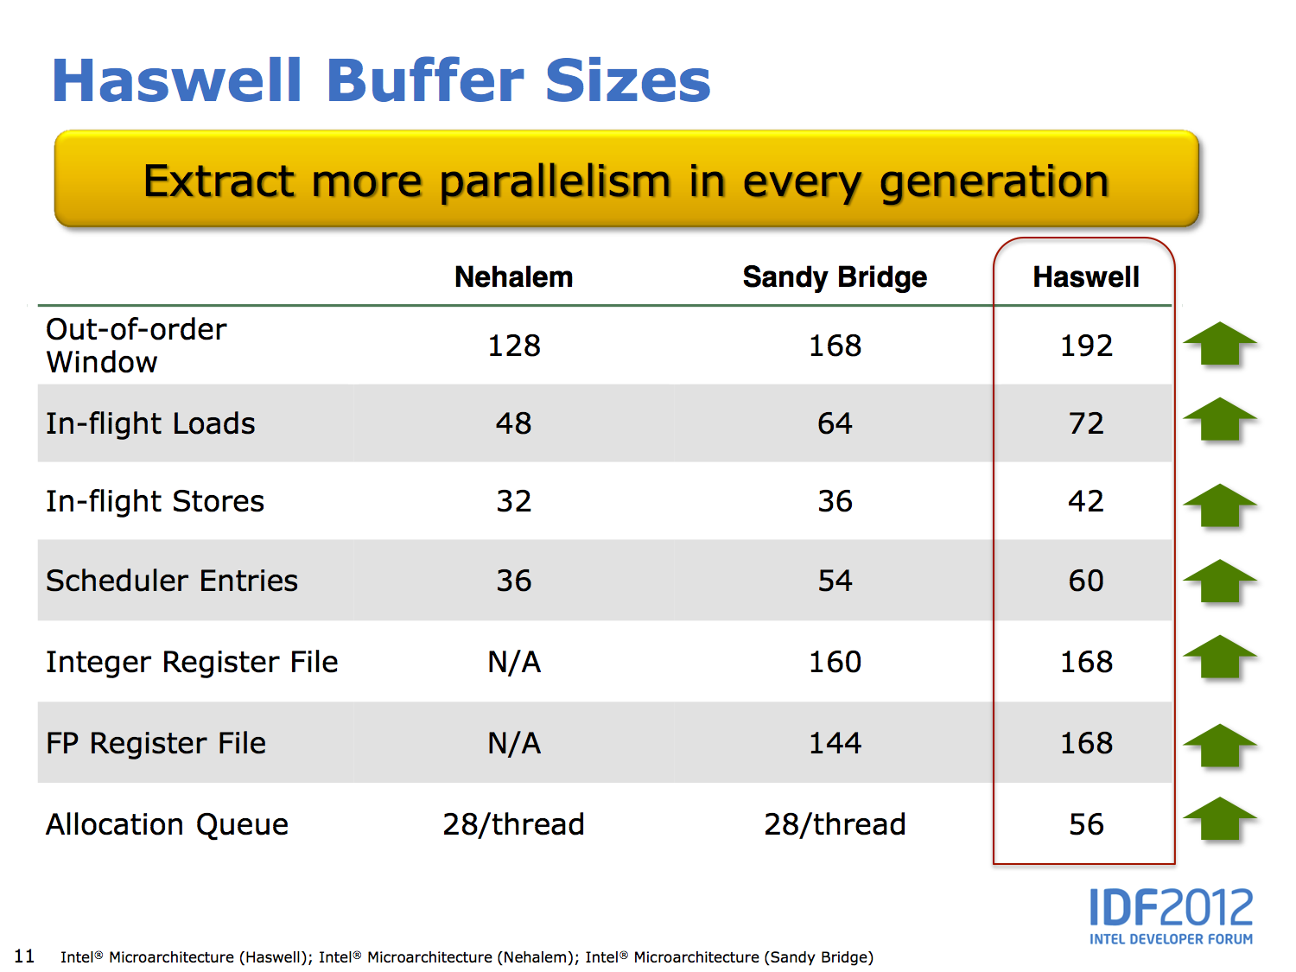

Slide 93
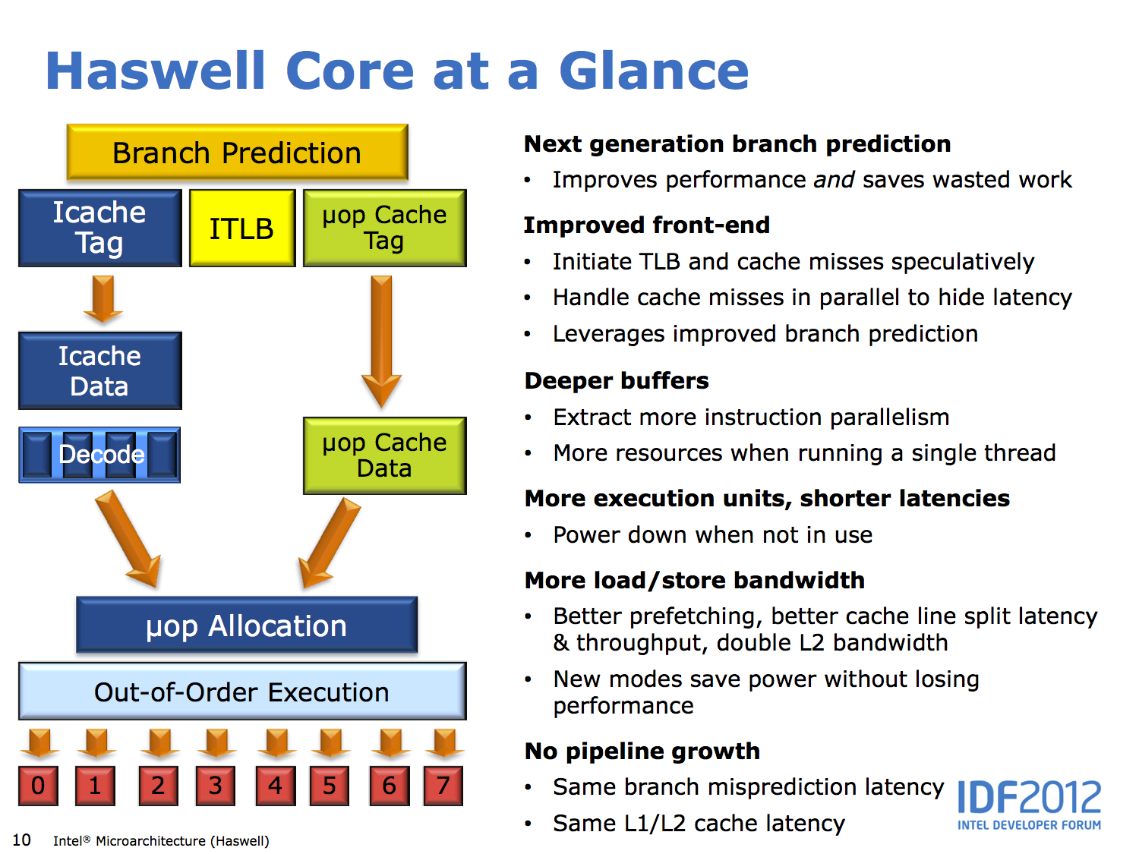

Slide 94
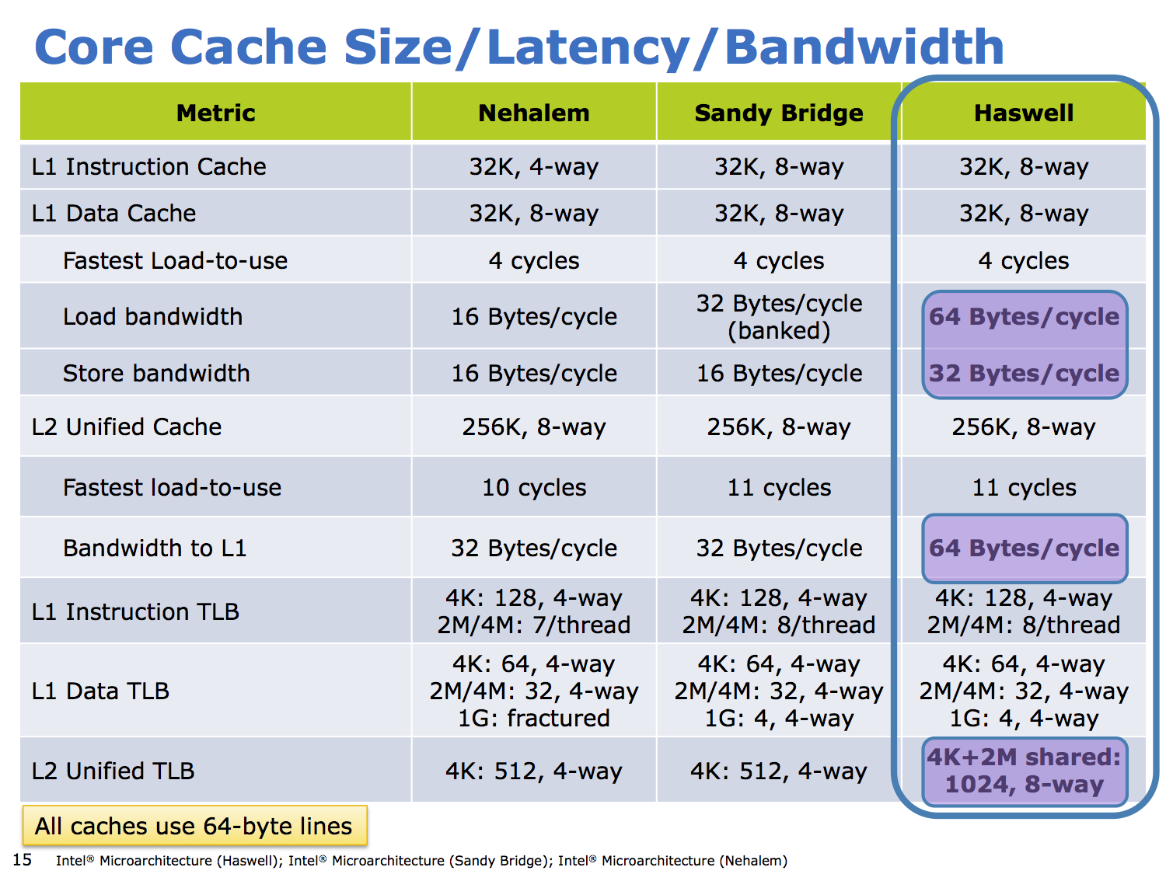
Notes:
check assoc, load-use penalties

Slide 95
OoO Execution is all around us
Example phone CPU: Qualcomm Krait 400 processor
based on ARM Cortex A15 processor
out-of-order 2.5GHz quad-core
3-wide fetch/decode
4-wide issue
11-stage integer pipeline
28nm process technology
4/4KB DM L1$, 16/16KB 4-way SA L2$, 2MB 8-way SA L3$
Notes:
Krait 400 released in 2012, 28nm

Slide 96
Out of Order: Benefits
Allows speculative re-ordering
Loads / stores
Branch prediction to look past branches
Done by hardware
Compiler may want different schedule for different hw configs
Hardware has only its own configuration to deal with
Schedule can change due to cache misses
Memory-level parallelism
Executes “around” cache misses to find independent instructions
Finds and initiates independent misses, reducing memory latency
Especially good at hiding L2 hits (~12 cycles in Core i7)

Slide 97
Challenges for Out-of-Order Cores
Design complexity
More complicated than in-order? Certainly!
But, we have managed to overcome the design complexity
Clock frequency
Can we build a “high ILP” machine at high clock frequency?
Yep, with some additional pipe stages, clever design
Limits to (efficiently) scaling the window and ILP
Large physical register file
Fast register renaming/wakeup/select/load queue/store queue
Active areas of micro-architectural research
Branch & memory depend. prediction (limits effective window size)
95% branch mis-prediction: 1 in 20 branches, or 1 in 100 insn.
Plus all the issues of building “wide” in-order superscalar
Power efficiency
Today, even mobile phone chips are out-of-order cores

Slide 98
Redux: HW vs. SW Scheduling
Static scheduling
Performed by compiler, limited in several ways
Dynamic scheduling
Performed by the hardware, overcomes limitations
Static limitation ➜ dynamic mitigation
Number of registers in the ISA ➜ register renaming
Scheduling scope ➜ branch prediction & speculation
Inexact memory aliasing information ➜ speculative memory ops
Unknown latencies of cache misses ➜ execute when ready
Which to do? Compiler does what it can, hardware the rest
Why? dynamic scheduling needed to sustain more than 2-way issue
Helps with hiding memory latency (execute around misses)
Intel Core i7 is four-wide execute w/ scheduling window of 100+
Even mobile phones have dynamically scheduled cores (ARM A9, A15)

