Slide 1
Introduction to Branch Prediction
David Gregg, TCD
Based on slides from Michele Co

Slide 2
Outline
What are branches?
Reducing branch penalties
Branch prediction
Why is branch prediction necessary?
Branch prediction basics
Issues which affect accurate branch prediction
Examples of real predictors

Slide 3
Branches
Instructions which can alter the flow of instruction execution in a program

Slide 4
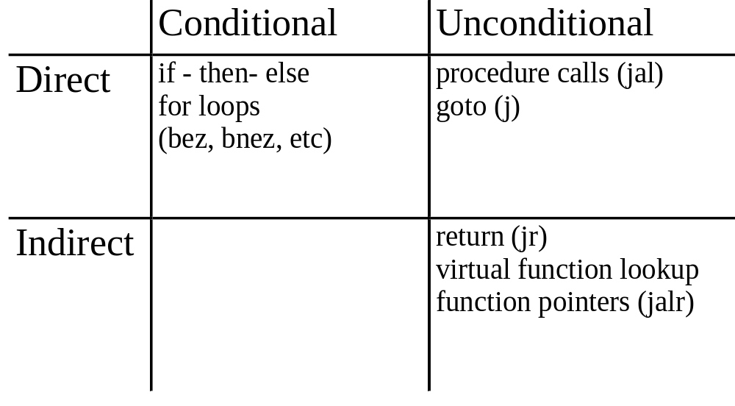
Types of Branches

Slide 5
Techniques for handling branches
IF
ID
EX
MEM
WB
Stalling
Delayed slots
  Relies on programmer/compiler to fill
  Depends on being able to find suitable instructions
  Ties resolution delay to a particular pipeline
Predication
  “if-conversion”: change control dependence to data dependence on branch condition

Slide 6
Why aren’t these techniques acceptable?
Branches are frequent - 15-25%
Today’s pipelines are deeper and wider
  Higher performance penalty for stalling
  Misprediction Penalty = issue width * resolution delay cycles
A lot of cycles can be wasted!!!

Slide 7
Branch Prediction
Predicting the outcome of a branch
  Direction:
    Taken / Not Taken
    Direction predictors
  Target Address
    PC+offset (Taken), or PC+4 (Not Taken)
    Target address predictors
      Branch Target Address Cache (BTAC) or Branch Target Buffer (BTB)

Slide 8
Why do we need branch prediction?
Branch prediction
  Increases the number of instructions available for the scheduler to issue. Increases instruction level parallelism (ILP)
  Allows useful work to be completed while waiting for the branch to resolve

Slide 9
Branch Prediction Strategies
Static
  Decided before runtime
  Examples:
    Always-Not Taken
    Always-Taken
    Backwards Taken, Forward Not Taken (BTFNT)
    Profile-driven prediction
Dynamic
  Prediction decisions may change during the execution of the program

Slide 10
What happens when a branch is predicted?
On mispredict:
  No speculative state may commit
    Squash instructions in the pipeline
    Must not allow stores in the pipeline to occur
      Cannot allow stores which would not have happened to commit
    Need to handle exceptions appropriately

Slide 11
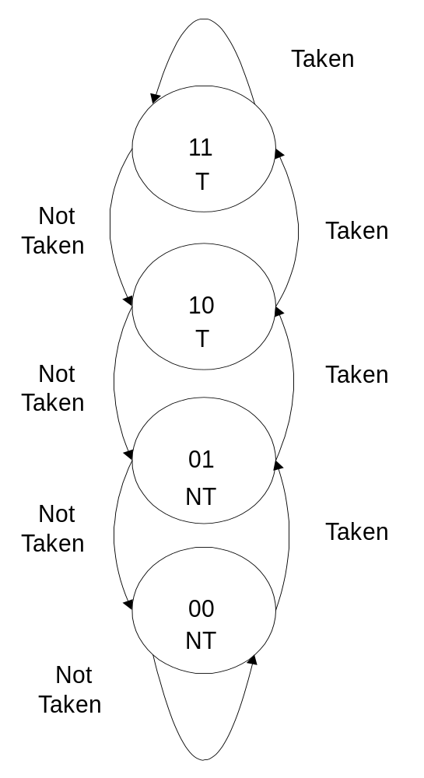
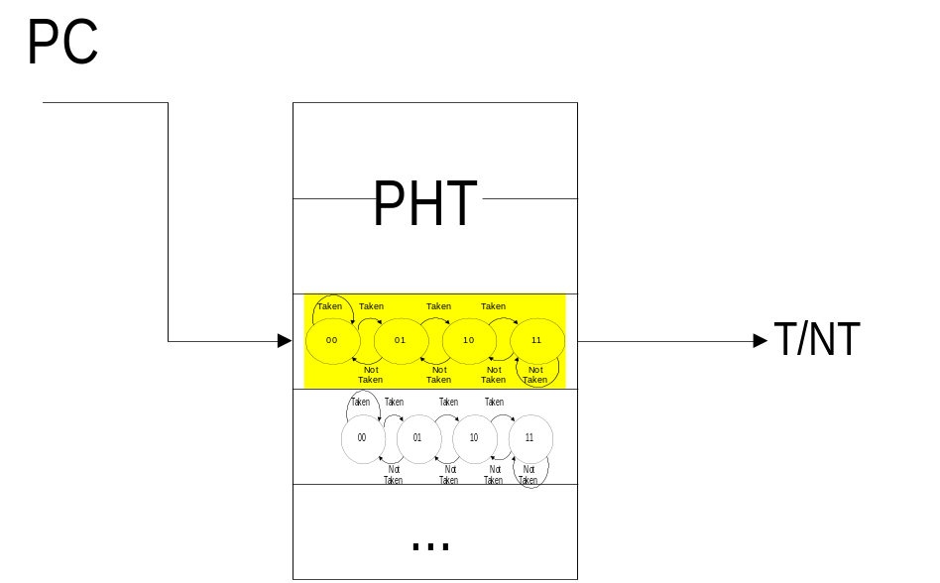
Bimodal Prediction
Table of 2-bit saturating counters
  Predict the most common direction
  Advantages: simple, cheap, “good”
  accuracy

Slide 12
Correlation
B1: if (x)
...
B2: if (y)
...
z=x&&y
B3: if (z)
...
B3 can be predicted with 100% accuracy based on the outcomes of B1 and B2

Slide 13
Two-Level Prediction
Uses two levels of information to make a direction prediction
  Branch History Table (BHT)
  PHT
Captures patterned behavior of branches
  Groups of branches are correlated
  Particular branches have particular behavior

Slide 14
Two-level Predictor Classification
Yeh and Patt 3-letter naming scheme
  Type of history collected
    G (global), P (per branch), S (per set)
    M (merge?)
      added by Skadron, Martonosi, Clark
  PHT type
    A (adaptive), S (static)
  PHT organization
    g (global), p (per branch), s (per set)

Slide 15
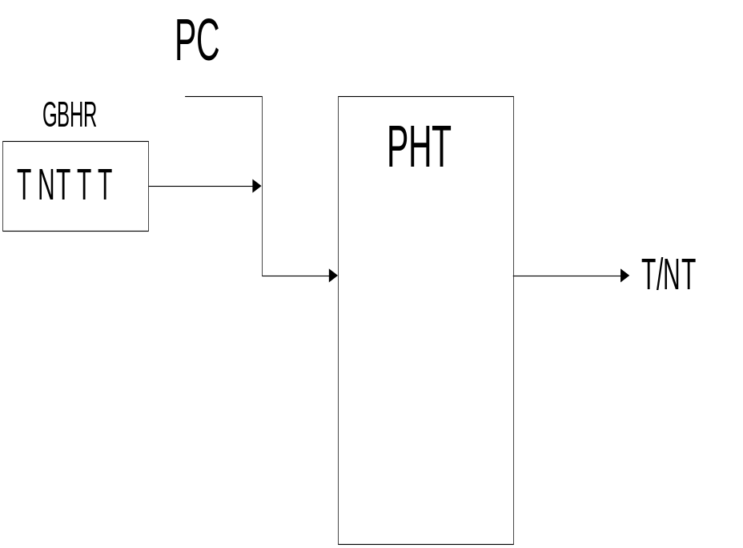
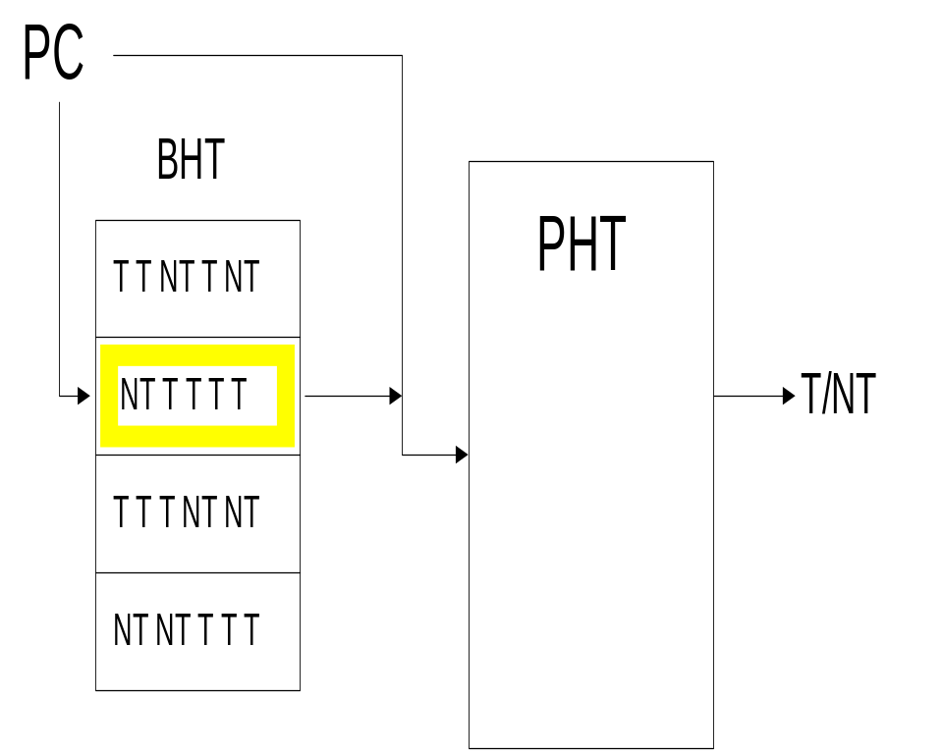
Some Two-level Predictors
GAs Predictor
PAs Predictor

Slide 16
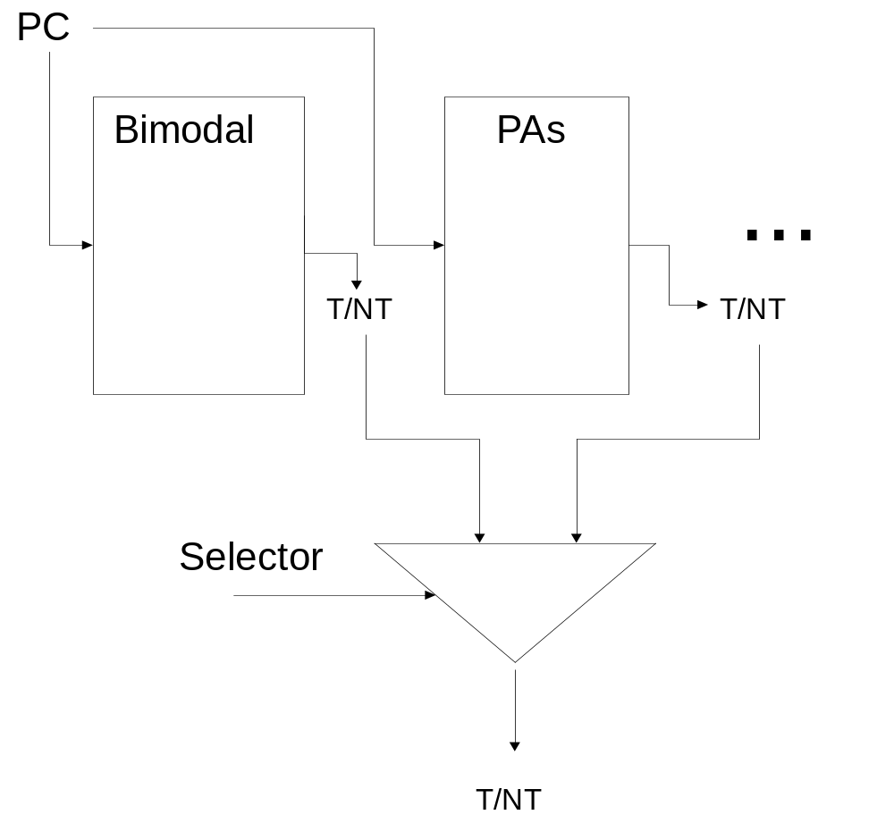
Hybrid Prediction
Two or more predictor components combined
Different
branches benefit
from different types
of history

Slide 17
Special Branches
Procedure calls and returns
  Calls are always taken
  Return address almost always known
Return Address Stack (RAS)
  On a procedure call, push the address of the instruction after the call onto the stack

Slide 18
Issues Affecting Accurate Branch Prediction
Aliasing
  More than one branch may use the same BHT/PHT entry
    Constructive
      Prediction that would have been incorrect, predicted correctly
    Destructive
      Prediction that would have been correct, predicted incorrectly
    Neutral
      No change in the accuracy

Slide 19
More Issues
Training time
  Need to see enough branches to uncover pattern
  Need enough time to reach steady state
“Wrong” history
  Incorrect type of history for the branch
Stale state
  Predictor is updated after information is needed
Operating system context switches
  More aliasing caused by branches in different programs

Slide 20
“Real” Branch Predictors
Alpha 21264
  8-stage pipeline, mispredict penalty 7 cycles
  64 KB, 2-way instruction cache with line and way prediction bits (Fetch)
    Each 4-instruction fetch block contains a prediction for the next fetch block
  Hybrid predictor (Fetch)
    12-bit GAg (4K-entry PHT, 2 bit counters)
    10-bit PAg (1K-entry BHT, 1K-entry PHT, 3-bit counters)

Slide 21
UltraSPARC-III
14-stage pipeline, bpred accessed in instruction fetch stages 2-3
16K-entry 2-bit counter Gshare predictor
  Bimodal predictor which XOR’s PC bits with global history register (except 3 lower order bits) to reduce aliasing
Miss queue
  Halves mispredict penalty by providing instructions for immediate use

Slide 22
Pentium III
Dynamic branch prediction
  512-entry BTB predicts direction and target, 4-bit history used with PC to derive direction
Static branch predictor for BTB misses
Return Address Stack (RAS), 4/8 entries
Branch Penalties:
  Not Taken: no penalty
  Correctly predicted taken: 1 cycle
  Mispredicted: at least 9 cycles, as many as 26, average 10-15 cycles

Slide 23
AMD Athlon K7
10-stage integer, 15-stage fp pipeline, predictor accessed in fetch
2K-entry bimodal, 2K-entry BTAC
12-entry RAS
Branch Penalties:
  Correct Predict Taken: 1 cycle
  Mispredict penalty: at least 10 cycles

