Slide 1
Instruction Level Parallelism
David Gregg
Department of Computer Science
University of Dublin, Trinity College

Slide 2
What is ILP?
Programs consist of a sequence of instructions
Goal of ILP is to execute several instructions simultaneously to make the program run faster
Some instructions are independent of others
We don’t always have to wait for all previous instructions to execute before executing a given instruction
If independent instructions are executed in parallel, the program runs faster

Slide 3
ILP example
Sequential computer Two-wide ILP computer
xsq = xdir * xdir; xsq = xdir*xdir; ysq = ydir*ydir;
ysq = ydir * ydir; xysumsq = xsq + ysq; tsq = tdir * tdir;
xysumsq = xsq + ysq; vsq = vdir * vdir; count = count + 1;
tsq = tdir * tdir; tvsq = tsq + vsq;
vsq = vdir * vdir;
tvsumsq = tsq + vsq;
count = count + 1;
Computation can be performed in 4 cycles instead of 7 (assuming a very simple architecture)

Slide 4
How much ILP is there?
ILP in typical programs?
Big question in 1960s
  Measure speedup from parallel execution of independent operations
  Assume infinite processors, registers, memory, etc.
  What is the most ILP we can get from a program assuming infinite hardware resources?
    Should give a limit on what is achievable

Slide 5
How much ILP is there?
Many limit studies in 1960s
All got roughly the same result
Limit of ILP speedup is 1.5-2.5 parallel instructions
Conclusion: Even with unrealistic machines with infinite resources, there is very little ILP in typical programs

Slide 6
The Branch Problem
ILP involves changing the order in which instructions are executed
  But you can’t safely move an instruction above a branch
  Branch target is unknown until branch executes
This operation can
be executed up
here

Slide 7
The Branch Problem
Branches are very common
  In typical C code there is a branch about every 5 instructions
  In FORTRAN scientific code every 8-9
Very limited ILP among instructions between branches
  Thus, the conclusion that there is little ILP in real programs

Slide 8
Riseman & Foster (1972)
What if we could somehow ignore the branches?
  What if each instruction could execute as soon as its inputs are available
Potential speedup of 51 (!)
  But how could we ignore or bypass all branches?
Suppose we have a machine the tentatively executes both paths from each conditional branch
  When branch resolves, half of paths are discarded

Slide 9
Riseman & Foster (1972)
A machine that tentatively bypasses two branches will execute four paths, but throw away results from 3
A machine that bypasses k branches will need to execute up to 2^{k} paths
Machine that bypasses all branches has k = ∞

Slide 10
Riseman & Foster 1972
7 benchmark programs on CDC-3600
Assume infinite “machines”
  i.e. infinite processors
If bounded to single basic block, speedup is 1.72 (Flynn’s bottleneck)
If one can bypass n branches (hypothetically), then:
BranchesBypassed | 0 | 1 | 2 | 8 | 32 | 128 | ∞
Speedup | 1.72 | 2.72 | 3.62 | 7.21 | 14.8 | 24.4 | 51.2

Slide 11
Riseman & Foster (1972)
Conclusion:
“To run ten times as fast as a one-instruction-at-a-time machine, 16 jumps must be bypassed. This implies up to 65,000 paths being explored simultaneously. Obviously, a machine with 65,000 instructions executing at once is a bit impractical.
Therefore we must reject the possibility of bypassing conditional branches as being of substantial help in speeding up the execution of programs”.

Slide 12
Riseman & Foster (1972)
Despite huge potential speedup, Riseman and Foster rejected ILP as a good way to speed up computers.
The main result of the work was that people believed that branches make ILP impossible

Slide 13
Branch Prediction
Problem
  65,000 paths is far too many to consider
But
  Not all those paths are equally likely to be followed
  The outcome of conditional branches is not random
  Branch outcomes are highly predictable

Slide 14
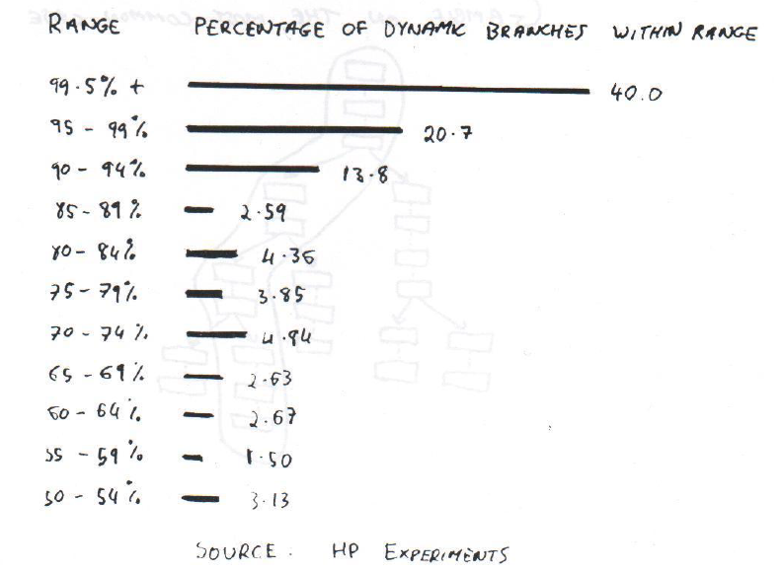
How often do branches take their majority direction?

Slide 15
One path of 65,000
Of all the 65,000 paths we might consider to bypass 16 branches
  One path is “more likely” than other 64,999
  Assuming that we have some way to predict the direction of conditional branches
We might bypass 16 branches
  But just on that one path

Slide 16
Single Path ILP
E.g., Trace Scheduling (Fisher 1979)
  Predict the direction of each branch
  Identify the most common path using branch predictions
  Find ILP in this common path ignoring branches
  If we choose the right path we get a big speedup
  Make sure we recover if we pick the wrong path

Slide 17
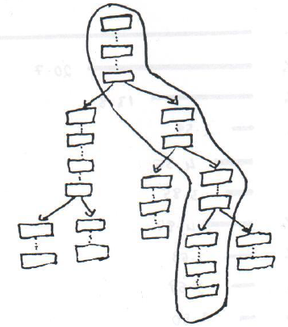
Single Path ILP
Gambling on the most common case

