Slide 1
Alex Castillo
Tourism Recommendations Bot

Slide 2
Models used:
ChatOpenAi: gpt-4-turbo
tried: gpt-3.5-turbo, gpt-4-turbo-preview, o1-preview
Indexation: dotproduct metric, dimension: 1536
Embedding: OpenAIEmbeddings(model = 'text-embedding-ada-002')
Vectorbase and VectorStore: Pinecone

Slide 3
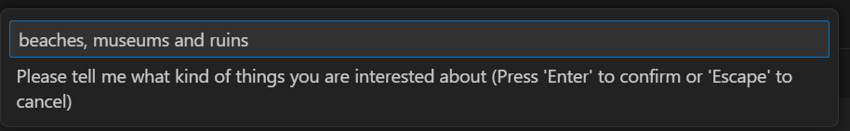
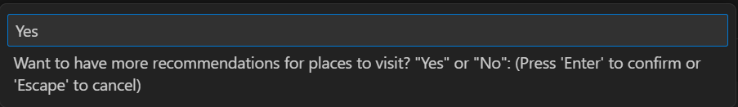

Input of the user interests

Slide 4
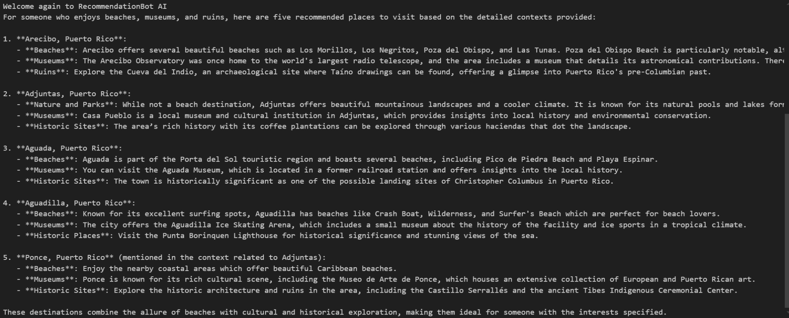
Tourism recommendations according to user interests.

Slide 5
Challenges faced
vectorstore - Couldn’t get it to work. Couldn’t fix error that appeared when I tried similarity_search.
Couldn’t run alex_app.py in environment. Environment needed since all the necessary packages are there. Had to run it in Jupyter Notebook.
First result of the app is out of context, then in the second run shows the result of the 1st query and 2nd query at the same time. Crazy.
Amount of tokens(200,000+) too high for the models. Had to shorten the context.

