Slide 1
Card Game
By: Jared DuPont, Matt Johnson, & Dylan Hericks

Slide 2
First, a demo!

Slide 3
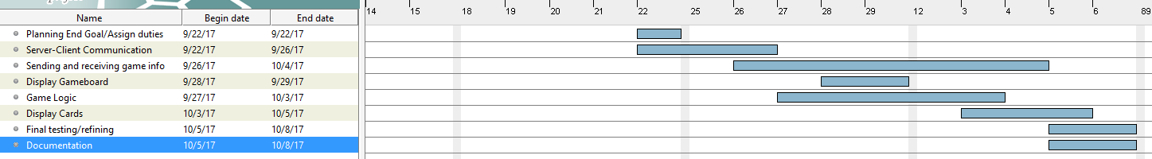
Gantt Chart
Most time was spent working on sending and receiving the game information for the game to function.
There was just enough lee-way at the end of the project to ensure we had proper documentation and had run enough test scenarios to debug.

Slide 4
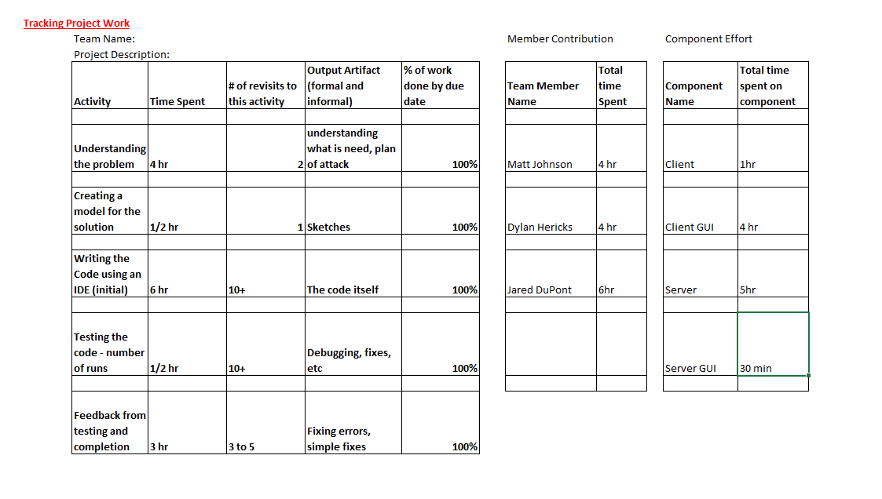
Time tracking

Slide 5
Development
IDE: Eclipse (ver. Luna, Oxygen)
Planning was hybrid between Waterfall and Incremental development.
We used GitHub to collaborate our development process, as well as document our time.

Slide 6
Takeaways
Planning is the most important step in the whole process.
Understanding each process in the software before coding helps coding move along more smoothly.
StackOverflow can give a quick answer, but it doesn’t matter if you don’t know why.
Creating shortcuts for localhost is the best decision I’ve ever made.

Slide 7
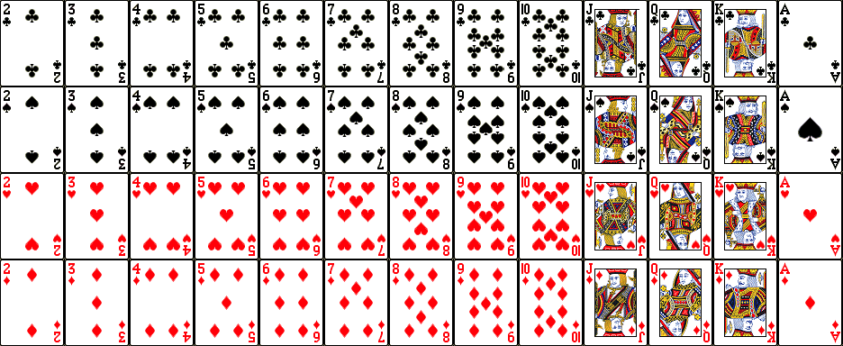
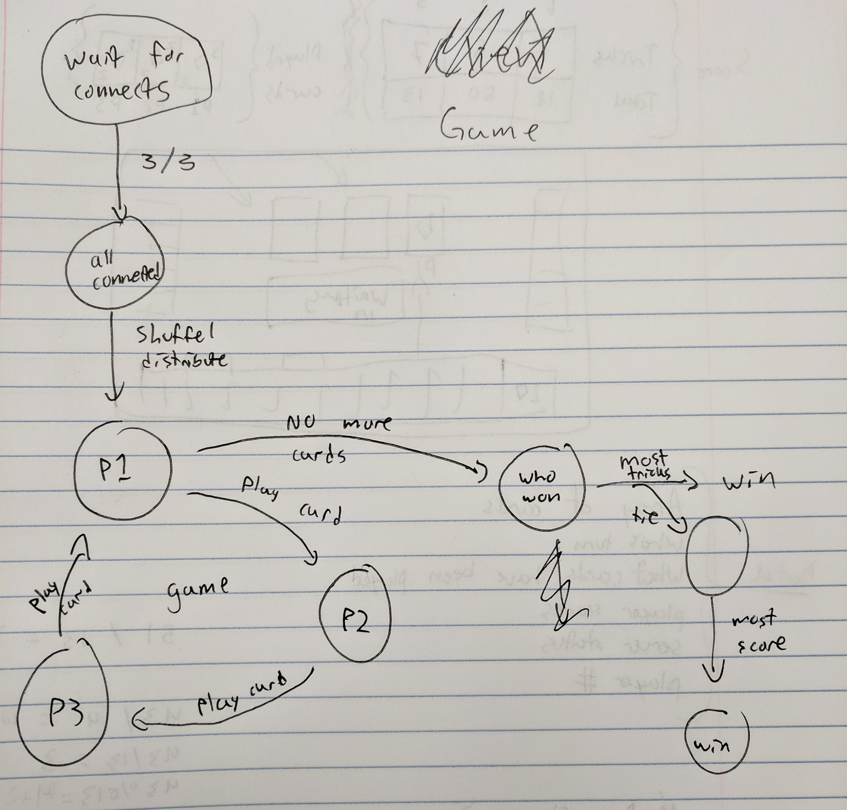
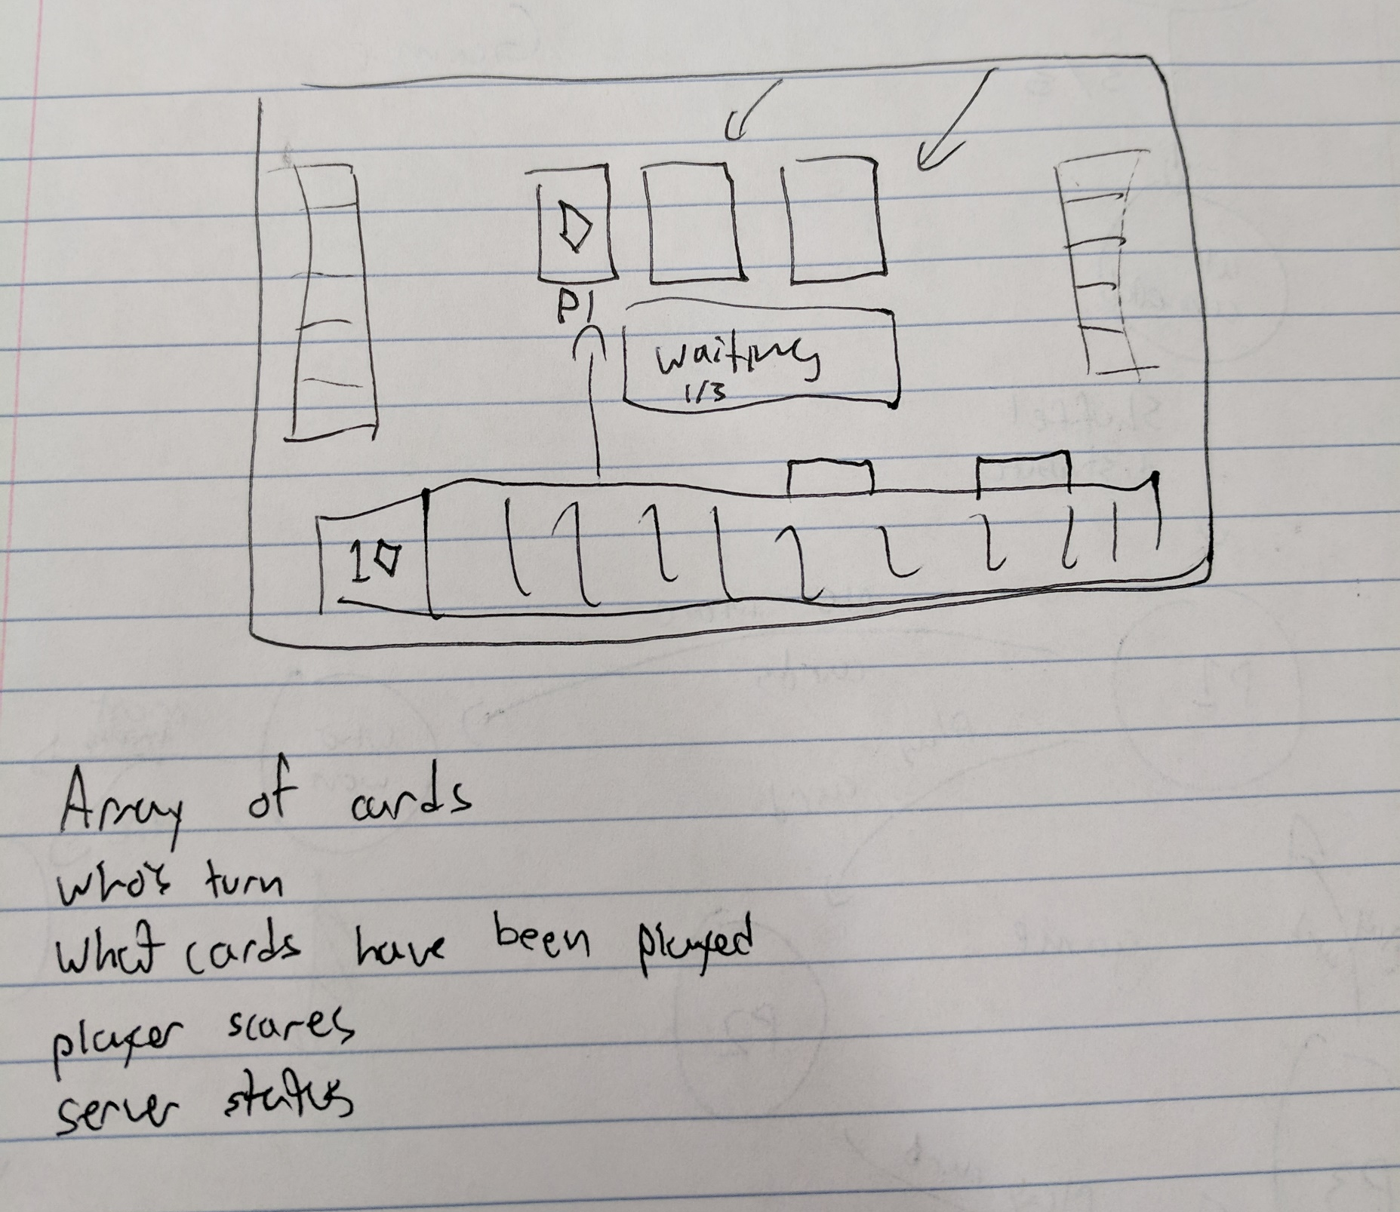
Documentation
Original sketches of plans (Game logic, Game Board)

Slide 8
Questions

