Slide 1
Beyond p-values: Utilizing Multiple Estimates to Evaluate Evidence
KD Valentine, Erin Buchanan, John Scofield
SIPS Lightning Talk 2018

Slide 2
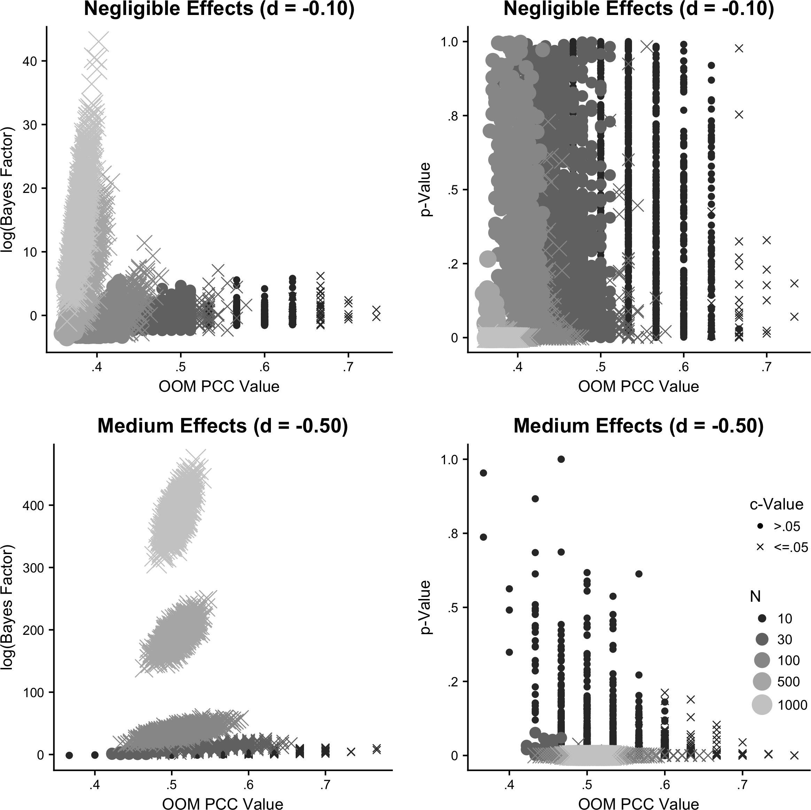


OOM match value
OOM match value
https://osf.io/u9hf4/
@kd_valentine3
@aggieerin
@jscofield24

