Slide 1
How to set up a big team science project within the PSA
Erin M. Buchanan, Associate Director
Chris Chartier, Former Director

Slide 2
Outline
An overview of the Psychological Science Accelerator
An overview of the specific application procedures for PSA projects
A special call for papers with the John Templeton Foundation
A hack to develop ideas for a JTF proposal

Slide 3

The Psychological Science Accelerator

Slide 4

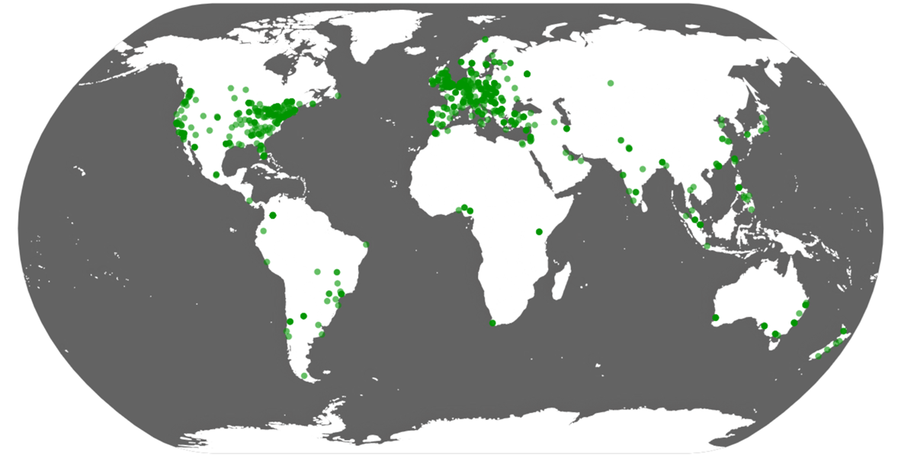
The Psychological Science Accelerator
The PSA is a globally distributed network of researchers which aims to accelerate the accumulation of psychological knowledge that is reliable and generalizable to a broader spectrum of humanity

Slide 5



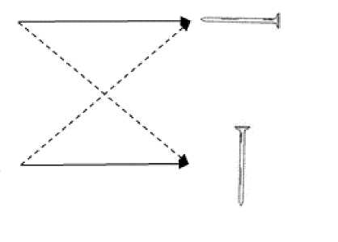


Current Projects
FACIAL PERCEPTION
Testing which world regions the valence–dominance model of social perception applies to
N=25,000 (48 Countries)
Status: Published at Nature Human Behavior
TRUE BELIEF
Multilab close replication of Experiment 1 from Turri et al. (2015) that explores knowledge attribution and justified true beliefs Status: Resubmitted - Accepted as Registered Report at Advances in Methods and Practices in Psychological Science
STEREOTYPE THREAT
Testing the stereotype threat in black college students across many operationalizations
Anticipated N= 2000
Status: Ongoing & accepting new labs
If interested contact: schnarrd@gmail.com
OBJECT ORIENTATION
Investigating object orientation effects across 14 Languages
Status: Data Analysis - Accepted as a Registered Report at Psychonomic Bulletin and Review)
TROLLEY PROBLEM
Testing the universality of the moral reasoning when responding to the trolley problem
Status: Published at Nature Human Behavior
GENDERED PREJUDICE
Exploring the gendered nature of prejudice across cultures and social groups
Status: Data Analysis

Slide 6






Current Projects
COVID: LOSS-GAIN
How does the framing of messages (in terms of loss versus gain) affect behavioral intentions regarding COVID-19 policies?
Status: Accepted at Affective Science
SEMANTIC PRIMING (PSA007)
The project aims to create a database of semantic priming stimuli with well defined similarity values particularly for non-English languages
Status: Ongoing, if interested contact buchananlab@gmail.com
COVID: COGNITIVE REAPPRAISAL
How effective is and what kind of cognitive reappraisal technique works best in reducing negative emotions and increasing positive emotions for covid-related stimuli? N=27,989 (87 Countries)
Status: Published at Nature Human Behavior
Minimal Groups Study (PSA 008)
We aim to test the cultural prevalence of the minimal groups effect and to compare it to two forms of real-group bias (bias in favor of family members and bias in favor of national ingroups).
Status: Ongoing, if interested contact kathleenschmidt1@gmail.com
COVID: SELF-DETERMINATION
Do messages that support human autonomy (rather than controlling or pressuring) increase intention to socially distance?
N= 25718 (89 Countries) Status: Published at PNAS
PSA 009
To be announced!

Slide 7


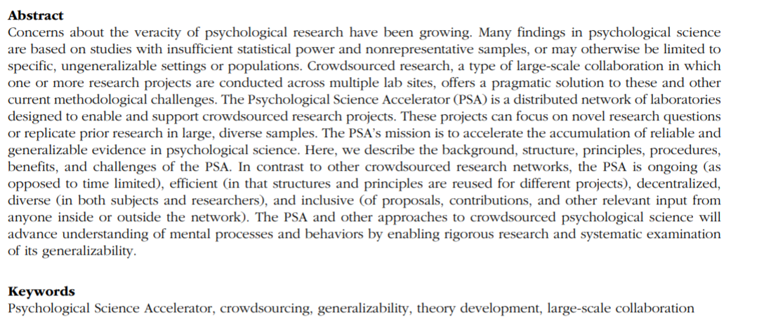
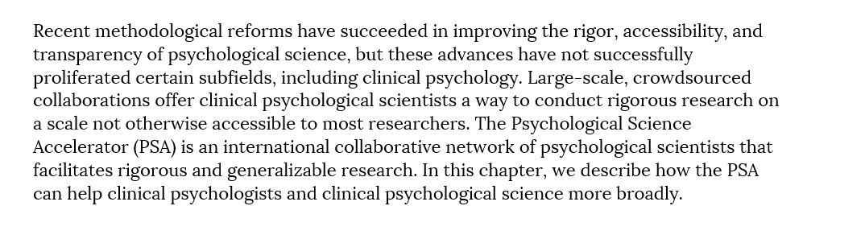
Other Publications

Slide 8








Committees
Study Selection
Ethics
Translation and Cultural Diversity
Community Building and Network Expansion
Project Monitoring
Data and Methods
Funding
Training

Slide 9
How can you be involved?
Join specific projects of interest
Be involved in one or more roles: peer review/study feedback, data collection, translation, analysis, project administration and/or writing & editing the manuscript.
Propose studies to the PSA
Join any of the various PSA committees
Flexibly contribute your expertise, perspective and passion

Slide 10
Why should you join the PSA?
1.) Propose and collaborate on large-scale, cross-cultural studies
2.) Garner co-authorship in high-readership publications
3.) Contribute to the methods reform movement in psychological science and
4.) Form regional support groups of other researchers in your area
5.) Collaborate on various initiatives and immerse in a community of passionate psychological science researchers

Slide 11
2021-2022 Community Initiatives
PSA Regional Support Groups
The PSA Expertise Hub
The PSA Regional Support Groups (Latin America, Arab Region, etc.) aim to bring together researchers to discuss shared needs and challenges in the local context and to support the production of culturally sensitive and culture specific research especially among developing countries
The PSA has a deep pool of expertise, The Hub aims to make expertise sharing among the PSA more accessible to increase collaboration, theory-building, and study feedback among others

Slide 12



Reach the PSA
https://twitter.com/PsySciAcc
https://psysciacc.org/
Use this invitation link
Notes:
PNG Attribution: https://docs.google.com/presentation/d/1ESToymq6h3cxx2-_7GkBRdSLtQULiRrX-eEnErfrLzo/edit#slide=id.ge4e1c75fa9_2_93

Slide 13
PSA Submission Process
The PSA releases periodic calls for studies when network capacity allows
General calls
Special calls
Registered Report Format
Cover Page, including the title of the study, date of the latest draft, and keywords
Abstract of up to 150 words
Main body submission text of up to 5,000 words
Intro
Methods
Analysis plan
A version of the submission with a cover page included
A masked version of the submission without the cover page
References
Supplementary materials

Slide 14
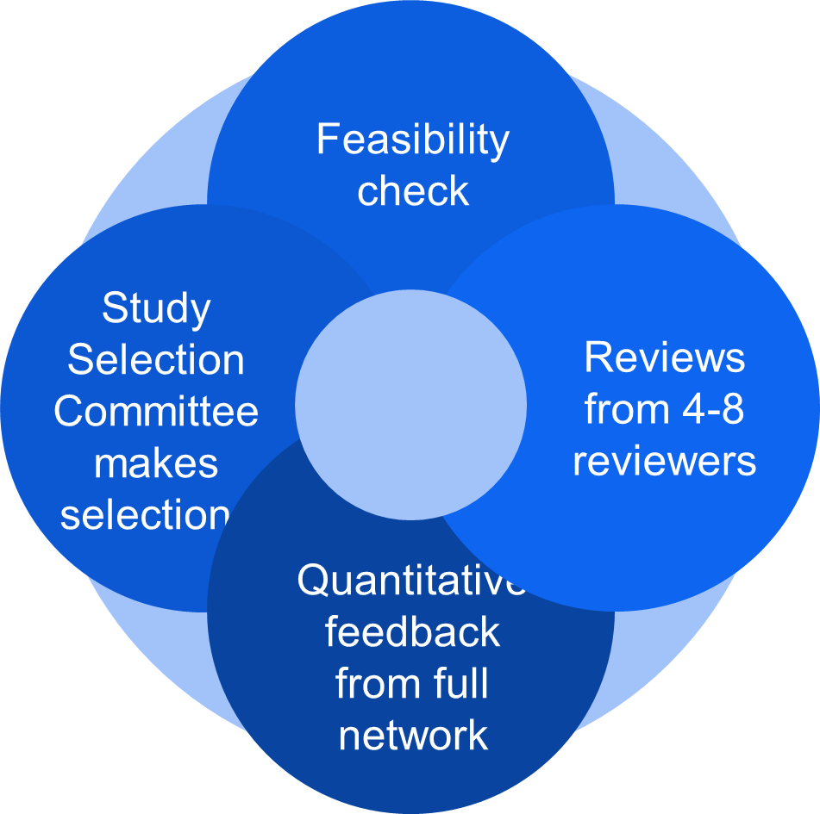
PSA Review Process
Round 1
• Initial feasibility/quality check by the SSC
• Decision to reject or send for full review
Round 2
• Reviews by internal and external experts, and committee representatives
• Network Evaluation
• Decision to reject, request revisions, or provisionally accept
Needs Assessment
• Process of identifying key personnel and likely challenges for projects
• Official acceptance comes only after a successful needs assessment phase

Slide 15

Collaboration with John Templeton Foundation
4 primary studies in JTF priority topic areas
Large-scale, multi-site projects with high geographical diversity
Prepared and conducted in collaboration with the PSA committees and network
Data collected from both college samples and community samples
3 overarching research questions
How well do research questions with global implications extend to global samples?
Do psychological investigations of community samples produce more varied results than investigations using undergraduate samples?
Can psychology researchers anticipate the limitations of their research?

Slide 16
Religious Change
The dynamics of religious change. Why do religions flourish or lose adherents? What kinds of features of religious organizations drive or repel members? Why and how do people switch religious identities?

Slide 17
Intellectual Humility
Intellectual humility. Which factors enhance or inhibit intellectual humility? How can we better study the concept of intellectual humility?

Slide 18
Religious Cognition
Religious cognition. What is the nature of religious belief and how can it be better measured? What causes religious or spiritual experiences and what are the effects of those experiences? How do individuals develop and revise their religious beliefs?

Slide 19
Character Virtue
The science of character virtue. In particular, what helps individuals to develop curiosity and love? What are the consequences of those virtues? How do religions and perceptions of supernatural agents affect virtue and morality development?

Slide 20
Health
Health, religion, and spirituality. Are there associations between religious/spiritual beliefs, experiences, practices, and identities, and physical and mental health? If so, are there underlying causal mechanisms?

Slide 21
Collaboration with John Templeton Foundation
Timeline
July 1, 2022-June 30, 2025
Data collection for 2 studies in 2023 and 2 studies in 2024
Funding
$40,000 per study for direct study costs
Small, but flexible pool of discretionary funding per study
Personnel Support
Research Coordinator: Erin Sievers
Postdoctoral Researcher: Dr. Priya Silverstein
Research Scientist: Dr. Kathleen Schmidt
PI: Dr. Chris Chartier

Slide 22
PSA & JTF Study Selection
JTF Submission Process for 4 Primary Studies
Currently reviewing submissions for the first call for studies
0 to 2 studies may be selected in round 1
Second call for studies in 2023
2 to 4 studies may be selected in round 2
Incubation Invitation
Our team is willing to work closely with proposing authors for round 2
We welcome your questions, ideas, fears, and perceived roadblocks
We may be able to connect you with willing collaborators from the PSA

Slide 23
Tips for Success in Submission
A focus on testing generalizability
Be sure to clearly define why your project would be a good candidate for global data collection as well as collection in both student and community samples
A match to one of the JTF priority topics, broadly construed
Clearly defined testable hypotheses
Variables that measure the topic of interest
Methods that assess the topic of interest
Analyses that map hypothesis through methods and variables
Consider https://www.nature.com/documents/NHB_Template_RR_Stage1.docx Table 1 from this document

Slide 24
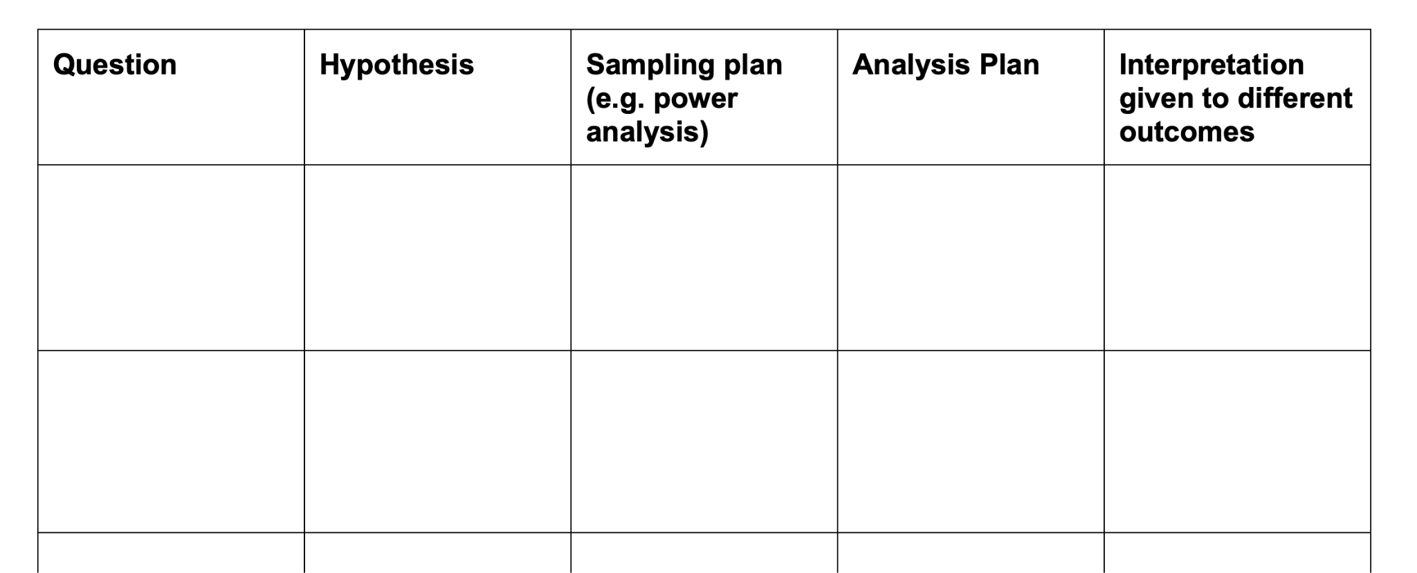
Tips for Success in Submission

Slide 25
Tips for Success in Submission
Hypothesis: Religiosity and meaning in life improve mental health.
Variables: Religion, life meaning, and mental health
Method: We will survey participants on their religion, meaning in life, and mental health.
Analysis: Correlations between each variable will be performed.
Hypothesis: Religiosity and meaning in life are related to positive psychological life outcomes (increased resilience, decreased depression, anxiety, stress).
Variables: Centrality of Religiosity Scale, the Purpose in Life Short Form, the Brief Resilience Scale, the Depression Anxiety and Stress Scale
Method: A cross-sectional correlational design will be used …
Analysis: A regression analysis will be performed for each DV … using IVs …

Slide 26
Tips for Success in Submission
Question: Does religiosity predict decreased anxiety after accounting for meaning in life?
Hypothesis:
Null: Religiosity does not predict or predicts higher anxiety after accounting for meaning in life.
Research: Religiosity does predict lower anxiety after accounting for meaning in life.
Sampling plan: We will use X participants to provide 80% power for b <= -.001 using two predictors in a simultaneous regression analysis.
Analysis plan: A simultaneous multiple linear regression with meaning in life (PIL) and religiosity (CRS) will be used to predict anxiety (DASS) scores.
Interpretation:
If religiosity b <= -.001, then the null is rejected and we will support the hypothesis that religiosity predicts decreased anxiety after controlling for meaning in life.
If religiosity b >= -.001, the null hypothesis cannot be rejected and the evidence is inconclusive.

Slide 27
Brainstorming/Hack Time
Hackathon plans
Working together in this google doc: https://docs.google.com/document/d/11GFCjJSDmO17xiu3CKMaMAGJR8znnZN660b3YiAnUjs/edit?usp=sharing
Brainstorm topic ideas

Slide 28
Brainstorming/Hack Time
Hackathon plans
Working together in this google doc: https://docs.google.com/document/d/11GFCjJSDmO17xiu3CKMaMAGJR8znnZN660b3YiAnUjs/edit?usp=sharing
Brainstorm methodology
For our favorite ideas - what are some potential hypotheses we could create?
How might we test those hypotheses?

Slide 29
Debrief
Studies will be solicited in 2023
Feel free to reach out to the PSA Network
Chris Chartier: cchartie@ashland.edu
Kathleen Schmidt: kschmidt@ashland.edu
We would love your proposal!

