Slide 1
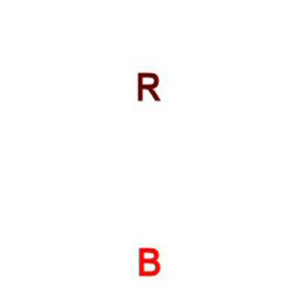
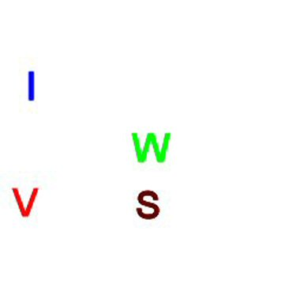
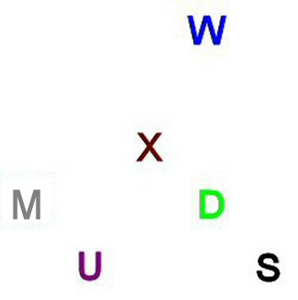
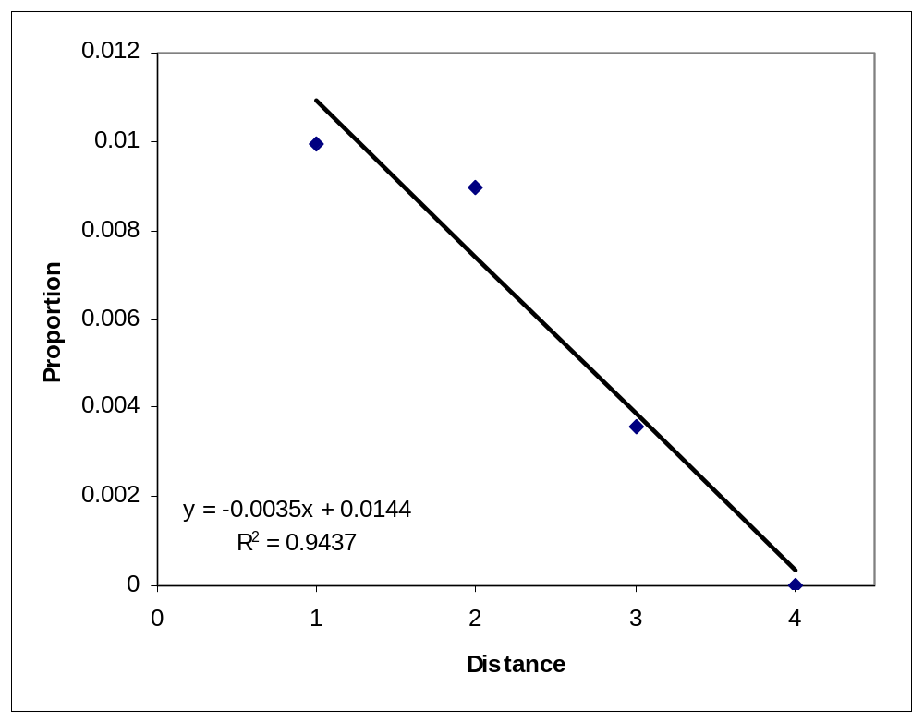
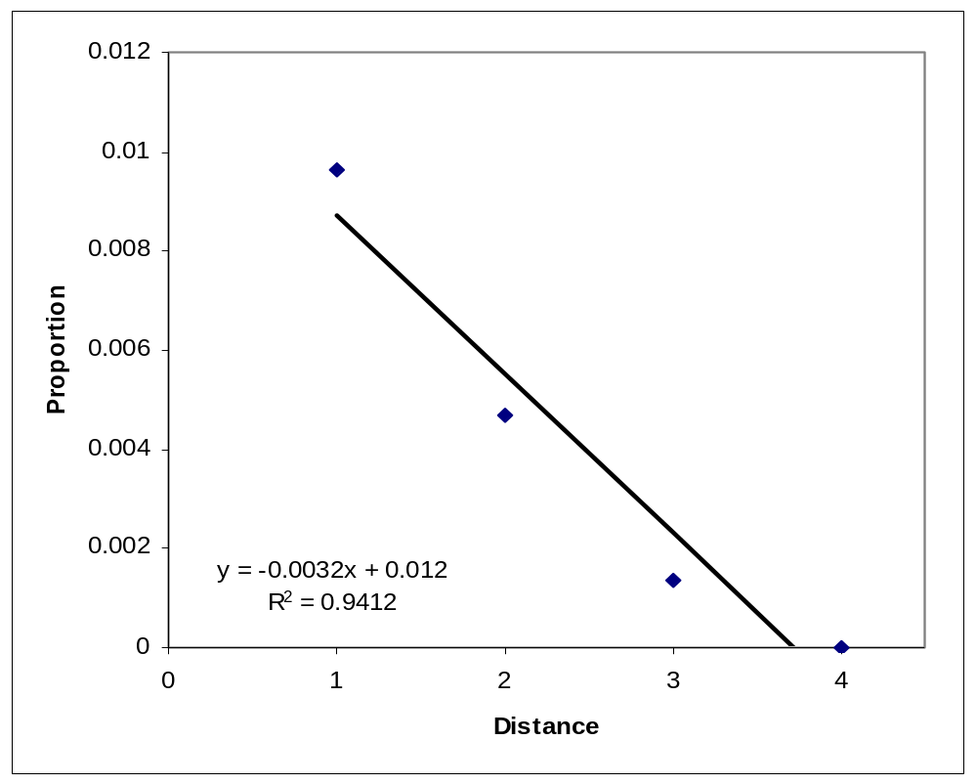
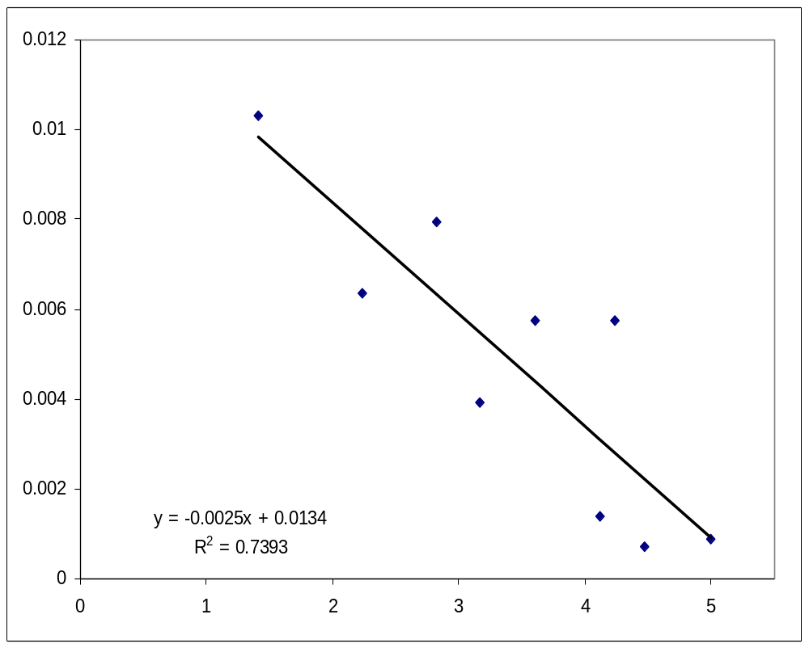
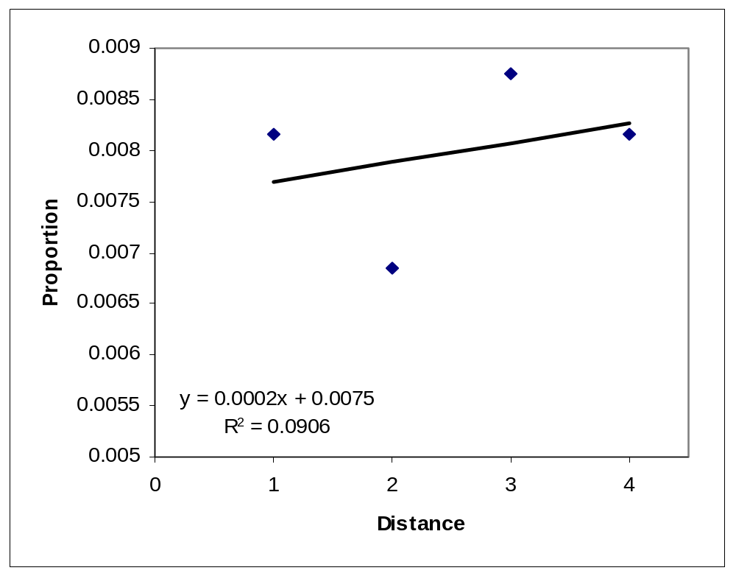
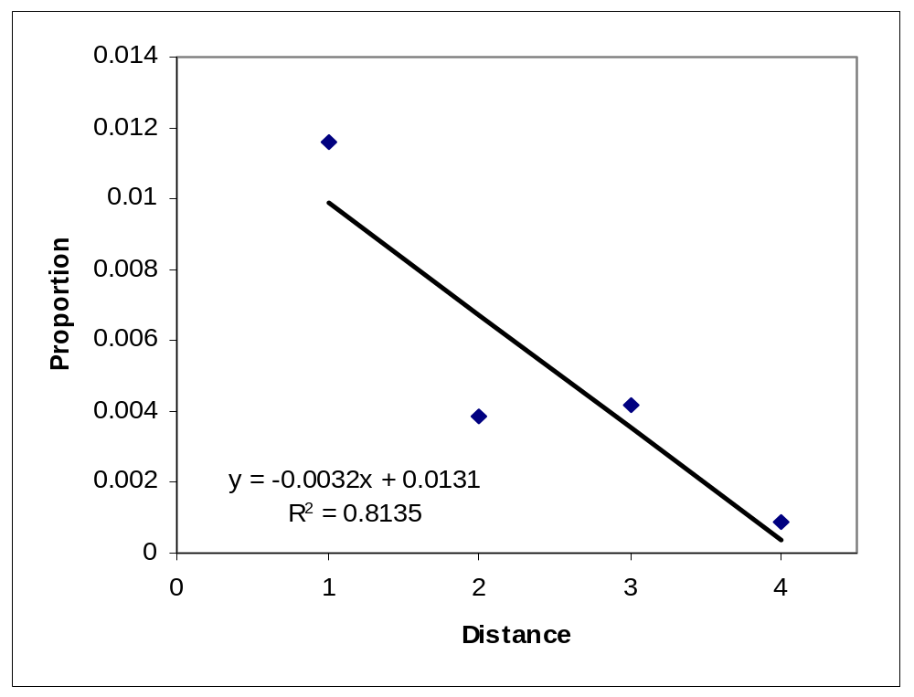
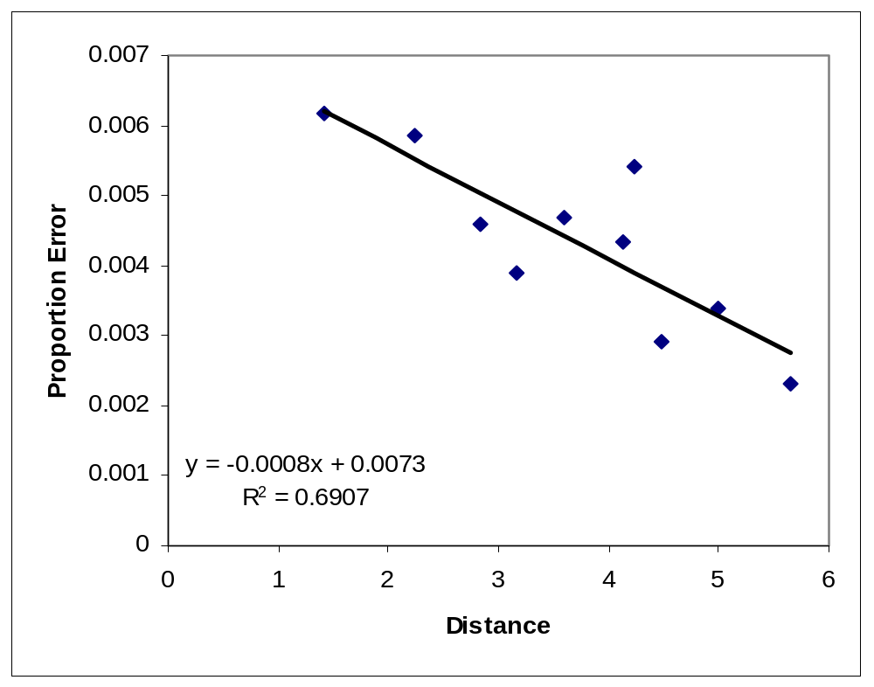
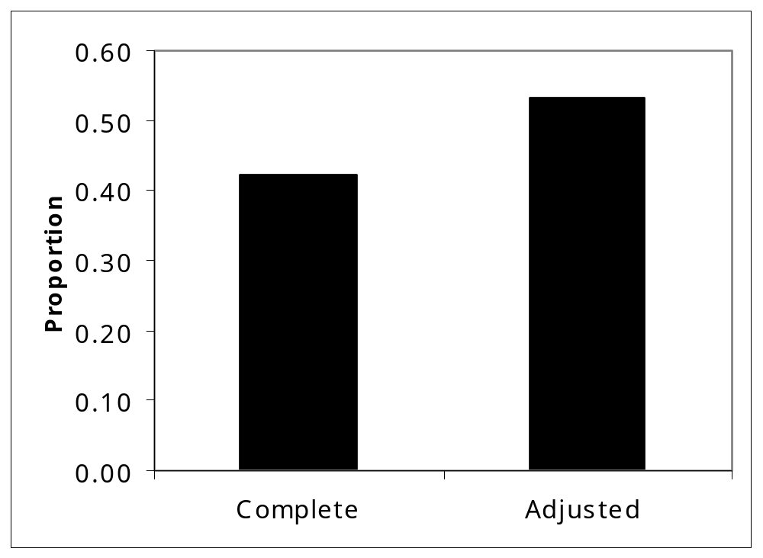
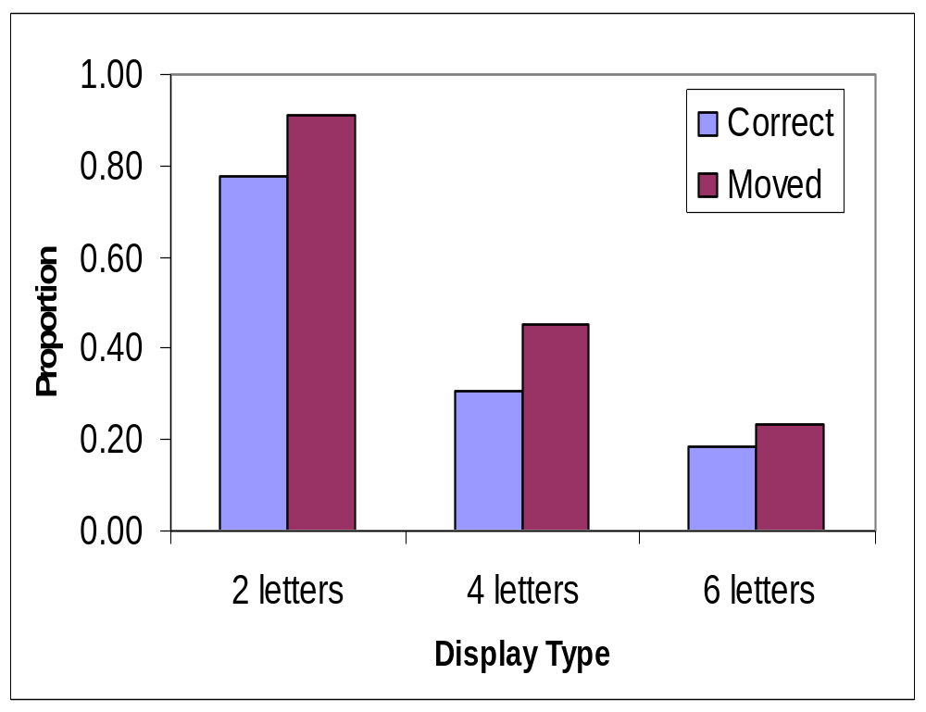

Feature Binding: How Exactly Do Features Move?
Erin Buchanan and M. Kathryn Bleckley
Texas Tech University
Abstract
Errors in feature binding have been attributed to poor location information (Ashby, Prinzmetal, Ivry, & Maddox , 1996; Balyis & Driver, 1993). Location uncertainty theory says errors are due to uncertainty about the location of the features seen. To correctly bind objects one must have all features appropriately tagged with their location. This study seeks to see if poor location tagging might explain errors in feature binding.
Also, paradigms that study how features migrate use only vertical or horizontal displays (Butler, Mewhort & Browse, 1991; Prinzmetal, 2005). However, real life displays are horizontal, vertical and diagonal. This paradigm allows for horizontal, vertical and diagonal movements, to see if diagonal errors are different from horizontal and vertical errors.
Results support the location uncertainty model, where errors remain close to their original locations. It was also seen that under load, error types do not follow the same patterns.
4 Item Displays
2 letter display
4 letter display
6 letter display
Coding And Error Types
Single answers were thrown out - only analyzed conjunctions
Correct Answers
- correct space, color and letter combination
Moved Answers
- correct color and letter combination, incorrect space
Color / Letter Intrusions
- reporting a color or letter not present on the display
Illusory Conjunctions
- incorrect color and letter combination, but features present on display
- these were coded using Euclidian distances
- Types
~ Horizontal - features move only horizontally
~ Vertical - features move only vertically
~ Diagonal - features move both horizontally and vertically
Horizontal Movement Errors
Vertical Movement Errors
Diagonal Movement Errors
6 Item Displays
Questions
Is poor location tagging a good explanation of errors in visual feature binding?
Are vertical and horizontal errors the same?
Are diagonal errors different somehow?
Methods
Participants
48 undergraduates at Texas Tech University
Reported normal vision to corrected normal vision
No reported color blindness
Apparatus
15-in CRT (60mHz) monitor controlled by an IBM (Pentium 3) computer
Displays
Stimuli were presented on an invisible 5 by 5 matrix.
Displays contain either 2, 4, or 6 colored letters.
Colors used were red, orange, blue, brown, green, pink, black, gray, and purple.
Letters used were A - Y, all in uppercase Times New Roman.
Procedure
Participants were allowed 2 seconds to study the display.
After two seconds, a screen with answer blanks was presented.
Participants were to fill in the answer blanks with the correct letter and color they had seen.
They were informed that they should try to get the color and letter together, along with the space it appeared in.
T | 1H | 2H | 3H | 4H
1V | 1.41D | 2.24D | 3.16D | 4.12D
2V | 2.24D | 2.83D | 3.61D | 4.47D
3V | 3.16D | 3.61D | 4.24D | 5D
4V | 4.12D | 4.47D | 5D | 5.67D
3.16D | 2.24D | 1.41D | 1V | 1.41D
3H | 2H | 1H | T | 1H
3.16D | 2.24D | 1.41D | 1V | 1.41D
3.61D | 2.83D | 2.24D | 2V | 2.24D
4.24D | 3.61D | 3.16D | 3V | 3.16D
Diagonal Movement Errors
Horizontal Movement Errors
Vertical Movement Errors
Discussion
Location Tagging
- If poor location tags were a factor in incorrect feature binding, then errors should be close to the original answers, indicating that tags are used just not veridical ones. If no tags were used, then errors should be spread evenly across distance. Except for horizontal errors on 6 item displays, close tagging was seen, which supports Location Uncertainty Theory.
Error Types
- For 4 item displays: horizontal, vertical, and diagonal errors all show the same pattern of results, with similar slopes and intercepts.
- For 6 item displays: vertical errors retain the same pattern of results seen with the 4 item displays. Diagonal errors keep the same negative slope, but it is much shallower. Horizontal errors show a small positive slope, where errors happen at almost the same rate across distances. These findings may indicate that memory load effects the quality of location tag, so that increasing the number of things to remember decreases the availability or veridicality of the location information.
- A follow up study is in progress, testing if working memory span can account for the differences seen on 6 item displays.
References
Ashby, F., Prinzmetal, W., Ivry, R., & Maddox, W. (1996). A formal theory of
feature binding in object perception. Psychological Review 103(1), 165-192.
Driver, J. & Baylis, G. (1991). Target-distractor separation and feature
integration in visual attention to letters. Acta Psychologia 76(2), 101-119.
Prinzmetal, W. (2005). Location perception: the x-files parable. Perception &
Psychophysics 67, 48-71.
Butler, B., Mewhort, D., & Browse, R. (1991). When do letter features migrate?
A boundary condition for feature-integration theory. Perception &
Psychophysics, 49(1), 91-99.
Examples of the coding scheme
Results
Correct and Moved Answers
Contact erin.buchanan@ttu.edu

