Slide 1
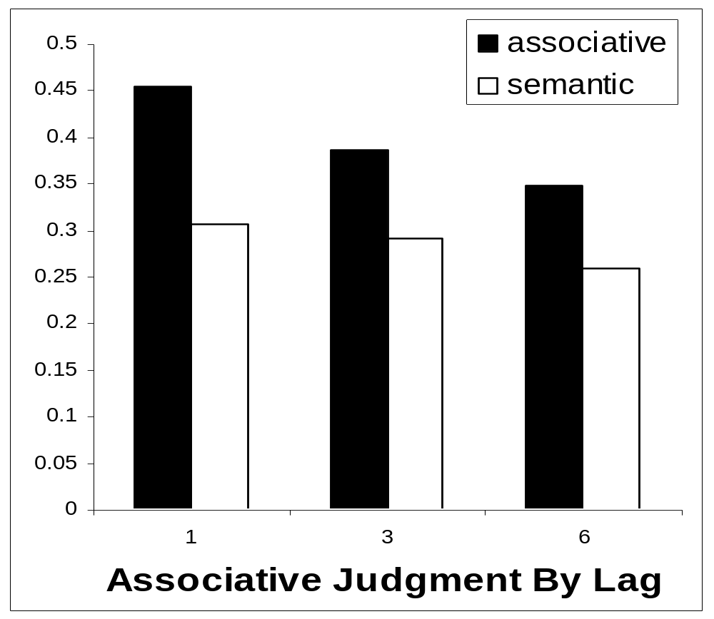
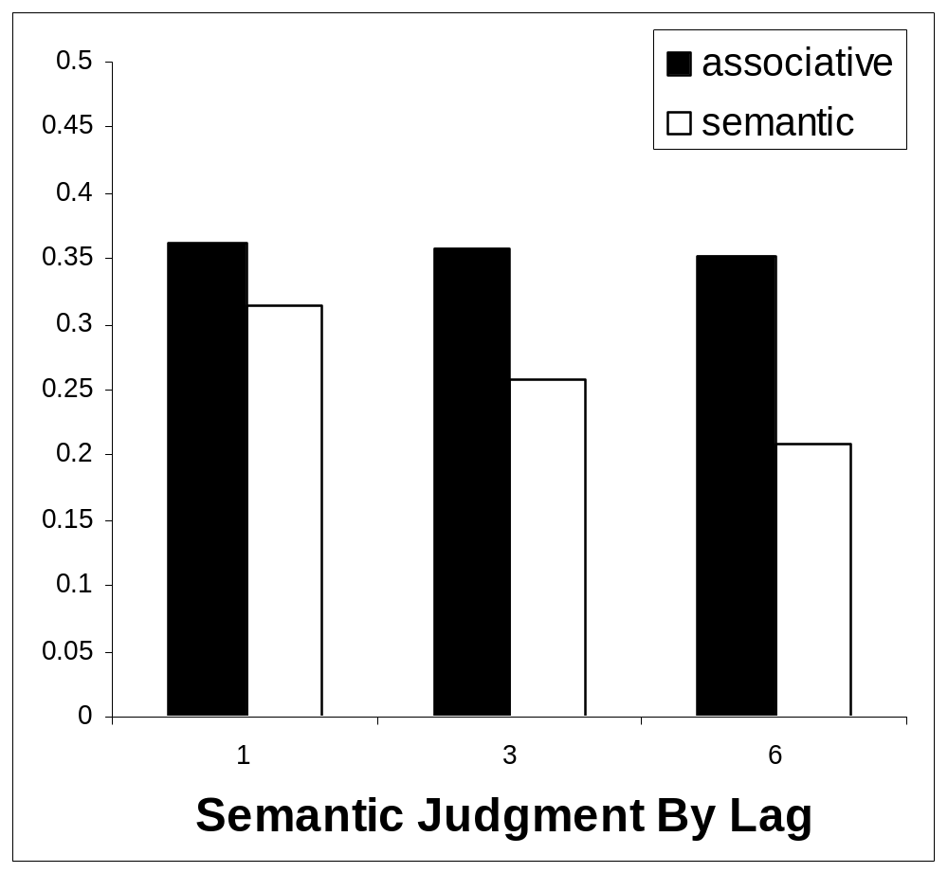
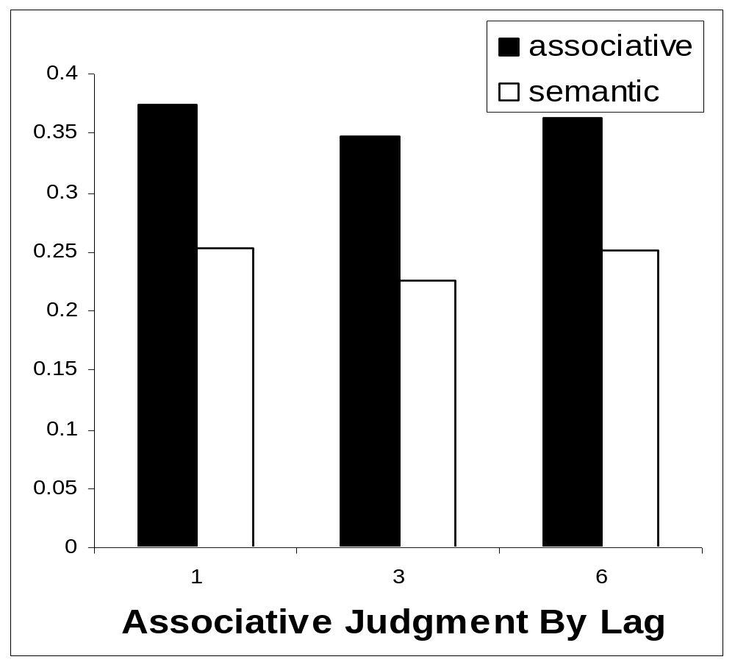
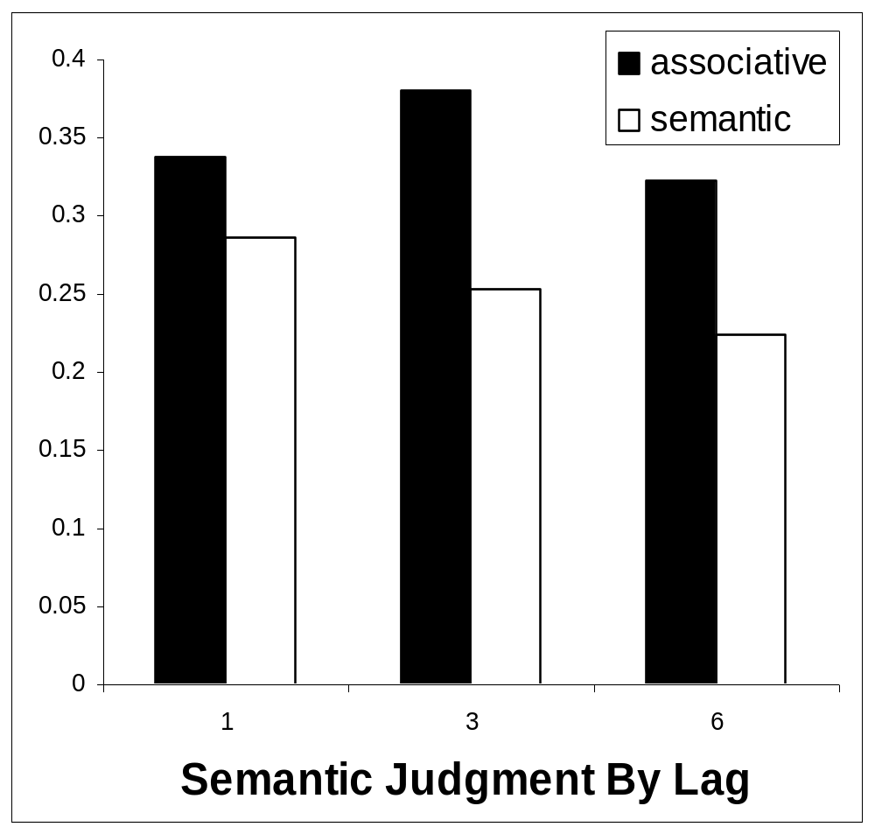
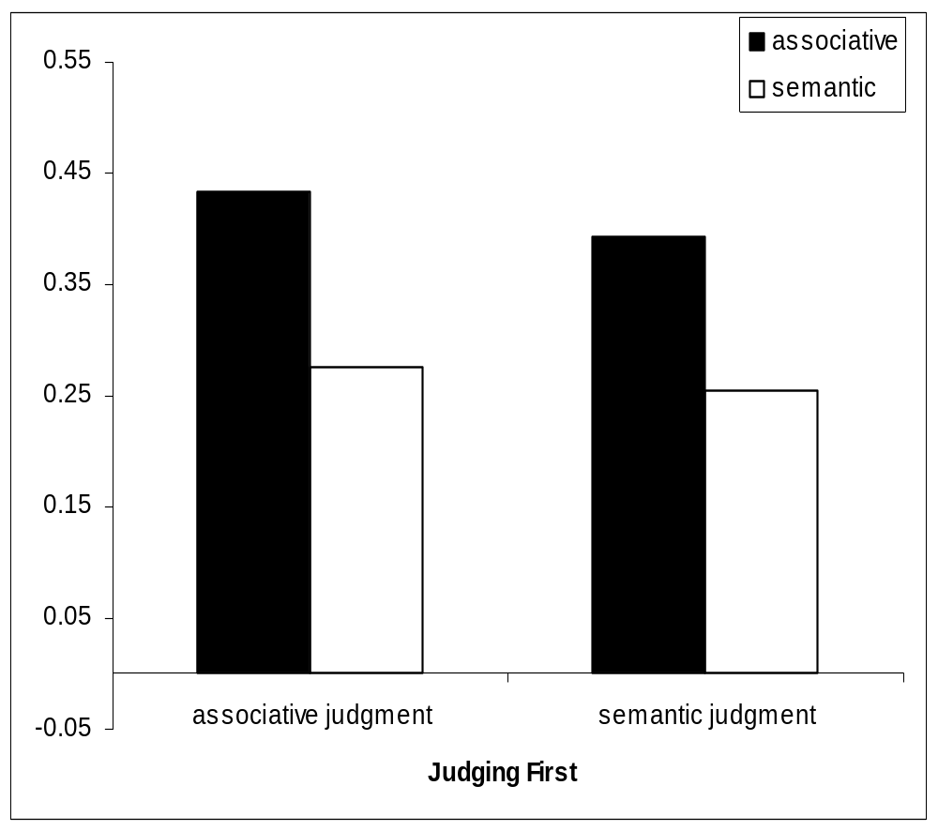
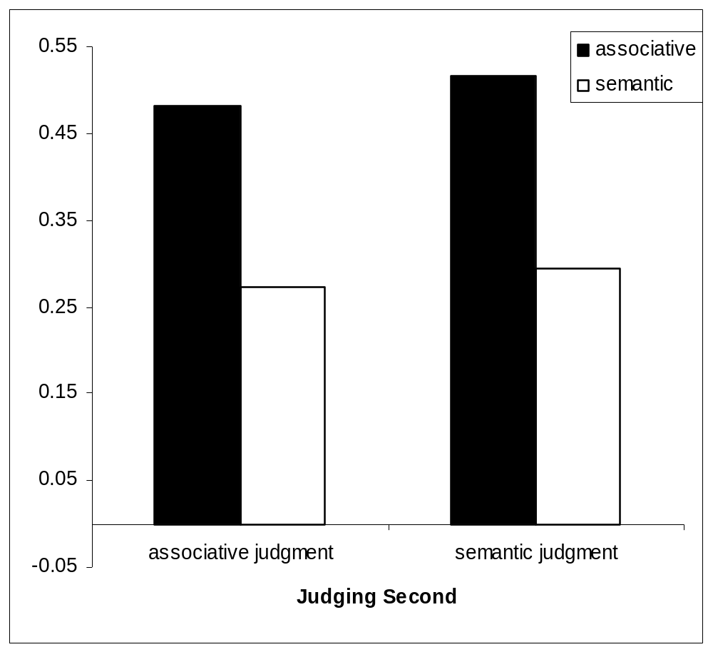

Associative Judgments Block Semantic Processing…
Erin Buchanan, William S. Maki, and Melissa Patton
Texas Tech University
Abstract
…but not vice versa. Several experiments were performed to understand the differences in processing associative and semantically related words. First, some participants judged how many people would report a word A in reference to a word B, while other participants were asked how much words A and B overlapped in meaning. Consistently, associative scores will predict judgments in both associative and semantic judgment conditions while semantic scores will only predict semantic judgments. From there, other participants were asked to both judge words and report words in an rapid serial visual presentation task (RSVP). There is a separation in priming for associative and semantic word types, and judgment data is replicated. However, judgments seem to be a higher level process that do not restrict priming, therefore they do not interact with priming for word types.
Experiment 2
Question
Differential processing has been shown for judgments, where associative information is used for both semantic and associative judgments. There has been substantial research in priming that shows priming for both associative and semantic word pairs (Lucas, 2000). We tested priming to see if this differential processing of word relationships would carry over to a priming task.
Stimuli
Word pairs were created so that there was orthogonal relationships using the associative databases from Experiment 1 and WordNET Norms (Fellbaum, 1998; Patwardhan and Pedersen, 2003) Informational distance (JCN).
Associative word pairs
    54 judgment pairs (ATOM-SCIENCE)
    54 priming pairs (ATOM-BOMB)
  Semantic word pairs
    54 judgment pairs (PATROL-POLICE)
    54 priming pairs (PATROL-GUARD)
  Unrelated word pairs
    108 judgment pairs (POPCORN-BUTTER)
    108 priming pairs (POPCORN-POP)
Procedure
Experiment 2 - Results
Experiment 2 – Discussion
Again, we see that associative information is available and used to make judgment even during semantic judgment tasks.
Priming results suggest that associative priming is stronger than semantic priming, in all types of judgment conditions.
We don’t see transfer appropriate processing, which indicates that priming and judgments may be at different levels of processing information.
Priming
General Discussion
Appears that semantic and associative memory can be separated.
When we make judgments on these memory types, associative information is available and accessed for the task.
Comparable results are found in priming tasks, where associative information of words directs priming at a higher level than semantic information.
It may be that associative information is stored in a lexical network, similar to Williams (1996) inter-lexical hypothesis.
Therefore, associative information would always be accessed in semantic tasks because accessing word information would activate associative links.
This idea could explain both higher levels of associative priming and the block of semantic information during an associative judgment task. The direct links for associative are being accessed during an associative task and semantic level representations are bypassed.
However, it is still the case that in lower-level tasks, such as priming, semantic information is activated (possibly automatically). This information is then blocked or not used during a higher cognition task, such as the judgment task.
Experiment 2A priming results by lag using difference scores (Related – Unrelated).
Experiment 1
Stimuli
- 72 word pairs that varied on semantic and associative measures.
Associative Measures
Nelson, McEvoy, and Schreiber, 2004 – Free Association Norms
  Forward Strength (FSG)
  Backward Strength (BSG)
Semantic Measures
McRae, Cree, Seidenburg, and McNorgan, 2005
  Feature Production Norms (COS)
Procedure
Participants (N=57 judged words on two categories: Semantic Relatedness: how many features do these words have in common?
  Associative Relatedness: how many college students out of a 100 would give the SECOND word given the FIRST?
Participants judged these words on a 10 point Likert scale.
Analyses
2 simultaneous Multiple Linear Regressions using database measures to predict participant scores (FSG and COS).
horse
+
cow
500 ms
Experiment 2B priming results by lag using difference scores (Related – Unrelated).
0?&^7*5
84 ms
48$&0^5
84 ms
Experiment 2A and 2B
pony
84 ms
?7>86&%
84 ms
horse
+
cow
…
Experiment 1 - Results
Judgment
Word Entry
Recall
Judgment Type | FSG (Associative Scores) | COS (Semantic Scores)
Associative | ß = .683**, pr²=.424 | ß = -.074, pr²=.005
Semantic | ß = .245*, pr²=.055 | ß = .561**, pr²=.286
0?&^7*5
Judgment
Experiment 2C priming results by lag using difference scores (Related – Unrelated).
References
Fellbaum, C. (Ed.). (1998). WordNet: An Electronic Lexical Database Cambridge, MA: The MIT Press. http://www.cogsci.princeton.edu/~wn
Lucas, M. (2000). Semantic priming without association: A meta-analytic review. Psychonomic Bulletin and Review, 7, 618-630.
McRae, K., Cree, G. S., Seidenberg, M. S., & McNorgan, C. (2005). Semantic feature production norms for a large set of living and nonliving things. Behavior Research Methods, 37, 547-559.
Nelson, D. L., McEvoy, C. L., & Schreiber, T. A. (2004). The University of South Florida free association, rhyme, and word fragment norms. Behavior Research Methods, Instruments, & Computers, 36, 402-407.
Patwardhan, S., & Pedersen, T. (2003). WordNet::Similarity. http://search.cpan.org/dist/WordNet-Similarity.
SPSS for Windows, Rel. 14.0.0. (2005). Chicago: SPSS Inc.
Williams, J. (1996). Is automatic priming semantic?. European Journal of Cognitive Psychology, 8(2), 113-161.
horse
+
cow
pony
0?&^7*5
48$&0^5
Judgments
Note: ** = p<.001, * = p<.01
Word Entry
 | Judgment | FSG | JCN
2A | Associative | ß = .392**, pr²=.136 | ß = -.108, pr²=.010
 | Semantic | ß = .191*, pr²=.030 | ß = -.407**, pr²=.145
2B | Associative | ß = .247**, pr²=.061 | ß = .021, pr²=.000
 | Semantic | ß = .191*, pr²=.036 | ß = -.195**, pr²=.038
2C | Associative | ß = .411**, pr²=.167 | ß = .100, pr²=.010
 | Semantic | ß = .296*, pr²=.087 | ß = -.023, pr²=.000
pony
Experiment 1 – Discussion
Associative information seems to be available at all times, and used to make judgments on all word types regardless of task.
During the associative judgment task, it appears that semantic information is “blocked” or not used to make the judgment.
48$&0^5
Word Entry
Experiment 2C
Judgment
Note: ** = p<.001, * = p<.01

