Slide 1

深入Dx12绘制二
杨璟昭 yangjingzhao@kingsoft.com

Slide 2
Objectives
Resource Binding in DX12了解
深入Resource Binding，掌握Root Signature，Descriptor Heap以及各种View的使用。
掌握相关数据的封装。
预习内容：
官方文档 Resource Binding in Direct3D 12
DX12技术白皮书3.3-3.5
Notes:
本课结束能，同学能够使用贴图，自定义buffer给gpu侧使用；
相关渲染数据的封装是针对rhi封装这部分加入的；本课程的要求，涉及到工业使用中基础的渲染对象封装；

Slide 3
Contents
深入Resource Binding
Resource Binding
Descriptor 及绑定
Root Signature
引擎关键对象封装
4. 引擎关键对象封装
Notes:
Gpu的memory相关内容
https://blog.csdn.net/ZJU_fish1996/article/details/109269448
Gpu编程和cpu编程

Slide 4

前置内容
DX12的初始化
DX12基本渲染管线
PSO
DX12 Work Submission
Notes:
今天的主要内容：
Vertex /Index Buffer View
Vertex Shader
Pixel Shader
非可编程stage简略提一下
PSO

Slide 5
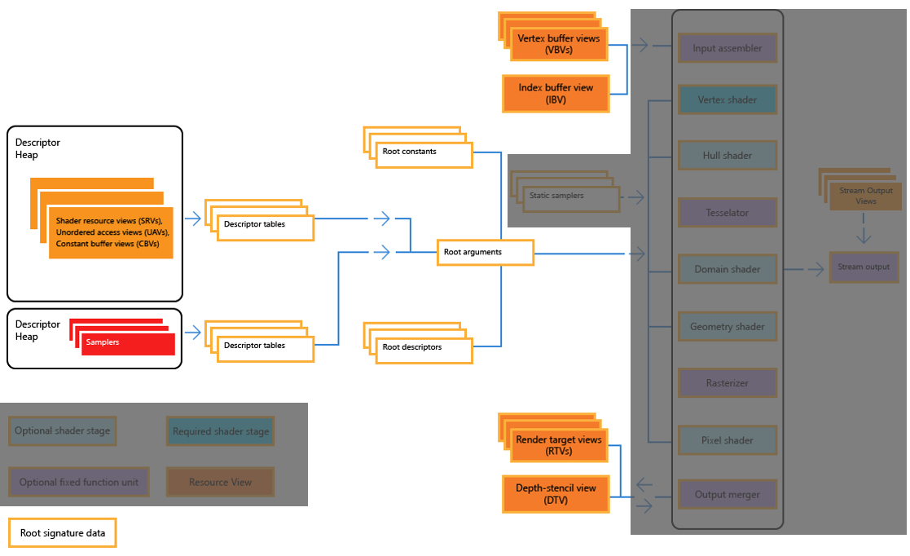
今天的主要内容
Notes:
今天的主要内容：
Vertex /Index Buffer View
Vertex Shader
Pixel Shader
非可编程stage简略提一下
PSO

Slide 6
ch1
Resource Binding

Slide 7
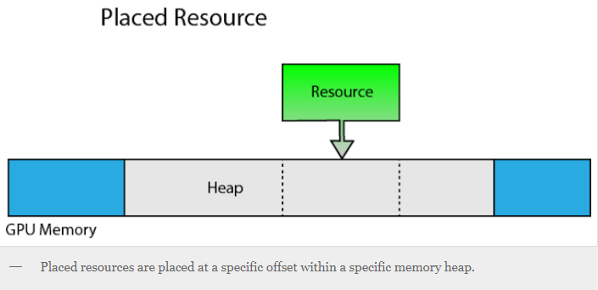
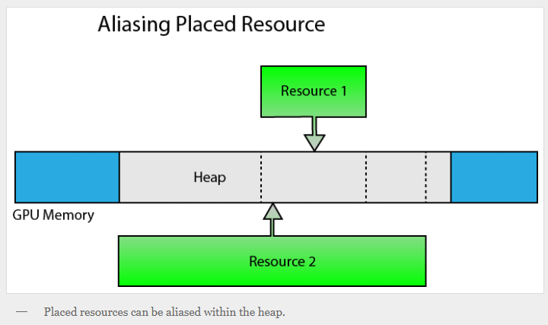
1. 1 Resource Binding
渲染管线的数据（ Shader Resource ）不能直接给GPU的计算使用；需要解释，Descriptor
Committed Resources
隐式分配Heap，自动分配
自动分配大小，大于实际使用量
Placed Resources
需要显式创建heap并分配
预先规划好占用的大小
对齐，。。等等都需要显示指定
Reserved Resources
Notes:
着重介绍Commited Resource和Placed Resource的差别；现阶段主要是用commited resource
参考：
Learning DirectX 12 – Lesson 2 – Rendering | 3D Game Engine Programming (3dgep.com)

Slide 8
1. 1 Resource Binding
不同的绘制目的，不同的管线阶段，等需求都一套比较科学的系统，称之为Resource Binding的机制
包括Heap的绑定，管理和使用，资源的生命周期，存储的管理，状态的转换等；
Notes:
1.说一下啥是shader resource；都有哪些：Shader resources (such as textures, constant tables, images, buffers and so on)
这些Resource 不能直接被gpu拿来使用
Binding：根据pipeline的要求，为GPU计算提供数据；不同的绘制目的，不同的管线阶段；需要不同的数据类型
2.提一下Descriptor Heap；Descriptor Table； Dx11中没有这么复杂的系统；很多东西都是固化的，驱动底层自动处理的；当然已经不适应现在的硬件发展

Slide 9
1.2 Resource Binding Model In Dx12
主要的思想是Resource Binding与其他的管理任务分离
优势在于application能够在没有大量cpu 消耗的情况下替换贴图binding；同时shaders计算能够使用大量resource，shader不用知道绑定的数量；
为了提升性能，binding model不再要求系统追踪appliction 请求的binding内容，在binding 和多线程的command list之前也有清晰的整合
Application层
Driver层
Notes:
明确右侧两个层：application指的是应用层，我们在DX12的基础上写的工程；Driver层指的是dx12这一层；后面会用到；因为dx12大量的管理现在需要application层去处理了；这两个概念在此区分是从dx12的官方文档中整理出来的
The main advantage of the D3D12 Binding Model is that it enables apps to change texture bindings frequently, without a huge CPU performance cost. Other benefits are that shaders have access to a very large number of resources, shaders need not know in advance how many resources will be bound, and that a unified resource binding model can be used regardless of hardware or the apps content flow.
To improve performance, the binding model does not require the system to keep track of what bindings an app has requested the GPU to use, and there is a clean integration between binding and multi-threaded command lists.

Slide 10
1.2 Resource Binding Model In Dx12
绑定方式的改进
D3D11的资源绑定是固化的，运行时给每一个Shader安排一定数量的资源Slot，应用程序只需要调用对应的接口就能够把资源绑定到Shader上。
在D3D12中，资源绑定流程很灵活，没有限定资源以何种方式或何种数量进行绑定，你可以自行组织资源的绑定风格
常驻memory管理与Binding分离
Application层需要管理那些resource是常驻memory
D3DX12Residency::ResidencyManager
Notes:
1. 下一章讲descriptor，及绑定的时候细说
2. Residnecy manager属于比较高阶的内容，我们的课程暂时不考虑介绍，感兴趣的去看dx12的官方example

Slide 11
1.2 Resource Binding Model In Dx12
Object生命周期管理从Binding分离
不再追踪Resource的binding，dx12之前常出现application层release，但是driver层不能release的情况Resource State跟踪管理从Binding分离
DX12中application如要release 一个资源必须确保使用该资源的GPU work完成
Resource State 状态跟踪从Binding分离
Application层需要明确资源状态转换的时机
Resource Barrier， Transition
CPU GPU 映射memory 同步从binding分离
Application需要负责同步CPU和GPU的memory访问
DX12为Application提供了可以请求CPU休眠的机制
Notes:
因为gpu work未完成，application 不知道；使用同步
状态转换目前阶段应用在back buffer的状态转换，render target ；present
这个主要使用在回读GPU数据的过程，从GPU回读一个资源到CPU（Stage，Map，UnMap）
参考DX12技术白皮书

Slide 12
ch2
Descriptor及绑定
Notes:
虚拟现实（VR）的呈现需要同时用到硬件和软件。创建VR内容时，应了解各种设备和软件解决方案。

Slide 13
2.1 Descriptor
Descriptor可以看作向GPU解析资源数据的小数据块，包含资源的解释信息。比如：RTV，DSV，UAV，CBV
Descriptor 尺寸可能不同，取决于硬件。可以通过硬件接口查询，descriptor是一块不可再分的单元
与驱动层分离，驱动层不跟踪或者持有Descriptor的引用；需要application层面去管理，确保正确的descriptor 类型被正确的使用
Descriptor创建的时候不会被分配memory，但是会引用其他分配的Memory（buffer或者resource），application需要确定Descriptor不会引用一个已经被Destroy的资源
Notes:
详细介绍descriptor是啥？A descriptor is a relatively small block of data that fully describes an object to the GPU, in a GPU-specific opaque format. 从此来看，descriptor是传给shader计算使用的
ID3D12Device::GetDescriptorHandleIncrementSize
3. CPU handles are for immediate use, such as copying where both the source and destination need to be identified. Immediately after use (for example, a call to ID3D12GraphicsCommandList::OMSetRenderTargets), they can be reused, or their underlying heap can be disposed.
GPU handles are not for immediate use—they identify locations from a command list, for use at GPU execution time. They must be preserved until any command lists referencing them have executed entirely.
Descriptor tables are stored in a descriptor heap. Descriptor heaps will ideally contain all the descriptors (in descriptor tables) for one or more frames to be rendered. All the resources will be stored in user mode heaps.

Slide 14
2.1 Descriptor
Descriptor Handle：the unique address of the descriptor
CPU Handles：Immediate Use
GPU Handles: Not Immediate Use
6. Null descriptors
把Descriptor的Resource指针置成Null，实现无Resource绑定到shader中的效果
出Resource外其他的描述应尽量完善，比如资源类型；确保shader中需要的资源类型与descriptor的类型对应。
Root Descriptor不能为null
7. Default descriptors
设置pResource，不设置pDesc参数；（covers the most obvious mapping of a resource to a view）
资源分配空间时使用完全限定格式（ fully qualified format name）
Notes:
Descriptor handle 类似一个pointer;何时使用Cpu Handle，何时使用GPU handle
Immediate， 立即执行 和not immediate 非立即执行； 关于哪些操作时立即执行哪些是非立即执行的；目前没有明确的说明；有几个例子copy descriptor，OMSetrender target的操作；不需要gpu做计算立即执行的使用cpu handle；如果向pipeline的shader中 binding 一个descriptor做计算；设置root descriptor或者设置descriptor table；这时候是 非立即执行的；需要gpu handle
2.

Slide 15
2.2 Views
Constant buffer view (CBV)
Unordered access view (UAV)
Shader resource view (SRV)
Samplers
Render Target View (RTV)
Depth Stencil View (DSV)
Index Buffer View (IBV)
Vertex Buffer View (VBV)
Stream Output View (SOV)
Notes:
介绍各种resource view，的用途
Constant buffer view (CBV)
Unordered access view (UAV)
Shader resource view (SRV)
Samplers
Render Target View (RTV)
Depth Stencil View (DSV)
Index Buffer View (IBV)
Vertex Buffer View (VBV)
Stream Output View (SOV)

Slide 16
2.3 Descriptor Heap
连续的显存空间，存储的内容是descriptor地址
Descriptor Heap的主要目的是尽可能多的包含窗口绘制所需要的所有类型的Descriptor
搭配Descriptor table 实现快速切换shader访问texture resource的目的
管理目的：对cpu可见；两个address（cpu address, gpu address）
Notes:
回到上面关于Descriptor的描述，（descriptor与驱动层分离，需要application层面去管理），阐述descriptor heap就是application用来管理descriptor的工具：
4. Gpu address 在绘制的时候设置view使用D3D12_GPU_DESCRIPTOR_HANDLE ；D3D12_CPU_DESCRIPTOR_HANDLE cpu address，管理descriptor使用
优势在于application能够在没有大量cpu 消耗的情况下替换贴图binding；同时shaders计算能够使用大量resource；一个统一的resource binding模型能够在不同的硬件平台和应用内容流上使用
Descriptor heaps contain many object types that are not part of a Pipeline State Object (PSO), such as Shader Resource Views (SRVs), Unordered Access Views (UAVs), Constant Buffer Views (CBVs), and Samplers.
连续的存储

Slide 17
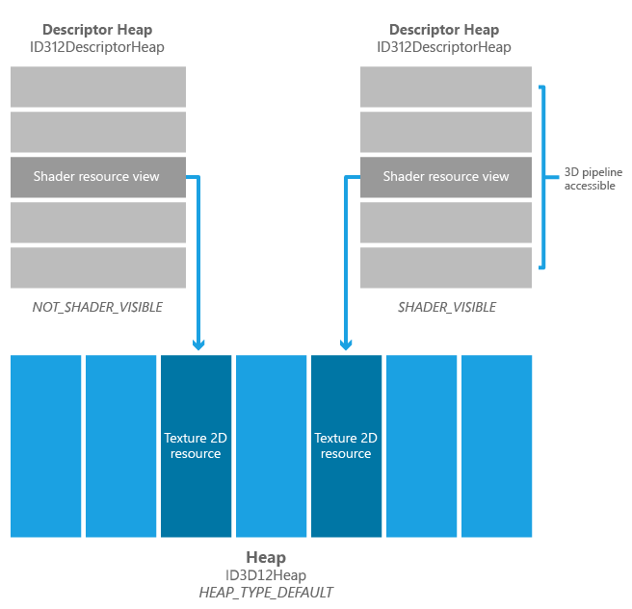
2.3 Descriptor Heap
Shader Visible Descriptor Heaps
被shader计算通过Descriptor Table引用的Descriptor Heap；设定Shader Visible
D3D12_SRV_UAV_CBV_DESCRIPTOR_HEAP
D3D12_DESCRIPTOR_HEAP_TYPE_SAMPLER
Hardware Size Limit
Notes:
Applications can create any number of descriptor heaps , and non shader visible descriptor heaps are not constrained in size. If a shader visible descriptor heap that is created by the application is smaller than the hardware size limit, the driver may choose to sub-allocate the descriptor heap out of a larger underlying descriptor heap so that multiple API descriptor heaps fit within one hardware descriptor heap. The reason this may happen is that for some hardware, switching between hardware descriptor heaps during execution requires a GPU wait for idle (to ensure that GPU references to the previously descriptor heap are finished). If all of the descriptor heaps that an application creates fit into the applicable hardware heap's maximum capacities, then no such waits will occur when switching API descriptor heaps during rendering. Applications must allow for the possibility, however, that switching the current descriptor heap may incur a wait for idle.

Slide 18
2.3 Descriptor Heap
Descriptor Heap Sub Allocation
DX11 Separate Buffers for Different Resource Types
DX12 One Buffer to Accommodate Different Resource Types
Notes:
为啥在这地方说descriptor heap的sub allocation？Shader visible 的dh，会引发这个操作
In Direct3D 12, you create one buffer to accommodate different types of resource data for uploading, and you copy resource data to the same buffer in a similar way for different resource data. Individual views are then created to bind those resource data to the graphics pipeline in the Direct3D 12 resource binding model.
In Direct3D 11, you create separate buffers for different types of resource data (note the different BindFlags used in the Direct3D 11 sample code below), explicitly binding each resource buffer to the graphics pipeline, and update the resource data with different methods based on different resource types.
https://docs.microsoft.com/en-us/windows/win32/direct3d12/uploading-resources

Slide 19
2.3 Descriptor Heap
Non Shader Visible Descriptor Heaps
直接传进Pipeline的Descriptor，未绑定给shaders；Recording CommandList的过程解析数据。
RTV，DSV， IVB, VBVs, SOVs
Recoding进Command List后Memory就可以复用了
Not Constrained in size

Slide 20
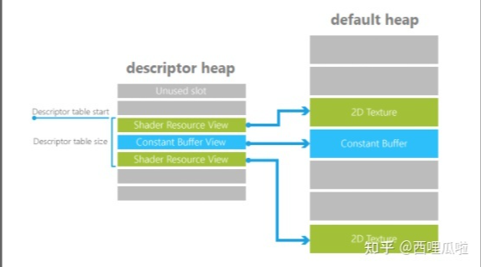
2.4 Descriptor Table
保存的是Descriptor Heap上的一段Descriptors 索引（Offset + Length）
图形管线使用Descriptor的索引访问Resource
所以，与Root Signature和Shader关联性；graphics pipeline通过Root Signature使用Descriptor Table，给管线访问resource的权限
Notes:
介绍descriptortable的作用，结构和具体使用，
The Root Signature references the descriptor table entry with a reference to the heap, the start location of the table (an offset from the start of the heap), and the length (in entries) of the table. The image below shows these concepts: the descriptor table pointers from the Root Signature and the descriptors within the descriptor heap referencing the full texture or buffer data in a heap (in the case of a texture, the default heap).

Slide 21
2.5 Descriptor Table VS Descriptor Heap
是否是Memory Allocation？
与Graphics pipeline的关联性
Notes:
介绍descriptortable的作用，结构和具体使用，
A descriptor table is actually just a sub-range of a descriptor heap. Descriptor heaps represent the underlying memory allocation for a collection of descriptors.
defining a descriptor table out of one is guaranteed to be as cheap as identifying a region in the heap to the hardware.

Slide 22
ch3
Root Signature
Notes:
虚拟现实（VR）的呈现需要同时用到硬件和软件。创建VR内容时，应了解各种设备和软件解决方案。

Slide 23
3.1 Root Signature
App层配置; 定义shader计算时需要的Resource类型
类似接口的定义，定义shader希望的数据类型，但不定义具体的数据
通过Root Parameter指定
Notes:
主要讲，RS在pipeline 中的作用；
Another concept is that of a root signature. The root signature is a binding convention, defined by the application, that is used by shaders to locate the resources that they need access to. The root signature can store:
Indexes to descriptor tables in a descriptor heap, where the layout of the descriptor table has been pre-defined.
Constants, so apps can bind user-defined constants (known as root constants) directly to shaders without having to go through descriptors and descriptor tables.
A very small number of descriptors directly inside the root signature, such as a constant buffer view (CBV) that changes per draw, thereby saving the application from needing to put those descriptors in a descriptor heap.
In other words, the root signature provides performance optimizations suitable for small amounts of data that change per draw.

Slide 24
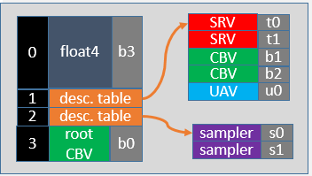
3.2 Root Signature
Root Constants
32 bit
Constant buffer
Root Descriptor（inline Descriptor，used many times）
尽量是最尝试用到的descriptor
无size limit
Descriptor Tables
切换Draw call时提升效率resource binding效率
Notes:
The root constants are inline 32-bit values that show up in the shader as a constant buffer.
The inlined root descriptors should contain descriptors that are accessed most often, though is limited to CBVs, and raw or structured UAV or SRV buffers. A more complex type, such as a 2D texture SRV, cannot be used as a root descriptor. Root descriptors do not include a size limit, so there can be no out-of-bounds checking, unlike descriptors in descriptor heaps, which do include a size.
Descriptor table entries within root signatures contain the descriptor, HLSL shader bind name and visibility flag. Refer to Shader Model 5.1 for details of shader names. On some hardware, there can be a performance gain from only making descriptors visible to the shader stages that require them (refer to D3D12_SHADER_VISIBILITY).

Slide 25
3.3 Root Signature
Root Signature的布局灵活，但app层应当控制Root Signature 越小越好
绘制时通过Root Signature 传给shader计算的resource会根据drawcall变化，所以，在绘制时每个Drawcall可能有一套独一无二的Root Signature状态；这就是所说的，Root Signature定义时只定义数据类型（Data Type），不定义数据内容（Data Content）
理想情况下，会有一组PSO对应一个相同的Root Signature，每个pso执行时可以单个设置自己的binding数据
App层可以控制descriptor table 和inline descriptor的数量
Notes:
The layout of the root signature is quite flexible, with some constraints imposed on less capable hardware. Regardless of the level of hardware, applications should always try to make the root signature as small as needed for maximum efficiency. Applications can trade off having more descriptor tables in the root signature but less room for root constants, or vice versa.
The contents of the root signature (the descriptor tables, root constants and root descriptors) that the application has bound automatically get versioned by the D3D12 driver whenever any part of the contents change between draw (graphics)/dispatch (compute) calls. So each draw/dispatch gets a unique full set of root signature state.
Ideally, there are groups of Pipeline State Objects (PSOs) that share the same root signature. After a root signature is set on the pipeline, all the bindings that it defines (descriptor tables, descriptors, constants) can each be individually set or changed, including inheritance into bundles.
An app can make its own tradeoff between how many descriptor tables it wants verses inline descriptors (which take more space but remove an indirection) verses inline constants (which have no indirection) they want in the root signature. Applications should use the root signature as sparingly as possible, relying on application controlled memory such as heaps and descriptor heaps pointing into them to represent bulk data.

Slide 26
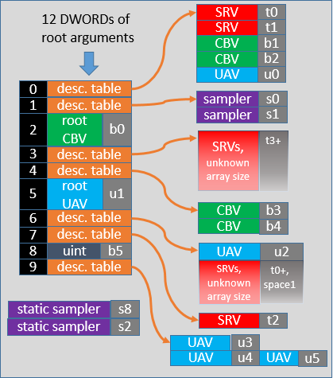
3.4 Limits
Memory limits and costs
RS最大占64 DWORD
Descriptor Table 1
Root Contant 1
Root Descriptor 2
Performance costs(Levels of Indirection)
Descriptor Table 2
Root Contant 1
Root Descriptor 2
Static Sample 0
Static samplers
RS的一部分，但不占空间
没有Performance cost
Notes:
Memory limits and costs
The maximum size of a root signature is 64 DWORDs.
This maximum size is chosen to prevent abuse of the root signature as a way of storing bulk data. Each entry in the root signature has a cost towards this 64 DWORD limit:
Descriptor tables cost 1 DWORD each.
Root constants cost 1 DWORD each, since they are 32-bit values.
Root descriptors (64-bit GPU virtual addresses) cost 2 DWORDs each.
Static samplers do not have any cost in the size of the root signature.
Performance costs
The performance cost (in terms of levels of indirection) are zero for a root constant, 1 for a root descriptor, and 2 for a descriptor table. If a root signature is large and overflows out of the fastest memory into slightly slower memory (which can happen on some hardware), then add 1 to the performance cost for the overflowing items at the end of the root signature.
An overflow can occur on hardware that might have, for example, a fixed size of 16 DWORDs for root argument space. This limit might be further reduced by one if the Input Assembler is used. In this case there is overflow into slightly slower memory if the root signature is too large for the 15 or 16 DWORD native memory. In other hardware there is no fixed native root argument memory (so the overflow situation never occurs).
For all hardware, if any root argument changes, the driver must maintain a version of all the root arguments (unlike other storage such as descriptor heaps and buffer resources, which are not versioned by the driver). In hardware that an overflow situation occurs, only the native or overflow area needs to be versioned, depending on where the change occurred. The amount of versioning should obviously be kept to the necessary minimum.
Generally, consider the following guidelines:
Use a small a root signature as necessary, though balance this with the flexibility of a larger root signature.
Arrange parameters in a large root signature so that the parameters most likely to change often, or if low access latency for a given parameter is important, occur first.
If convenient, use root constants or root constant buffer views over putting constant buffer views in a descriptor heap.
Static samplers
Static samplers (samplers where the state is fully defined and immutable) are part of root signatures, but do not count towards the 64 DWORD limit. If a sampler can be defined as static, there is no need for the sampler to be part of a descriptor heap.
There is no performance cost to using static samplers, and a root signature can contain a mix of static samplers (stored in the root signature, or in reserved space on some hardware) and dynamic samplers (stored in a sampler descriptor heap). Samplers in a descriptor heap can be dynamically assigned and indexed, which static samplers cannot.
Static samplers can be written as part of the root signature in HLSL shaders (refer to Specifying Root Signatures in HLSL)
Hardware Tiers

Slide 27
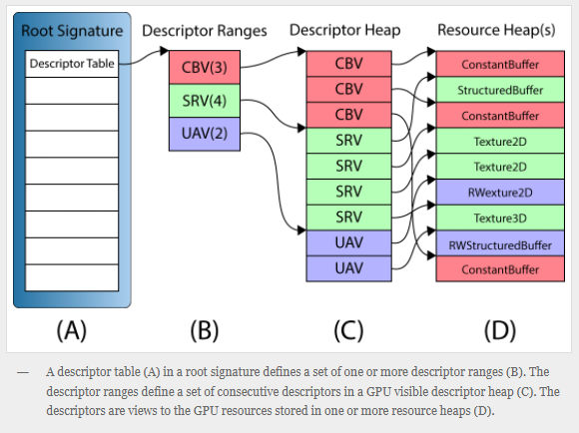
3.5 关系总结
1. 关系总结
Root Signature相当于函数签名
Descriptor Heap是存储Resource地址的连续内存块
Descriptor Table是Descriptor Heap上的一段索引，可以根据不同的draw call需求更改
Notes:
结合VS
d3dxbook\Chapter 9 Texturing\Crate 示例；梳理过程

Slide 28
ch4
引擎关键对象封装
Notes:
下面两章介绍rhi封装相关的内容；帮助大家建立一个直观的框架想象！最起码知道游戏引擎的框架大概啥样
在此基础上做rhi 封装

Slide 29
4.1 Game Thread VS Render Thread
为什么要分游戏线程，渲染线程？
工作的复杂性
游戏线程的工作
加载资源，
构造世界，
其他工作（事件处理，对象生命管理，游戏逻辑，等）
渲染线程具体负责哪方面的工作？
收集渲染对象
渲染器工作
RHI命令提交
如何分？

Slide 30

4.2 Game Thread Objects
World
容纳场景actor
Actor
容纳物体逻辑
Mesh
物体绘制资源
Notes:
结合右图说明

Slide 31
Mesh
Mesh
Mesh
4.2 Render Thread Objects
Actor
Actor
Actor
World
Render Proxy
渲染对象对应Actor
Material
物体外观
Scene
对应World
Renderer
渲染过程
根据不同的渲染技术实现不同的渲染流程（前向，延迟）
Proxy
Proxy
Proxy
Scene
Render
RHI
Driver(DX, OpenGL, Metal)
Notes:
右图；简单表示；实际很复杂；但是从最核心过程来说，这是一个非常简单的框架流程表示
上面是Game Thread
下面是Render Thread
看作数据由上至下传递
Render 调用rhi向 硬件发送渲染命令

Slide 32
4.4 RHI
What‘s RHI？
Render hardware interface
对接driver级别的硬件命令
Render的下一层
平台无关性
考虑跨平台需求

Slide 33
Reference： 参考
Resource Binding（DX12 Document）
DX12技术白皮书
DirectX 12 | 3D Game Engine Programming (3dgep.com)
Notes:
参考：https://docs.microsoft.com/en-us/windows/win32/direct3d12/resource-binding

Slide 34
作业：
基础作业：
实现对本课中对象的封装
进阶作业：
实现RHI跨平台化

