Slide 1

深入Dx12绘制一
杨璟昭 yangjingzhao@kingsoft.com

Slide 2

Objectives
掌握DX12管线基础流程，以及相应的GPU编程和数据组织。
掌握DX12 Work Submission的方式
预习内容
龙书第五，六章
官方DirectX12 文档（Work Submission in Direct3D 12部分）
Notes:
结束本节课可以自己使用DX12的流程渲染一个自己导入的模型
熟悉DX12的先进性。。。
以理论为主，不介绍某个绘制实例的具体实现；但是中间会穿插关键的DX12的使用介绍；为编写作业打基础

Slide 3
Contents
DX12渲染流程和管线初始化（前置知识）
数据组织
Key Stage
PSO（Pipeline State Object）
Work Submission
Notes:
从Dx12的渲染管线图带入，并介绍本节课使用的基础数据和关键Stage（与之前赵帅的课程衔接）
需要的Mesh数据，如何组织？
可编程管线，如何编程
PSO的概念阐述，抽象PSO的作用
Command 提交，引入DX12的Work Submission机制，并介绍
结束
作业

Slide 4
Ch1
前置知识回顾

Slide 5
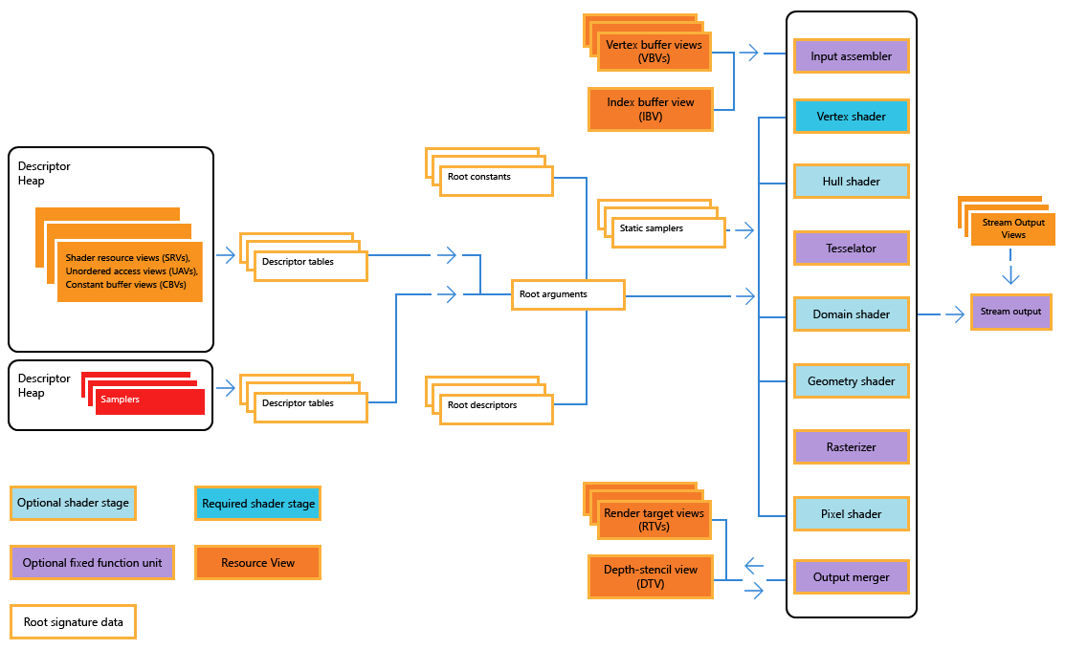
1. DX12渲染流程（前置知识）
Notes:
只看目录可能有点迷糊，为了让大家有一个全局的关系理解，在流程图的基础上标出今天的主要课程内容
顺道咨询同学，是否都认识了这个图里的内容
顺道说对应的DX12初始化时的流程，理论和实践对应

Slide 6
2. DX12渲染管线初始化（前置知识）
渲染管线初始化
框架组织结构
Dxgi factory
Device
Command quque
Swap chain
Descriptor heap
Command allocator
Initpipeline
Loadasset
Onupdate
Onrender
Ondestroy
。。。
Notes:
此处确保都已经了解了dx12渲染管线的初始化过程
Dxgifactor
Device
Swapchain
Command allocator
Command queue
Command list
Render target
Rtv descriptor heap
已经写过第一个示例的作业，默认对基础的框架结构都清楚了

Slide 7
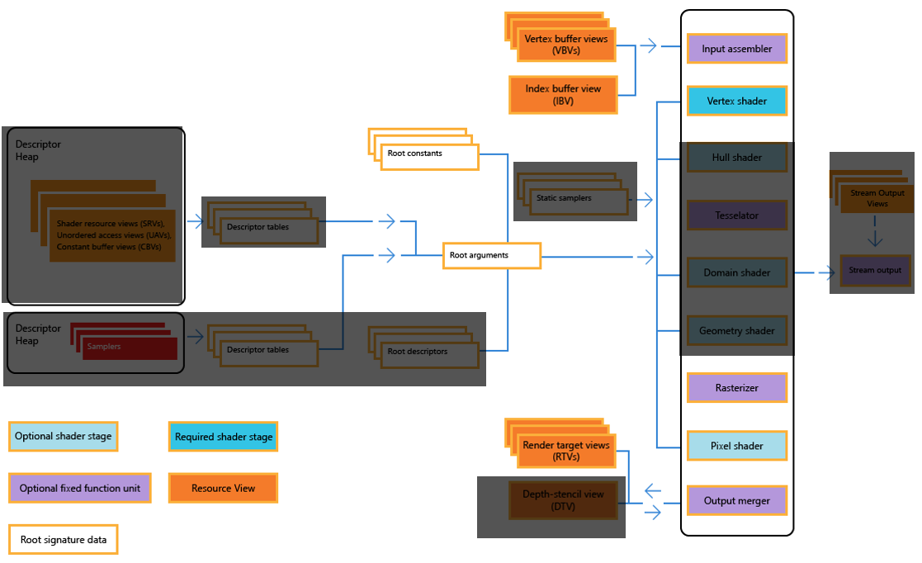
3. 今天的主要内容
Notes:
今天的主要内容：
Vertex /Index Buffer View
Vertex Shader
Pixel Shader
非可编程stage简略提一下
PSO

Slide 8
Ch2
Key Stage
Notes:
本节课使用到的渲染数据

Slide 9
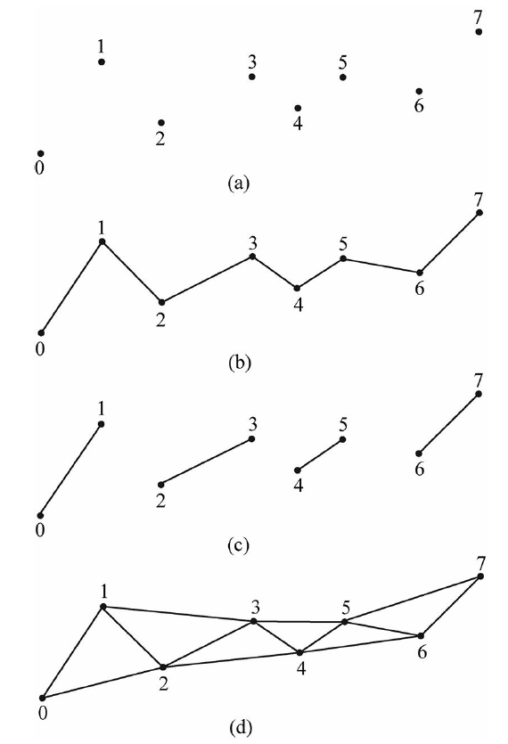
1. Input Assemble
负责从Memory读取几何数据（Geometric Data），并使用这些数据组装几何体（Geometric Primitive）
几何数据包括Vertex和Index信息
模型拓扑表示（ Primitive Topology ）
Point
Line List
Line Strip
Triangle List
Triangle Strip
a. Point List b. Line List
c. Line Strip d. Triangle Strip
Notes:
这部分涉及到模型的数据表示。。是前置内容；应该会在第二节课（表面的集合表示体现）
常用的Triangle List

Slide 10
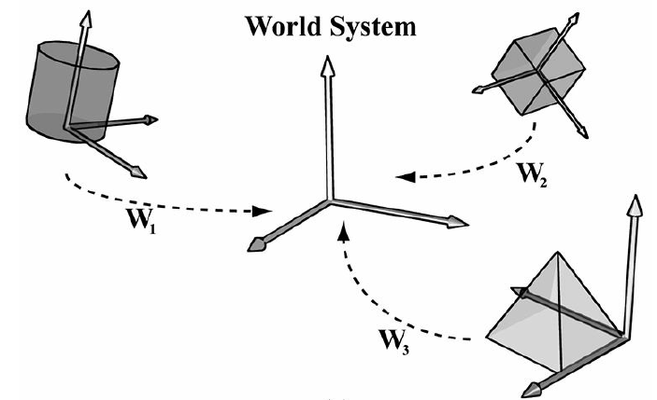
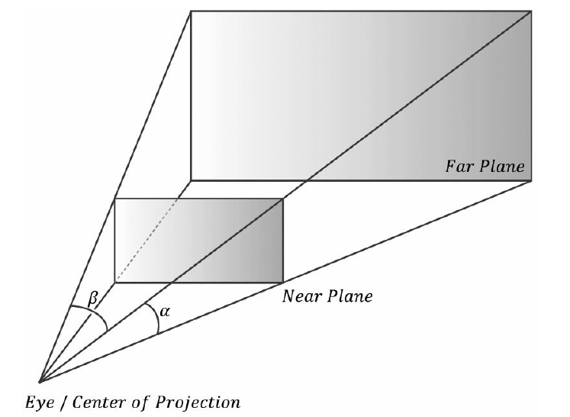
2. Vertex Shader
1. 作用在Vertex上
2. 主要负责对顶点进行空间变换
世界空间
相机空间
Frustum空间（Projection and Homogeneous Clip Space）
3. 其他计算
Notes:
1. 涉及到前置知识；空间变换的部分；
2. World Space， Local Space，Camera Space， homogenous clip space
3. 此处可讨论后适当增加篇幅；主要看变换部分的前置内容之前的课程（第二课）有多少
4. 关于homogeneous clip space or projection space ，齐次裁剪空间，投影空间
4. 其他计算比如蒙皮；涉及到Skeletal Mesh的实现；world position offset 其他变形的处理等。

Slide 11
3. Rasterizer
1. 硬件自动处理过程，不能进行配置或者控制
2. 主要作用根据屏幕范围计算屏幕中像素的颜色数据
3. 顶点属性插值（ Vertex Attribute Interpolation ）
Notes:
1. 适当提一下软光栅化
2. 扩展屏幕裁剪，背面剔除
3. 如何计算？扩展
4. 目前的技术，物体表面颜色由base color表示，此时主要以计算个像素的属性为主；用在pixelshader的光照着色上

Slide 12
4. Pixel Shader
处理对象是Pixel Fragment；
会使用到光栅话中的顶点属性插值
主要进行颜色计算
Notes:
某些驱动有对应的Fragment Shader的说法
此处的计算是物体外观展示的决定性因素；

Slide 13
5. Output Merge
Write Color into Back Buffer
Depth Test
Stencil Test
Blend
Notes:
涉及到Depth test， stencil test和blend的概念
1. 写颜色值到back buffer或者rt上
2. 不一定所有的像素都能写上，此处会有深度测试，模板测试，
3. 会有blend混合

Slide 14
ch3
渲染数据组织
Notes:
本节课使用到的渲染数据

Slide 15
1. 关键Stage的输入和输出
VB/IB
顶点数据World Space，Homogenous Space
顶点属性值
颜色值
Back buffer或者RT

Slide 16
2. Vertex Buffer / Index Buffer
数据结构与组织
Input Layout与Root Signature指定
Shader中使用
Notes:
Cpu端如何定义
如何建立联系
Gpu如何使用

Slide 17
3. Constant Buffer
如何理解Constant Buffer
VS使用到的变换矩阵数据
DX12中如何使用
Notes:
1.最基础的Contant Buffer如何使用
2. cpu如何创建
3. Gpu如何使用

Slide 18
Ch4
PSO
Notes:
1.学习了以上内容后；我们把管线的各基础阶段和所需的基础数据了解的差不多
2. 但还不能直接就绘制；绘制还需要准备PSO
3. PSO的
https://docs.microsoft.com/en-us/windows/win32/direct3d12/managing-graphics-pipeline-state-in-direct3d-12

Slide 19
1. 如何理解PSO
PSO的作用来历
当几何体被提交到GPU上进行绘制的时候，有许多的硬件设置需要指定，这些设置决定数据解析和渲染方式
统一称为graphics pipeline state；比如：Rasterizer state，blend state， depth stencil，topology type，shaders，等

Slide 20
1. 如何理解PSO
PSO的作用来历
Direct3D 11 allows pipeline state manipulation through a large set of independent objects
In Microsoft Direct3D 12, most graphics pipeline state is set by using pipeline state objects (PSO).
PSOs in Direct3D 12 were designed to allow the GPU to pre-process all of the dependent settings in each pipeline state, typically during initialization, to make switching between states at render time as efficient as possible.
Notes:
“The idea behind this was that the GPU could gain efficiencies by setting settings, like the blend state settings, all at once. However, with today's graphics hardware, there are dependencies between the different hardware units. For example, the hardware blend state might have dependencies on the raster state as well as the blend state. ”

Slide 21
2. PSO内部
PSO的作用来历
Notes:
PSO的设置，rasterizer state，blend state， RS， VS， PS等等列举介绍一下

Slide 22
2. 如何使用PSO
DX12中如何使用
Direct3D 12 addresses this scheme by unifying much of the pipeline state into immutable pipeline state objects (PSOs), which are finalized upon creation. Hardware and drivers can then immediately convert the PSO into whatever hardware native instructions and state are required to execute GPU work、
跟work submission相关，非Immediately submit
Notes:
截止到这，可以使用dx12绘制一个基础的模型了；传入vb ib，给pso，

Slide 23
Ch5
Work Submission
Notes:
To improve the CPU efficiency of Direct3D apps, as of version 12, Direct3D no longer supports an immediate context associated with a device. Instead, your application records and then submits command lists, which contain drawing and resource management calls. You can submit these command lists from multiple threads to one or more command queues, which manage the execution of the commands. This fundamental change increases single-threaded efficiency by allowing your application to pre-compute rendering work for later re-use, and it takes advantage of multi-core systems by spreading rendering work across multiple threads.
https://docs.microsoft.com/en-us/windows/win32/direct3d12/command-queues-and-command-lists

Slide 24
简单绘制流程
绘制前设置PSO，descriptor heap，RS
绘制drawcall
Close和excute
同步
Notes:
1. 介绍基础绘制；承接上面的内容；确保到本页，听众能完成一个基础模型的绘制
2. 下面的内容在简单绘制流程的基础上改进，便于理解

Slide 25
2. Command List& Command Queue
Elimination of the immediate context. This enables multi-threading. 2. Apps now own how rendering calls are grouped into graphics processing unit (GPU) work items. This enables re-use. 3. Apps now explicitly control when work is submitted to the GPU . This enables items 1 and 2.
multiple command lists can be recorded concurrently, which takes advantage of modern, multi-core processors.
Notes:
理解D3D12 的重要改变具体体现在记录command list，通过command quque 提交指令

Slide 26
3. Executing and Synchronizing
DX12中如何使用
Notes:
创建command list 过程，记录的过程以及执行，同步， command queue signal同步
To execute work on the GPU, an app must explicitly submit a command list to a command queue associated with the Direct3D device.
A direct command list can be submitted for execution multiple times, but the app is responsible for ensuring that the direct command list has finished executing on the GPU before submitting it again.
Bundles have no concurrent-use restrictions and can be executed multiple times in multiple command lists, but bundles cannot be directly submitted to a command queue for execution.
Any thread may submit a command list to any command queue at any time, and the runtime will automatically serialize submission of the command list in the command queue while preserving the submission order.

Slide 27
4. Grouping of GPU work items
Preprocess
通常的使用方式
Notes:
理解command bundles写内容出现的原因和使用方法
In addition to command lists, Direct3D 12 takes advantage of functionality present in all hardware today by adding a second level of command lists, which are called bundles. To help to distinguish these two types, the first-level command lists can be referred to as direct command lists. The purpose of bundles is to allow apps to group a small number of API commands together for later, repeated execution from within direct command lists. At the time of creating a bundle, the driver will perform as much pre-processing as possible to make later execution efficient. Bundles can then be executed from within multiple command lists and multiple times within the same command list.
The re-use of bundles is a large driver of improved efficiency with single CPU threads. Because bundles are pre-processed and can be submitted multiple times, there are certain restrictions on what operations can be performed within a bundle. For more information, see Creating and recording command lists and bundles.

Slide 28
5. 多线程
DX12中如何使用
Notes:
Submit的多线程机制学习理解
把绘制任务所需要的指令分配在多个线程去提交
为每个线程创建command list
Command queue 在excute的时候可以同时提交多个command list
同步和等待问题
SetEvent(m_workerFinishedRenderFrame[threadIndex]);
WaitForMultipleObjects(NumContexts, m_workerFinishedRenderFrame, TRUE, INFINITE);

Slide 29
exercise： content
基础作业：实现一个基础模型的渲染
list
进阶作业：
list

Slide 30
Reference： 参考
Introduction to 3D Game Programming with DirectX12
Direct3D 12 graphics（DX12 Document）

