Slide 1
SMART COMPUTER HEALTH MONITOR
Comprehensive project presentation
An explainable, offline operating-system resource monitoring application
Operating Systems project
Student: Ajay | Review presentation
GitHub: https://github.com/ranjansuman-collab/Smart-Computer-Health-Monitor

Slide 2
Abstract
What the project does
Collects live CPU, memory, disk, I/O, battery, and process data.
Converts raw telemetry into a deterministic health score from 0 to 100.
Detects sustained resource pressure instead of reacting to a single transient spike.
Explains evidence, operating-system impact, confidence, recommended action, and verification step.
Stores all data locally in SQLite and exports historical results to CSV/PDF.
Smart Computer Health Monitor

Slide 3
Problem statement
Why a conventional monitor is insufficient
Raw reading
User question
Project response
CPU: 95%
Normal workload or hung process?
Sustained samples + process context
RAM: 89%
Memory pressure or temporary cache?
Evidence + OS impact explanation
Disk: 92%
How much space is safe to recover?
Threshold insight + safe recommendation
Repeated alert
New event or duplicate noise?
Cooldowns + deduplication
Smart Computer Health Monitor

Slide 4
Objectives and scope
Academic and engineering goals
Provide non-blocking real-time monitoring in a desktop interface.
Keep analysis rule-based, deterministic, and explainable.
Persist metrics, process snapshots, insights, alerts, and settings.
Handle unavailable sensors, permission errors, and disappearing processes safely.
Provide history, reports, recommendations, and alert recovery.
Out of scope: malware detection, physical hardware diagnosis, automatic process killing, automatic file deletion, and mandatory cloud services.
Smart Computer Health Monitor

Slide 5
System architecture
Separation of concerns
Layer
Main components
Responsibility
Presentation
PySide6 UI, pages, cards, charts
Display live state and controls
Application
AppController, worker thread, settings
Coordinate sampling and signals
Monitoring
SystemMonitor, ProcessMonitor, PlatformInfo
Read OS and process telemetry
Analysis
Thresholds, score, interpretation, recommendations
Convert readings into decisions
Persistence
SQLite database manager and schema
Store local history and state
Output
History service, CSV/PDF exporter
Summaries and reports
Smart Computer Health Monitor

Slide 6
End-to-end data flow
One monitoring cycle
1. Worker wakes at the configured sampling interval.
2. SystemMonitor captures a SystemReading using psutil.
3. ProcessMonitor captures top processes with lifecycle error handling.
4. HealthScoreCalculator computes deductions and classification.
5. InterpretationEngine compares recent samples and creates or recovers insights.
6. AlertManager applies deduplication, cooldowns, escalation, acknowledgement, and recovery.
7. DatabaseManager persists the result; Qt signals refresh the dashboard.
Smart Computer Health Monitor

Slide 7
Repository structure
Important modules
Path
Role
main.py
Application entry point and Qt event loop
src/config.py
Validated settings and paths
src/monitoring/
System and process telemetry
src/analysis/
Thresholds, health score, insights, recommendations
src/alerts/
Alert lifecycle and deduplication
src/database/
SQLite schema and CRUD operations
src/history/
Time-window queries and statistics
src/reports/
CSV and ReportLab PDF export
src/ui/
Main window, pages, components, styles
tests/
Unit and integration tests
Smart Computer Health Monitor

Slide 8
Monitoring subsystem
Metrics collected
Metric
Source
Use
CPU percent
psutil.cpu_percent
Contention and score
Per-core CPU
psutil.cpu_percent(percpu=True)
Load distribution
RAM
psutil.virtual_memory
Memory pressure and availability
Disk capacity
psutil.disk_usage
Storage exhaustion
Disk I/O
psutil.disk_io_counters
Read/write activity rates
Battery
psutil.sensors_battery
Discharging low-battery warning
Processes
psutil.process_iter
Top contributors and evidence
Smart Computer Health Monitor

Slide 9
Health score model
Deterministic 0-100 calculation
HealthScore = clamp(100 - (CPU + RAM + Disk + Battery deductions) × damper, 0, 100)
Subsystem
Maximum deduction
Behavior
CPU
35 points
70% warning, 90% critical
RAM
35 points
70% warning, 85% critical
Disk
20 points
70% warning, 90% critical
Battery
10 points
Only present, unplugged, and low
Correlation damper
0.85 multiplier
Avoids double penalty for CPU + RAM
Bands: 80-100 Excellent | 60-79 Good | 40-59 Warning | 0-39 Critical
Smart Computer Health Monitor

Slide 10
Interpretation engine
From measurements to an explanation
Explanation point
Example output
Detection
High memory pressure detected
Observed measurement
91.4% used; 1.3 GB available
OS significance
Less room for file cache; paging may increase
Evidence
Recent samples and top memory processes
Possible factor
A browser process maintains a large working set
Confidence
High confidence from direct metrics
Action
Review active tabs and dormant applications
Verification
Watch the history chart for recovery
Smart Computer Health Monitor

Slide 11
Alert lifecycle
Avoiding alert fatigue
New insight: create an alert when a condition becomes active.
Duplicate condition: suppress repeated notifications during cooldown.
Escalation: increase severity when the condition persists or worsens.
Acknowledgement: record that the user has seen the alert.
Recovery: resolve the insight when readings return to healthy conditions.
The lifecycle is persisted so the dashboard and reports remain consistent.
Smart Computer Health Monitor

Slide 12
Database design
Local SQLite persistence
Table
Stored data
system_metrics
Timestamp, CPU, RAM, disk, I/O, battery, score
process_snapshots
PID, name, CPU%, memory%, status, timestamp
insights
Resource, severity, explanation, evidence JSON, confidence, status
alerts
Severity, message, acknowledged/resolved state, timestamps
settings
Key-value configuration and monitoring preferences
Smart Computer Health Monitor

Slide 13
User interface
Main pages and user flow
Page
Purpose
Overview
Live cards, score, current status, summaries
Resource Monitor
Detailed CPU/RAM/disk/battery charts
Process Explorer
Search and sort process resource usage
Health Insights
Expandable nine-point explanations
Recommendations
Safe corrective actions and warnings
Alerts
Active, acknowledged, escalated, recovered events
History
15m/1h/6h/24h trends and statistics
Settings
Thresholds, sampling interval, retention, cooldown
About
Project scope, privacy, limitations
Smart Computer Health Monitor

Slide 14
Reports and privacy
Outputs and safety boundaries
CSV export supports analysis of historical telemetry.
PDF export produces a structured diagnostic report.
All monitoring data is written to local SQLite and local files.
No telemetry is uploaded to an external server.
Recommendations are advisory and non-destructive.
High usage alone is not treated as proof of malware or hardware failure.
Unavailable sensors are represented explicitly rather than guessed.
Smart Computer Health Monitor

Slide 15
Testing strategy
What is verified
Area
Examples
Health score
Boundaries, deductions, plugged-in battery, clamping
Interpretation
Normal, transient spike, sustained CPU, RAM/disk, recovery
Alerts
Suppression, escalation, acknowledgement, resolution
Database
Initialization, CRUD, settings, clearing history
Processes
NoSuchProcess and AccessDenied handling
Recommendations
Mapping active insights and ignoring resolved insights
Reports/config
Validation, empty history, CSV/PDF generation
Smart Computer Health Monitor

Slide 16
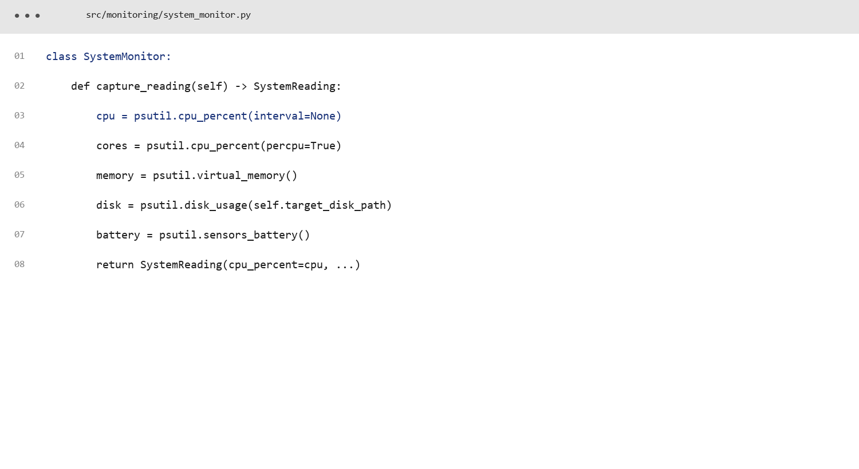
Code screenshot: system monitor
Collects live OS telemetry.
src/monitoring/system_monitor.py
Smart Computer Health Monitor

Slide 17
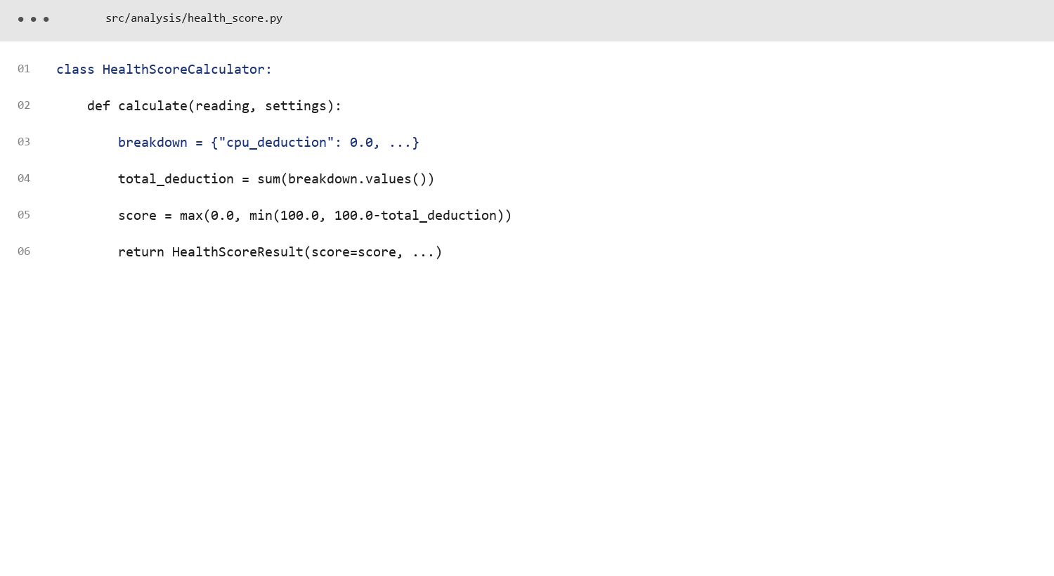
Code screenshot: health score
Calculates bounded, explainable scoring.
src/analysis/health_score.py
Smart Computer Health Monitor

Slide 18
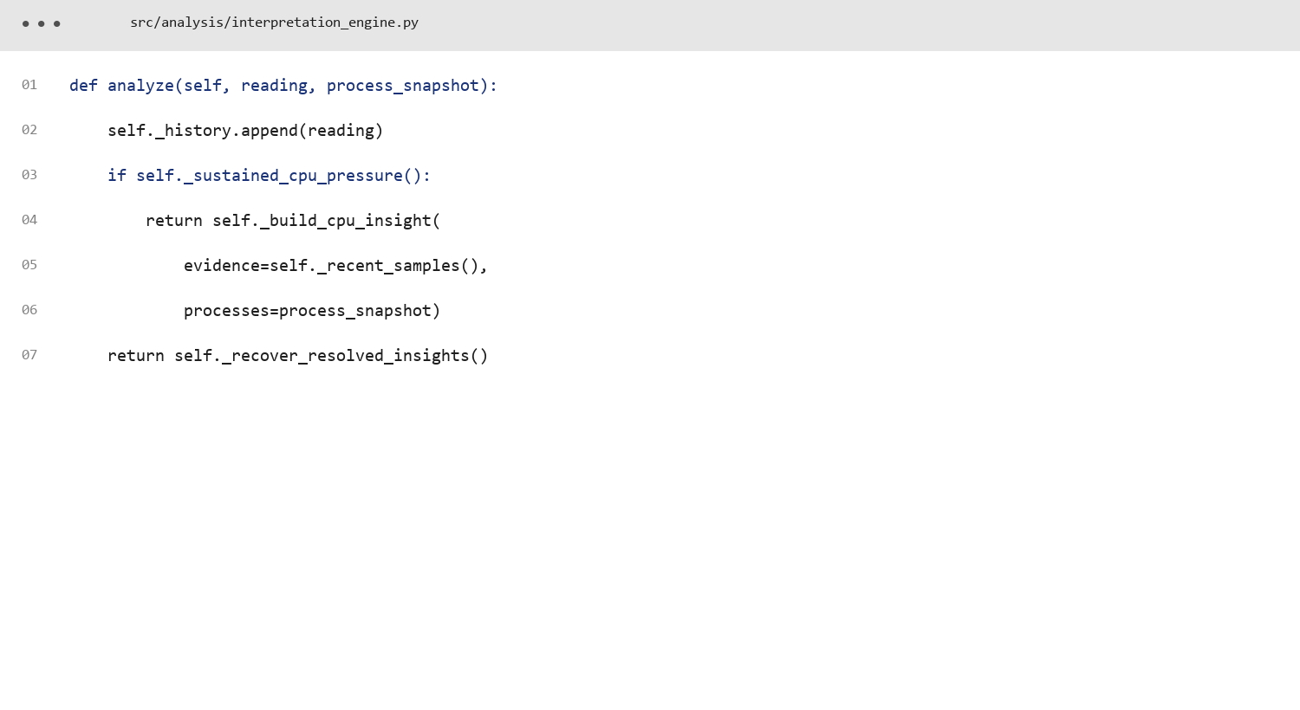
Code screenshot: interpretation engine
Requires sustained evidence and builds insights.
src/analysis/interpretation_engine.py
Smart Computer Health Monitor

Slide 19
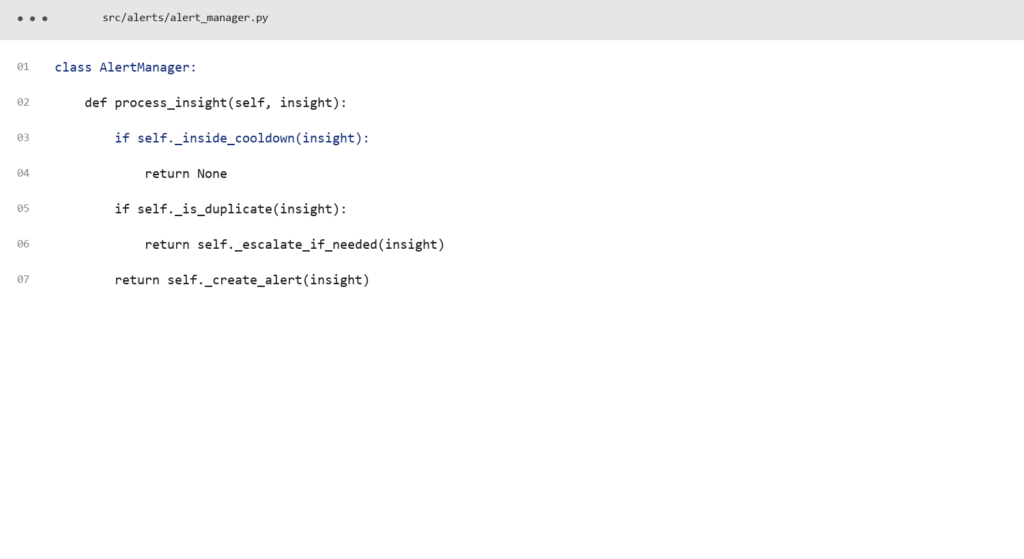
Code screenshot: alert manager
Deduplicates and manages alert state.
src/alerts/alert_manager.py
Smart Computer Health Monitor

Slide 20
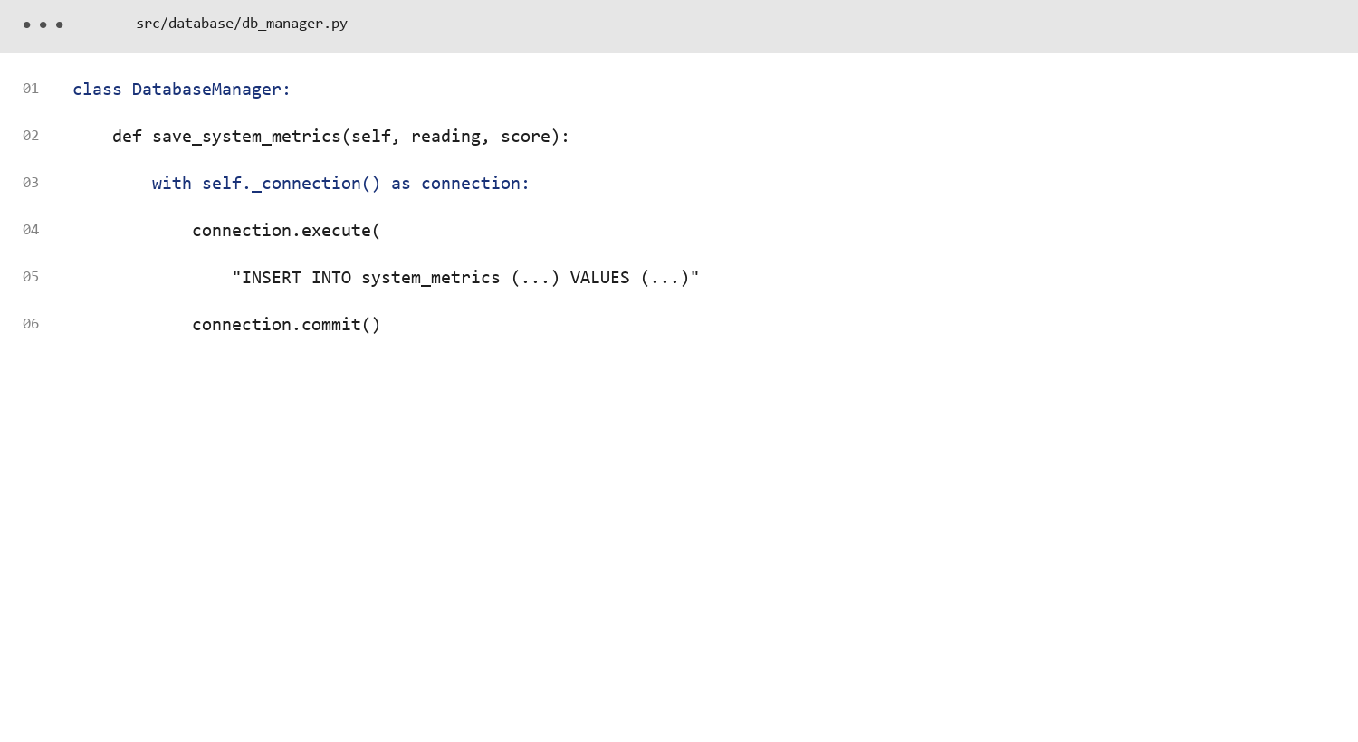
Code screenshot: database manager
Persists metrics and application state.
src/database/db_manager.py
Smart Computer Health Monitor

Slide 21
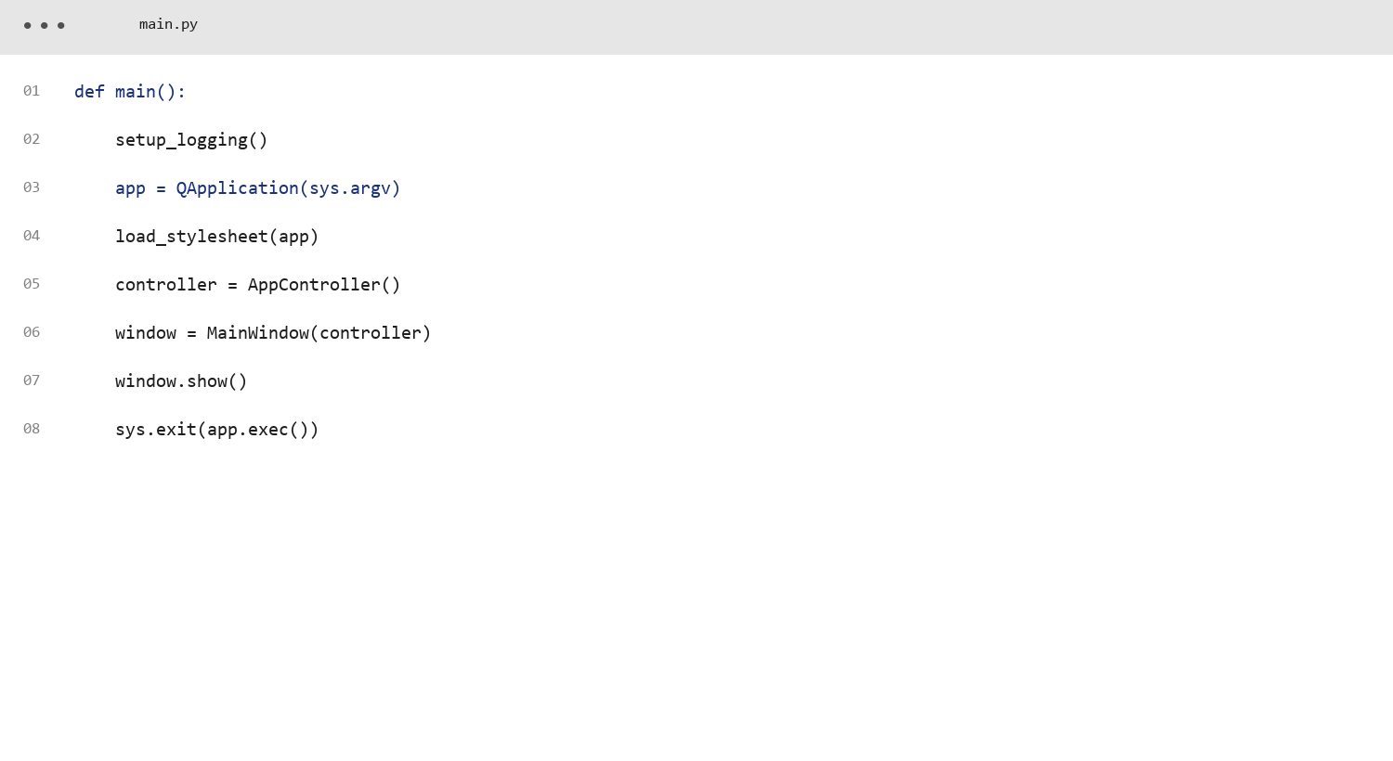
Code screenshot: application entry point
Starts logging, controller, UI, and event loop.
main.py
Smart Computer Health Monitor

Slide 22
Limitations and future work
Known boundaries and extensions
User-space APIs cannot diagnose every physical hardware fault.
Thresholds are heuristics and may need environment-specific tuning.
Battery data is unavailable on desktops and some virtual machines.
GPU utilization and network socket attribution are not core features yet.
Future work: GPU counters, network attribution, adaptive baselines, cgroup/container views, scheduled reports, and optional authenticated remote dashboards.
Smart Computer Health Monitor

Slide 23
Conclusion and submission links
Project summary
The project bridges raw operating-system counters and human decisions.
Its main contribution is an interpretation layer combining evidence, OS significance, confidence, recommendations, and verification.
The design is modular, testable, offline-first, and safe by default.
Verification result: 22 automated tests pass.
GitHub: https://github.com/ranjansuman-collab/Smart-Computer-Health-Monitor
Review 10 documentation: docs/REVIEW_10_DOCUMENTATION.md
Smart Computer Health Monitor

