Slide 1
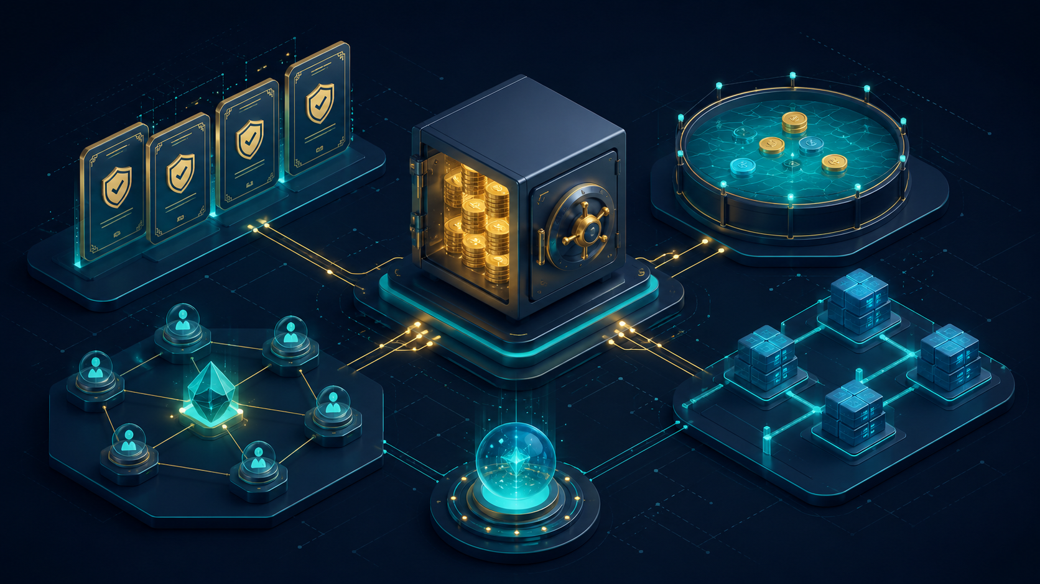
Decentralized Insurance Pool
Option E - Blockchain Technologies 2 Final Project
• Risk pool where users stake collateral to underwrite policies.
• Chainlink oracle triggers claims based on external market conditions.
• ERC-4626 vault manages underwriter liquidity and payout capacity.
• DAO governance controls risk types, premiums, and protocol parameters.
Group members: Zhambyl - contracts/integration/deployment | Murat - frontend/subgraph | Daulet - tests/reports
Blockchain Technologies 2 | Option E | Slide 1/10

Slide 2
1. Problem and Product Idea
What the protocol solves and how users interact with it
Problem
Our answer
• Traditional insurance is slow, centralized, and often opaque.
• Users cannot easily verify how premiums, reserves, and payouts are calculated.
• Crypto risks like depeg events need fast and transparent claim logic.
• Manual claim review does not fit well with automated DeFi systems.
• Underwriters deposit collateral into a vault and earn protocol yield.
• Policy buyers pay a premium for coverage against a specific risk type.
• The Chainlink oracle checks the trigger condition, such as a price depeg.
• If the condition is met, the ClaimManager executes the payout automatically.
Blockchain Technologies 2 | Option E | Slide 2/10

Slide 3
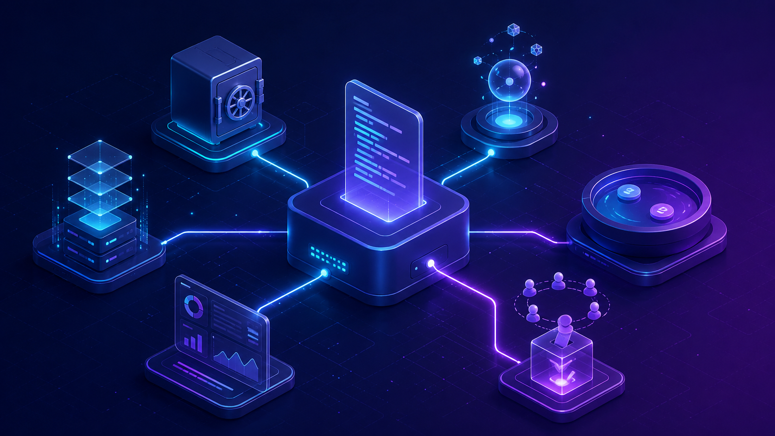
2. System Architecture
The protocol is split into contracts, frontend, subgraph, and deployment layer
1. Users interact through the React frontend: connect wallet, read state, and submit actions.
2. Core contracts handle vault deposits, policy purchases, risk registry, AMM swaps, and claim execution.
3. ChainlinkOracleAdapter reads price data and rejects stale or invalid oracle answers.
4. ProtocolGovernor and ProtocolTimelock provide DAO control over key parameters.
5. The Graph subgraph indexes protocol events for UI and analytics queries.
Frontend
Contracts
Oracle
Subgraph
Blockchain Technologies 2 | Option E | Slide 3/10

Slide 4
3. Smart Contract Modules
Each contract has one clear responsibility
GovernanceToken
PolicyNFT
InsuranceVault
ERC20Votes + ERC20Permit token used for voting power and delegation.
ERC-721 representation of active insurance policies and ownership.
ERC-4626 vault for deposits, withdrawals, free liquidity, and claim payouts.
RiskRegistry
InsurancePool
ClaimManager
Stores accepted risk types, premium rates, limits, and active status.
Sells policies, tracks coverage, and releases or consumes reserved liquidity.
Checks oracle conditions and executes eligible claim payouts.
InsuranceAMM
Governor + Timelock
Factory + UUPS
Constant-product AMM with swap, liquidity, fee, and slippage logic.
DAO flow with proposal, vote, queue, delay, and execution.
CREATE/CREATE2 deployment and V1 to V2 upgrade path.
Blockchain Technologies 2 | Option E | Slide 4/10

Slide 5
4. Critical User Flows
Deposit, buy policy, execute claim, and govern parameters
A. Underwriter deposits
B. Buyer purchases policy
• User deposits collateral into InsuranceVault.
• Vault mints shares and exposes available free liquidity.
• Reserved coverage reduces max withdraw/redeem capacity.
• Buyer selects risk type and coverage amount.
• InsurancePool calculates premium and mints PolicyNFT.
• Active coverage increases and vault liquidity becomes reserved.
C. Claim is executed
D. DAO governance
• ClaimManager reads oracle price through adapter.
• If trigger condition is met, payout goes to policy owner.
• Double claim and inactive policy paths are rejected.
• Token holders delegate votes and create proposals.
• Proposal passes, queues in Timelock, then executes after delay.
• Timelock protects treasury and protocol parameters.
Blockchain Technologies 2 | Option E | Slide 5/10

Slide 6
5. Oracle, Governance, and Security
The project includes access control, stale-price protection, and DAO safeguards
Oracle safety
Governance safety
Security practices
• ChainlinkOracleAdapter rejects zero feed addresses.
• Negative, zero, stale, or incomplete answers revert.
• Claim logic uses the oracle to decide whether a policy trigger is met.
• Governor uses voting delay, voting period, quorum, and proposal threshold.
• Timelock enforces delay before execution.
• Privileged actions are restricted with roles or ownership.
• ReentrancyGuard and CEI pattern are used where relevant.
• SafeERC20 is used for ERC-20 transfers in production logic.
• Known limitations are documented instead of overclaiming.
Blockchain Technologies 2 | Option E | Slide 6/10

Slide 7
6. Testing and Coverage
The final suite passes and meets the quantitative testing target
Final validation result
Test types included
• forge build: passed
• forge test: 134 passed, 0 failed, 0 skipped
• forge coverage line: 93.60% (760/812)
• Statements: 92.67%, branches: 66.94%, functions: 88.44%
• Frontend production build also passed.
• Unit tests cover public/external functions and important revert paths.
• Fuzz tests target AMM swaps, vault deposit/withdraw, and governance voting power.
• Invariant tests check non-decreasing k, vault accounting, and risk exposure.
• Fork tests are present; full live fork validation requires RPC URLs.
Blockchain Technologies 2 | Option E | Slide 7/10

Slide 8
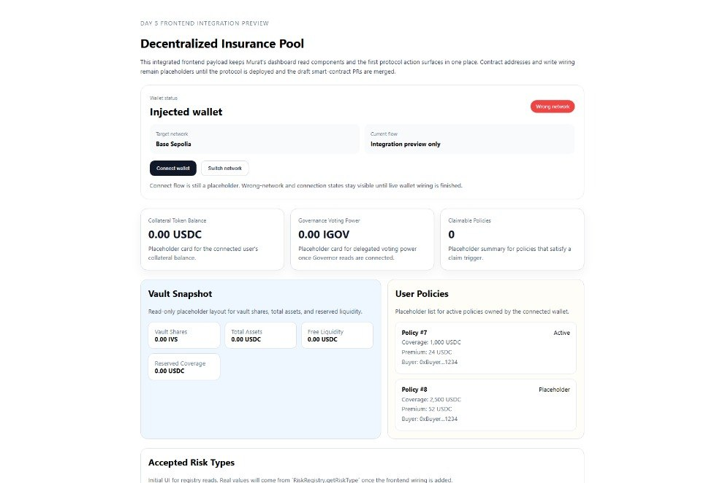
7. Frontend and Subgraph
The UI and indexed data layer are configured for the recorded deployment
Frontend
• React frontend includes wallet connection, dashboard reads, and protocol action forms.
• State-changing forms cover deposit, buy policy, claim, swap, and vote flows.
• Readable error messages are prepared for wrong network, rejected transaction, and insufficient balance cases.
• The frontend build passes, and contract configuration uses recorded Base Sepolia addresses.
Subgraph
Subgraph manifest is wired to the same Base Sepolia addresses. It includes 8 entities and documented GraphQL queries. A hosted live endpoint is not claimed unless deployed separately.
Blockchain Technologies 2 | Option E | Slide 8/10

Slide 9
8. Deployment and Reproducibility
The repository can be cloned, built, tested, and connected to Base Sepolia artifacts
Deployment status
Reproducible setup
• Base Sepolia deployment addresses are recorded in deployments/base-sepolia.json.
• Frontend contract configuration and subgraph manifest use the same addresses.
• VerifyDeployment passed locally against Base Sepolia after deployment artifact review.
• No fake explorer verification links or fake live subgraph endpoint are claimed.
• Fresh clone setup is documented with git submodule update --init --recursive.
• Backend commands: forge build, forge test, forge coverage.
• Frontend commands: npm install and npm run build.
• Main branch is used only for the final release after develop validation.
Blockchain Technologies 2 | Option E | Slide 9/10

Slide 10
9. Final Result
What is complete, what is honest, and who explains each part
Final project status
• Core Solidity protocol is implemented: vault, pool, claims, oracle, AMM, governance, upgrade, factory, and benchmark.
• Tests pass with 134/134 and line coverage above 90%.
• Frontend, subgraph, deployment scripts, reports, architecture, and README are included.
• Base Sepolia deployment artifacts are recorded and synced across config files.
Blockchain Technologies 2 | Option E | Slide 10/10

