Slide 1
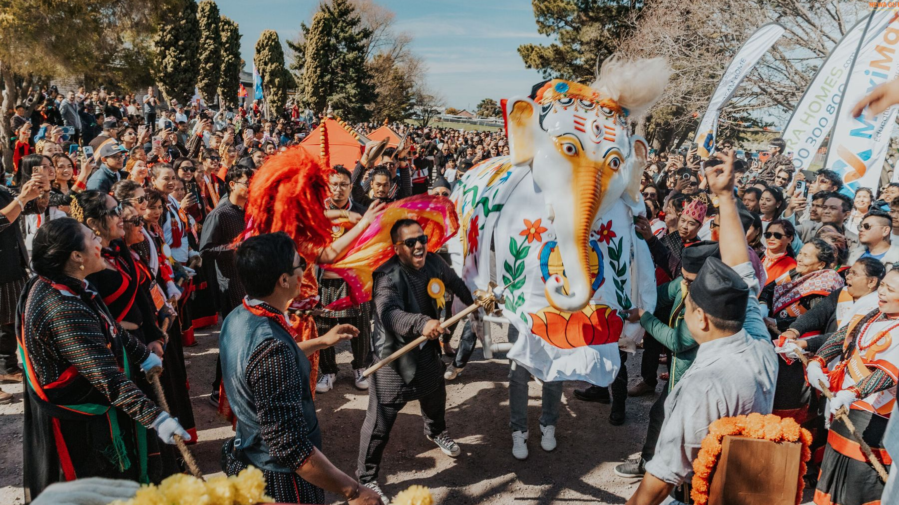
TEAM BRIEFING
Indra Jatra
Melbourne 2026
Visitor guide, cultural trail and event-day operations
Newa Guthi Victoria
Notes:
Open with the visitor problem: one trusted place for what is happening, where to go and what the cultural elements mean. Image: NGV project festival photograph.

Slide 2
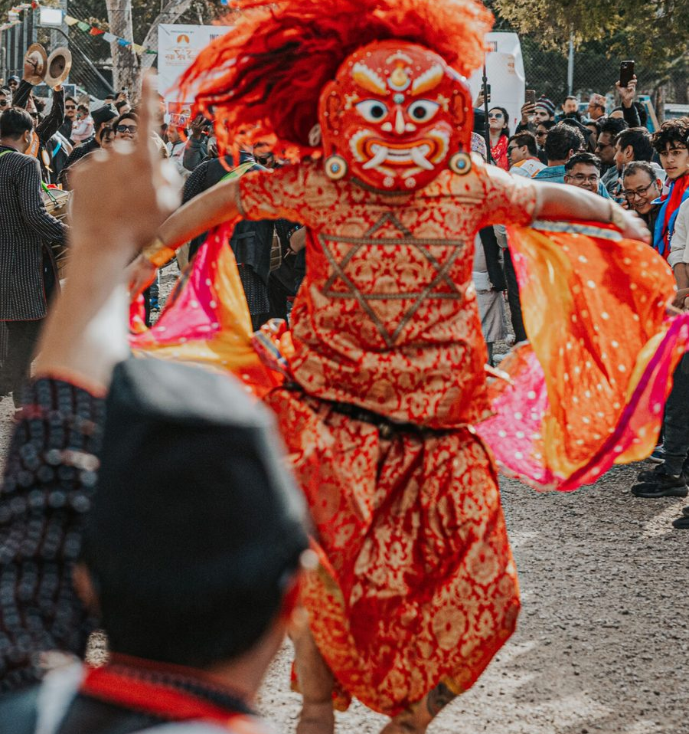
THE PRODUCT
02
One pocket guide for the whole festival
Live programme
Now, next and full schedule with useful filters.
Venue wayfinding
A planned site map plus facilities and landmarks.
Cultural trail
Twelve stories, QR entry points and a festival passport.
Personal festival
Saved sessions, collected stamps and offline access.
SEED / DEMO MODE
Notes:
The current build is designed for rehearsal with seeded content. Visitor routes render, assets load and the PWA builds successfully. Cultural copy still needs committee approval.

Slide 3
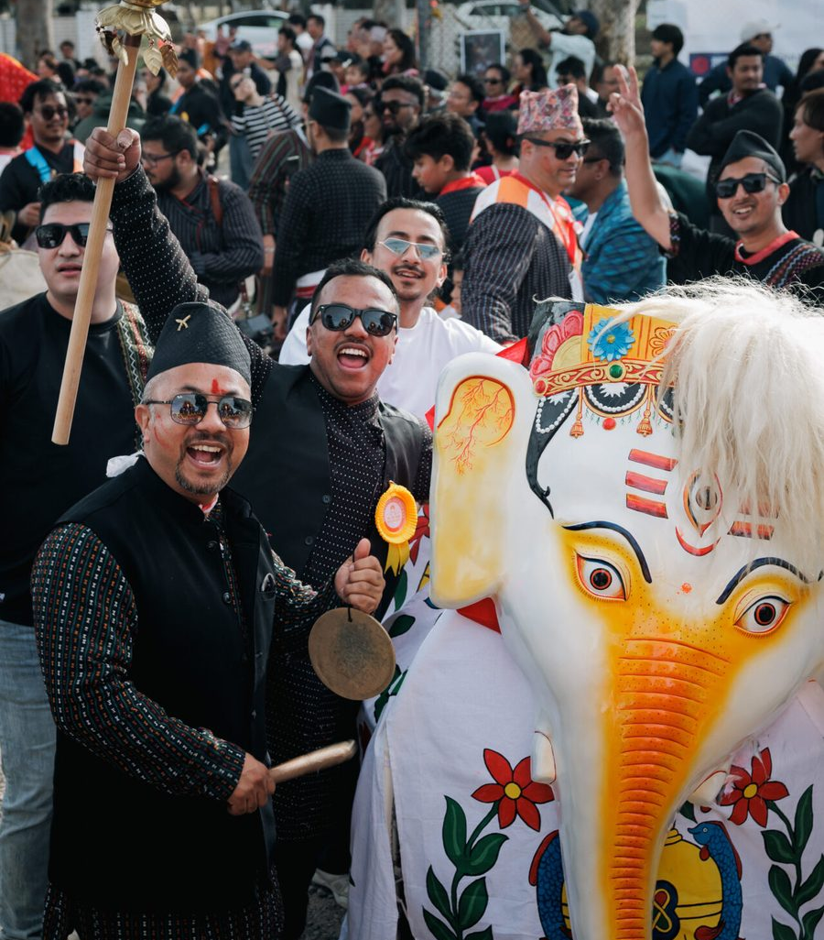
HOW VISITORS USE IT
03
A simple journey from arrival to memory
1
Open and orient
See what is on now and what starts next.
2
Find the place
Use the map, facilities and directory.
3
Explore the story
Scan signs or browse the cultural trail.
4
Keep the day
Save sessions and build a digital passport.
Designed for one-handed use
on a busy festival day
Notes:
Demo this as a story, not a menu tour. Start on Home, open the programme, locate First Aid, scan a trail code, then show the saved passport.

Slide 4
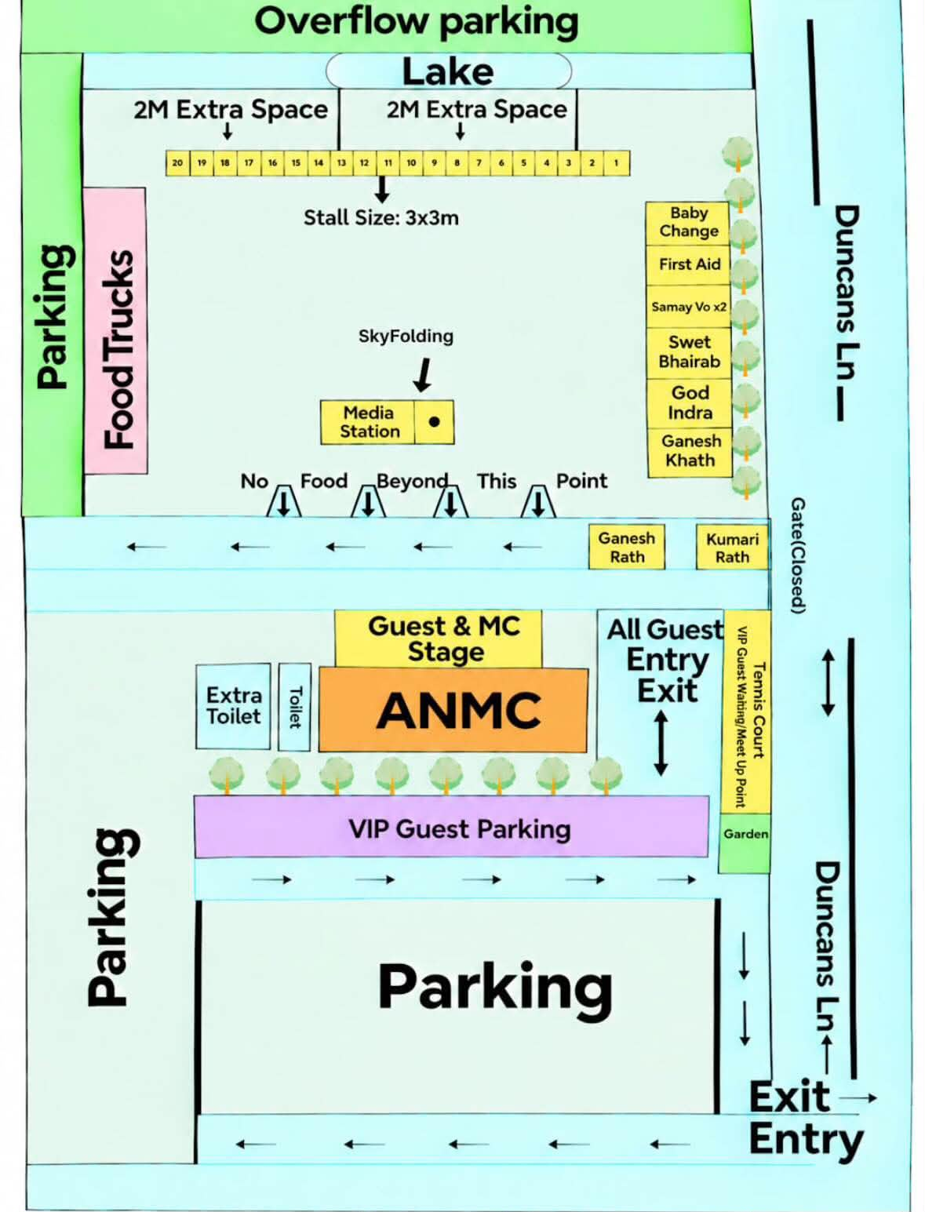
EVENT DAY
04
Clear ownership keeps information trustworthy
1
Content owner
Approves programme, locations, cultural copy and alerts.
2
Organiser operator
Updates event status and tests the visitor view.
3
Support lead
Monitors QR, install, access and help-desk issues.
Before launch: organiser access must be secured, and updates must use a shared server API rather than browser-only storage.
Notes:
The map shown is the supplied planned 2026 site map. Be explicit that current live overrides only sync within the same browser profile; the shared API is a release blocker.

Slide 5

COMMUNITY CONVERSION
05
Use one trusted form for each intent
Sponsorship
Reuse the website sponsorship form and package choices.
Stall EOI
Create a dedicated website form with stall type and requirements.
The app should route people to maintained website forms, not duplicate sensitive data handling in demo code.
Volunteer / classes
Use the general contact form until dedicated workflows exist.
Notes:
Recommended sponsorship destination: https://newaguthi.org.au/sponsors/#sponsorship-form. The WordPress implementation already supports packages, business details, consent, spam protection, private enquiry storage and email notification.

Slide 6
RELEASE DECISION
06
Ready to demonstrate. Not ready to publish.
READY NOW
BEFORE PUBLIC LAUNCH
Internal demo
Release gates
• Visitor routes and imagery
• Programme, trail, map and directory
• Saved sessions and passport
• PWA production build
• Team rehearsal documentation
1. Secure organiser access and implement the API
2. Restore agreed Login / Register onboarding
3. Add a real install-to-home-screen flow
4. Approve cultural stories and final run sheet
5. Rehearse on iPhone and Android over HTTPS
Next milestone: private stakeholder test
Notes:
Close with a go/no-go statement. The app can be shared internally today, but publishing with an unauthenticated organiser console and missing production API would expose operational controls and break core flows.

