Slide 1
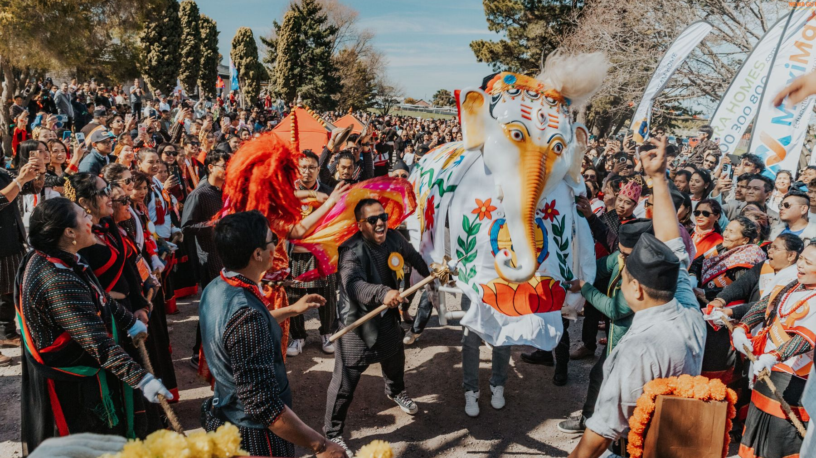
TEAM BRIEFING
Indra Jatra
Melbourne 2026
Visitor guide, cultural trail and event-day operations
Newa Guthi Victoria
Notes:
Open with the visitor problem: one trusted place for what is happening, where to go and what the cultural elements mean. Image: NGV project festival photograph.

Slide 2
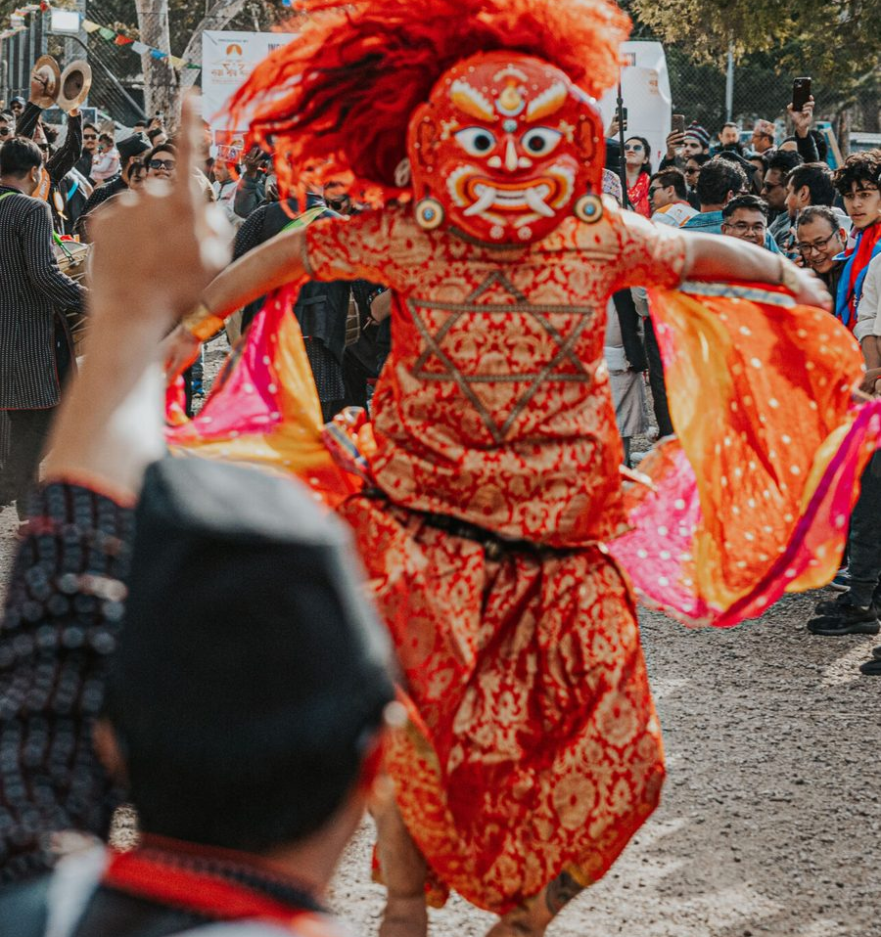
THE PRODUCT
02
One pocket guide for the whole festival
Live programme
Now, next and full schedule with useful filters.
Venue wayfinding
A planned site map plus facilities and landmarks.
Cultural trail
Twelve stories, QR entry points and a festival passport.
Personal festival
Saved sessions, collected stamps and offline access.
SEED / DEMO MODE
Notes:
The current build is designed for rehearsal with seeded content. Visitor routes render, assets load and the PWA builds successfully. Cultural copy still needs committee approval.

Slide 3
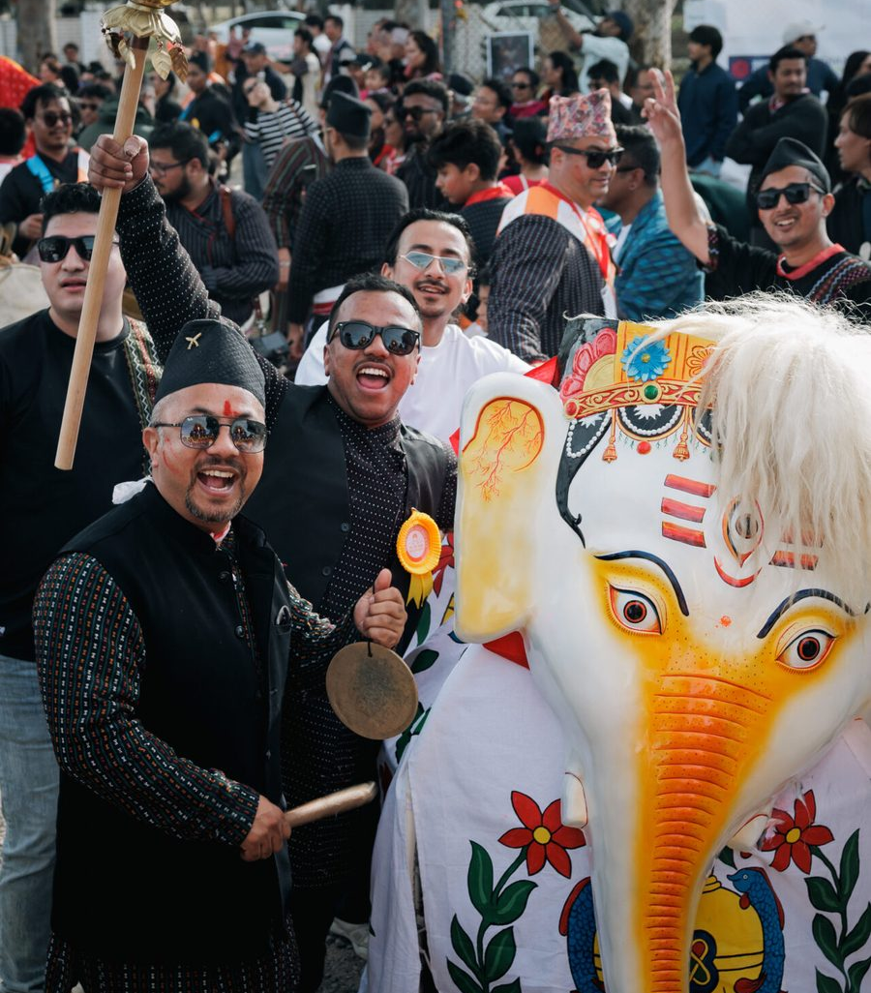
HOW VISITORS USE IT
03
A simple journey from arrival to memory
1
Open and orient
See what is on now and what starts next.
2
Find the place
Use the map, facilities and directory.
3
Explore the story
Scan signs or browse the cultural trail.
4
Keep the day
Save sessions and build a digital passport.
Designed for one-handed use
on a busy festival day
Notes:
Demo this as a story, not a menu tour. Start on Home, open the programme, locate First Aid, scan a trail code, then show the saved passport.

Slide 4
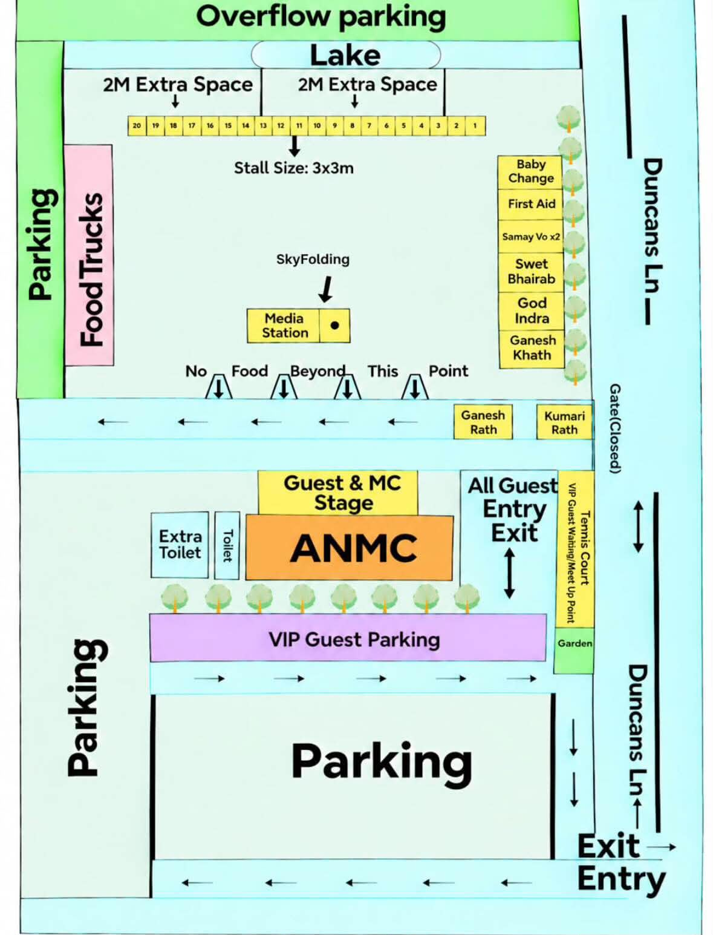
EVENT DAY
04
Clear ownership keeps information trustworthy
01
Content owner
Approves programme, locations, cultural copy and alerts.
02
Organiser operator
Updates event status and tests the visitor view.
03
Support lead
Monitors QR, install, access and help-desk issues.
Before launch: organiser access must be secured, and updates must use a shared server API rather than browser-only storage.
Notes:
The map shown is the supplied planned 2026 site map. Be explicit that current live overrides only sync within the same browser profile; the shared API is a release blocker.

Slide 5

COMMUNITY CONVERSION
05
Use one trusted form for each intent
Sponsorship
Reuse the website sponsorship form and package choices.
Stall EOI
Create a dedicated website form with stall type and requirements.
The app should route people to maintained website forms, not duplicate sensitive data handling in demo code.
Volunteer / classes
Use the general contact form until dedicated workflows exist.
Notes:
Recommended sponsorship destination: https://newaguthi.org.au/sponsors/#sponsorship-form. The WordPress implementation already supports packages, business details, consent, spam protection, private enquiry storage and email notification.

Slide 6
RELEASE DECISION
06
Ready to demonstrate. Not ready to publish.
READY NOW
BEFORE PUBLIC LAUNCH
Internal demo
Release gates
• Visitor routes and imagery
• Programme, trail, map and directory
• Saved sessions and passport
• PWA production build
• Team rehearsal documentation
1. Secure organiser access and implement the API
2. Restore agreed Login / Register onboarding
3. Add a real install-to-home-screen flow
4. Approve cultural stories and final run sheet
5. Rehearse on iPhone and Android over HTTPS
Next milestone: private stakeholder test
Notes:
Close with a go/no-go statement. The app can be shared internally today, but publishing with an unauthenticated organiser console and missing production API would expose operational controls and break core flows.

