Slide 1
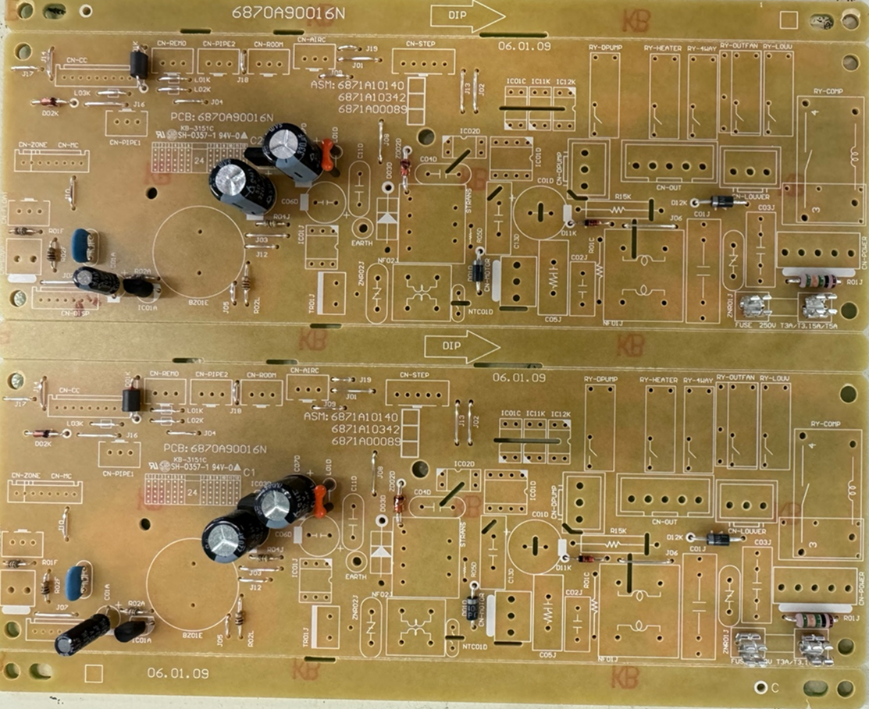
품명 | 카세트
P/NO | 6871A100089C_R
제정일 | 24.08.29
작성자 | 유병수
공정 | RADIAL
5
6
7
4
1
2
3
8
9
KIA78L05B
SHL_330uF_35V
BFD2070
CSTLS_8M
SHL_220uF_50V
FUSE
FUSE
SHL_3.3uF_50V
KIA7036
라인 별 공정 확인 표 (กระบวนการเส้น)
Radial | 총점수(คะแนน) | 9점 |  |  |  | 옵션: เนื้อหาคำเตือน:

