Slide 1
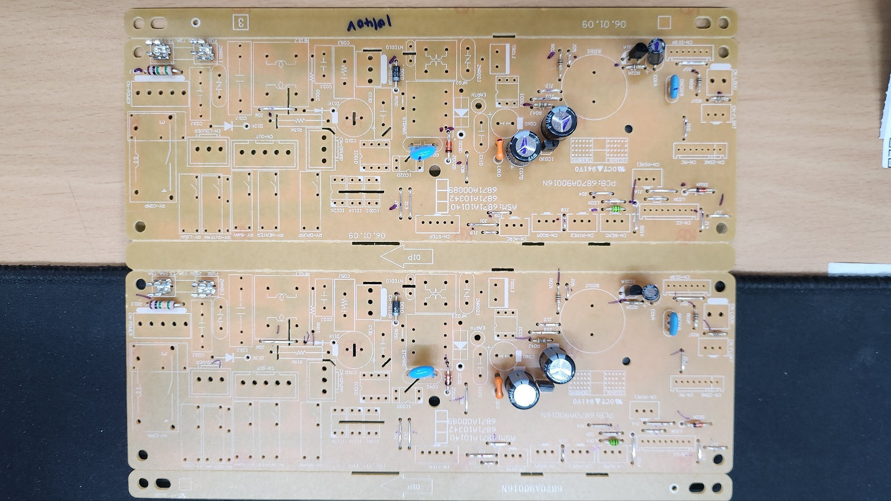
품명 | 카세트
P/NO | 6871A10140V_R
제정일 | 24.08.29
작성자 | 유병수
공정 | RADIAL
5
6
7
8
4
1
2
3
9
10
SHL_220uF_50V
KIA78L05B
HONEYCOMB
472M
CSTLS_8M
SHL_330uF_35V
FUSE
FUSE
KIA7036
SHL_3.3uF_50V
라인 별 공정 확인 표 (กระบวนการเส้น)
Radial | 총점수(คะแนน) | 10점 |  |  |  | 옵션: เนื้อหาคำเตือน:

