Slide 1
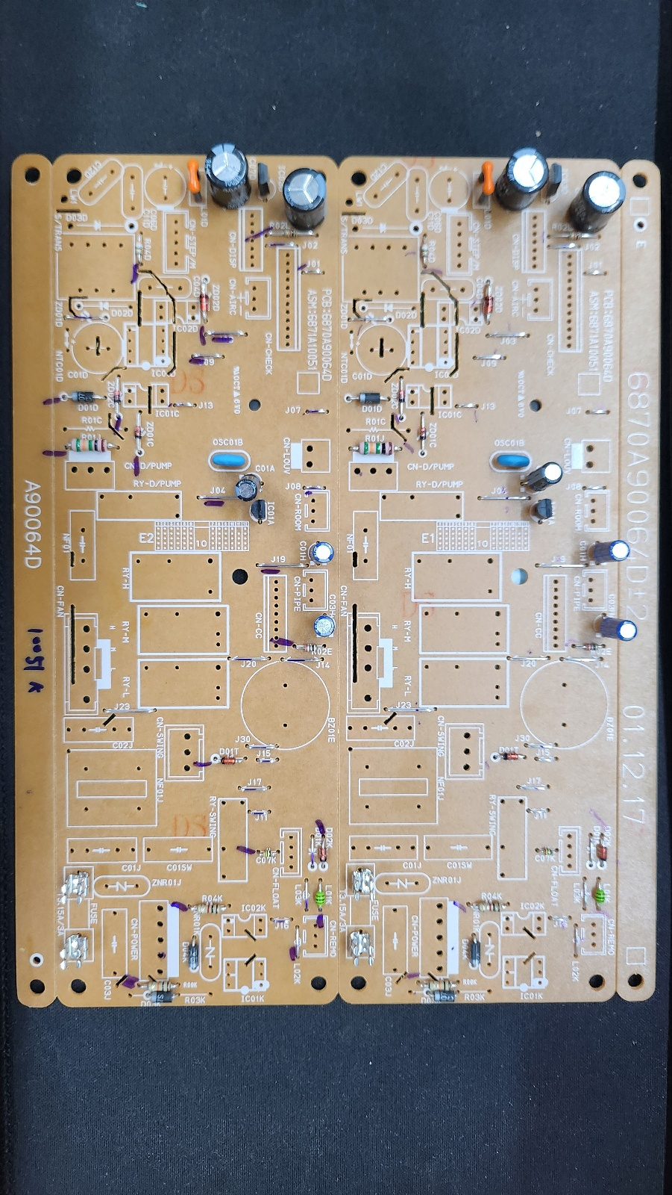
품명 | 카세트
P/NO | 6871A10051K_R
제정일 | 24.08.29
작성자 | 유병수
공정 | RADIAL
4
8
9
3
2
6
7
1
5
10
11
SHL_220uF_50V
SHL_1uF_50V
SHL_1uF_50V
KIA78L05B
KIA7036
SHL_330uF_35V
SHL_3.3uF_50V
HONEYCOMB
CSTLS_4M
FUSE
FUSE
라인 별 공정 확인 표 (กระบวนการเส้น)
Radial | 총점수(คะแนน) | 11점 |  |  |  | 옵션: เนื้อหาคำเตือน:

