Slide 1

Arduino 101
@prakashwagle89
@siddhartha_b

Slide 2
Setup
Arduino IDE for Mac OSX, Linux & Windows!
FTDI Drivers for MAC OSX, Linux, Windows!

Slide 3
Github
https://github.com/iot-pune/Arduino-101

Slide 4
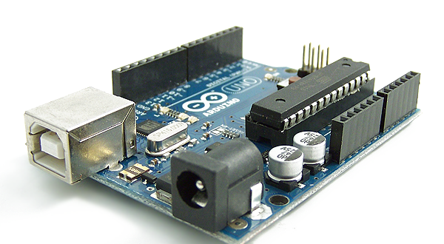
What is an Arduino?

Slide 5
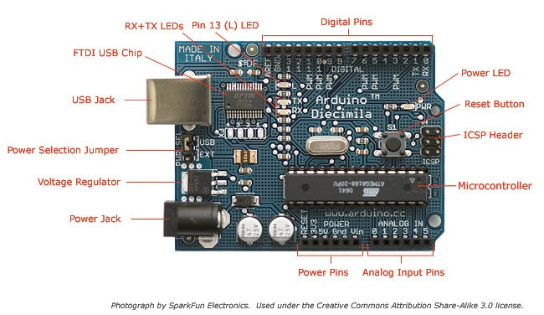
The Board

Slide 6
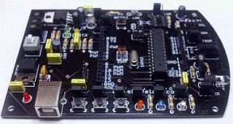
Why is my board so ugly?

Slide 7
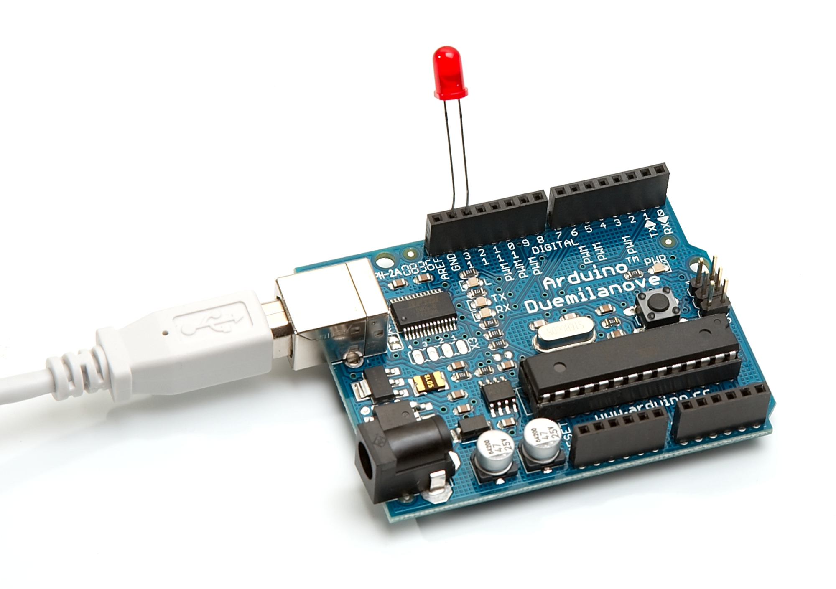
What can it do?

Slide 8
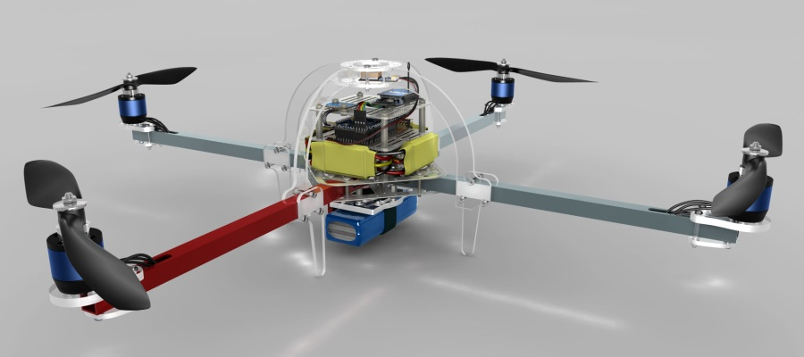
What else can it do?

Slide 9
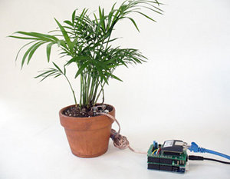
And what else can it do!?

Slide 10
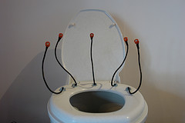
WTH!!!

Slide 11


Slide 12

Hands on I Hardware Hello World!
Programming with Arduino
IDE
LED Blink

Slide 13
PIN Mappings
1. RGB Tri-colour LED
Red : Pin 5 (PWM)
Green : Pin 6 (PWM)
Blue : Pin 3 (PWM)
2. Tactile switches
Switch 1 : Pin 7
Switch 2 : Pin 8
Switch 3 : Pin 9

Slide 14
PIN Mappings
3. LEDs (Colours of the LEDs may vary depending upon the version you have)
LED 1 (red) : Pin 11 (PWM)
LED 2 (blue) : Pin 12
LED 3 (white) : Pin 13
4. IR LED : Pin 14 (Analog 0)
5. TSOP : Pin 15 (Analog 1)
6. LDR : Pin 17 (Analog 3)
7. DS1307 (RTC)
SDA : Pin 18 (Analog 4)
SCL : Pin 19 (Analog 5)

Slide 15
Tech Specs
FTDI vs Atmel Chip
Sensors
8bit MicroController 32KB
Power
ATmega328
Digital / Analog Pins
16MHz Clock Speed

Slide 16
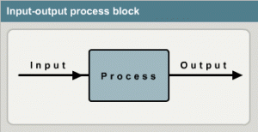
Sensing the Environment

Slide 17
Hands on II
LDR Based Light Switch

Slide 18
Hands On III
LCD Interfacing

Slide 19
Hands on IV
TIC – TAC – TOE!

Slide 20
Hands on V
IR AC Bulb

Slide 21


Slide 22


Slide 23
IOT Pune
Google Groups – internet-of-things-pune
Meetup.com –
http://www.meetup.com/The-Internet-of-Things

Slide 24
Thank You!
Revealing Hour Creations
Nishant Modak
Prateek Chaudhari
Prashant Tiwari
Anuj Deshpande
Sharmaji

