Slide 1

Arduino 101
@prakashwagle89
@siddhartha_b

Slide 2
Setup
Arduino IDE for Mac OSX, Linux & Windows!
FTDI Drivers for MAC OSX, Linux, Windows!

Slide 3
Github
https://github.com/iot-pune/Arduino-101

Slide 4
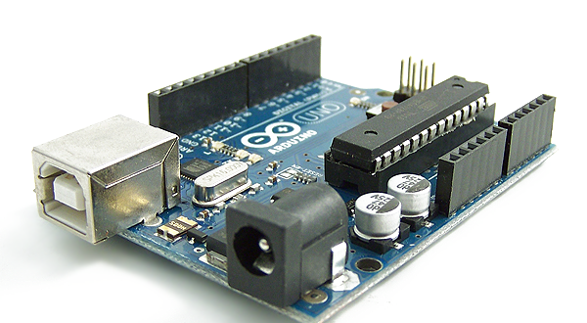
What is an Arduino?

Slide 5
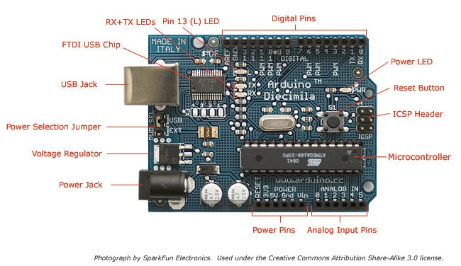
The Board

Slide 6
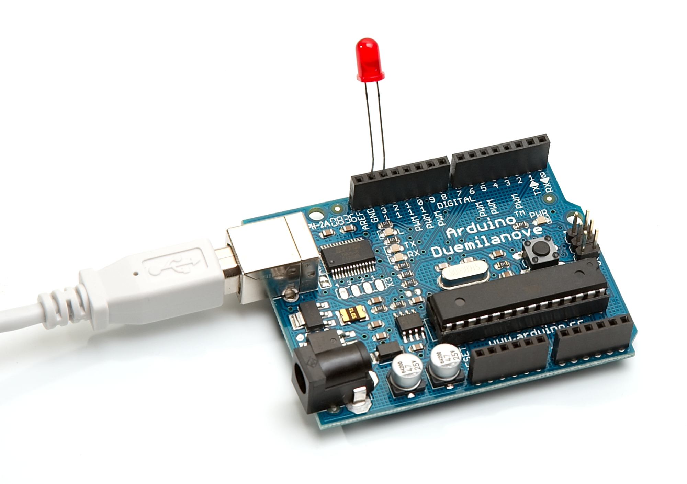
What can it do?

Slide 7
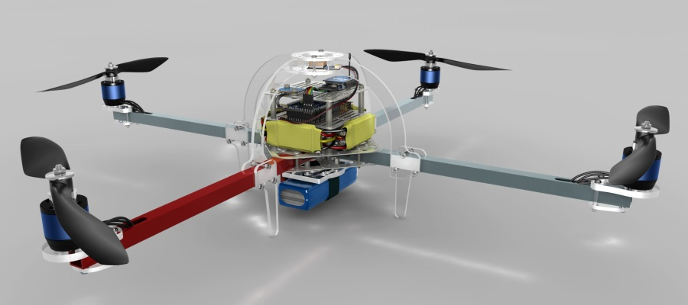
What else can it do?

Slide 8
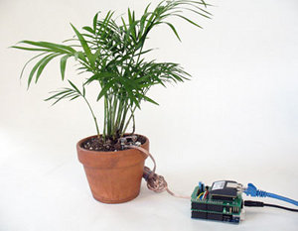
And what else can it do!?

Slide 9
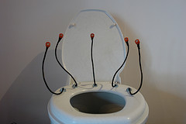
WTH!!!

Slide 10
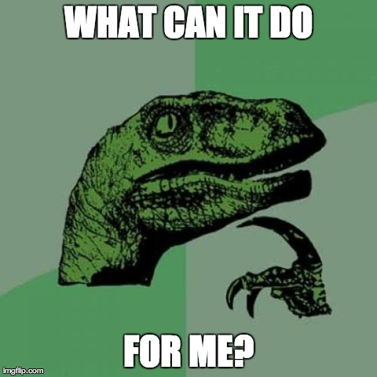

Slide 11

Hands on I Hardware Hello World!
Programming with Arduino
IDE
LED Blink

Slide 12
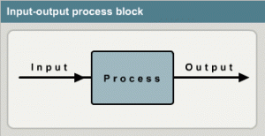
Sensing the Environment

Slide 13
Hands on II
LDR Based Light Switch

Slide 14
Hands On III
LCD Interfacing

Slide 15
Hands on IV
TIC – TAC – TOE!

Slide 16
Hands on V
IR AC Bulb

Slide 17
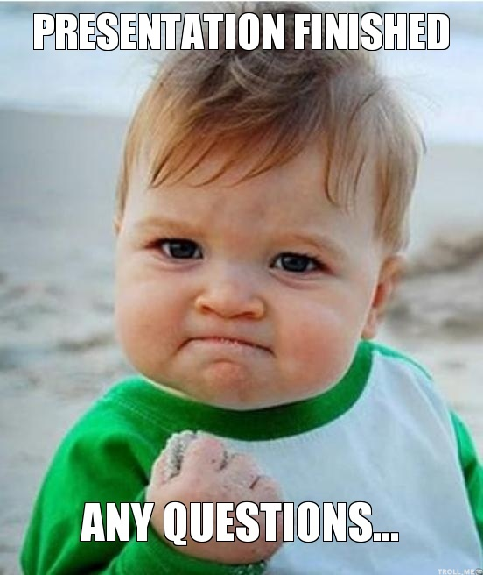

Slide 18


Slide 19
IOT Pune
Google Groups – internet-of-things-pune
Meetup.com –
http://www.meetup.com/The-Internet-of-Things

Slide 20
Thank You!
Revealing Hour Creations
Nishant Modak
Prateek Chaudhari
Prashant Tiwari
Anuj Deshpande
Sharmaji

