Slide 1

Arduino 101

Slide 2

Prakash Wagle @prakashwagle89
Siddharth Bhagwan @siddhartha_b

Slide 3
Setup
Arduino IDE for Mac OSX, Linux & Windows!
FTDI Drivers for MAC OSX, Linux, Windows!

Slide 4
Github
https://github.com/iot-pune/Arduino-101

Slide 5
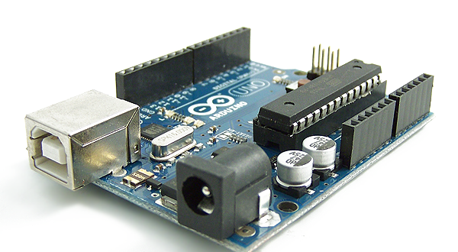
What is an Arduino?

Slide 6
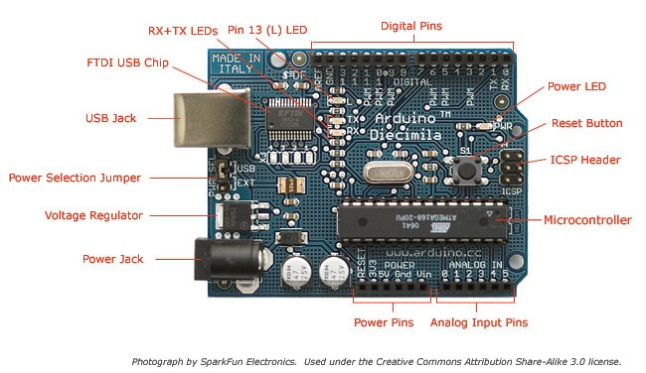
The Board

Slide 7
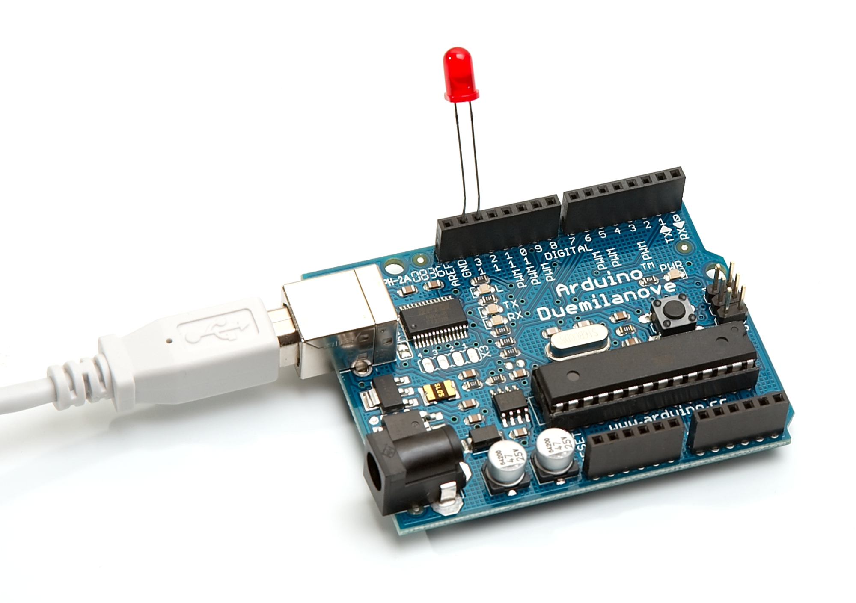
What can it do?

Slide 8
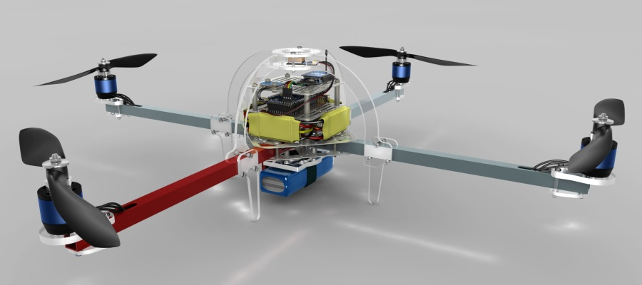
What else can it do?

Slide 9
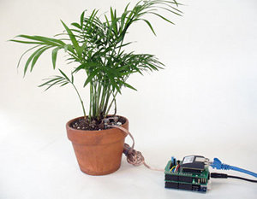
And what else can it do!?

Slide 10
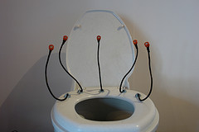
WTH!!!

Slide 11
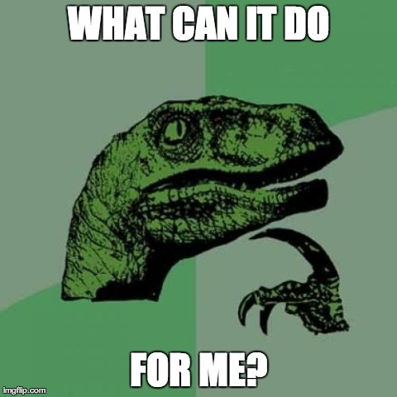

Slide 12
Hands on I Hardware Hello World!
Programming with Arduino
IDE
LED Blink

Slide 13
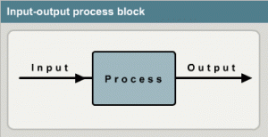
Sensing the Environment

Slide 14
Hands on II
LDR Based Light Switch

Slide 15
Hands On III
LCD Interfacing

Slide 16
Hands on IV
TIC – TAC – TOE!

Slide 17
Hands on V
IR AC Bulb

Slide 18
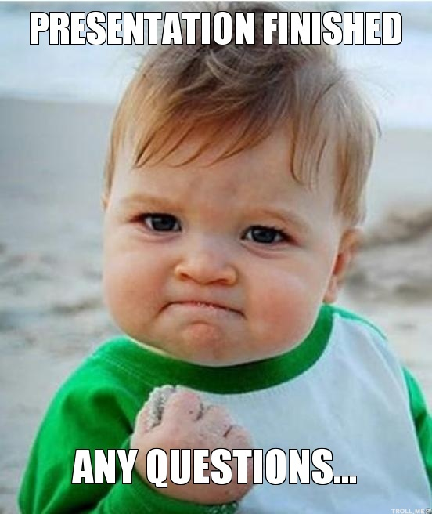

Slide 19


Slide 20
IOT Pune
Google Groups – internet-of-things-pune
Meetup.com –
http://www.meetup.com/The-Internet-of-Things

Slide 21
Thank You!
Revealing Hour Creations
Nishant Modak
Prateek Chaudhari
Prashant Tiwari
Anuj Deshpande
Sharmaji

