Slide 1
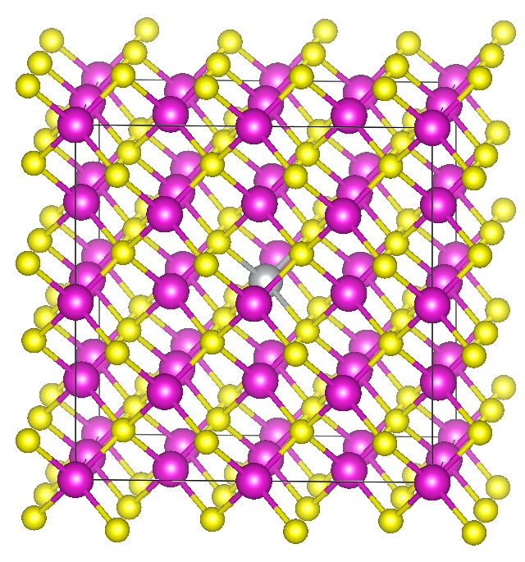
DopeDefects: Predicting impurity energy levels of semiconductors using machine learning
Motivation:
Chemical space of possible solar cell materials is large
DFT calculations used to find properties of materials
DFT is expensive
Use models to predict properties instead
Problem:
Descriptors: position of atoms (64), unit cell defect (22), elemental (23)
Predict: Supercell enthalpies of formation (3), energies of transition levels (6)
Method:
Feature selection
Random forests, neural networks, Gaussian process
Ryan Beck, Lauren Koulias, Linnette Teo
Sponsor: Argonne National Lab

