Slide 1


Lesen durch Schreiben – A Computational Investigation
Notes:
Who am I, my background, Ox, CompNSC
Interdisciplinarry project at intersection of Didactics, CogSci, Neuroscience and AI
Idea: Simulate writing and reading skill acquisition of children of the 2 most popular methods used in German primary schools
First ever simulation (comp model) of LdS, controversially discussed, lots of media attraction
My idea, spoke to 2 professors of didactics/teaching research in Cologne, who are supporting the project
Just going through, discuss on the fly, interrupt whenever sth unclear

Slide 2
What is Lesen durch Schreiben?
An alternative method to classical, primer-based learning of writing and reading in primary school [Reichen 1988]
Slogan: Children learn better with less instruction
Very popular among teachers despite lack of supporting evidence
Controversially discussed
Notes:
LdS: Heavily discussed in German media. Some parties/districts think about an official prohibition to use this method.

Slide 3
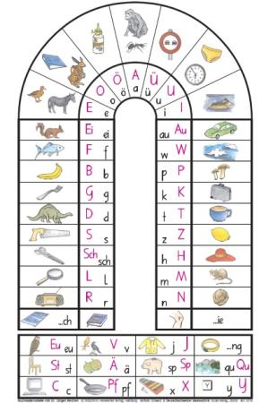
Anlauttabelle
=
“Phonetic scheme”
Notes:
Children write based on this phonetic scheme and then use their own writings in order to learn reading
Explain procedure (letter corresponds to first sound of word depicted image, e.g. dinosaur is dinosaurier. E.g. write dog, go through list for every phoneme)
Do not correct all writings that make sense from a phonetic perspective (doc for dog is ok). Children write orthografic rubbish for 2 years! Year 3-4: classical correcting (one version per word)
Then, you learn reading, partially from your uncorrected own writings and partially from correct sources (books etc)
Why the heck??
- Children can write complicated sentences fairly quickly (no bothering with correctness)
Assumed (by reichen) to evoke less frustration (self-controlled speed of learning, enhances creativity, makes more fun, better learning, soft and shallow arguments)
Applied a lot in schools, since convenient for teachers (hands-off, can praise, less need to correct)

Slide 4
Empircal evidence of LdS
Very ambiguous [Funke 2014]
Reading: LdS children perform worse after year 1, but no significant impairments anymore after year 2-4
Writing: LdS children perform slightly better after year 1, but minimally worse after year 2-4
Conclusion: No evidence that LdS induces permanently better or worse performances in reading and writing tests
Critics to Funke’s paper:
Very different studies → comparability
Many important questions not adressed
Notes:
There is comparably little evidence and it is ambiguous and so, having better and more evidence of this method may be crucial for the debate.
Ambiguoous: Funke meta-analyzed a dozen studies comparing writing and reading abiliites of children after each of the 4 years of primary school. Partly D, partly CH betwen 1990 and 2010.
Performance in other subjects was not tested (compensated worse skills by learning with parents → neglect of other subjects), maybe less frustration in year 1+2, but more in 3+4 -> more problematic social behavior ??
Across academia/scientists fairly consensus that this method is based on wrong assumptions and cannot work. But evidence is not that clear due to mentioned problems -> discrepancy between expectations of scientists and real evidence due to difficultiy of obtaining clean data
How to solve? 2 possibilities

Slide 5
Empiric studies vs comp. model
Empirical studies about LdS are:
time-consuming
ressource-consuming
Biased by confounding variables (uncontrolled environment)
Use computational model instead
Controlled setup allows to better quantify efficiency of LdS method
Questions
Which aspects of LdS can we model?
How does the model look like?
Which research questions can be answered by modelling these aspects?
Notes:
Disadvantages of empiricla studies
All this are not there in models. Efficiency: Empiric: Difficult to say how much of the performance in the test is actually explained by the method itself (children learn reading&writing not only in school but also with their parents, when watching videos etc.). In simulation: 100% of performance is explained by usage of method.
All models are wrong but some are useful so we will definitely make assumptions and disregard things
Let‘s look at Q1 + Q2 first

Slide 6
Which aspect of LdS can be modelled and how?
Both, learning to write (1) and learning to read (2) with LdS as well as with the primer can be modelled by NLP techniques
Writing is Phoneme-To-Grapheme-Conversion (P2G)
Reading is Grapheme-To-Phoneme-Conversion (G2P)
Model instances only differ in teaching signal (single-label vs multi-label)
Notes:
To compare LdS + primer technique, we need 2 model instances for the writing model and 2 for the reading model.
Writing model: LdS method assumes children can already speak. Write dog -> can speak dog -> having access to phonetic representation -> find mapping from P to G
Similarily reading: Children can access the graphemic representation, look at all components and then speak it out. -> Find mapping from G to P
Ultimately, what‘s amazing is that the most crucial difference between LdS and primer is way in which teaching signal is provided: Primer based learning is classical supervised learning (unique spelling thus one label) while LdS allows multiple spellings thus multiple labels

Slide 7
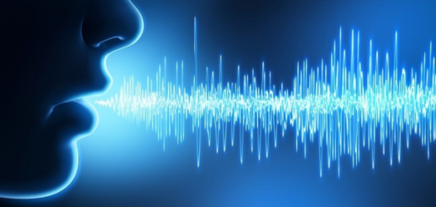
What we cannot model
Motoric skills required to produce readable letters
Frustration tolerance – relation of learner to language
Primer based learning boosts lexical access to language whereas LdS boosts phonetical access to language
…

Slide 8
Is it, from a statistical perspective, advantageous for a learning system to use the LdS method (Anlauttabelle) instead of classical methods (primer) in order to obtain writing and reading abilities?
Research Question:
Notes:
Does not attempt to model which method is better
Learning system can be a kid or the model.
Saying statistical because frustration etc are not incorporated. Is it statistically useful to first learn roughly how to write a word and later learn the unique spelling?
Is it goog to first solve the problem roughly and then precisely?
Trying to add a very new argument to the heated-up debate about the LdS method. Trying to objectify the learning process in order to add an argument from a modelling rather than empirical perspective which has never been done before.
How can we actually do this?

Slide 9
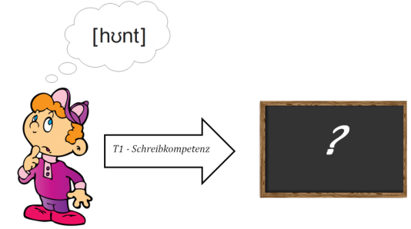
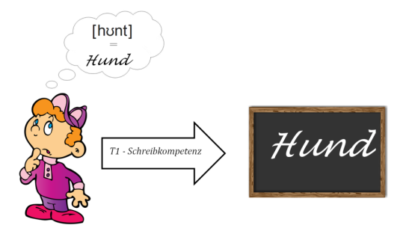
Part 1 – Writing – Intuition
Before
training
After
training
Notes:
- Was muss passieren, damit ein Kind ein Wort korrekt schreibt?

Slide 10
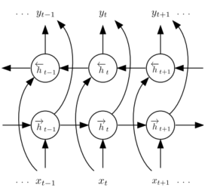

Part 1 – Writing – Implementation
Task: Convert a given sequence of phonemes into a sequence of graphemes (P2G)
Assumption: Kid can speak the word properly
Model: bidirectional LSTM [Graves 2005, 2013] $→$ context sensitive to past & future
2 instances of model: Primer (accepts only correct spelling) vs. LdS (accepts all phonetically valid writings)
To write „dog“, doc and dug would be corrected to dog by primer instance, whereas LdS instance would only correct dug but accept doc
Phonemes
Graphemes
Notes:
bLSTM, originally used to convert audio sequences into phonetic labels (framewise phoneme class). Used a lot for G2P (what I called reading).
P2G and G2P are essentially alignment problems and so we can use bLSTM for P2G („writing“) as well by simply swapping the labels
B-LSTM nice since no one-to-one correspondence between phonemes and graphemes. LSTM has memory/backward context thus considering previous phonemes for grapheme output. But Future phonemes matter as well, thus combine forward and backward context to yield b-LSTMs.
Reasonable intuitively since if a kid wants to learn writing it can speak out the word loudly, listen to all individual components before it writes (this is indeed exactly what happens with LdS)
Model instance primer is traditional supervised learning whereas instance LdS uses multiple labels.

Slide 11
Part 1 – Writing – Properties & Evaluation
b-LSTM starts from scratch like child does
Train 2 units of time (school year 1-2) with individual methods (primer vs LdS), then both model instances with primer method for 2 units of time (school year 3-4)
Evaluate both model instances on same writing test
Which model learned a more accurate P2G mapping?
Further simulations depending on the results
If e.g. primer instance outperforms LdS instance: How much more primer-training is needed for LdS instance to catch up to primer instance?
Notes:
von scratch, also wie Kind das nicht schreiben kann.
Writing test allows only 1 correct writing, like the tests done at end of school year.
Better to first solve the problem roughly and later learn precise mapping (lds) or do precisely from beginning (primer)?
Train LdS instance for 2 more time units with primer method, so both had 4 units of training from the metric used for testing
Asymptotic behavior? Low level representations destroyed?
Special instance of retraining in NN, usually difficult

Slide 12
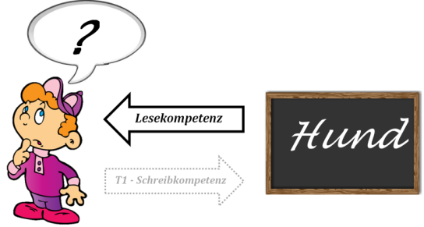
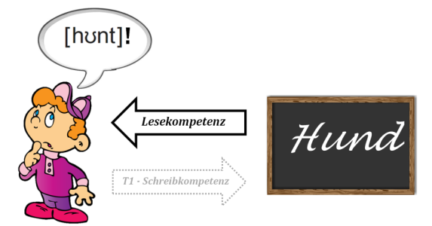
Part 2 – Writing & Reading – Intuition
Before
training
After
training
Notes:
Extension of part 1. Only attempted if part 1 works. Key is that reading is learned based on self-produced, potentially incorrect writings
Before training: No chance to convert sequence of latters to phonemes, after learning possible

Slide 13
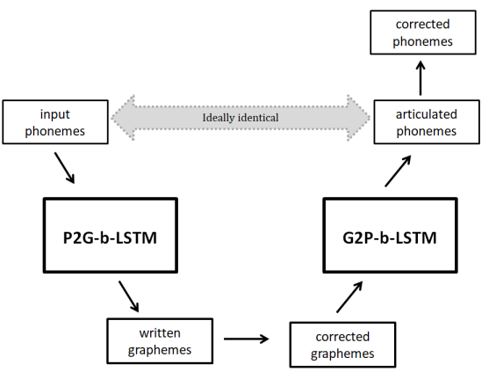
Part 2 – Writing & Reading - Implementation
Task: Convert a given sequence of phonemes into a sequence of graphemes (see part 1), then convert the potentially corrected grapheme sequence into phonetic sequence
First P2G, then G2P → auto-encoding bidirectional LSTM
Phonetic feedback (7) is identical in both model instances, (only correct pronunciation is accepted) while orthographic feedback (4) is differrent (see part 1)
(7)
(4)
Notes:
Don‘t train reading isolated from writing but use as input for reading module the output of the writing module (i.e. learn reading from the own writings)
Just extend part 1 by a backwards step (G2P model), ideally output is identical to input -> similar to auto-encoding b-LSTM
Left side is writing: Child speaks out word a couple of times, then writes it down, gets potentially corrected. Some point later in time (since 2 separate modules) it returns and reads the own writings and speaks it out

Slide 14
Part 2 – Writing & Reading – Properties & Evaluation
Extension of writing model (part 1) by reading component: Both model instances (LdS and primer) consist of writing and reading module
Training identical to part 1: 2 time units (school year 1-2) individual training (primer or LdS), then 2 time units primer training (school year 3-4)
Evalute both model instances on same writing & reading test
Which model learnt the better P2G (writing) and G2P (reading)?
How do the types of mistakes the model make differ?
Notes:
Wenn wir an den Punkt gelangen, können wir zumindest die Forschungsfrage beantworten. Inwieweit uns das etwas über LdS bei Kindern sagt ist naturlich diskutierbar

Slide 15
Cooperation
Very interdisciplinary project
No background in Didactics/teaching research
Experience with DL (CNN mainly), little experience with NLP (POS-Tagging) but no with LSTM
Chance to do pioneering work about LdS
Notes:
Coxi/neuroscience but no experience with didactics/teaching research → cologne
Have used DL (mainly CNNs) beforehand, also little NLP experience (POS tagging with HMM) but not used LSTMs before. Know it‘s too much for 6 weeks, but the time does not matter for me, I‘m interested in starting this project from scratch and bringing it to an end. Great to have you to supervise my progress, so I can ask questions regarding the modelling part.
Nobody has tested LdS method with self-learning modells, so we can do that pioneering work and look at it from very new perspective

Slide 16
Thanks! ☺

Slide 17
Sources
[1] Reichen, Jürgen, and Regina Reichen. Lesen durch schreiben. sabe AG, Verlagsinstitut für Lehrmittel, 1988.
[2] Funke, Reinold. "Erstunterricht nach der Methode Lesen durch Schreiben und Ergebnisse schriftsprachlichen Lernens–eine metaanalytische Bestandsaufnahme." Didaktik Deutsch 19.36 (2014): 20-41.
[3] Graves, Alex, and Jürgen Schmidhuber. "Framewise phoneme classification with bidirectional LSTM and other neural network architectures." Neural Networks 18.5-6 (2005).
[4] Graves, Alex, Navdeep Jaitly, and Abdel-rahman Mohamed. "Hybrid speech recognition with deep bidirectional LSTM." Automatic Speech Recognition and Understanding (ASRU), 2013 IEEE Workshop on. IEEE, 2013.
Notes:
German corpus with phonemic + graphemic
gpu

Slide 18
ToDo - List
Get access to a German corpus with phonetic and graphemic representations
Ideally words that are word pool of primary school children
For every word of dataset, generate set of writings accepted by LdS
Implement b-LSTM and auto-encoding b-LSTM in Tensorflow
Implement model instance primer (classic, single-label)
Implement model instance LdS (how to allow multiple labels?)
Test writing abilities
Simulate (train+test)
Evaluate results, further simulate, try to make more realistic
Test reading abilities in combined writing-reading-model
Simulate (train+test)
Evaluate results, further simulate, try to make more realistic
Report results

