Slide 1
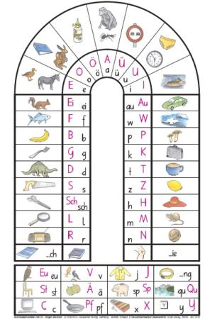
What is Lesen durch Schreiben?
An alternative method to classical, primer-based learning of writing and reading in primary school [Reichen 1988]
All phonetically reasonable spellings of a word are treated as correct
E.g. spelling “through” as ”thru” is accepted.
Idea: Create 2 models, one for classical one for LdS learning regime
Each model consists of 2 modules, one for writing and one for reading

Slide 2
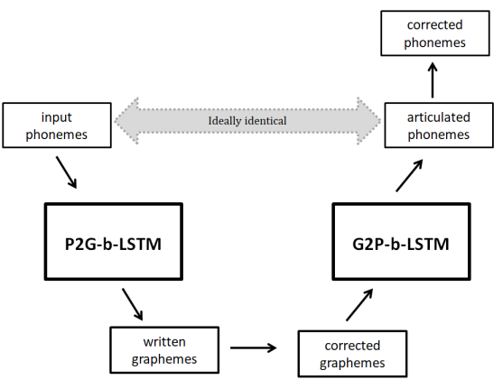
Model implementation
Reading: Convert a sequence of phonemes into a sequence of graphemes
Writing: Convert the potentially corrected grapheme sequence into phonetic sequence
First P2G, then G2P → auto-encoding bidirectional LSTM
(7)
(4)
Notes:
Don‘t train reading isolated from writing but use as input for reading module the output of the writing module (i.e. learn reading from the own writings)
Just extend part 1 by a backwards step (G2P model), ideally output is identical to input -> similar to auto-encoding b-LSTM
Left side is writing: Child speaks out word a couple of times, then writes it down, gets potentially corrected. Some point later in time (since 2 separate modules) it returns and reads the own writings and speaks it out

Slide 3
Is it, from a statistical perspective, advantageous for a learning system to use the LdS method (Anlauttabelle) instead of classical methods (primer) in order to obtain writing and reading abilities?
Research Question:
Notes:
Does not attempt to model which method is better
Learning system can be a kid or the model.
Saying statistical because frustration etc are not incorporated. Is it statistically useful to first learn roughly how to write a word and later learn the unique spelling?
Is it goog to first solve the problem roughly and then precisely?
Trying to add a very new argument to the heated-up debate about the LdS method. Trying to objectify the learning process in order to add an argument from a modelling rather than empirical perspective which has never been done before.
How can we actually do this?

Slide 4
Loss Function
2 models only differed in their loss function (tensorflow sequence loss)
Regular model: Built-in tensorflow sequence loss was computed
LdS model: Targets were adjusted, logits were kept untouched
Exp (1): Logits are „THRU“ instead of THROUGH
THROUGH was taken out of the label matrix and replaced by through
Next, sequence loss was computed as regularly
Exp (2): Logits are “THRW“ instead of THROUGH
No change is made (THROUGH remains in label matrix)
LdS model minimizes a suboptimal loss function
Notes:
2 models only differed in their loss function
Sequence loss = weighted cross entropy for a sequence of logits
Tedious implementation in tf:
Deep in core
No loops since graph structure does not allow, took a long time
Only rarely suboptimal, still similar to original loss

Slide 5
Dataset
CELEX dataset used as scaffold [2]
35.000 German words + their phonology (SAMPA)
Standard dataset, but unrepresentative of word lexicon of pupils
Childlex – A German corpus with words from children‘s books
Extracted 10.000 lemmata via online tool (6-8 years old)
More representative, but purely semantical
Retrieved phonological data from CELEX dataset (word by word)
Ca. 7500 (word, SAMPA) pairs remained
Next: Create alternative spellings for every word
Converted words from SAMPA to IPA
Generated alternative writings
Ca. 4000 (word, SAMPA, alt_spelling) tuples remained
E.g. [hund, hUnt, [hunt, huntt, hundt, hunth, hunnd, …]]
Notes:
Celex exists for many languages, including English, Dutch

Slide 6
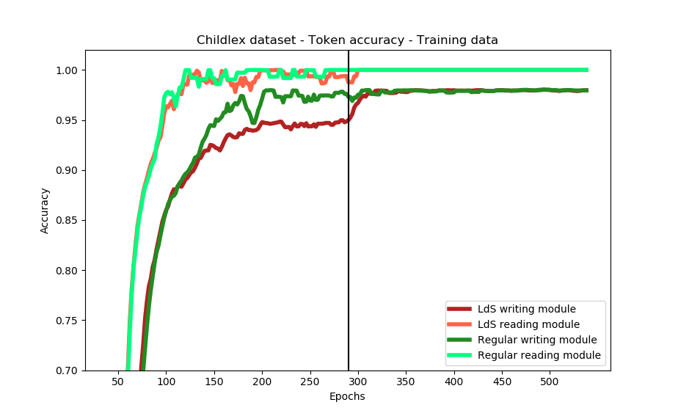
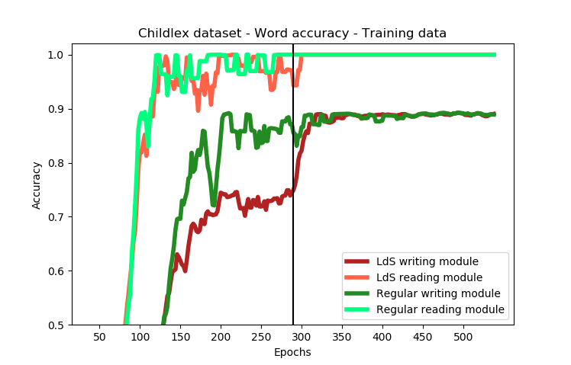
Results Training data
Notes:
- > Mainly looked at training data performance since kids have troubles writing words they should know
# Reading can be solved perfectly - better than reading - task too easy
# Even during LdS regime, Reading is as good as in regular
# Writing is wirse but catches up after changing regime very quickly

Slide 7
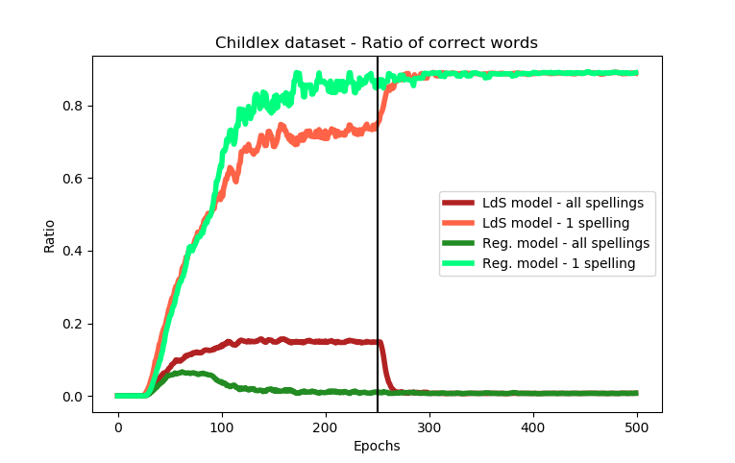
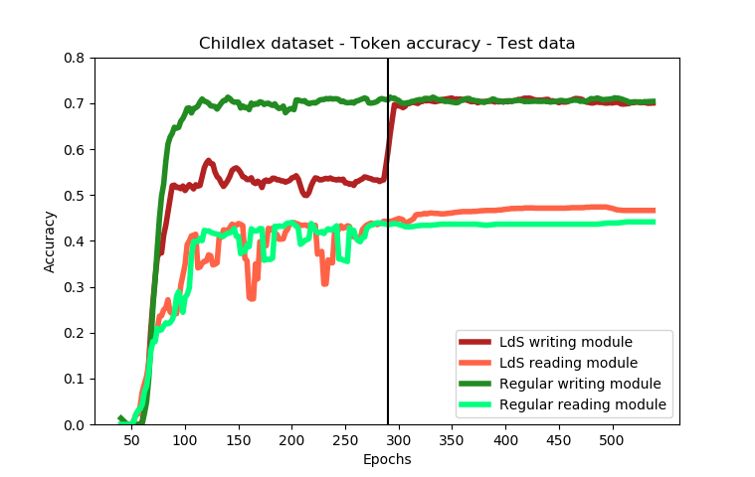
Notes:
Ratio of correct words:
- LdS model learns not to avoid spellings that are accepted (ratio goes up to 0.2)
- When regime changes, it quickly adapts
- Even regular model does same mistakes initially, but then the objective function pulls it away from subideal writings
Test results:
- Writing works better than reading, inverse from training data
- LdS reading module outperforms regular reading (very slight tendency)

Slide 8
Embedding vectors
Regular agent
LdS agent

Slide 9
Next steps
Redo some of the simulations
Revise dataset creation to make task harder
Prevent overfitting (dropout and other params)
Investigate other optimizer
Investigate stereotypical errors of both models
Write things up

Slide 10
Sources
[1] Reichen, Jürgen, and Regina Reichen. Lesen durch schreiben. sabe AG, Verlagsinstitut für Lehrmittel, 1988.
[2] Baayen, R H., R Piepenbrock, and L Gulikers. CELEX2 LDC96L14. Web Download. Philadelphia: Linguistic Data Consortium, 1995.
[3] Schroeder, Sascha, et al. "childLex: A lexical database of German read by children." Behavior research methods 47.4 (2015): 1085-1094.
Notes:
All results prelim, need to run crossval. And check stability of tendencies

Slide 11
ToDo - List
Get access to a German corpus with phonetic and graphemic representations
Ideally words that are word pool of primary school children
For every word of dataset, generate set of writings accepted by LdS
Implement b-LSTM and auto-encoding b-LSTM in Tensorflow
Implement model instance primer (classic, single-label)
Implement model instance LdS (how to allow multiple labels?)
Test writing abilities
Simulate (train+test)
Evaluate results, further simulate, try to make more realistic
Test reading abilities in combined writing-reading-model
Simulate (train+test)
Evaluate results, further simulate, try to make more realistic
Report results

