Slide 1
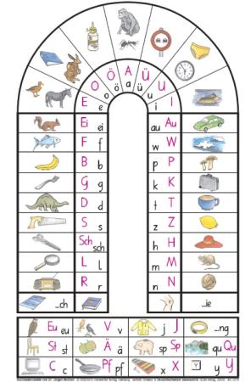
What is Lesen durch Schreiben?
An alternative method to classical, primer-based learning of writing and reading in primary school [Reichen 1988]
All phonetically reasonable spellings of a word are treated as correct
E.g. spelling “through” as ”thru” is accepted.
Idea: Create 2 models, one for classical one for LdS learning regime
Each model consists of 2 modules, one for writing and one for reading

Slide 2
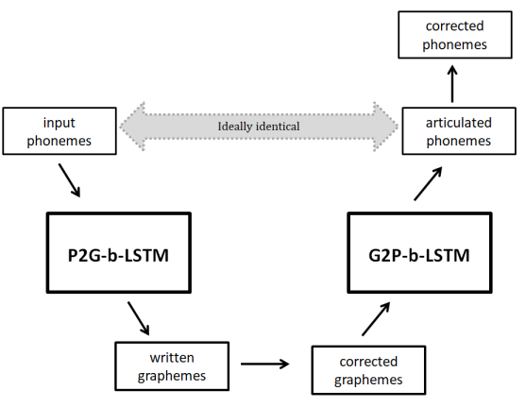
Model implementation
Reading: Convert a sequence of phonemes into a sequence of graphemes
Writing: Convert the potentially corrected grapheme sequence into phonetic sequence
First P2G, then G2P → auto-encoding bidirectional LSTM
(7)
(4)
Notes:
Don‘t train reading isolated from writing but use as input for reading module the output of the writing module (i.e. learn reading from the own writings)
Just extend part 1 by a backwards step (G2P model), ideally output is identical to input -> similar to auto-encoding b-LSTM
Left side is writing: Child speaks out word a couple of times, then writes it down, gets potentially corrected. Some point later in time (since 2 separate modules) it returns and reads the own writings and speaks it out

Slide 3
Recent steps
Redo some of the simulations
Revise dataset creation to make task harder
Tried to prevent overfitting (dropout and other params)
Investigate stereotypical errors of both models
Write things up

Slide 4
Datasets
Datasets thus far:
CELEX dataset used as scaffold [2]
35.000 German words + their phonology (SAMPA)
Childlex – A German corpus with words from children‘s books [3]
Extracted 10.000 lemmata via online tool (6-8 years old)
Retrieved phonological data from CELEX dataset and generated alternative writings e.g.: [hund, hUnt, [hunt, huntt, hundt, hunnd, …]]
Now:
Resimulated Childlex dataset with adjusted parameters
Used entire CELEX dataset (400.000 words)
Used espeak to generate phonetic representations
Restricted to 100 alternative writings (cutting off)
Notes:
Celex exists for many languages, including English, Dutch

Slide 5
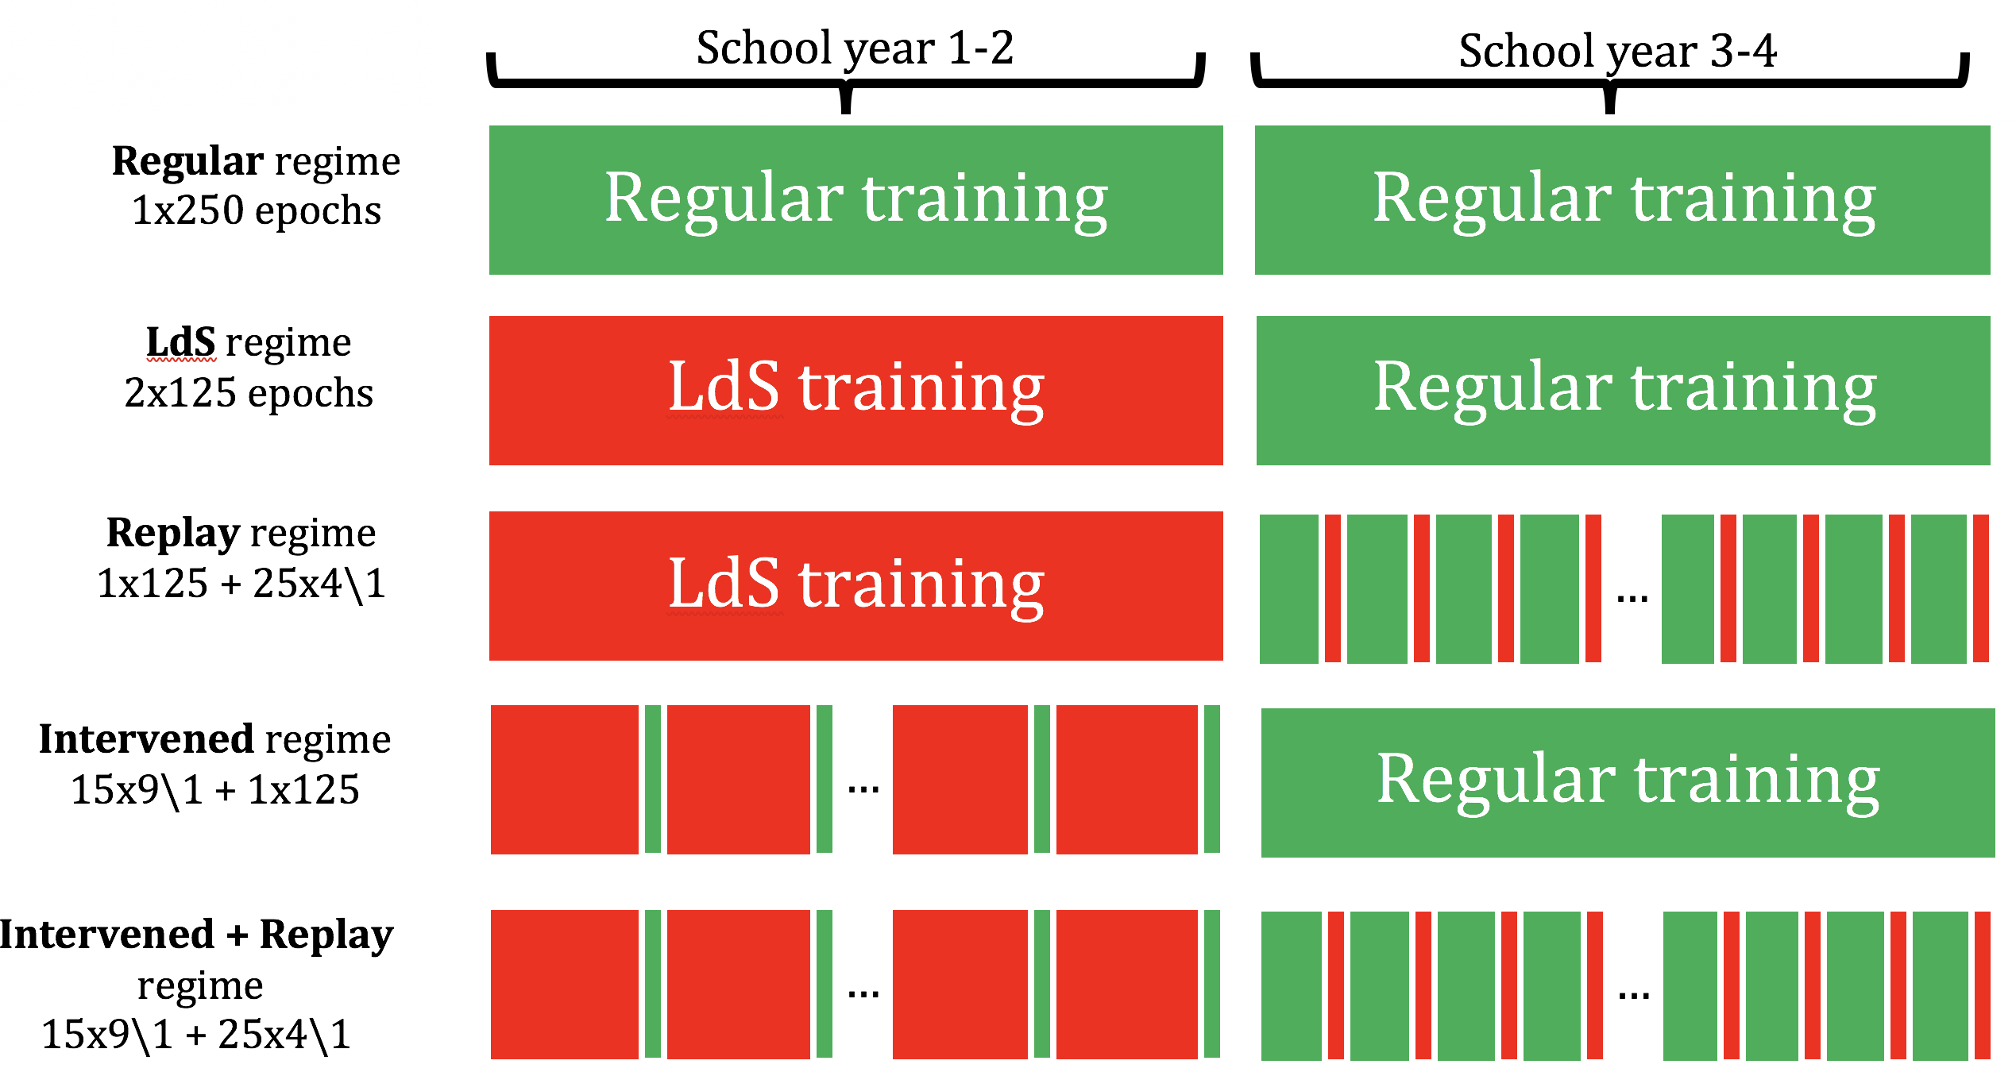
Training Regimes

Slide 6
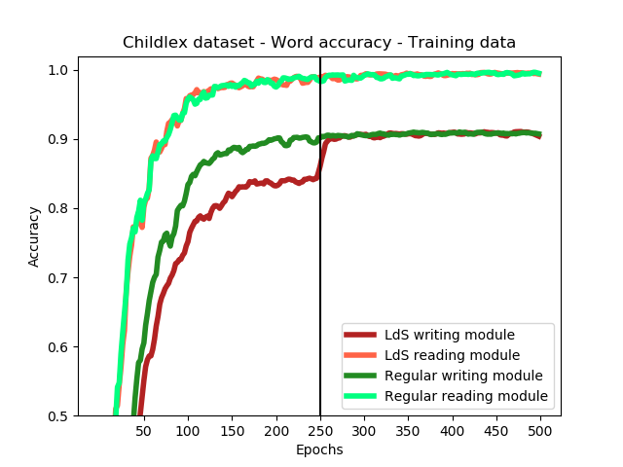
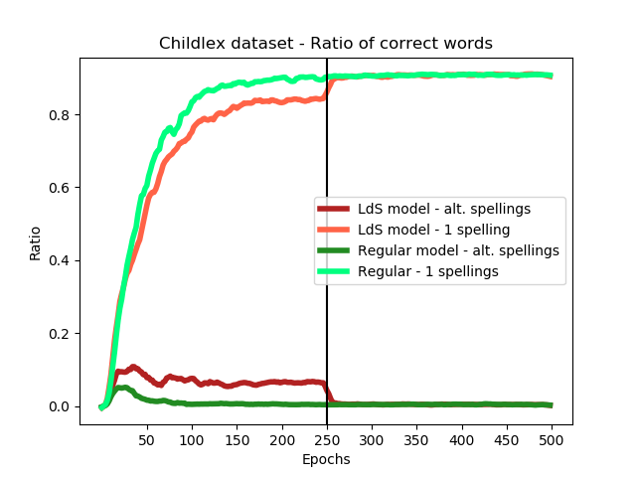
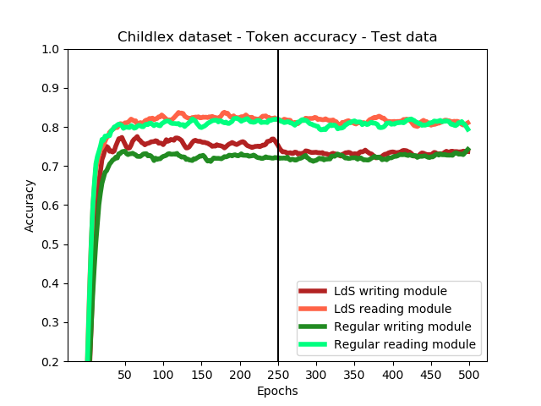
Notes:
# Reading can be solved perfectly - better than reading - task too easy
# Even during LdS regime, Reading is as good as in regular
# Writing is wirse but catches up after changing regime very quickly
Proof of concept that indeed biased loss function is learned (validation study)
WORD RATIOS
- LdS model learns not to avoid spellings that are accepted (ratio goes up to 0.1)
- When regime changes, it quickly adapts
Even regular model does same mistakes initially, but then the objective function pulls it away from subideal writings
TEST: Indicates that dataset is too small for generalization. Interesting that LdS model is better, do not really understand.

Slide 7
Expanded dataset
Entire CELEX dataset
400.000 words (but no labels)
Used espeak to generate phonetic representations
Restricted to 100 alternative writings (cutting off)
Resimulated Childlex dataset with adjusted parameters
Notes:
Celex exists for many languages, including English, Dutch

Slide 8
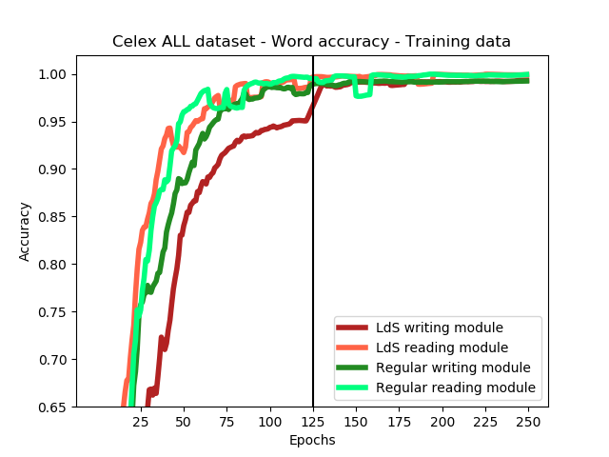
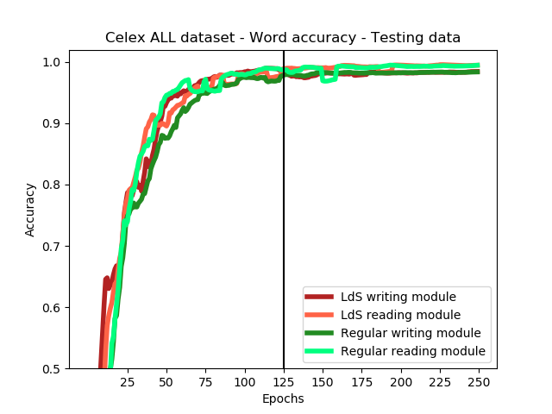
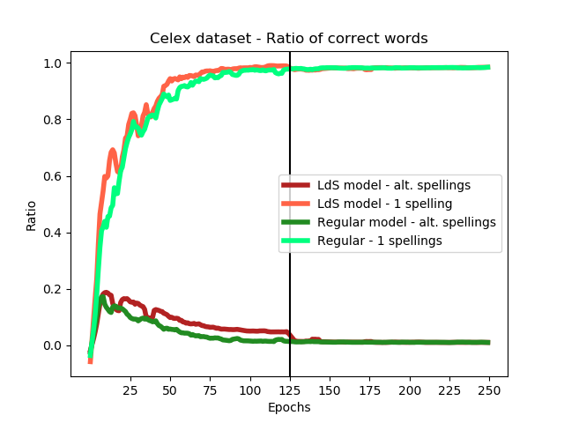
CELEX
Notes:
- LEFT: Writing train data: Same tendency like in childlex, LdS performs initially worse but catches up when regime changes.
RIGHT: Testing data: Reading and writing are equally difficult and the training regime does not matter.
PROBLEM: Used espeak to generate the labels?

Slide 9
Stereotypical mistakes
Writing:
30%: vowel type:
25% for a vs. e e.g. helfe vs hälfe
15% consonant type
8%: d vs t vs dt e.g. Winder vs Winter
10%: Homophones e.g. das vs dass
10%: consonant doubling e.g. rennen vs renen

Slide 10
Stereotypical mistakes
Writing:
30%: vowel type:
25% for a vs. e e.g. helfe vs hälfe
15% consonant type
8%: d vs t vs dt e.g. Winder vs Winter
10%: Homophones e.g. das vs dass
10%: consonant doubling e.g. rennen vs renen
Reading:
30%: intonation mistakes
20%: Missing ending consonant
15%: Vowel type
15%: Phoneme insertion

Slide 11
Embeddings - PCA
Notes:
Still todo: Comparing stererotypical msitakes of both agents (not possible atm, since model saved at wrong timestep, rerunning atm)

Slide 12
Sources
[1] Reichen, Jürgen, and Regina Reichen. Lesen durch schreiben. sabe AG, Verlagsinstitut für Lehrmittel, 1988.
[2] Baayen, R H., R Piepenbrock, and L Gulikers. CELEX2 LDC96L14. Web Download. Philadelphia: Linguistic Data Consortium, 1995.
[3] Schroeder, Sascha, et al. "childLex: A lexical database of German read by children." Behavior research methods 47.4 (2015): 1085-1094.

Slide 13
Loss Function
2 models only differed in their loss function (tensorflow sequence loss)
Regular model: Built-in tensorflow sequence loss was computed
LdS model: Targets were adjusted, logits were kept untouched
Exp (1): Logits are „THRU“ instead of THROUGH
THROUGH was taken out of the label matrix and replaced by through
Next, sequence loss was computed as regularly
Exp (2): Logits are “THRW“ instead of THROUGH
No change is made (THROUGH remains in label matrix)
LdS model minimizes a suboptimal loss function
Notes:
2 models only differed in their loss function
Sequence loss = weighted cross entropy for a sequence of logits
Tedious implementation in tf:
Deep in core
No loops since graph structure does not allow, took a long time
Only rarely suboptimal, still similar to original loss

Slide 14
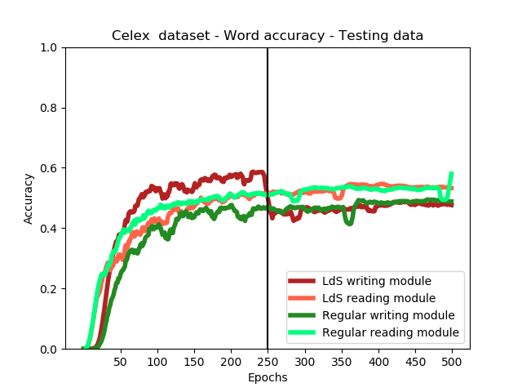
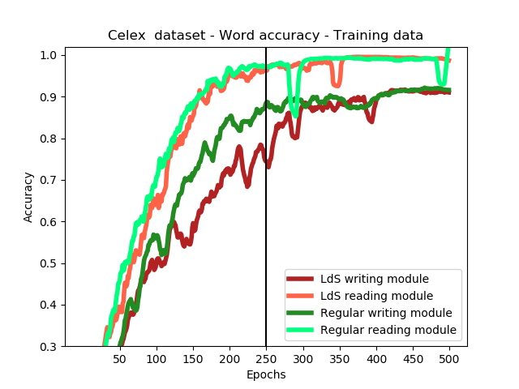
CELEX (40.000 samples)
Notes:
CELEX dataset (40000 samples): Even with dropout, not really good testing error

