Slide 1
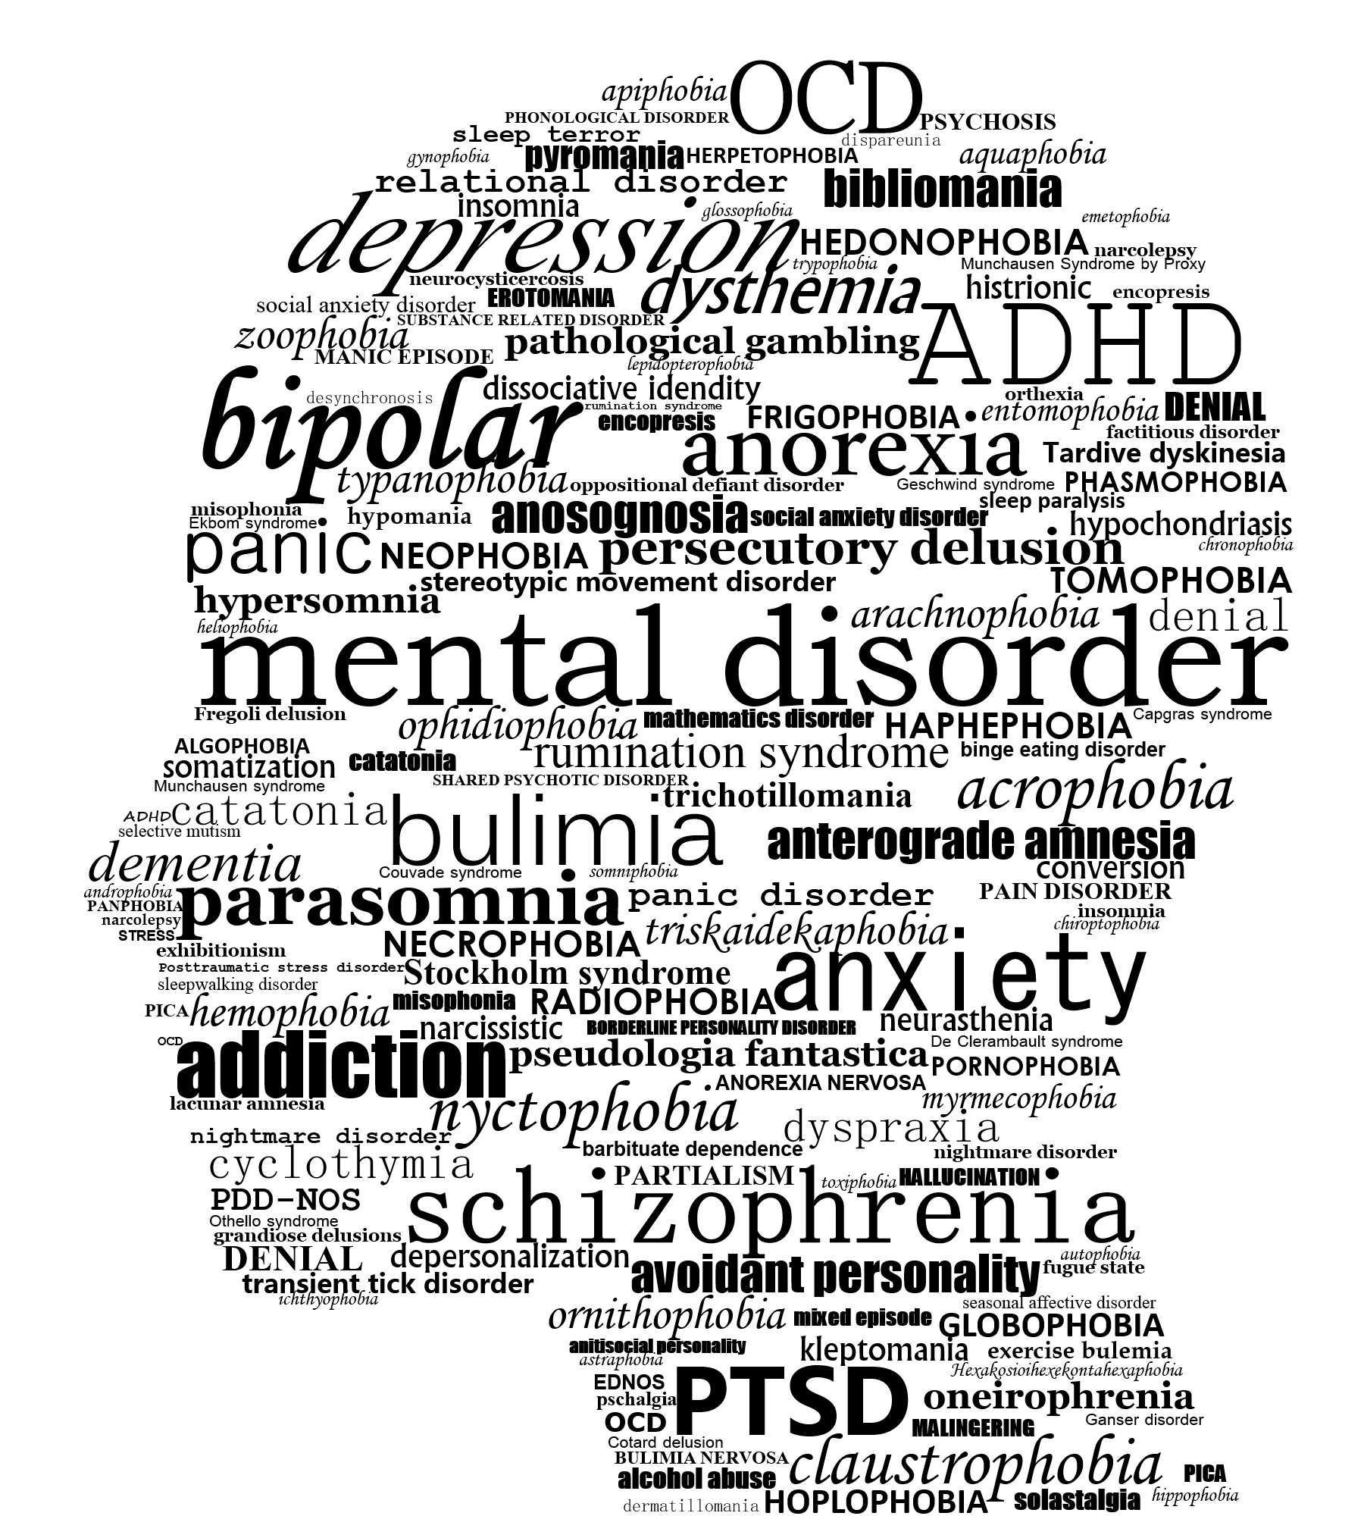
For many psychiatric symptoms, there is a mild form of the same pattern of behavior that serves adaptive purposes in healthy people.
Paget Michael Creelman

Slide 2


Slide 3


Slide 4
Do computational quantities have physiological correlates?
To what degree do aversive vs. neutral stimuli bias behavior?
… could this degree potentially be used as diagnostic tool in computational psychiatry?

Slide 5
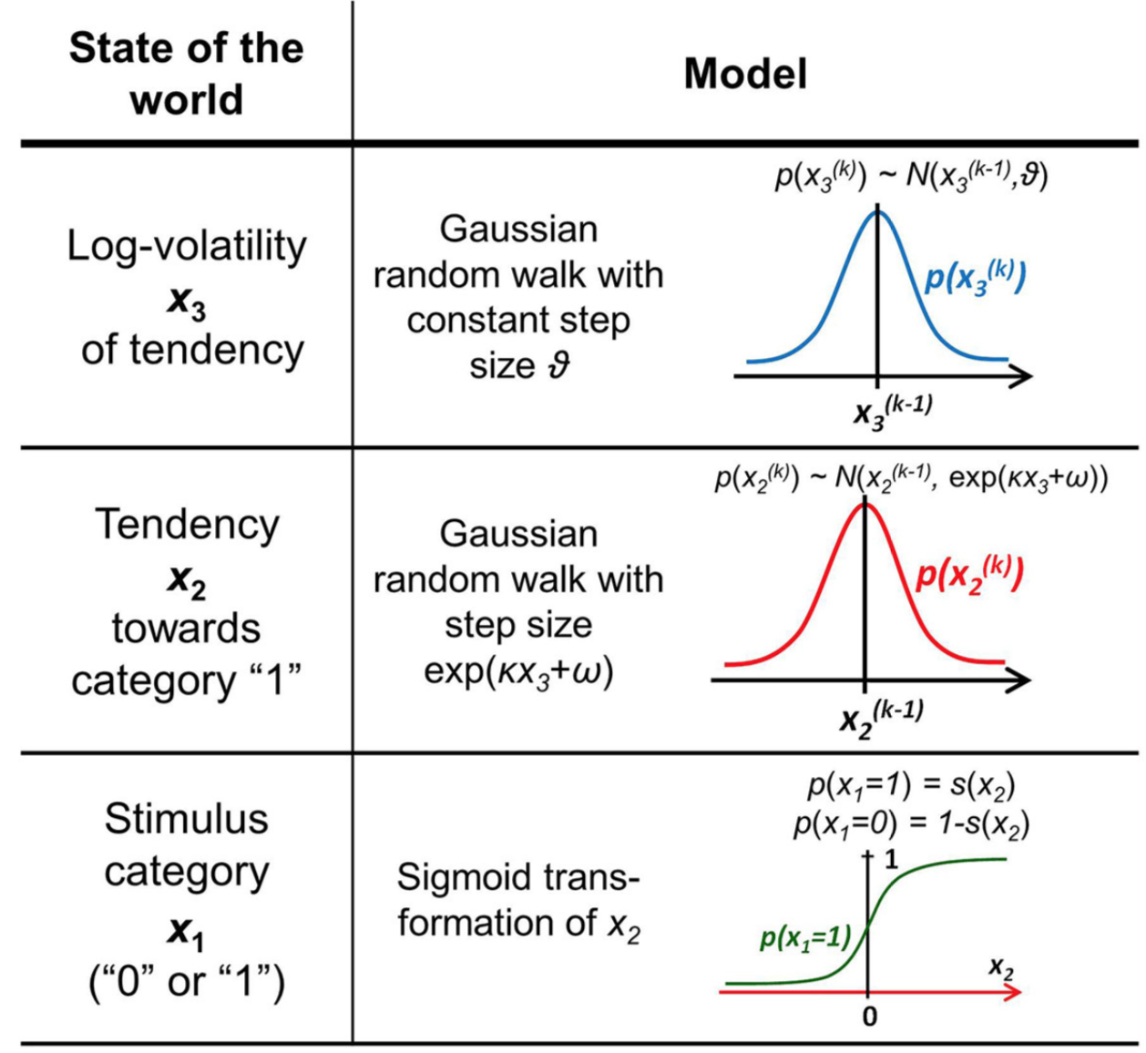
The HGF – A generative model of behavior
STIMULUS CATEGORY and TENDENCY to be read in cue-stimulus-contingency terms:
1 is defined as square → tone or circle → no tone
0 is defined as square → no tone or circle → tone
To what degree do aversive vs. neutral stimuli bias behavior?
Fit HGFs for both neutral and aversive blocks for all subjects and compare parameters.

Slide 6
References
By Paget Michael Creelman - Own work, CC BY-SA 4.0, https://commons.wikimedia.org/w/index.php?curid=67346556

