Slide 1
The Slot Finder
Put the right squad on every project, see overload before it happens, and re-plan in one click.
app.slotfinder.duckdns.org
Notes:
Open: one sentence. We built a tool that plans squads, forecasts overload and re-plans when things move. 2-3 minutes, four hero features.

Slide 2
Squad planning breaks the moment anything moves
THE PROBLEM
1
2
3
Blind spots
Slow matching
Fragile plans
Who is overloaded or idle next month? Nobody knows until it hurts.
A project arrives and someone hunts for people with the right skill and level.
A project slips or someone takes leave, and the plan is redone by hand.
Notes:
Three pains: no early warning, slow matching, plans that rot. The next four slides show how the app answers each.

Slide 3
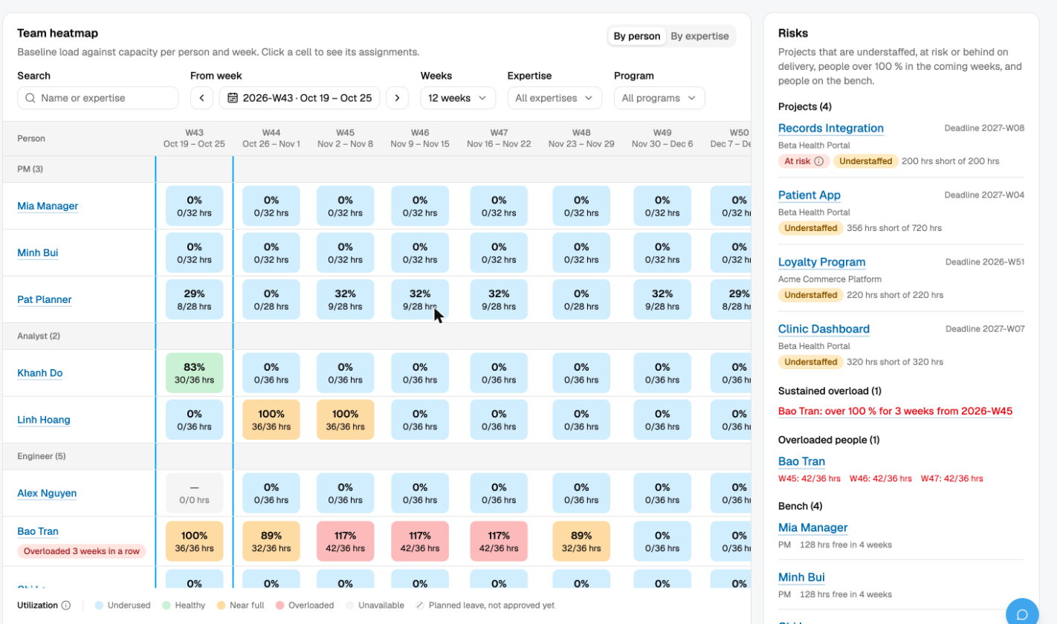
One heatmap: load against capacity, per week
HERO 1 · SEE IT
Every person, every week, coloured by utilization
Risks panel: understaffed projects and sustained overload
Bao Tran: over 100% for 3 weeks from W45, flagged early
Notes:
Planner dashboard. Point at the heatmap, then the Risks panel: Bao Tran is flagged for three weeks of overload before it happens. Metrics are computed on the server.

Slide 4
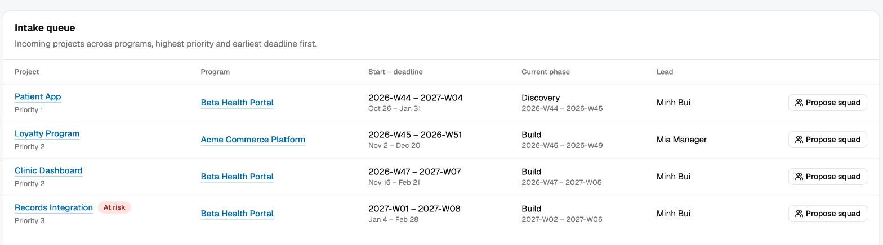
New project in Intake, one click proposes a squad
HERO 2 · FILL IT
Matches skill and level to demand, respects capacity and leave, and never proposes a stretch.
Notes:
Click Propose squad on Loyalty Program. Nothing is real until the planner accepts.

Slide 5
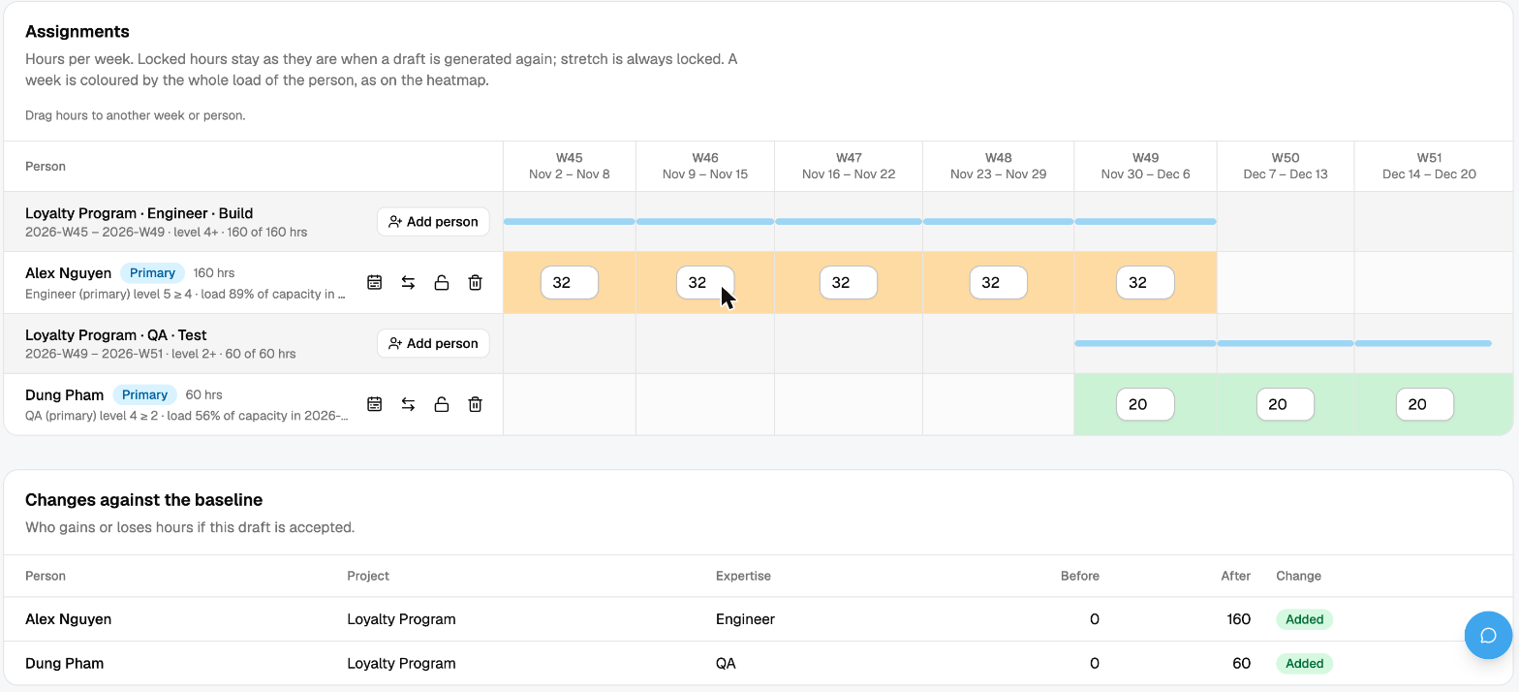
The draft: who works which week, ready to edit
HERO 2 · FILL IT
Alex Nguyen: Engineer, 32 hrs a week for 5 weeks
Dung Pham: QA, 20 hrs a week for 3 weeks
Planner drags hours, locks or removes people, then accepts
Notes:
Engine picked the primary-expertise people. Planner can still drag hours between weeks and people.

Slide 6
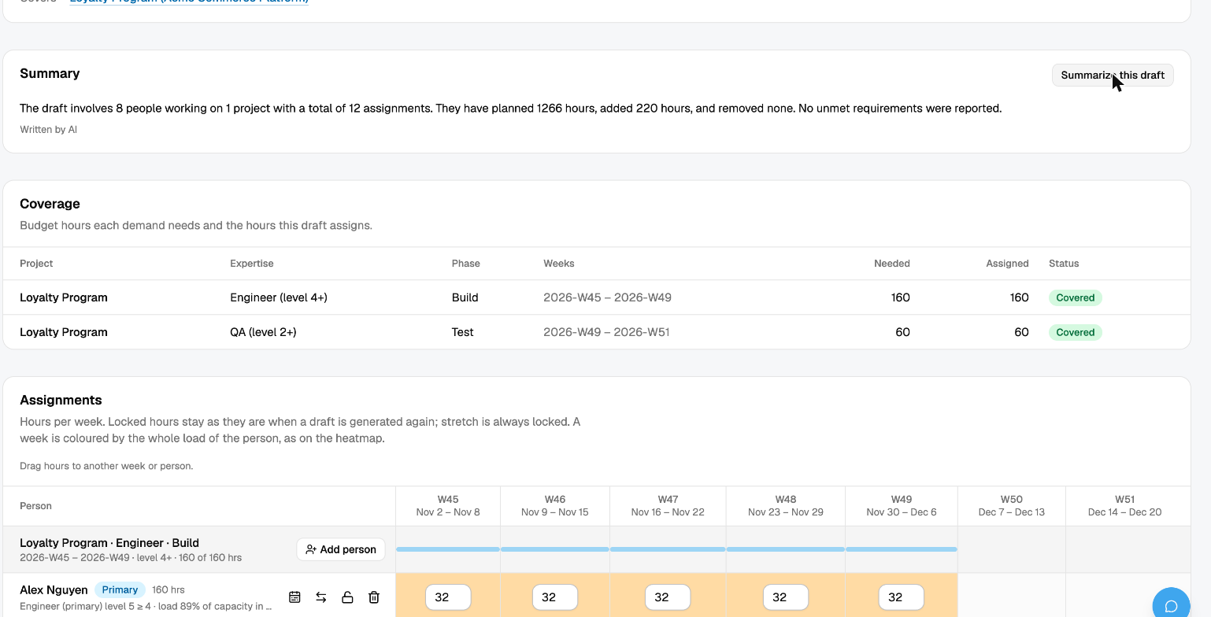
Every draft is explained, nothing changes until accepted
HERO 3 · TRUST IT
Coverage per demand: needed vs assigned
AI summary, customer names masked before it leaves the server
Changes against the baseline before you accept
Notes:
Coverage shows 160/160 Engineer and 60/60 QA hours. The AI summary only sees masked data. Accept creates the new baseline.

Slide 7
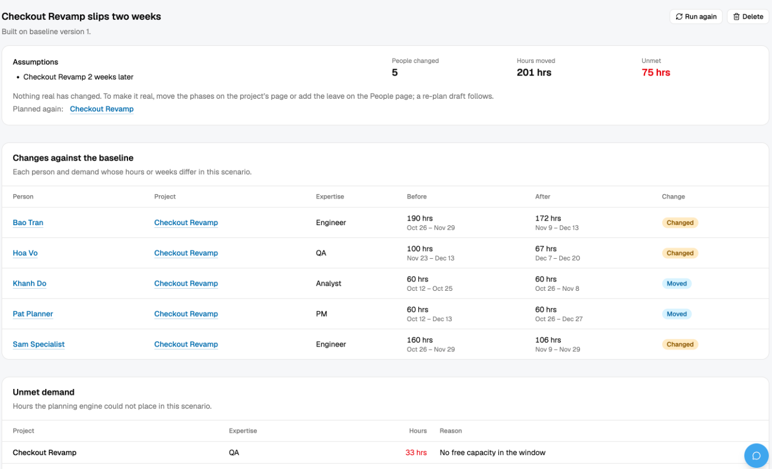
What-if: Checkout Revamp slips two weeks
HERO 4 · TRY IT
5
people affected
201 hrs
move
75 hrs
left unstaffed
Nothing real changes. A real slip or leave triggers the same re-plan automatically.
Notes:
Simulate a slip before it happens. The same engine runs when a real phase slips or leave is approved, and produces a re-plan draft.

Slide 8
Plan once. Re-plan in seconds.
Forecast
Match
Adapt
Heatmap and risks, computed on the server
Planning engine proposes, a human accepts
Leave or slip creates a re-plan draft; what-ifs are free
app.slotfinder.duckdns.org
Notes:
Close: forecast, match, adapt. Offer a live demo or questions.

