Slide 1
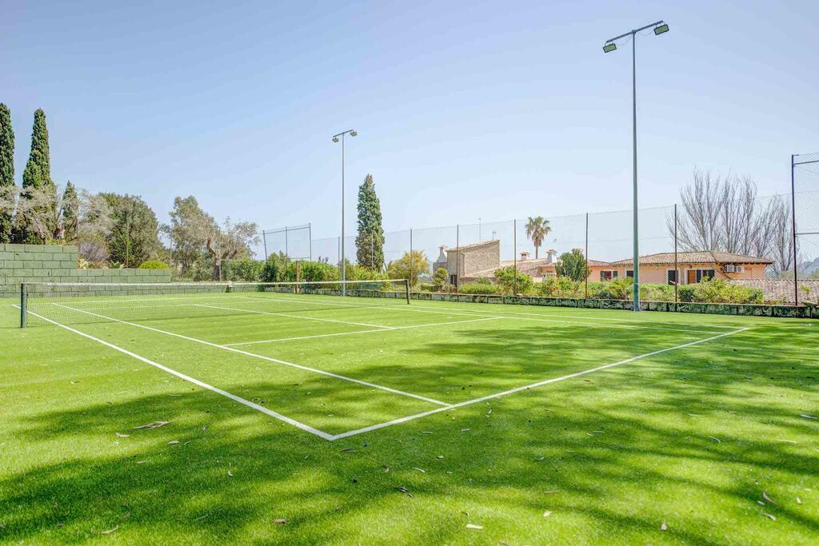
Tennis-NET
Requirements spec

Slide 2
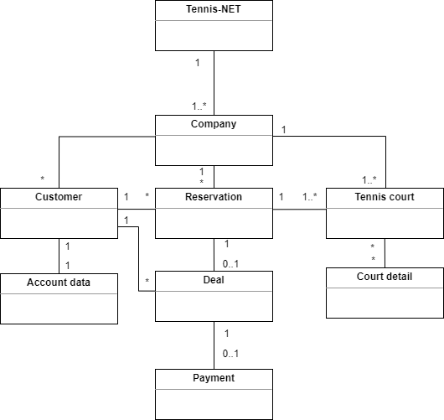
Business concept model of Tennis-NET

Slide 3
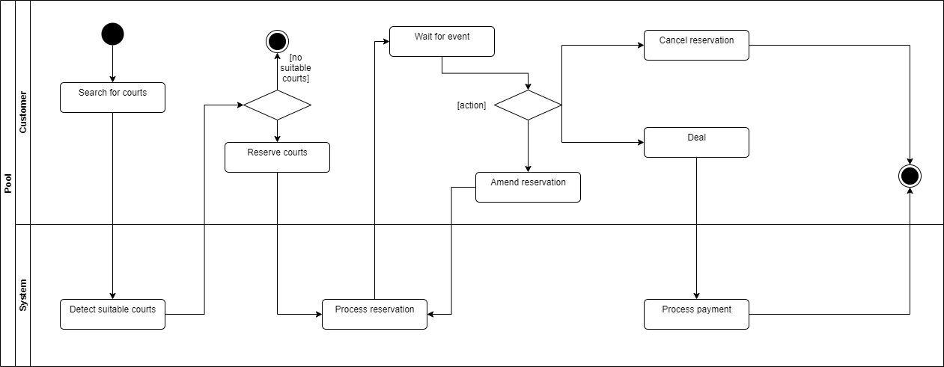
Business process of Tennis-NET

Slide 4
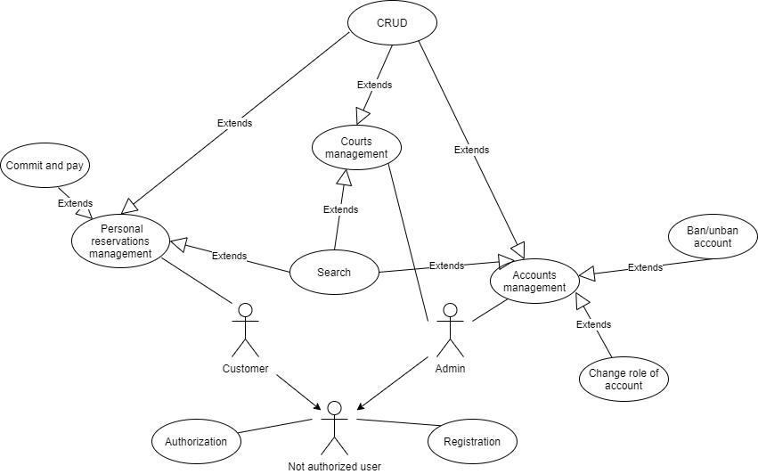
Use case diagram for Tennis-NET

Slide 5
Use case description
Name | CRUD
Initiator | Customer & Admin
Goal | To create, show, update or delete information
Pre-Conditions | An authorized user is on the Tennis-Net platform, the user opened a definite web-page
Main Scenario | Create: user inputs data into html-forms user presses “submit” button user is redirected to the “success” page Read: user presses “show” button all the information being presented in tables is shown to the user Update: user chooses an exact subject in the table by pressing its “modify” button a window with html-form for a new data is opened user fills in html-forms with a new data user presses “modify” button user is redirected to the “success” page Delete: user presses “delete” button in the row of a subject subject gets deleted

Slide 6
Alternative Flow | Create: user inputs data into html-forms user presses “submit” button user is redirected to the “fail” page whenever an error occurred or some creational constraints are met Read: user presses “show” button user gets message “No content” if there is nothing to show Update: user chooses an exact subject in the table by pressing its “modify” button a window with html-form for a new data is opened user fills in html-forms with a new data user presses “modify” button user is redirected to the “fail” page if an error occurred Delete: user presses “delete” button in the row of a subject subject is not deleted due to an error
Business Rules | The System shows appropriate errors when it is needed

Slide 7
Name | Search
Initiator | Customer & Admin
Goal | Find data filtered by some order
Pre-Conditions | An authorized user is on the Tennis-Net platform, on searching web-page
Main Scenario | an authorized user applies searching filters the system shows filtered data
Alternative Flow | an authorized user applies searching filters user gets message “No content” if there is nothing to show
Business Rules | The user can search subjects ordered by different categories dependable on the type of subject

Slide 8
Name | Commit and pay
Initiator | Customer
Goal | To pay for reserved tennis courts
Pre-Conditions | An authorized user is on the Tennis-Net platform, he reserved desirable tennis courts, he is on the page of the reserved courts
Main Scenario | user asks for paying for the courts user is offered payments methods user chooses payment method user makes a payment user is redirected to the “successful payment” page user is sent the bill to the via email
Alternative Flow | user asks for paying for the courts user is offered payments methods user chooses payment method user makes a payment user is redirected to the “unsuccessful payment” page due to internal server error

Slide 9
Name | Register
Initiator | Unauthorized user
Goal | To register on the Tennis-Net platform to be able to reserve courts online
Pre-Conditions | An unauthorized user is on the Tennis-Net platform, on the registration page
Main Scenario | user fills out the form, providing necessary information user submits the form system checks the correctness of the entered data system registers the user system notifies the user of successful registration and redirects him to the log in page
Alternative Flow | The user didn’t fill in the required fields or filled in incorrectly. 1. The system notifies the user about failed submitting. 2. return to step 1. The System failed to register the User The System notifies the User about unsuccessful attempt Return to step 1
Business Rules | The required fields are specially marked. When it’s necessary to fill in the field in a special format, the user is notified about it.

Slide 10
Name | Authorization
Initiator | Unauthorized user
Goal | To log in to the Tennis-Net platform to be able to reserve courts online
Pre-Conditions | The user is on the Tennis-Net platform, on the log in page. The user has already registered on the platform
Main Scenario | system provides the User with the log’s in form user fills out the form system checks the correctness of the entered data system logs in the User to his account
Alternative Flow | The user didn’t fill in the required fields or filled in incorrectly. 1. The system notifies the user about failed submitting. 2. return to step 1. The System didn’t find account with such data The System shows error message Return to step 1
Business Rules | The system shows appropriate errors, that provide the user with information about what kind of mistake he made

