Slide 1
Stock Prediction
Multivariate Time Series Forecasting
with LSTM
Jesse King, Ryan Little, James Park, Keshia Vereda

Slide 2
Overview
The team used Machine Learning (ML) to predict stock market information.
The model selected looked at stock data quarterly and daily data to help forecast opening prices to help make the buying process easier.
Compared stocks from different sectors to see the impact of other influential factors (ex. COVID, politics) had an impact on the accuracy of the model.
Libraries used:
Python Pandas
Python MatPlotLib
Python NumPy
Sci-Kit Learn
Keras
TensorFlow
HTML / CSS / BootStrap
Web Scraping (Finnhub, Yahoo, and Financial Model Prep)
Notes:
jesse

Slide 3
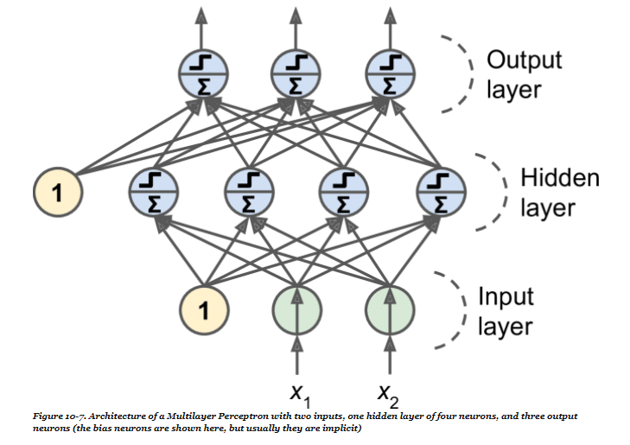
LSTM vs Traditional Models
Traditional machine learning models use input features like samples and examples to learn which lacks a time dimension feature
Time-series forecasting models predict future values with values that are constantly changing
LSTM was chosen because of its layering format (each mini-batch is passed and is sent to the next layer the “forward pass” but the results are preserved incase a “backward pass is needed.” )
Notes:
jesse

Slide 4
Data pre-processing
Data pulled from Financial Modeling Prep, Yahoo and Finhub
Used Quarterly and Daily and found that Quarterly was harder to use for prediction purposes
Best: Financial Modeling Prep
Data must be in float format in order to be processed into a matrix
One feature vs Multiple features:
Forecasting improves with additional features
Features : Open, High, Low, Close, Volume, RSI, market price, volatility index
Standard scaler was used for each type of variables
Independent (High, Low, Close, Volume, RSI, market price, volatility index)
Dependent (open prices)
Notes:
james

Slide 5
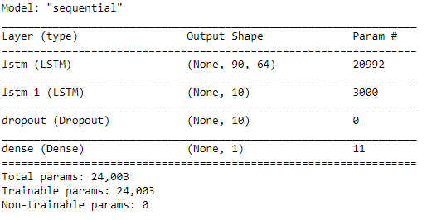
Training a Multivariate LSTM -
Hyperparameters used:
2 LSTM layers
1 Dropout layer at 25% (regularization technique to prevent overfitting )
Dense (1 output)
Optimizer used: Adam
Mix of AdaGrad + RMSprop
Used to calculate individual learning rates for each parameter
Our Model:
Notes:
keshia

Slide 6
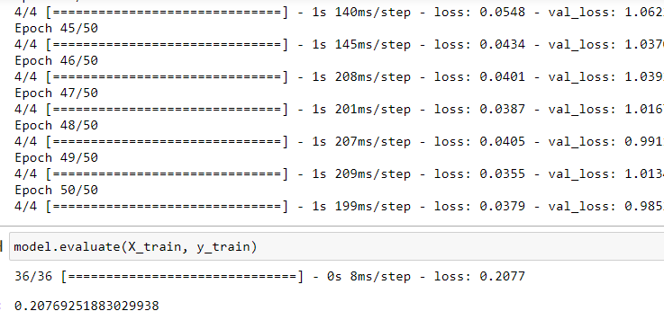
Testing and Validating
Validation Split : 20% of our data before shuffling for validation
Validation Error is computed at the end of each epoch
Training Error is computed during each epoch
Training loss and validation loss decrease with each pass
Notes:
keshia

Slide 7
Forecasting:
Demo site:
https://mrryanlittle.github.io

Slide 8
References:
DataSeries. Data-Preprocessing with Python. Ajay, Muktha Sai. Sep. 29, 2020. https://medium.com/dataseries/data-preprocessing-with-python-3914d3e9dd30
Financial Modeling Prep. https://financialmodelingprep.com/developer
Multivariate Time Series Prediction with LSTM and Multiple features (Predict Google Stock Price) https://www.youtube.com/watch?v=gSYiKKoREFI
O’Reilly. Hands-on Machine learning with Scikit-Learn, Keras & TensorFlow. Aurelien Geron 2nd Edition
Towards Data Science. In 12 Minutes: Stocks Analysis with Pandas and SciKit-Learn. Tatan, Vincent. May 26, 2019. https://towardsdatascience.com/in-12-minutes-stocks-analysis-with-pandas-and-scikit-learn-a8d8a7b50ee7
Towards Data Science. Machine Learning for Stock Prediction, A Quantitative approach. Malato, Gianluca. Feb. 27, 2020. https://towardsdatascience.com/machine-learning-for-stock-prediction-a-quantitative-approach-4ca98c0bfb8c
Towards Data Science. What Happened When I tried Market Prediction with Machine Learning. Bowling, Jason. Nov. 22, 2019. https://towardsdatascience.com/what-happened-when-i-tried-market-prediction-with-machine-learning-4108610b3422
Yahoo! Finance. http://finance.yahoo.com

