Slide 1
Classifications
Group E: Randy Chase, Rylan Housenga, Alex Adams

Slide 2
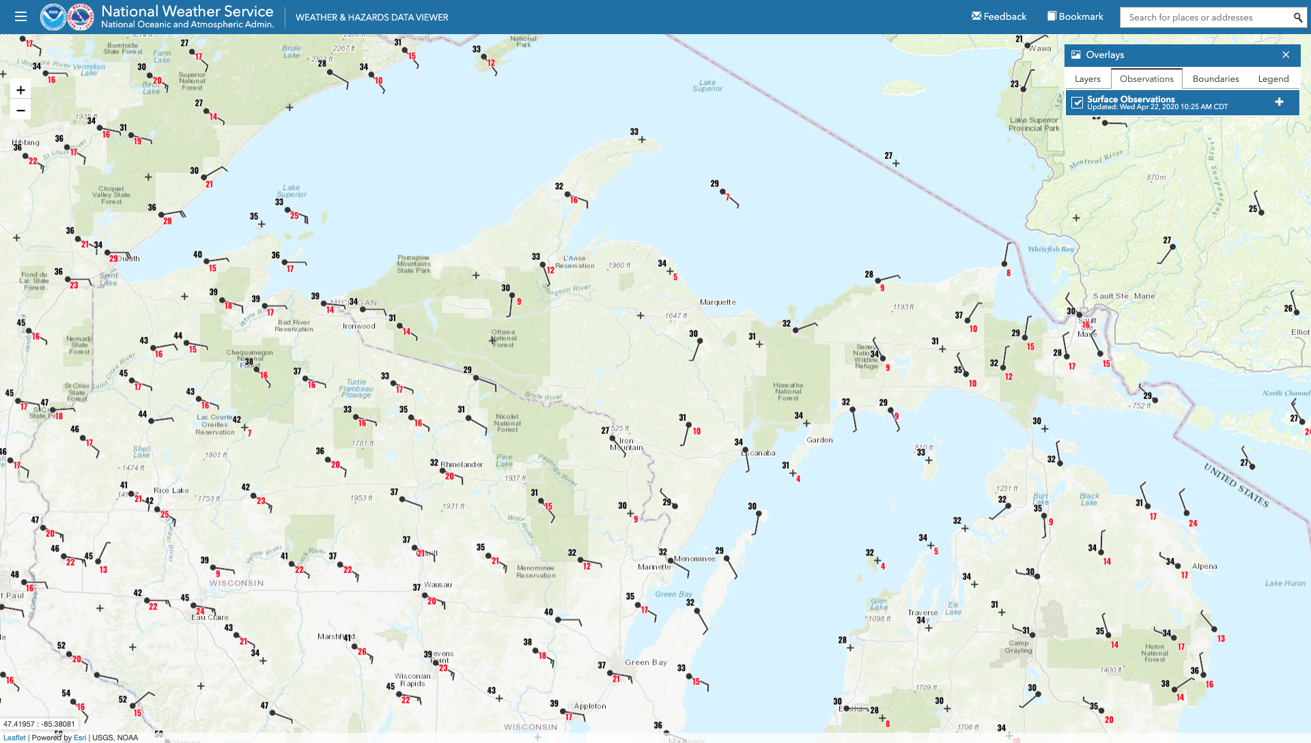
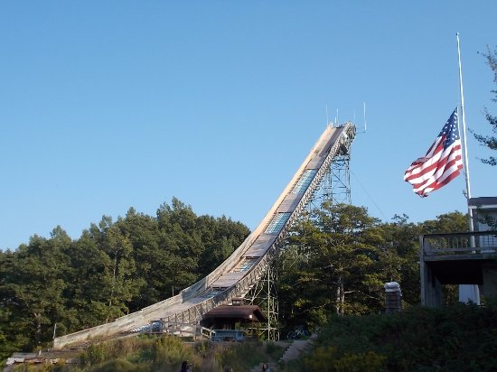
Station: Iron Mountain, Michigan

Slide 3
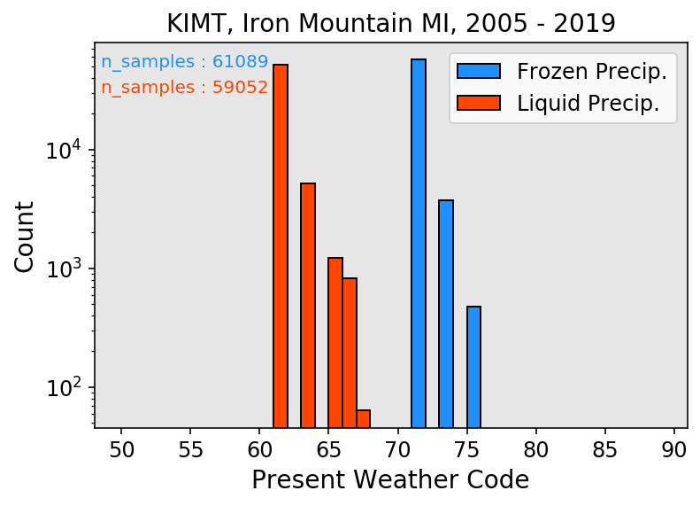
Data download & processing:
Queries ftp for links, downloads files locally
2)
Decodes METAR (parallelized w 24 proc., 17 s per month)
3)
Concat all files, find when weather is happening, calculate SLP, P, Wet bulb.
4)
Split data into rain/snow, save csvs

Slide 4
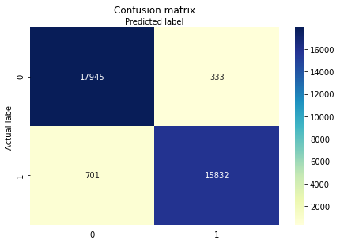
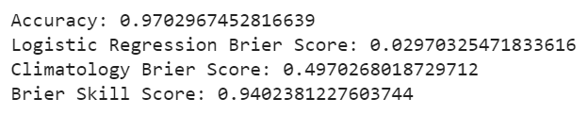
Logistic Classification:
Input variables:
wind direction
wind speed
air temperature
dewpoint temperature
pressure
wet bulb temperature

Slide 5
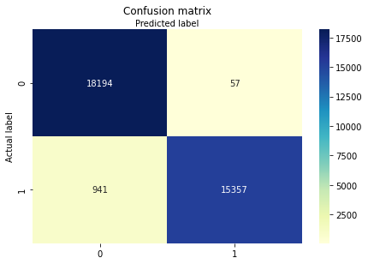
Gaussian Naive Bayes Classifier:
Accuracy: 0.971
Brier Score: 0.029
Brier Score (Climo): 0.501
Brier Skill Score: 0.942

