Slide 1
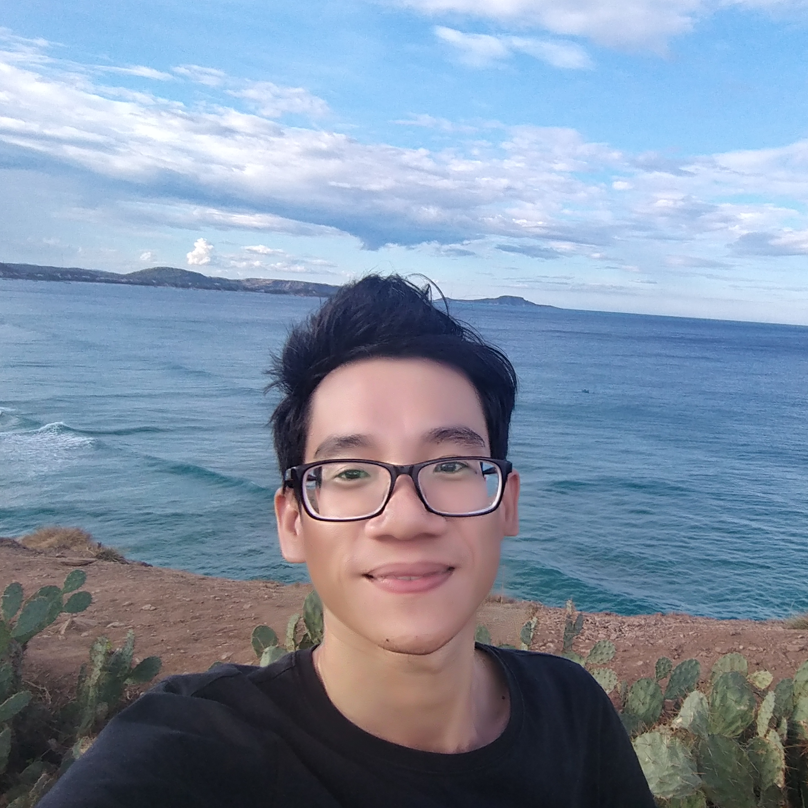








20/10/1995
+84 356 653 0909
webmaster@olit.vn
Thanh Bình, Đồng Tháp
CAREER OBJECTIVES
Mong muốn được làm việc, học tập và tra đổi kinh nghiệm để phát triển bản thân cũng như nghề nghiệp Công Nghệ Thông Tin tại môi trường mới của công ty.
NGUYỄN THIÊN TỨ
Developer C#
EDUCATION
Nov 2012: Third place winner, the Fifth Dong Thap Province Children and Youth Creativity Contest
Windows Form C#: DP v1.0 – Dictionary Pascal while student in grades 11A1 of Thanh Binh 2 High School.
Sept 2013 – Sept 2017: Specialize in IT of Tây Đô University in Can Tho City
Nov – Dec 2015 T4Cafe software for cafe management, Windows Form C# and Database MS SQL Server. Product has been sold to a café in Can Tho.
Sept – Dev 2016 group homework Calculator Basic (CalculatorTTH) with 3 people (Tứ, Tiến and Hòa).
Jan 2017 develop Restaurant Management Software with 2 people (Tứ and Đức).
Jan – May 2017 graduation thesis T4Travel DongThap - Dong Thap province tourism lookup application.
1. Dashboard and API: ASP.NET MVC, Entity Framework, Linq, MS Sql Server, Bootstrap 3.
2. Web: HTML, CSS, JS + Jquery without using framework template, ASP.NET MVC C3.
3. Android: PhoneGap Framework (Apache Cordova). Available on Google Play.
July 2015: Join the program KIV – Korea IT Volunteer in Tay Do University
C# and Linq Basic.
Feb – Apr 2017: Interns Mekong Data Co., Ltd in Can Tho City
Web JSP and Liferay CMS.
PROFESSIONAL EXPERIENCE
Sept 2017 – Now: VACS Technology Co., Ltd in Ho Chi Minh City
Sept 2017 position Developer: Web ASP.NET MVC with project AMS, RPS, OSM, AAS, AR of iOS.
- Library: jQuery, jqGrid, DHTMLX (Grid, Gantt Chart, Scheduler), Google Chart, ARKit, SignalR.
Nov 2018 to now position Developer and Team Leader project 3D.
- Web 3DCIS with ASP.NET MVC, THREE.JS, Xbim: Demonstration of 3D models.
- Software VacsCad with C++ and Python: create 3D CAD modeler and a building information modeling.
PERSONAL PROJECTS
Dec 2014: Transfer Image to Icon
Windows Form Application C#, tool converts all image formats to .icon format.
Feb 2015: Website t4vn.com
Build personal website with PHP and Database Firebase.
Jan 2016: IrrVer – Irregular Verbs
Web (PHP and XML), Windows Form Application C#, mobile Android with PhoneGap (Apache Cordova).
Nov 2018: Game mobile Android: Fly to The End
Apache Cordova and library THREE.JS. Available on Google Play.
Jan 2019: Website siteaudit.olitvn.com – Site Audit
1. Web and Web API: ASP.NET MVC. Get info WHOIS, check Security Header, analytics SEO and check Page Speed.
2. Windows Service Application C#. Run in background on Windows Server 2019, send mail if the list sites is set up to find problems.
Mar 2019: Website image.olitvn.com – Compress Image
Web ASP.NET MVC. Resize image, change extension file image, no quality degrade when compress image.
Apr 2019: Re-building website for Faculty of Library and Information Science – Hanoi University Of Culture
Web ASP.NET Core 2.0 with template using library W3CSS and database MS Sql Server.
Dec 2019 – Jan 2020: Build package on nuget.org
1. CipherSharp.Core (.NETStandard 2.0): Library supports fastest coding, decoding just once “using”.
2. SendMailFast (.NETStandard 2.0): Library supports send mail. Users do not need to set up too much with traditional Microsoft library.
3. T4Query.SqlServer (.NETStandard 2.0): Provides developers with a single class to query SQL Server with the query.
CERTIFICATE
Aug 2016: SoloLearn Online
Level 7 with 2086 XP
Aug 2016: Udemy Online
Complete learn: HTML 5 and Algorithms and Data Structures C++
Apr 2017: MOS - Microsoft Office Specialist
Microsoft Office PowerPoint

