Slide 1
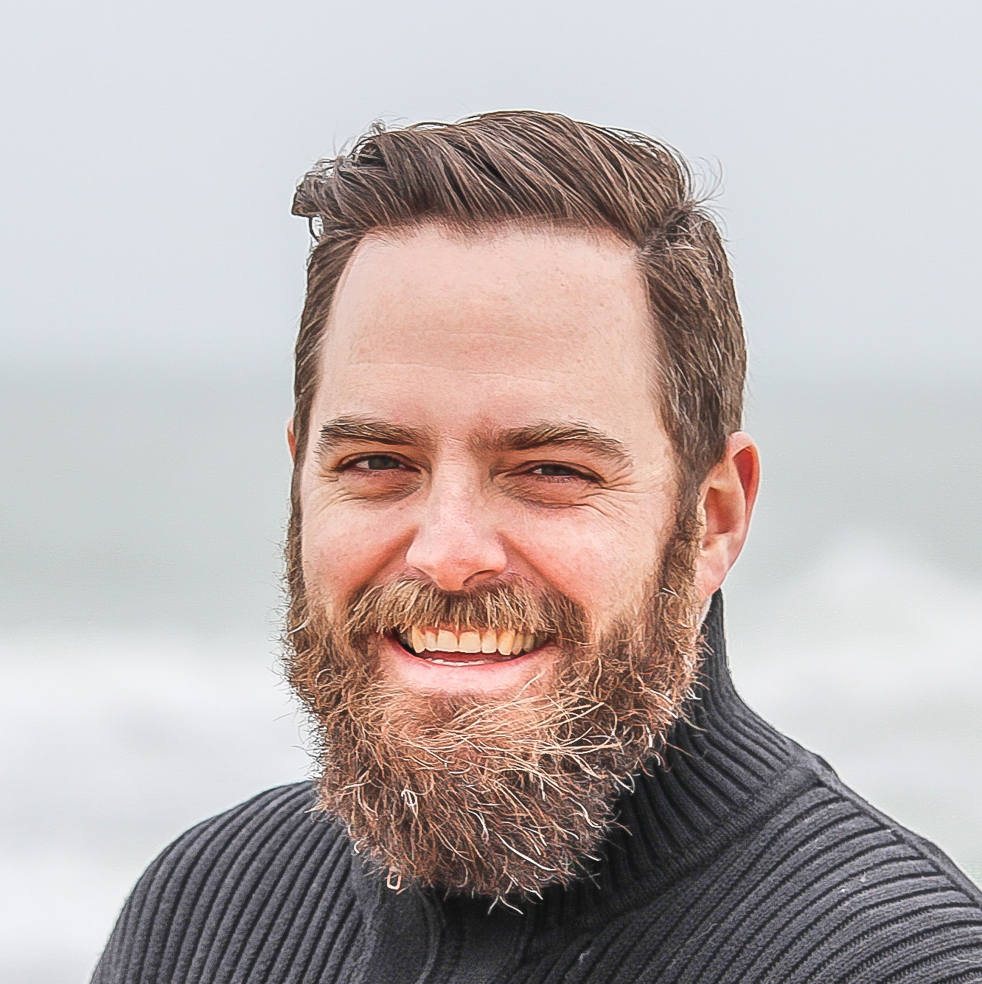
Expert Persona
Description
Demands for graphs
Dominik is working for humanity development working in a United Nation in Geneva. He lives in Bern and commutes frequently for work.
Informative and relevant
Interests
Tracking trends
Understand different factors that influence happiness
Help the less developed countries to improve certain aspects
Improve life quality
Get funding to develop humanitarian projects
Important information and statistics
Complex plots
Dominik Meister
Channels
Frustrations
Age: 32
Website, can be article in the World economic forum website
Periodic journals/reports
Bad graphs with wrong information
Education: MA Political Science and sociology
Occupation: Working for United Nation

Slide 2

Lay Public Persona
Description
Demands for graphs
Stefan lives in Zürich city centre and just graduated from his Bachelor. Even though he loves Zürich, he always desires to live abroad and explore life in various cities around the world. Therefore, Stefan now searches for his dream destination to start his career in another country.
Eye-catching
Clear trends
Interests
Statistics
Exploring interesting information around the world
Happy places with happy vibes to work and live for a year
Reading news whenever having time, on public transports
Experiencing different things in life
Ease to understand
Frustrations
Complex graphs that are hard to understand
Boring news and plots
Stefan Frei
Personality
Curious, trend follower
Out-going, friendly, extrovert
Cool, swag
Explorative
Tech savvy
Channels
Age: 22
Education: BA in Hospitality management
E-news from website
Newspapers
Social medias
Occupation: Young bachelor newly graduate

