Slide 1
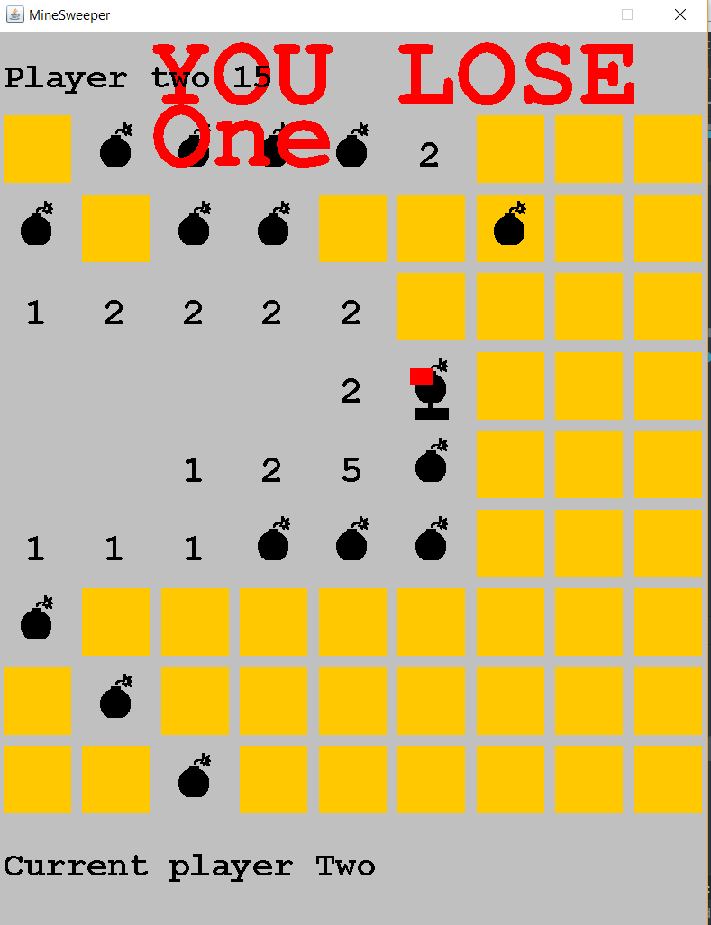
Minesweeper
done by Darkhan Baizhan and Asset Baisalov
EEE, 2nd year
Nazarbayev University
Spring, 2019
Instructor: Aresh Dadlani

Slide 2
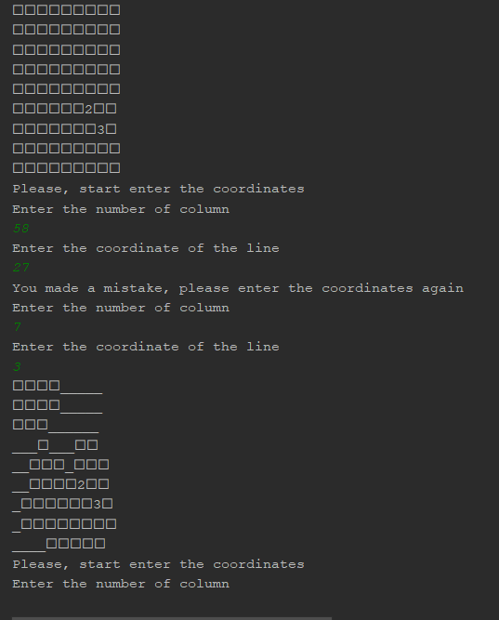
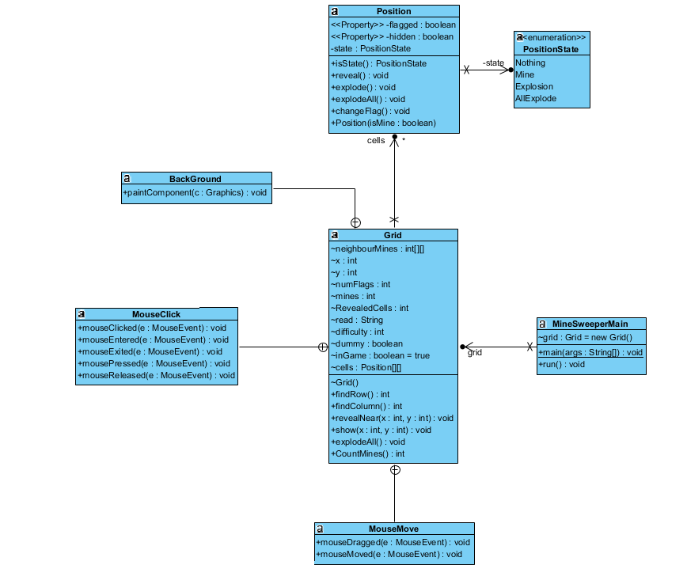

Slide 3
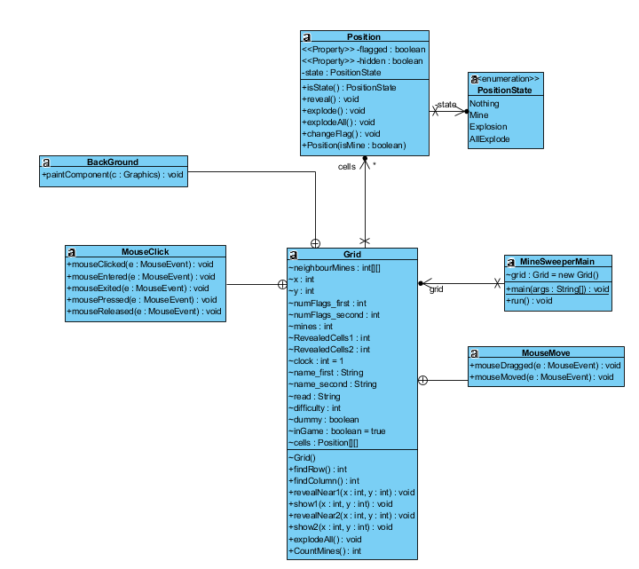
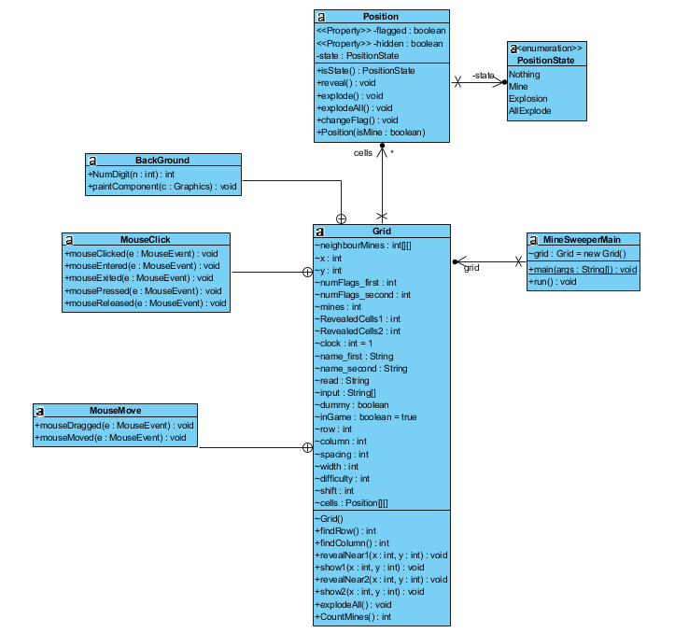

Slide 4
Asset Baisalov
Level A (including algorithm of non-OOP program)
Recursion for revealing neighbor cells
Implementing the multiplayer at the level C
Darkhan Baizhan
Full development of level B
Graphical part of the program
Recursion for revealing neighbor cells
Creating a flexible grid

Slide 5
Challenges
Creating flags and cells
Binding the coordinates of the grid with the cells of the basic cell in case of resizable grid
Catching exception in case of inputs, revealing other cells
Drawing the square cell in case of resizable grid
Binding the changing the players order and desirable clicks (avoid miscliks)
Right displaying the information in case of two players playing

