Slide 1
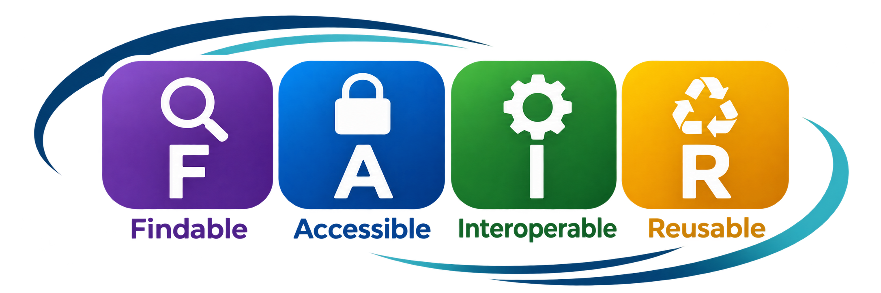
FAIR RESEARCH DATA
From principles to practical workflows
A workshop for making scientific data easier to discover, interpret, and reuse—responsibly.

Slide 2
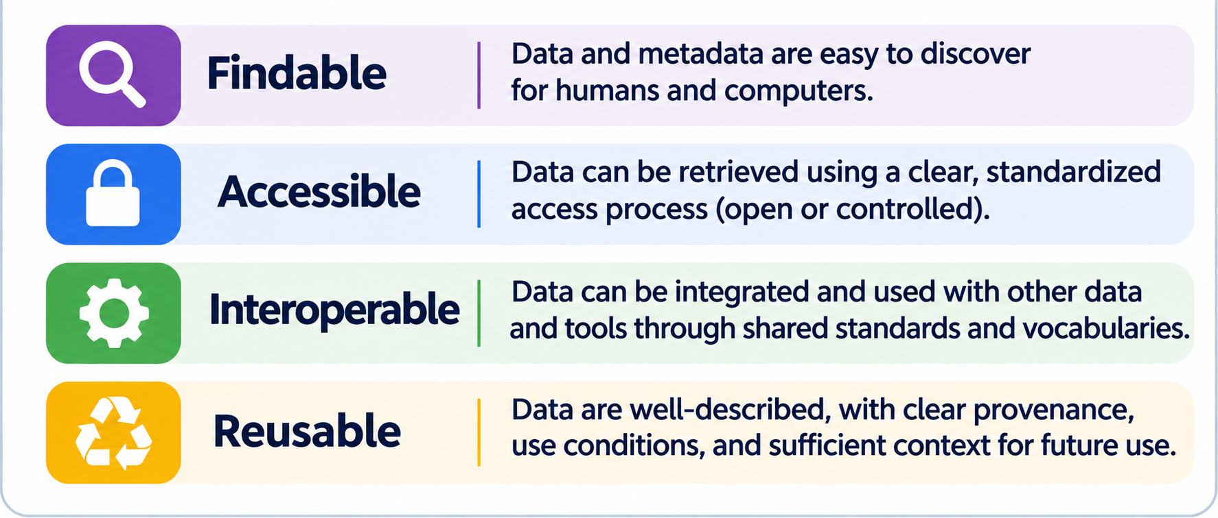
FAIR DATA WORKSHOP
THE Four FAIR PRINCIPLES
02
Notes:
Analogy: a fence is a governance boundary. FAIR makes the boundary legible and predictable through identifiers, metadata, access mechanisms, and reuse conditions. Do not equate FAIR with making protected data public.
[Sources]
- https://www.nature.com/articles/sdata201618
[/Sources]

Slide 3
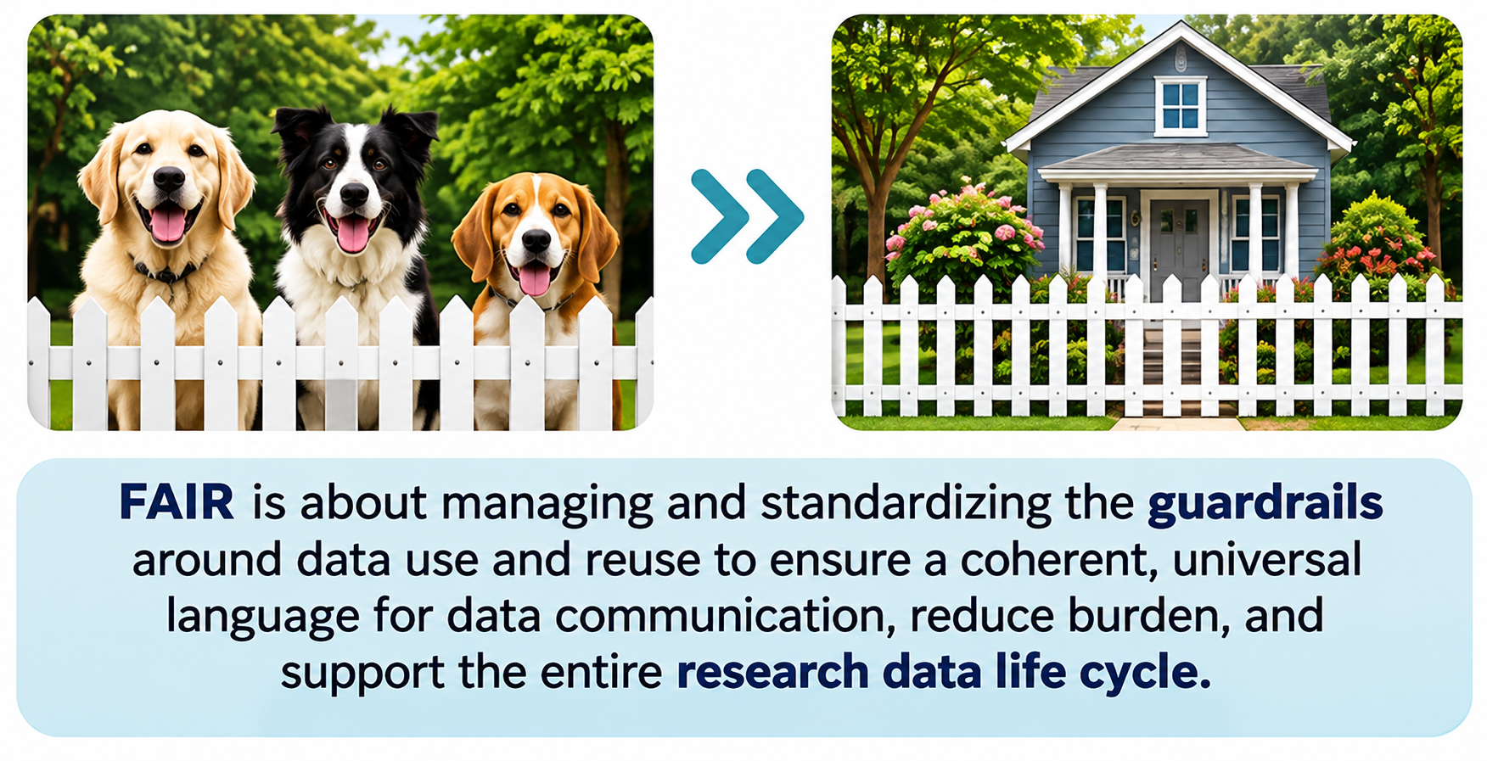
FAIR DATA WORKSHOP
Why FAIR? Shared guardrails, less friction
Think of FAIR as a common language for describing and navigating data—not a mandate to remove every fence.
02
Notes:
Analogy: a fence is a governance boundary. FAIR makes the boundary legible and predictable through identifiers, metadata, access mechanisms, and reuse conditions. Do not equate FAIR with making protected data public.
[Sources]
- https://www.nature.com/articles/sdata201618
[/Sources]

Slide 4
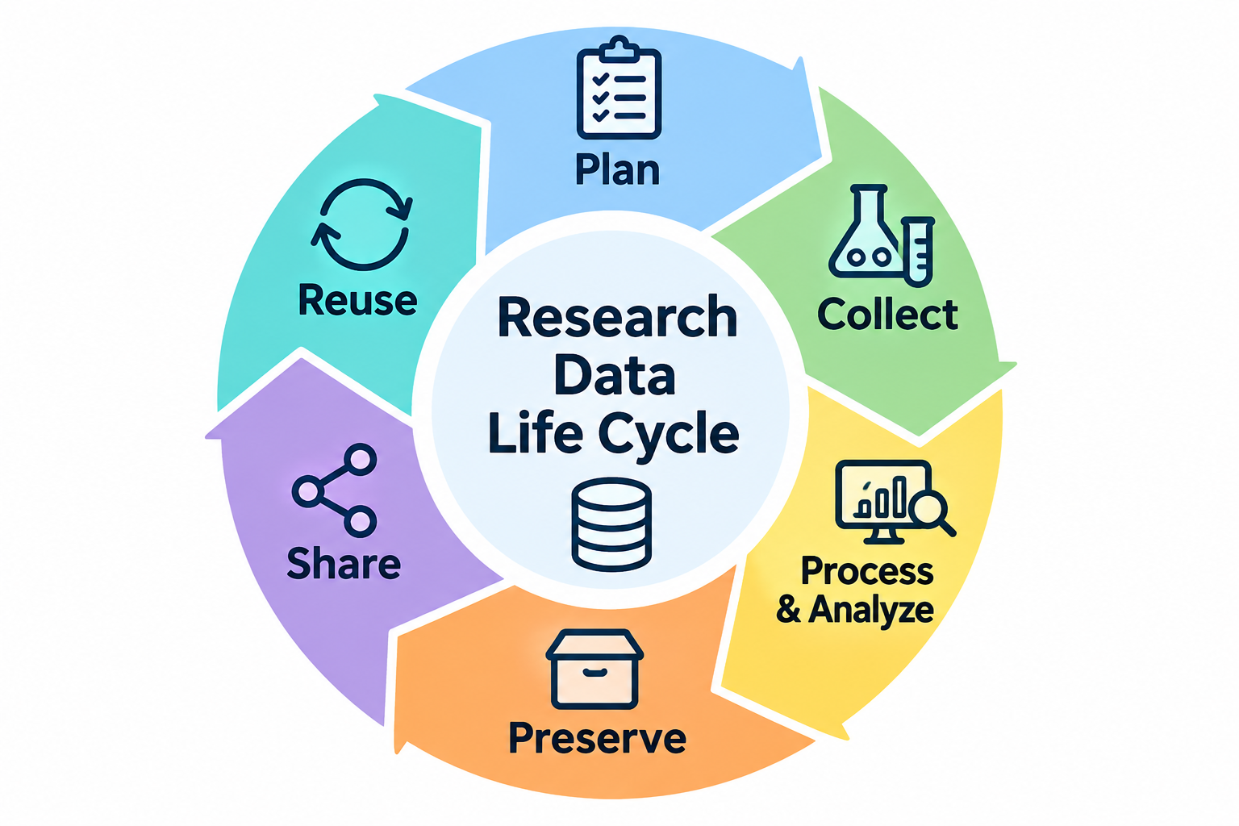
FAIR DATA WORKSHOP
FAIR across the research data lifecycle
R -- Reusable
I -- Interoperable
Provide clear use, conditions, provenance, and documentation
Use community standards, shared vocabularies, and compatible formats
A -- Accessible
Define and implement appropriate access (e.g., open or controlled)
All FAIR
F -- Findable
Make each step more efficient, reproducible, and easier to build upon for future research.
Assign persistent identifiers, describe w. rich metadata, and register in a registry
03
Notes:
Discuss FAIR as an iterative practice, not a final upload step. Planning, collection, processing, analysis, preservation and reuse all create opportunities to improve FAIRness.
[Sources]
- https://www.nature.com/articles/sdata201618
- https://www.go-fair.org/fair-principles/
[/Sources]

Slide 5
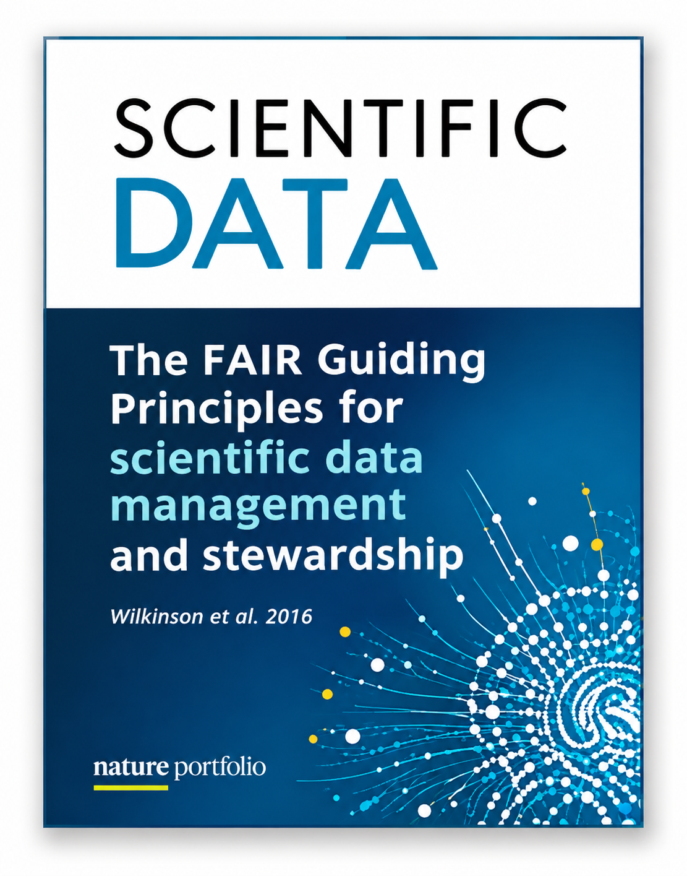
FAIR DATA WORKSHOP
Original contribution
The FAIR Guiding Principles (Wilkinson et al, 2016)
Wilkinson et al., Scientific Data (2016): 15 guiding principles for data and metadata stewardship.
Metadata matters
Descriptions and identifiers are essential even when the underlying data cannot be released.
Machine-actionability
The goal is for computational systems—not only people—to find and work with research resources.
Not a single technology
FAIR is a set of outcomes; repositories, schemas, identifiers and protocols are implementation choices.
04
Notes:
Emphasize the distinction between guiding principles and a specific technical stack. FAIR addresses data and metadata, with strong attention to machine-actionability.
[Sources]
- https://www.nature.com/articles/sdata201618
[/Sources]

Slide 6

FAIR ≠ Open
FAIR DATA WORKSHOP
OPEN DATA
FAIR CONTROLLED DATA
Freely available to anyone
No access restrictions
Often used for non-sensitive data
Accessed w/o defined process
May lack metadata
Discoverable: Metadata is publicly available
Accessible: Data has defined access process
Interoperable: Uses community standards
Reusable: Clear conditions for reuse
Can be open or controlled-access(e.g., sensitive human data)
About “who” can access
About “how” and “effect” access and use
05
Notes:
Open describes availability. FAIR describes characteristics that support discovery, access under explicit conditions, integration, and reuse. Authentication and authorization can be part of an accessible protocol.
[Sources]
- https://www.nature.com/articles/sdata201618
- https://www.go-fair.org/fair-principles/
[/Sources]

Slide 7
FAIR DATA WORKSHOP
F — Findable:
Make data discoverable and uniquely identifiable for humans and computers
F1
Persistent, globally unique identifier
A DOI or accession that distinguishes the dataset. Globally
F2
Rich descriptive metadata
Title, creator, methods, variables, dates, organism, context.
F3
Metadata explicitly cites the data ID
The catalog record clearly states which dataset it describes.
F4
Indexed in a searchable resource
A repository or catalog enables discovery by humans and software.
Examples: GEO / SRA / ENA accessions • PubMed PMIDs for articles • DOIs for deposited datasets
06
Notes:
F1 is identifiers for data and metadata; DOI is a common dataset identifier, ORCID is for people, PMID is for publications, and GEO/SRA/ENA provide domain-specific accessions. F2 rich metadata, F3 explicit data identifier in metadata, F4 indexing in searchable resources.
[Sources]
- https://www.go-fair.org/fair-principles/
- https://www.gofair.foundation/fair-principles
- https://www.ncbi.nlm.nih.gov/geo/
[/Sources]

Slide 8
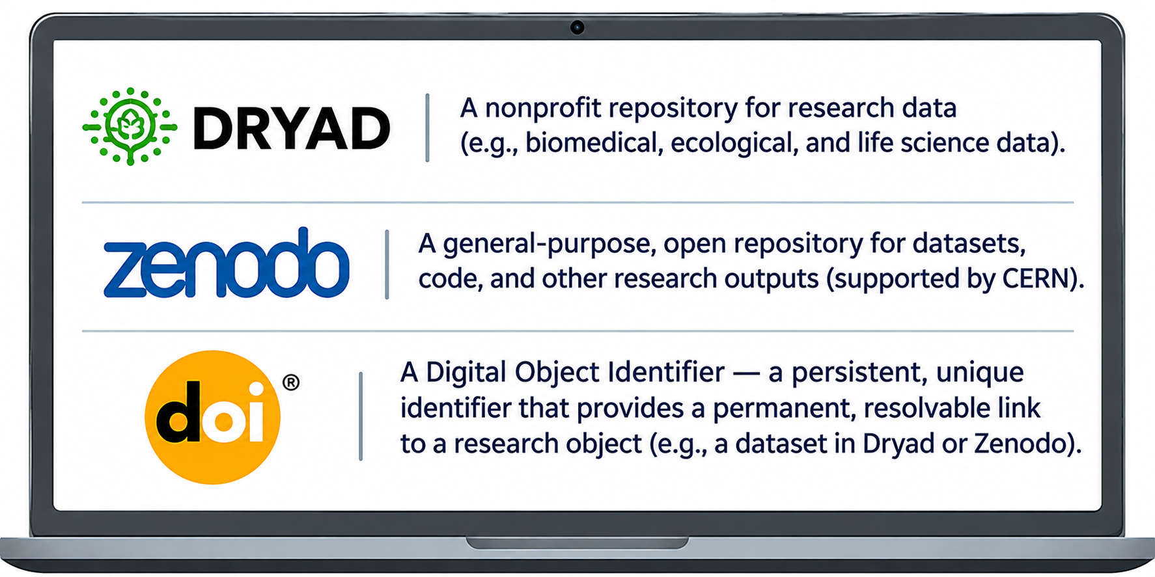
FAIR DATA WORKSHOP
DOIs, Dryad, and Zenodo: where findability becomes real
Trusted repositories and persistent identifiers that make research outputs findable, citable, and long-lived.
Before deposit: check disciplinary repository expectations, privacy constraints, license, documentation, and versioning.
08
Notes:
Distinguish DOI from repository: a DOI is an identifier and resolution system, while Dryad and Zenodo are repositories that host and describe research outputs. Domain repositories such as GEO may be more appropriate for certain data types.
[Sources]
- https://www.doi.org/
- https://datadryad.org/
- https://zenodo.org/
[/Sources]

Slide 9
FAIR DATA WORKSHOP
Findable in practice: from folder to indexed record
01
02
03
04
Organize
Describe
Identify
Register
README + data dictionary
Rich machine-readable metadata
Accession or DOI
Repository + search index
Discovery path: search query → indexed metadata → persistent landing page → data or access instructions
07
Notes:
Demonstrate how a dataset moves from a local folder to a durable, searchable record. The DOI typically resolves to a landing page, not necessarily directly to a file.
[Sources]
- https://www.datacite.org/
- https://www.go-fair.org/fair-principles/
[/Sources]

Slide 10
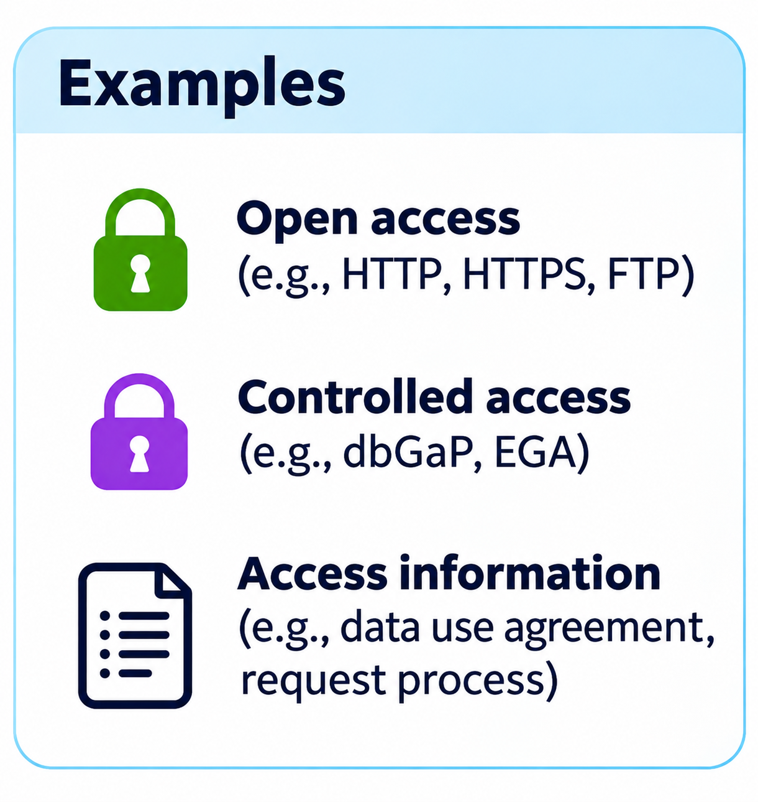
FAIR DATA WORKSHOP
A — Accessible:
Make data retrievable using clear, durable, retrievable rules
A1
Use a standardized, open, and universally implementable protocols (e.g., HTTP, HTTPS, FTP)
A2
Provide authentication and authorization process where necessary
A3
Ensure metadata remains accessible even if the data are access-restricted
A4
Clearly describe access conditions and any data use restrictions
Example: public cohort metadata → access request → approved secure workspace
06

Slide 11
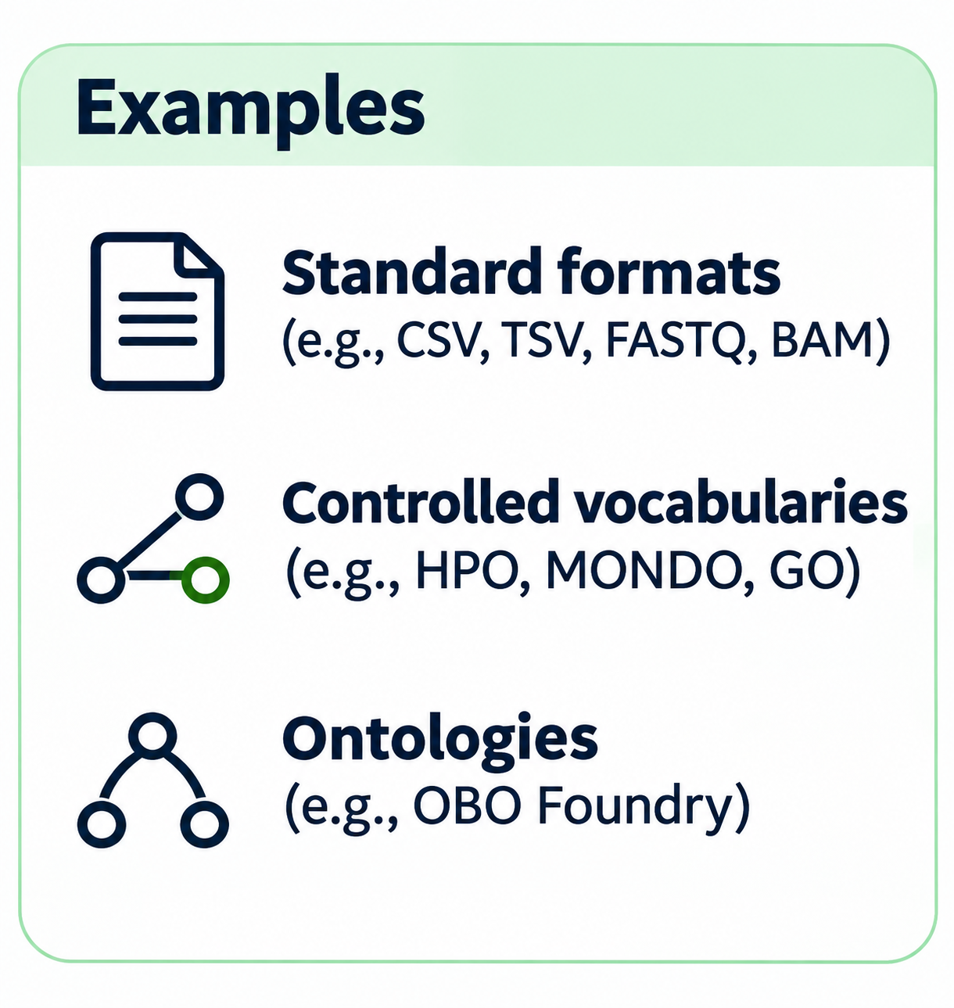
FAIR DATA WORKSHOP
I — Interoperable:
Data can be combined, exchanged, and interpreted across tools and systems. Data can speak together.
I1
Use formal, shared and broadly applicable representation (e.g. standard file formats)
I2
Use shared vocabularies and ontologies (e.g., disease, phenotype, and experimental design)
I3
Include qualified references to other data (linked datasets, publications, identifiers, knowledge graphs)
I4
Use community standards that enable integration and computational use
Example: “Disease = ALL” → map to a defined ontology term + version + meaning → comparable across studies
06
Notes:
Interoperability is not just CSV instead of Excel. It requires shared semantics, formal representations and qualified links. HPO = Human Phenotype Ontology; MONDO = Mondo Disease Ontology; OBI = Ontology for Biomedical Investigations.
[Sources]
- https://www.go-fair.org/fair-principles/
- https://hpo.jax.org/
- https://mondo.monarchinitiative.org/
- https://obi-ontology.org/
[/Sources]

Slide 12
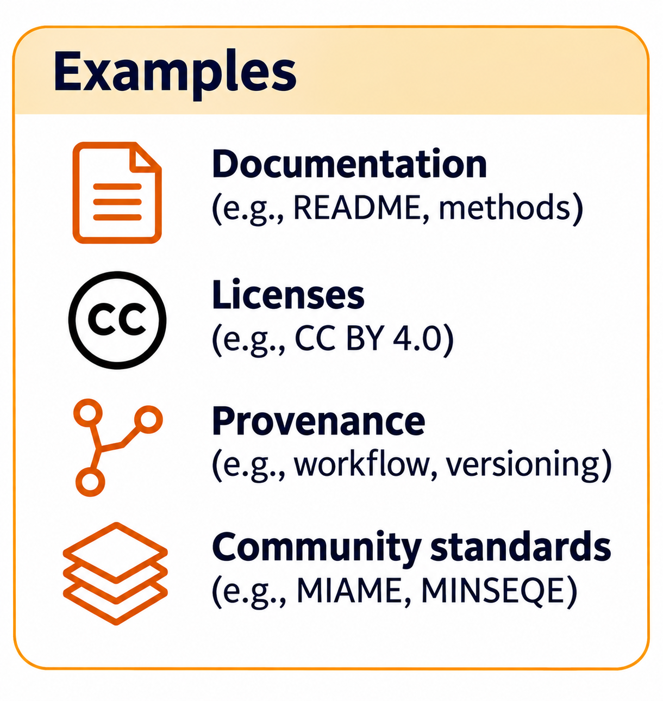
FAIR DATA WORKSHOP
R — Reusable:
Make the next study possible; ensure data is well-described and contextualized so they can be confidently and appropriately reused
I1
Provide rich, accurate, and relevant metadata (e.g., methods, context, and data provenance).
I2
Include a clear data-use/reuse license or conditions. Specify permitted use, restrictions, and citation expectations.
I3
Specify data provenance and processing steps (data generation, and analysis workflow documentation).
I4
Meet domain-relevant community standards and conventions (e.g. MIAME for expression data, MINSEQE for sequencing).
Reusable ≠ merely downloadable: a file without context may be impossible to interpret safely.
06
Notes:
Discuss documentation, license/terms, provenance and community standards. In controlled human-subjects data, reuse terms may include governance conditions rather than an unrestricted open license.
[Sources]
- https://www.go-fair.org/fair-principles/
- https://www.nature.com/articles/sdata201618
[/Sources]

Slide 13
FAIR DATA WORKSHOP
A practical FAIR workflow for a research team
1
2
3
4
5
PLAN
CAPTURE
VALIDATE
DEPOSIT
MAINTAIN
Choose standards + access model
Record IDs, metadata, provenance
Check schema, vocabularies, files
Select repository + register ID
Version, link, update, preserve
Build FAIRness into everyday research operations—not only at publication.
12
Notes:
Ask participants where their teams currently lose metadata, provenance, or access decisions. A data management plan should specify repository, standards, access governance and stewardship responsibilities.
[Sources]
- https://www.nature.com/articles/sdata201618
[/Sources]

Slide 14
FAIR DATA WORKSHOP
Biomedical example: a pediatric genomics cohort
F — Findable
A — Accessible
Public study record, accession, sample identifiers, and searchable metadata.
Public description; individual-level files released only through approved access.
I — Interoperable
R — Reusable
Common phenotype terms, assay schemas, reference genome version.
Methods, QC, provenance, consent-compatible reuse conditions.
Sensitive does not mean un-FAIR. Good metadata and governance can coexist.
13
Notes:
Illustrative fictional cohort, not a claim about a specific institutional dataset. Avoid exposing identifying patient information in public metadata. Reuse conditions must follow consent, IRB, agreements and applicable regulations.
[Sources]
- https://www.nature.com/articles/sdata201618
[/Sources]

Slide 15
FAIR DATA WORKSHOP
Workshop exercise: FAIR audit in five minutes
Can another researcher FIND this dataset by a stable ID?
Can they understand HOW to request or retrieve it?
Can software INTERPRET its fields and relationships?
Can a new team REUSE it with confidence and permission?
Pick one dataset. Identify one improvement you could make this month.
14
Notes:
Facilitation: 60 seconds per FAIR pillar; ask each group to identify one concrete action and one owner. Potential actions: publish a metadata record, document access process, standardize a phenotype variable, add provenance.
[Sources]
- https://www.go-fair.org/fair-principles/
[/Sources]

Slide 16
FAIR DATA WORKSHOP
Takeaways & selected references
FAIR is a design practice: identify, describe, connect, govern, and preserve.
• Wilkinson et al. (2016). Scientific Data 3, 160018. nature.com/articles/sdata201618
• GO FAIR Principles. go-fair.org/fair-principles/
• GO FAIR Foundation. gofair.foundation/fair-principles
• DataCite DOI infrastructure. datacite.org | DOI Foundation. doi.org
• Dryad. datadryad.org | Zenodo. zenodo.org
• NLM FAIR / common data elements resources. nlm.nih.gov
Discussion: What is the smallest FAIR improvement with the largest impact on your next study?
15
Notes:
References and further reading. Full source URLs are provided in speaker notes on individual slides.
[Sources]
- https://www.nature.com/articles/sdata201618
- https://www.go-fair.org/fair-principles/
- https://www.gofair.foundation/fair-principles
- https://www.datacite.org/
- https://datadryad.org/
- https://zenodo.org/
[/Sources]

