Slide 1


Dorado Environmental, Inc.
Training Slides – Fryer Management P1

Slide 2
Fryer Design and Purpose
Three types of Fryer Designs
Open Pot
Tube-Style
Flat Bottom
Different Fryers and cook zones/surfaces
Built in filtration through gravity filtration

Slide 3
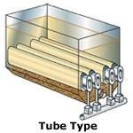
Tube Style Fryer
General Purpose Fryer
Extremely Common
Wide sentiment zone below the burners
Harder to access than the other types in terms of cleaning

Slide 4
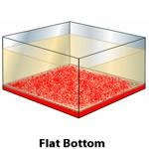
Flat Bottom Fryer
Normally used for specialty products (donuts, funnel cakes)
Doesn’t have a sediment containment area
Oil can break down more rapidly but cleaning is generally easier

Slide 5
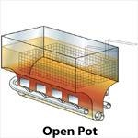
Open Pot Fryer
General Purpose Fryer with a sediment collection area in the bottom
Sediment valley
Easier to clean and access the bottom

Slide 6
Cook Zones
All fryers have some or all of the following characteristics:
Cook Zones and Surfaces
Cool zones
Functions and features (dials, manual and digital readouts, kickouts)
Built-In Filtration
Generally speaking, the majority of fryers serviced will be gas fryers. Most table top fryers are electric.
UNDER NO CIRCUMSTANCE, DO WE ADJUST OR MANIPULATE THE GAS CONNECTION. IT IS A CRIME TO DO SO
UNDER NO CIRCUMSTANCE DO WE LIGHT PILOT LIGHTS

Slide 7
Cool Zones
Cool zones are found below the heat source
Designed to help extend the life of the oil
Sediment levels generally collect here, constricting and confining the cool zone from properly functioning
Having a cool zone helps preserve the oil characteristics

Slide 8
Features and Functions
What is a kick-out switch?
Describe oil level indicators?
What are the two types of thermostats you will encounter?
Can we service filters that use RTI or a bulk delivery/removal service?
What is cascading?

Slide 9
RTI
How do we sell into a bulk oil customer of RTI?
What is the magnesol product and how is it used?
How do we handle customers who already filter the oil?

