Slide 1
A Plagiarism detection system based on cloud

Slide 2
The method of Plagiarism detection
Source file
Suspicious file
yesterday upon the stair i met a man
a man who was not there he was
he was not there again today i wish
i wish that man would go away
MD5
a87fd87c3af8c6a81cb94ccdc9293d0d
975eb304652a32c9760a2a7ce394971f
0c2a2315f76e082338a218fcbc403ae9
10b8869bc3aaf60ba9a1180a5dd04bef
today upon the stair i met a man
a man who was not there he was
he was not there again
MD5
73914de5ac2f3c32476a94d1d1f5f2b2
975eb304652a32c9760a2a7ce394971f
aac2fced9cd88d62a3d13ff3019f51ef

Slide 3
Description of Task
Building a Plagiarism detection system on 3 different cloud systems
GAE – a webpage to interactive with users and store the result in datastore
EC2 – build the index of source files
OpenStack – analyse text similarity

Slide 4
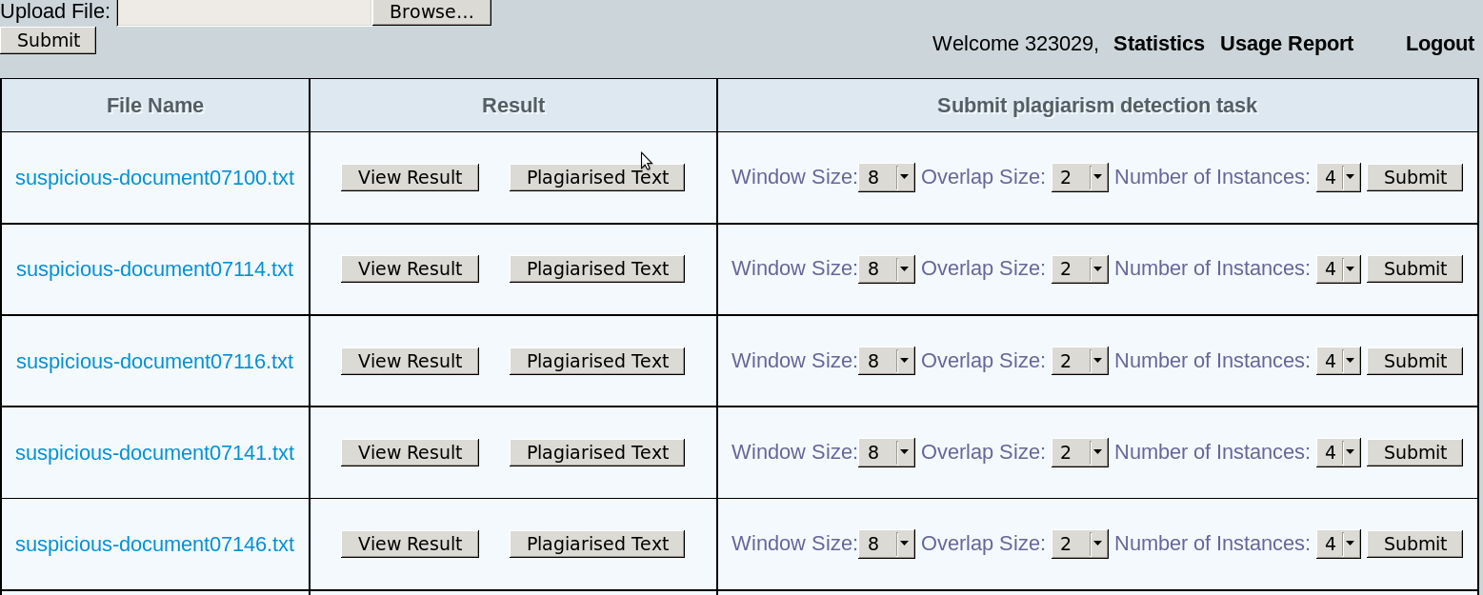
GAE

Slide 5
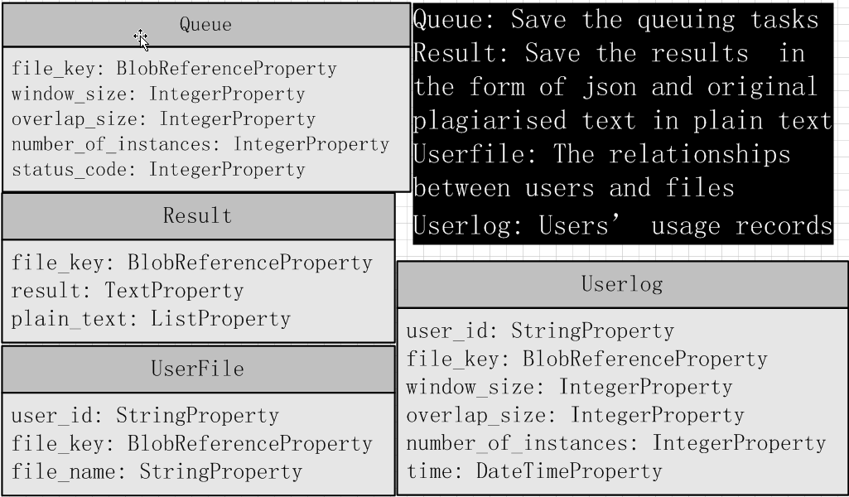
The Structures of Tables in Datastore

Slide 6
Handlers
QueueHandler — Put a task in queue with parameters
GetQueueHandler – OS gets a task from queue via this handler, it is secured by Base64.
ResultHandler – OS puts the matched result in datastore
PlainTextHandler – OS puts 10 plagiarised original text in result in one request (due to limited length of URL in GAE)
Other handlers – Upload and download files, show result, show statistics and usage report

Slide 7
EC2
Task: Build the index
Build a web application by Apache2 and Mod-Python
OpenStack can get the index built by specified parameters via URL
Load_banlancer://build_index?window_size=8&overlap_size=2&start=1&end=100
EC2 will build the index with window_size=8,overlap_size=2 from the source file between 1 and 100
Result is written in json

Slide 8
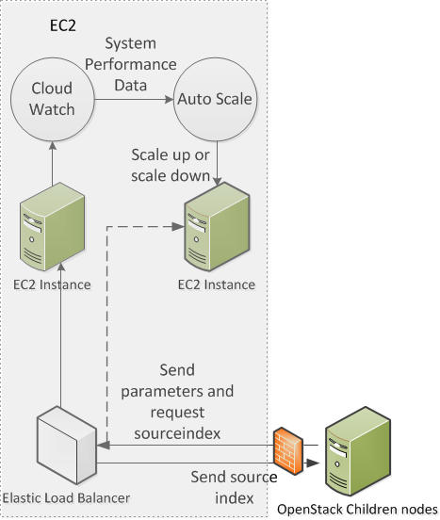
Cloud Watch

Slide 9
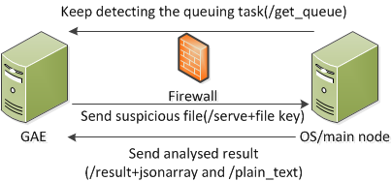
OpenStack
Task: Analyse the text similarity
Get the task and suspicious file

Slide 10
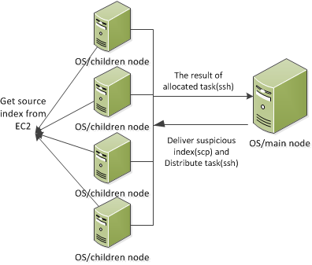
The Architecture in OpenStack
Main Node
Children Nodes
Get the tasks and build suspicious index
Distribute tasks (Map)
Integrate the results (Reduce)
Send integrated result to GAE
Get source index from EC2
Match suspicious and source index, send the result to main node

Slide 11
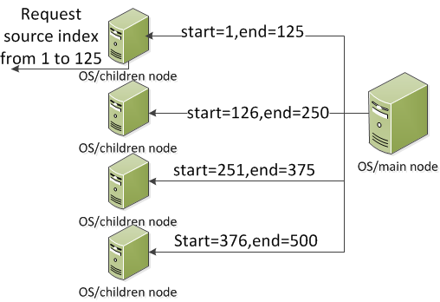
For example : Number or instances = 4
Implement in parallel
pool = Pool(processes=number_of_instances)
results=pool.map(matching,parameters)
Decrease the consuming time outstandingly
Most of time is spent on transmit source index from EC2 to OS

Slide 12
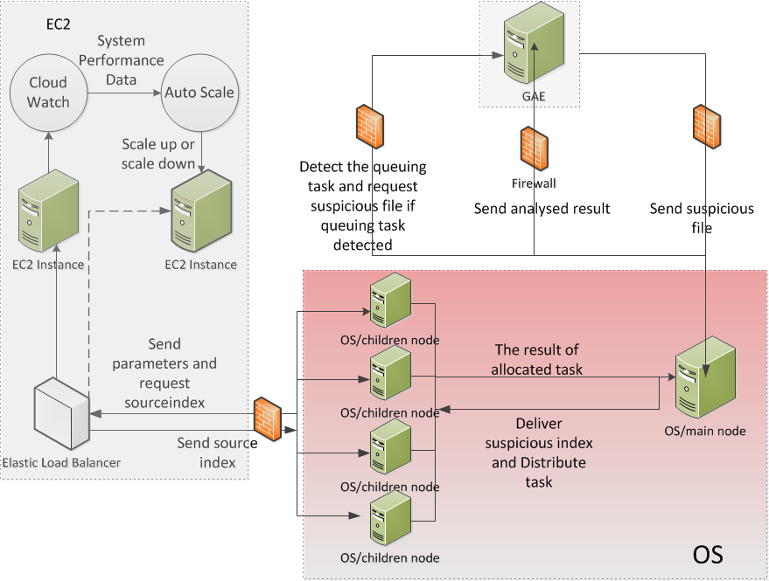

Slide 13
Drawbacks and Future Work
Duplicated result and plain text
The operation in datastore is not done immediately
No https
Hard to change the source files
Change in EC2 instance
Save a new AMI
Update the auto scaling group

Slide 14
Conclusion
The method to detect plagiarisms
Architecture, data communication and implementation of system
Drawback and future work

