Slide 1

COMM033 Viva
PREDICTING eGFR TRENDS OF HEALTH-CARE RECORDS
Student Name: GIANG TRAN HOANG
YAN HUANG
Di Wang
Group 6

Slide 2
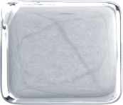

Table of Contents
1
Project Definition & Introduction
2
Data preparation & Exploration
3
Data Mining & Evaluation
4
Result collection & Conclusion

Slide 3

Project Definition
Our project is to use the given health records database to predict the trend of eGFR value.
The project uses the provided codes (including symptoms, tests, drugs, treatments etc), their values and eGFR trend in a period of time as training data to predict the future eGFR trend by some given codes.

Slide 4
Project Definition (cont)
The Procedure of Data Mining
  Gather the Data in the Form of Text
  Transform Text to Vector
  Build the Model and Train
  Evaluate the Model

Slide 5
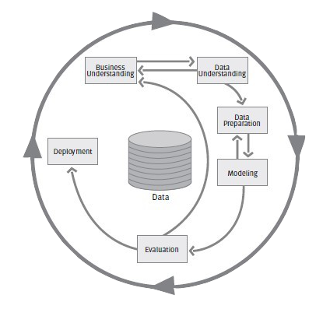
Project Definition (cont)
This Figure shows the phrase of the CRISP-DM reference model which applied in the project.

Slide 6
Data Preparation
From the health records database, only codinggroup and journalsubset table have been used.
For each patient with eGFR value in journalsubset table, the variation of eGFR in a period of time from one year to one and half years is set as a valid record.
For each patient, retrieve all the other codes in all records. These codes can be in either two categories: most of them just have a binary value, exist or not exist; some of them have specific values, and only the variation trend is taken into account as binary values of up or down.

Slide 7
Data Preparation (cont)
Those binary values of codes will be used in training process as input factors and the existing eGFR trend is set as the ground truth.
The actual presentation of the features here are a bag of words which will be the code name itself or the code name with (_up,_down) prefixes.
So far, the data is ready to be used by mining solutions.

Slide 8
Data Mining
Count the codes to build vector:
  Find all the codes and give each code a position. Then vectorise all the text of a person’s journal in a time frame, including training and testing set.
  For example, the number of codes is 10. The text of a person in a time frame is:
  “INTA1449 INTA1449 AMTA101 AMTA17004NEMIS 4672 312 246_down”
  The positions for INTA1449, AMTA101, AMTA17004NEMIS, 4672, 312, 246_down are 1,2,3,6,8,9 respectively.
  This text will be vectorised as [2,1,1,0,0,1,0,1,1,0]

Slide 9
Data Mining (cont)
Build the NB and Logistic Regression model
  After vectorisation, train the Naïve Bayes model by training set.
  classifier = MultinomialNB()
  classifier.fit(traning_vector,label)
  Then predict the testing set and get the mean accuracy.
  classifier.score(testing_vector, label_test)
  And train the logistic regression model:
  classifier = linear_model.LogisticRegression()
  classifier.fit(traning_vector,label)
  Use the same code to get the mean accuracy.

Slide 10
Data Mining (cont)
VALIDATION USING REPEATED RANDOM SAMPLING CROSS VALIDATION:
  Pick out 95% data as training data and 5% to test randomly to get the accuracy. Train and test the NB and Logistic Regression models 10 times. The mean accuracy is 62.93% for NB, 61.26% for Logistic Regression respectively.

Slide 11



Data Mining (cont)
Another method to vectorise (TF-IDF):
TF (Term Frequency) :
IDF (Inverse Document Frequency) :
TF-IDF=TF*IDF

Slide 12
Data Mining (cont)
For example:
consider a document containing 100 words wherein the word cat appears 3 times. The term frequency (i.e., TF) for cat is then (3 / 100) = 0.03. Now, assume we have 10 million documents and the word cat appears in one thousand of these. Then, the inverse document frequency (i.e., IDF) is calculated as log(10,000,000 / 1,000) = 4. Thus, the TF-IDF weight is the product of these quantities: 0.03 * 4 = 0.12.

Slide 13
Data Mining (cont)
After vectorisation by TF-IDF, train the NB and Logistic Regression model in the same method and use the same way to validate the model. The mean accuracy is 63.21% and 60.13% respectively.
Find the most important features:
During training the NB model, The top 5 code with the biggest coefficient in NB are GLTA4960, BETA17553NEMIS, 29B, 4672, 246. They are 'OAD', 'DiureticDrug', 'MissingSens’, ‘UrineStickTestProteinuria', 'O/E - blood pressure reading'. They can be considered as the most 5 important variable for eGFRorig.

Slide 14
Data Mining (cont)
Improvements
Get rid of the interfere codes:
  Using Logistic Regression model and get the coefficient, if the absolute value of a code’s coefficient is lower than a threshold, the code is deleted from the all the text.
  Then use the new text to generate the training and testing set and get the mean accuracy. The best threshold is 0.33 and the accuracy increase to 68.89% and 65.38%

Slide 15
Conclusion
Mean Accuracy
 | Naïve Bayes | Logistic Regression
Counting code | 62.93% | 61.26%
TF-IDF | 63.21% | 60.13%
Improved TF-IDF | 68.89% | 65.38%
5 most important feature to eGFR
Code | Code_String
GLTA4960 | OAD
BETA17553NEMIS | DiureticDrug
29B | MissingSens
4672 | UrineStickTestProteinuria
246 | O/E - blood pressure reading

Slide 16

END
That’s all. Thank you!

