Slide 1
Hyperparameter tuning with SKLEARN
Krithika Iyer
Department of Biomedical Informatics, University of Utah

Slide 2
Difference between model parameters and hyperparameters
Model parameters is what defines the model and using which predictions are made.
Example : In linear regression and logistic regression – w and b
Hyperparameters control how the model parameters are updated-knobs on the model which have to be tuned.
Example – Learning rate, regularization strength

Slide 3
SVM Example
http://vision.stanford.edu/teaching/cs231n-demos/linear-classify/

Slide 4
Jupyter Notebook Examples for Sklearn
Cross Validation
Grid Search - All parameter combinations tried
Random Search - not all parameter values are tried out, but rather a fixed number of parameter settings is sampled from the specified distributions. The number of parameter settings that are tried is given by n_iter

Slide 5
Perceptron as a Linear Separator
Since perceptron uses linear threshold function, it is searching for a linear separator that discriminates the classes.
o₃
??
Or hyperplane in
n-dimensional space
o₂
University of Texas Austin, Raymond J. Mooney, CS 388: Natural Language Processing: Neural Networks

Slide 6
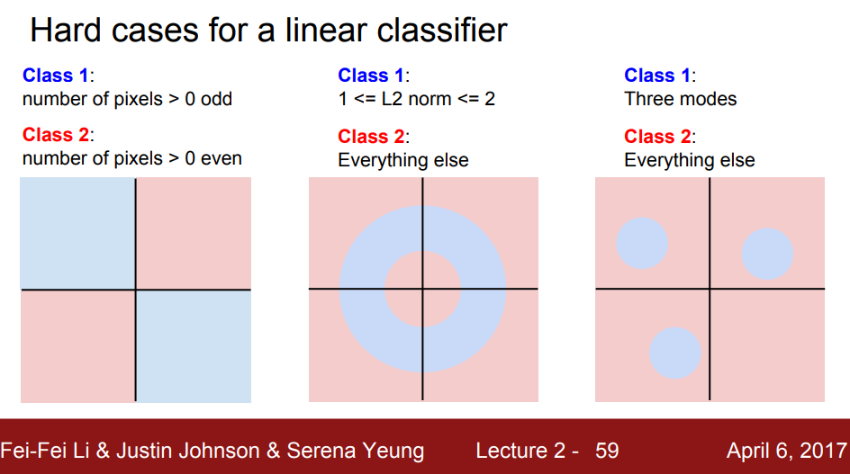
Linear Classifier Limitations
http://cs231n.stanford.edu/slides/2017/cs231n_2017_lecture2.pdf

Slide 7
Neural Network
All neurons get same input why don’t they all produce same outputs?
https://playground.tensorflow.org/

Slide 8
Visualizing Neural Network Weights
https://arxiv.org/pdf/1312.6034.pdf
https://cs.nyu.edu/~fergus/papers/zeilerECCV2014.pdf

