Slide 1
Webassembly Security

Slide 2
Related Work
JEST: N+1-version Differential Testing of Both JavaScript Engines and Specification, ICSE 2021
Montage: A Neural Network Language Model-Guided JavaScript Engine Fuzzer, USENIX Security 2020
Fuzzing JavaScript Engines with Aspect-preserving Mutation, IEEE S&P 2020
JVM Fuzzing for JIT-Induced Side-Channel Detection, ICSE 2020
CodeAlchemist: Semantics-Aware Code Generation to Find Vulnerabilities in JavaScript Engines, NDSS 2019
FuzzIL: Coverage Guided Fuzzing for JavaScript Engines 2018
Random Testing for C and C++ Compilers with YARPGen 2020
Differential Fuzzing the WebAssembly 2020

Slide 3
01
Difference between JIT fuzzing and normal fuzzing
Paper Environment setup
Basic knowledge
Compilation principle
Javascript
AFL
Linux
C++
JS engine

Slide 4
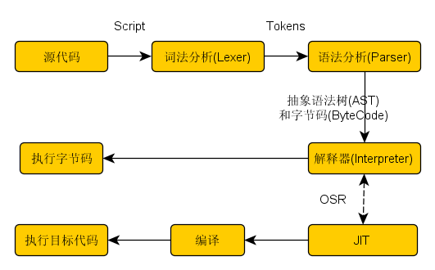
JIT in JSC (old)
Js source code →
Lexer: lexical analysis to Tokens →
Parser : tokens to AST → traverse AST to bytecode
Bytecode is the high-level intermediate representation
Now jsc doesn’t need js source code anymore, all operations relay on bytecode
LLInt : execute bytecode
→ low performance?
Using Baseline JIT, compile bytecode to machine code
→ still low performance?
Using DFG JIT, re-compile bytecode and optimize to machine code
→ still low performance?
Virtual machine (LLVM), compile IR code of DFG to optimized machine code

Slide 5
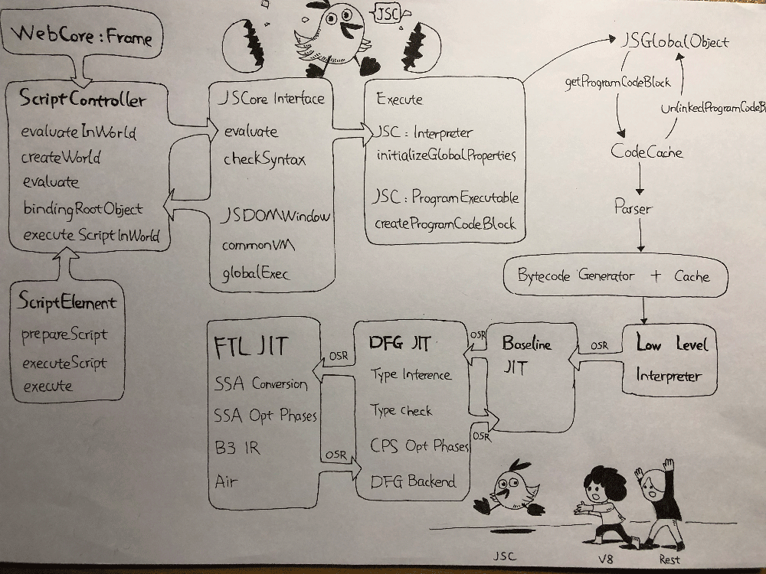
JIT in JSC
Baseline JIT: real-time compilation. Triggered when the functinois called 6 times or a certain code is looped more than 100 times
DFG JIT: low latency optimization. Triggered when the function is called 60 times or a certain code is looped more than 1000 times.
Will collect parameters from LLint and Baseline JIT, to do type judgment. If type prediction fails, DFG will cancel the optimization, also called OSR exit.
If exit to Baseline JIT for several times, it will re-optimize, collect more info and then call DFG.
FTL JIT: B3 tailored LLVM. Using B3 instead of LLVM to reduce memory overhead

Slide 6
JIT in V8
The JIT process in V8 is similar to JSC.
Js source code → parser → AST → Ignition (baseline interpreter) → bytecode → execute
Collected information deoptimization
TurboFan (optimization compiler) → optimized machine code

Slide 7
Difference between JIT fuzzing and normal fuzzing
In JIT, code will run and be compiled at the same times.
JIT engine will compile the hot code based on the run-time information, and sometimes will deoptimize.
This process is much more complicated than just using compiler or interpreter, which means fuzzing should consider more cases to trigger these feature and not stop by normal errors and exception before triggering JIT.
· Test cases cannot be called only one time ---- optimization compiler will not be triggered.
· need to call functions for different times --- to trigger different JIT strategies
· need to call the same function with different type parameters --- to trigger deoptimization

Slide 8
Environment setup
Montage -- NNL model
It is tested on a machine running Ubuntu 20.04 with GTX Titan XP GPUs. Python 3.8 and PyTorch 1.4.0 with CUDA are required to run Montage.
Favocado -- fuzzing binding code
only contain core parts. you may need to implement new binding objects

Slide 9
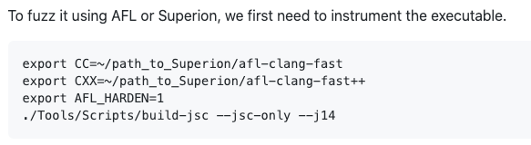
Environment setup
3. Superion : Grammar-Aware Greybox Fuzzing
on Ubuntu 16.04 with gcc-5.4.0 and clang-3.8.
Successfully setup, but having bugs when try to fuzz WebKit:
It seems that the ICU version is too low but still not working after the upgrade.

Slide 10
Environment setup
4. Die : Aspect - preserving mutation
Tested on Ubuntu 18.04 with Python 3.6.10, npm v6.14.6, n v6.7.0.
Missing /sys/devices/system/cpu/cpu0/cpufreq/scaling_governor, should use cpufrequtils to set GOVERNOR=”performance”
Seems that it is a kernel bug
Successfully setup
Make Corpus Directory using make_initial_corpus.py ----- need to modify n_cpu (multiprocessing.cpu_count() -4 to 1)
No error information but the nothing happens after run the .sh file

Slide 11
AFL
Setup original AFL2.52b on Ubuntu 18.04
Use AFL to do some simple fuzzing

Slide 12
todo
AFL -- projects of papers are all based on AFL
JIT -- details of JIT in JS cores
Basic -- LLVM, js, linux

Slide 13
02
V8 engine details
AFL details
Method to improve jit-fuzzing

Slide 14
V8 -- AST
AST is the key stage of JS engine, V8 engine used to directly compile AST rather than using bytecode.
The paper “aspect mutation” also focused on AST stage, trying to reserve type and structure from JS source code to AST.
The NNL paper tries to use neural network to learn rules of effective input case with serialized AST.
Seems that using AST to produce valid corpus is a effective way to fuzzing JIT

Slide 15
V8 -- AST
V8 AST process:
Source JS code
→ lexical analysis scanner : tokens, to identify the structure, type and value of the source code. Using automate machine
→ syntax analysis parser : transfer tokens to objects,
V8 uses its own syntax standard to increase compile speed.

Slide 16
V8 -- bytecode
V8 will translate AST to bytecode using BytecodeGenerator class with Ignition engine.
Ignition code directly execute bytecode, which means it is a virtual machine like JVM, actually JVM and V8 are both written by Lars Bak.
Is bytecode a kind of assembly language?

Slide 17
V8 -- optimization
?
Will the optimization and deoptimization influence the improvement of jit fuzzing?

Slide 18
AFL
Coverage measurements
Insert instrumentation in the compiled program, to catch the branch and the branch-taken hit counts.
Record the code route as tuples.
Detecting new behaviors
Map all tuple to find the input case which causes new tuple
Put this input case into input queue

Slide 19
AFL
3. Evolving the input queue
Mutated test cases, which will cause new tuples, will be add to input queue as the start point of next fuzz.
AFL will use some strategies to randomly mutate the seed, which means most of the mutation are not valid, or will only cause simple crash.
And that is the reason why DIE and NNL tries to modify AFL to produce effective corpus.

Slide 20
AFL
4. Culling the corpus
The test cases in the input queue are iteratively mutated by the former cases, which means the coverage of the new cases are the superset of the former ones.
Therefore, AFL will periodically re-evaluates the input queue to choose a small queue that could still coverage all tuples.

Slide 21
Improve jit fuzzing
How to fuzz effectively?
Optimize the strategies to produce high-quality input cases (AST).
DIE, NNL
Reserving the feature of the existed seed.
Try to optimize corpus culling?
Try to optimize bytecode generating rather than AST?

Slide 22
todo
JIT
AFL
Practice
Compilation principle
Virtual machine
How to fuzz jit?

Slide 23
03
Automate program generator
Differential testing
Environment setup
Fuzzilli

Slide 24
Program generator
Generative Fuzzing
In generative fuzzing, each input file is generated from scratch, often following a set of predefined rules. Commonly, grammar-based approaches are used, in which the set of all inputs is first defined through a context-free grammar [GKL08]. The generation of new inputs is then achieved by taking random production rules starting from an initial ”root” production.
pros
the resulting samples will always be syntactically valid if the grammar is correct.
high degree of control over the produced samples by the grammar engineer, easy to tune
Cons
hard to achieve semantic correctness without some form of code emulation
runtime exception would stop further processing of the generated code
Common solution: wrap each generated statement or expression into a try-catch block so that execution continues even in the event of a runtime exception.
[GKL08] Godefroid, Patrice, Adam Kiezun and Michael Y Levin: Grammar- based whitebox fuzzing. In ACM Sigplan Notices, volume 43, pages 206–215. ACM, 2008.

Slide 25
Goals of mutation
all generated programs have to be syntactically correct under all circumstances.
syntactically invalid programs will most of the time fail to reach past the parsing stage of the engine.
Parser is a small and simple part of the whole javascript engine,
define sensible mutations to preserve most of the interesting features of existing samples
necessary to define mutations that are able to change the control and data flow of a program
Goal of coverage-guided fuzz, goal of JIT compiler
high percentage of semantically valid samples
Complete semantic correctness is not desirable, cause vulnerabilities often occur due to unexpected internal exceptions being raised

Slide 26
Fuzzilli
define a custom intermediate language which we call FuzzIL.
enables to define new mutation strategies that could not easily be implemented as AST mutations
mutate on a ”bytecode” level which is closer to the engines internal representation of the code.
Instead of mutating syntactic constructs like the AST or even the textual source code representation
bytecode level resembles a control and data flow graph, which is what is ultimately required to reach the majority of the attack surface of a scripting engine
syntactic information, such as the AST, is largely discarded during the parsing step.
Notes:
Instead of mutating syntactic constructs like the AST or even the textual source code representation, Fuzzilli instead propose to mutate on a ”bytecode” level which is closer to the engines internal representation of the code.
define a custom intermediate language which we call FuzzIL. This enables us to define new mutation strategies that could not easily be implemented as AST mutations
In essence, the bytecode level resembles a control and data flow graph, which is what is ultimately required to reach the majority of the attack surface of a scripting engine while syntactic information, such as the AST, is largely discarded during the parsing step.

Slide 27
Fuzzilli
To achieve 3 requirements
syntactical correctness -- guarantee that the conversion from our IL to JavaScript is always possible
Define mutations to control and data flow of a program -- define new mutation strategies on “bytecode” level
high percentage of semantically valid -- all mutations are required to obey to a set of basic semantic correctness rules of the IL,

Slide 28
Fuzzilli
Mutation on different levels:
Source code: bit and byte mutation, String insertion, replacement…
AST : mutations of literals and identifiers, subtree insertion, replacement…
Bytecode : mutations of operands and registers, instruction insertion, replacement…

Slide 29
jackiequ@ubuntu:~/work/fuzzilli$ swift run -c release -Xlinker='-lrt' FuzzilliCli --profile=v8 --storagePath=./output ~/v8/v8/out/fuzzbuild/d8
[0/0] Build complete!
[Coverage] Initialized, 692962 edges
[JavaScriptEnvironment] initialized static JS environment model
[JavaScriptEnvironment] Have 56 available builtins: ["parseFloat", "JSON", "Set", "Int8Array", "TypeError", "Int32Array", "Promise", "SyntaxError", "String", "Error", "ReferenceError", "EvalError", "Int16Array", "undefined", "Boolean", "isFinite", "PrepareFunctionForOptimization", "Map", "this", "OptimizeFunctionOnNextCall", "BigInt", "DeoptimizeNow", "WeakMap", "Reflect", "WeakSet", "print", "Float32Array", "RangeError", "Uint8ClampedArray", "RegExp", "Symbol", "Proxy", "Float64Array", "parseInt", "ArrayBuffer", "isNaN", "Uint16Array", "Object", "Infinity", "DataView", "Date", "placeholder", "Function", "eval", "DeoptimizeFunction", "OptimizeOsr", "Uint32Array", "Array", "gc", "Uint8Array", "NeverOptimizeFunction", "Math", "NaN", "AggregateError", "arguments", "Number"]
[JavaScriptEnvironment] Have 211 available method names: ["setUTCSeconds", "trimStart", "random", "pow", "abs", "setUTCMinutes", "has", "test", "getUTCDate", "exec", "trimRight", "filter", "for", "trunc", "reverse", "every", "seal", "toJSON", "isSafeInteger", "setInt32", "getUint32", "setUTCFullYear", "lastIndexOf", "toUTCString", "sign", "defineProperty", "findIndex", "getInt8", "toGMTString", "localeCompare", "getUTCFullYear", "setMinutes", "getFullYear", "fromCodePoint", "values", "toTimeString", "setUTCHours", "setUTCDate", "set", "getUTCMonth", "getFloat64", "asUintN", "includes", "sinh", "cbrt", "forEach", "isArray", "call", "create", "isSealed", "allSettled", "matchAll", "race", "min", "of", "setUint8", "delete", "push", "fround", "indexOf", "toISOString", "floor", "getMonth", "charCodeAt", "getInt32", "isInteger", "getMilliseconds", "sqrt", "match", "imul", "log1p", "setMilliseconds", "p", "setTime", "isView", "ownKeys", "deleteProperty", "entries", "now", "from", "get", "toString", "repeat", "max", "toUpperCase", "finally", "shift", "getPrototypeOf", "search", "bind", "setDate", "all", "trimLeft", "getOwnPropertySymbols", "getUTCMilliseconds", "asin", "apply", "raw", "setPrototypeOf", "getTimezoneOffset", "getUint8", "getUTCSeconds", "splice", "getTime", "reject", "toDateString", "compile", "add", "expm1", "pop", "cosh", "log10", "getMinutes", "toLowerCase", "isNaN", "preventExtensions", "trim", "log", "getUTCHours", "stringify", "setFloat64", "getOwnPropertyDescriptor", "asIntN", "setHours", "getUTCDay", "fromCharCode", "resolve", "toLocaleString", "substring", "getHours", "log2", "endsWith", "freeze", "codePointAt", "o", "cos", "getInt16", "getOwnPropertyNames", "setFloat32", "slice", "trimEnd", "getUint16", "then", "hypot", "acosh", "UTC", "construct", "m", "tan", "setUint16", "catch", "getUTCMinutes", "parse", "flatMap", "isExtensible", "getOwnPropertyDescriptors", "fromEntries", "sin", "atan2", "setUint32", "setInt8", "keyFor", "charAt", "some", "exp", "round", "setUTCMilliseconds", "setMonth", "copyWithin", "acos", "atan", "getDay", "split", "setSeconds", "getFloat32", "padStart", "concat", "tanh", "setYear", "startsWith", "map", "is", "unshift", "clz32", "setInt16", "asinh", "atanh", "getYear", "setFullYear", "flat", "fill", "replaceAll", "n", "assign", "clear", "setUTCMonth", "keys", "reduce", "getDate", "join", "padEnd", "sort", "ceil", "isFinite", "find", "defineProperties", "reduceRight", "getSeconds", "subarray", "replace", "isFrozen"]
[JavaScriptEnvironment] Have 51 property names that are available for read access: ["__proto__", "global", "match", "isConcatSpreadable", "message", "PI", "NEGATIVE_INFINITY", "length", "NaN", "name", "MIN_SAFE_INTEGER", "c", "dotAll", "source", "a", "sticky", "search", "E", "iterator", "e", "byteLength", "byteOffset", "d", "description", "MAX_SAFE_INTEGER", "matchAll", "unicode", "EPSILON", "asyncIterator", "split", "multiline", "unscopable", "constructor", "b", "prototype", "POSITIVE_INFINITY", "replace", "caller", "hasInstance", "MIN_VALUE", "species", "arguments", "MAX_VALUE", "size", "toPrimitive", "toString", "toStringTag", "buffer", "flags", "ignoreCase", "valueOf"]
[JavaScriptEnvironment] Have 10 property names that are available for write access: ["constructor", "b", "length", "c", "e", "valueOf", "a", "__proto__", "d", "toString"]
[JavaScriptEnvironment] Have 5 custom property names: ["d", "e", "a", "c", "b"]
[JavaScriptEnvironment] Have 4 custom method names: ["n", "p", "o", "m"]
[Fuzzer] Initialized
[Fuzzer] Recommended timeout: at least 300ms. Current timeout: 250ms
[Fuzzer] Startup tests finished successfully
[Fuzzer] Let's go!

Slide 30
Fuzzer Statistics --v8
-----------------
Total Samples: 475
Interesting Samples Found: 193
Valid Samples Found: 338
Corpus Size: 194
Correctness Rate: 71.16%
Timeout Rate: 2.74%
Crashes Found: 0
Timeouts Hit: 13
Coverage: 5.10%
Avg. program size: 144.53
Connected workers: 0
Execs / Second: 27.64
Fuzzer Overhead: 4.74%
Total Execs: 20649
[Fuzzer] Mutator correctness rates: CodeGenMutator: 69.66%, InputMutator: 52.50%, OperationMutator: 65.67%, CombineMutator: 100.00%, JITStressMutator: 89.55%

Slide 31
[Corpus] Corpus cleanup finished: 395 -> 395
[Fuzzer] Mutator correctness rates: CodeGenMutator: 67.45%, InputMutator: 56.71%, OperationMutator: 65.45%, CombineMutator: 98.24%, JITStressMutator: 86.91%
Fuzzer Statistics --v8
-----------------
Total Samples: 1430
Interesting Samples Found: 394
Valid Samples Found: 1015
Corpus Size: 395
Correctness Rate: 70.98%
Timeout Rate: 2.52%
Crashes Found: 0
Timeouts Hit: 36
Coverage: 7.34%
Avg. program size: 141.78
Connected workers: 0
Execs / Second: 21.84
Fuzzer Overhead: 3.51%
Total Execs: 43374

Slide 32
Corpus seed
https://source.chromium.org/chromium/chromium/src/+/master:v8/test/mjsunit/
https://github.com/chakra-core/ChakraCore/tree/master/test
https://github.com/v8/v8/tree/master/test
https://github.com/WebKit/webkit/tree/main/JSTests
https://github.com/mozilla/spidernode/tree/master/test
https://github.com/tunz/js-vuln-db

Slide 33
04
Automate program generator
Web assembly
Environment setup

Slide 34
JS random code generator
Differential testing need to be used for randomly generated code .
Some projects have tried to generate random test case to fuzz C and C++ compilers.
But seems that there is few random code generator for JavaScript

Slide 35
Random program generation
Mutation-based fuzzing : pros and cons
The primary advantage of mutation is that since it builds on existing test cases, the expressiveness of the generated code is limited only by the expressiveness of the test cases that are used as the basis for mutation.
The main disadvantage is that the generator is not stand-alone and cannot easily guarantee the absence of undefined behavior in test cases.
mutation-based and generation-based approaches to fuzzing are sufficiently different that they cannot be compared directly. Moreover, neither approach is likely to subsume the other: in practice, we need to employ both kinds of fuzzing.

Slide 36
webassembly
WebAssembly needs to communicate with JavaScript. And that is the task of JS engine.
WebAssembly can only communicate in number type. JavaScript supports other types. Even the number types are different.
The difference between these types is not only the name, their values are also stored in memory in different ways.

Slide 37
Jsc -- fuzzilli
[Corpus] Corpus cleanup finished: 242 -> 242
[Fuzzer] Mutator correctness rates: CodeGenMutator: 71.60%, InputMutator: 69.23%, OperationMutator: 68.52%, CombineMutator: 96.77%, JITStressMutator: 91.38%
Fuzzer Statistics
-----------------
Total Samples: 460
Interesting Samples Found: 241
Valid Samples Found: 352
Corpus Size: 242
Correctness Rate: 76.52%
Timeout Rate: 0.87%
Crashes Found: 0
Timeouts Hit: 4
Coverage: 7.17%
Avg. program size: 397.23
Connected workers: 0
Execs / Second: 28.71
Fuzzer Overhead: 5.08%
Total Execs: 55508

Slide 38
Jsc -- fuzzilli
[Corpus] Corpus cleanup finished: 1337 -> 1337
[Fuzzer] Mutator correctness rates: CodeGenMutator: 17.45%, InputMutator: 18.51%, OperationMutator: 27.73%, CombineMutator: 25.37%, JITStressMutator: 21.62%
Fuzzer Statistics
-----------------
Total Samples: 24235
Interesting Samples Found: 1336
Valid Samples Found: 4969
Corpus Size: 1337
Correctness Rate: 20.50%
Timeout Rate: 0.44%
Crashes Found: 0
Timeouts Hit: 106
Coverage: 15.57%
Avg. program size: 302.87
Connected workers: 0
Execs / Second: 21.19
Fuzzer Overhead: 7.10%
Total Execs: 323253

Slide 39
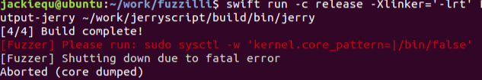
Jerryscript
swift run -c release -Xlinker='-lrt' FuzzilliCli --profile=jerryscript --storagePath=./output-jerry ~/work/jerryscript/build/bin/jerry
Fuzzer Statistics
-----------------
Total Samples: 46500
Interesting Samples Found: 958
Valid Samples Found: 32956
Corpus Size: 959
Correctness Rate: 70.87%
Timeout Rate: 1.56%
Crashes Found: 0
Timeouts Hit: 725
Coverage: 42.87%
Avg. program size: 49.28
Connected workers: 0
Execs / Second: 191.60
Fuzzer Overhead: 58.10%
Total Execs: 90758
########## Unique Crash Found ##########
function placeholder(){}
function main() {
var v2 = Array(1337);
var v4 = Promise.race(v2);
}
main();
// STDERR:

Slide 40
Fuzzer Statistics
-----------------
Total Samples: 119450
Interesting Samples Found: 1244
Valid Samples Found: 83729
Corpus Size: 1245
Correctness Rate: 70.10%
Timeout Rate: 1.36%
Crashes Found: 1
Timeouts Hit: 1625
Coverage: 47.37%
Avg. program size: 51.45
Connected workers: 0
Execs / Second: 242.54
Fuzzer Overhead: 58.78%
Total Execs: 176587
########## Unique Crash Found ##########
function placeholder(){}
function main() {
function v0(v1,v2,v3,v4) {
var v5 = new v0();
}
var v6 = v0();
}
main();
// STDERR:
[Fuzzer] Mutator correctness rates: CodeGenMutator: 55.09%, InputMutator: 73.03%, OperationMutator: 70.79%, CombineMutator: 99.88%, JITStressMutator: 80.48%
Fuzzer Statistics
-----------------
Total Samples: 154985
Interesting Samples Found: 1334
Valid Samples Found: 109220
Corpus Size: 1335
Correctness Rate: 70.47%
Timeout Rate: 1.32%
Crashes Found: 2
Timeouts Hit: 2042
Coverage: 48.58%
Avg. program size: 54.17
Connected workers: 0
Execs / Second: 213.86
Fuzzer Overhead: 56.00%
Total Execs: 216542
########## Unique Crash Found ##########
function placeholder(){}
function main() {
var v2 = new Promise(RegExp);
do {
var v5 = v2.then();
} while (-3662418045 < 8);
}
main();
// STDERR:

Slide 41
[REPRL] Script execution failed: Child unexpectedly terminated with signal 11 between executions. Retrying in 1 second...
########## Unique Crash Found ##########
function placeholder(){}
function main() {
var v1 = "function";
var v4 = [13.37,13.37];
var v6 = [1337,1337];
var v7 = [1337,-1024,13.37];
var v8 = {__proto__:v7,a:-1024,c:AggregateError,e:1337,valueOf:-1024};
var v9 = {__proto__:1337,constructor:v7,length:1337,valueOf:-1024};
var v10 = 3217819641;
var v11 = v10++;
var v13 = 44994;
var v14 = v13++;
var v21 = [13.37,-290921985,13.37];
var v22 = [];
var v29 = [13.37,13.37,13.37,Uint8ClampedArray,13.37];
var v31 = [13.37];
async function v32(v33,v34,v35,v36) {
var v37 = v32(v22,v36,v36,v36);
var v40 = new Uint8ClampedArray(39449);
var v41 = v40.copyWithin(2231875224,v40);
}
var v42 = [13.37,"-4294967297",v29,"-4294967297",2231875224,v31,"QvTV1zxcVp","QvTV1zxcVp",RangeError];
var v43 = {a:v21,constructor:v32};
var v44 = v32(1337,v43,RegExp,v42);
var v46 = [13.37,v11,13.37];
var v47 = [];
var v52 = [13.37,13.37,13.37,Uint8ClampedArray,13.37];
var v54 = [13.37];
async function v55(v56,v57,v58,v59) {
var v60 = v55(v47,v59,v59,v59);
var v63 = new Uint8ClampedArray(39449);
var v64 = v58.slice(2231875224,v63);
}
var v65 = [13.37,"-4294967297",v52,"-4294967297",v14,v54,"QvTV1zxcVp","QvTV1zxcVp",RangeError];
var v66 = {a:v46,constructor:v55};
var v67 = v55(1337,v66,RegExp,v65);
}
main();
// STDERR:

Slide 42
Fuzzer Statistics
-----------------
Total Samples: 4027850
Interesting Samples Found: 2507
Valid Samples Found: 1519197
Corpus Size: 1029
Correctness Rate: 37.72%
Timeout Rate: 0.39%
Crashes Found: 2082
Timeouts Hit: 15571
Coverage: 61.67%
Avg. program size: 62.81
Connected workers: 0
Execs / Second: 13.86
Fuzzer Overhead: 28.47%
Total Execs: 4873900

Slide 43
05
Set up
Wasm runtime
https://github.com/appcypher/awesome-wasm-runtimes
emscripten
Random program generator
Yarpgen
Csmith

Slide 44
wasm
Using Emscripten to compile c/c++ source code to .wasm code for wasm runtime to execute.

Slide 45
Randomly generating programs
Design Goals
Csmith:
• be well formed and have a single meaning according to the C standard.
• maximize expressiveness.
(support many language features and combinations of features)
YarpGen:
• to avoid, or at least delay, saturation.
(diversity, expressiveness, target specific optimization pass)

Slide 46
Randomly generating programs
Advantage
Csmith:
• cover a large subset of C, avoiding the undefined and unspecified behaviors. (to ensuring single interpretation.)
• C features supporting: complex control flow, data structures, pointers, arrays, structs.
(cost: analysis and dynamic checks increase Csmith code size. 40k lines)
YarpGen:
• generating programs without using dynamic checks.
• Using generation policies to target different parts of an optimizer.
• Automated tools for compiler fuzzing. (Harness)
• Do not support function call.

Slide 47
Randomly generating programs
Csmith:
• governed by a grammar for a subset of C.
• maintains: a global environment, a local environment (for safety check)
• top-down recursive generation with 6 steps.
YarpGen:
• Top-down recursive generation.
• No function call. Top level is main block.
• Lowering IR to the target language.

Slide 48
How to avoid Undefined and Unspecified Behaviors (UBs)
Csmith:
• Easy UBs: can be avoided structurally by generating programs in such a way that problems never arise.
• Hard UBs: using static analysis and adding run-time checks to the generated code.
• Static: to avoid use variables without initialization, initialize variables close to where they are declared.
• Run-time check: null pointer checks.
YarpGen:
• easy UBs: same with Csmith
• Hard UBs: It interleaves analysis and code generation. While generating, convert operations that trigger undefined behavior into similar operations that are safe.

Slide 49
06
Setup
Using csmith to generate random C program
Using Emscripten to compile C source code to .wasm file
Differential testing on wasmer, wasmtime, wasm3, wavm (most popular runtimes)
Some issues
Csmith may generate programs with infinite loops -- using timeout to limit execution time.
Emscripten may fail to compile codes generated by csmith -- try to use yarpgen.
Todo
add other compiler than Emscripten
use optimize options of the wasm runtimes
add other random code generators
add other language other than c/c++

Slide 50
Wasm Runtime coverage
Compile error handle

Slide 51
coverage
Libfuzzer for wasmer
Kcov -- for rust: wasmer & wasmtime
Gcov -- for c: wasm3
Honggfuzz-rs, afl-rs, cargo-fuzz
wasm-runtimes-fuzzing

Slide 52
收集动态执行trace, 从trace获取basic block执行信息 -- coverage info
Binary tool -- pin, qemu, valgrind
Script-- capture error info,

Slide 53
Coverage info
Using Gcov to collect coverage info of wasm3
Using Kcov to collect coverage info of wasmer, wasmtime
Using pin to collect instruction execution times -- slow
todo
Clean up test case files regularly -- the number of files will significant influence execution efficiency.
Integrate Kcov and Gcov to collect coverage info in real-time
Further test the timeout test case

Slide 54
07
Pintool :
collect number of total executed instructions, basic blocks, and modules, with addresses. Output the detail cov-info of every test, and a brief summary.
Issue
the numbers of instructions and basic blocks running at different time with the same input are always different. The difference is not huge, but it may influence the analysis.
If we want to compare basic block addresses executed at two different times, we need to load binary at the same base address.
using binary BI could simply get the basic block info, but we do not know the coverage ratio.
since Csmith is a random program generator, the test cases generated sequentially may have no relationship. Therefore, it is hard to do mutation like other coverage-guide testing tools.
Seems that wasmtime runs mush slower with pintool than other WebAssembly runtimes. And sometimes will thow “compiling function run over the stack limit” error
TODO
a way to analyze the coverage info. -- json may be suitable.
need to feed the coverage info back to the baseline.
feed back what?
feedback , then what? -- mutate like AFL?

Slide 55
08
Use RTN to ban dynamic BBL
Disable ASLR to load the test at the same address
Implement a statistic script to show the new coverage of each test

Slide 56
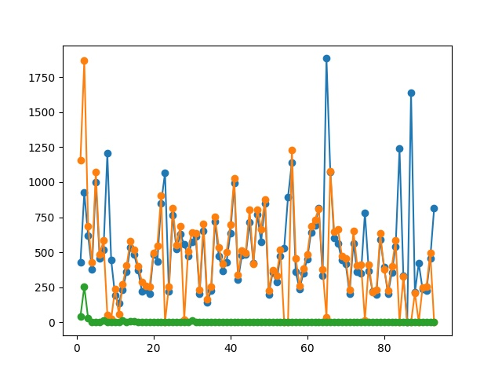
Part of the new coverage of each test, -1 means there is no data in the cov-*-*.log(wasm running error)
Blue: wasmer, orange: wasmtime, green: wasm3

Slide 57
todo
Does RTN api really works?
Feedback to generator

Slide 58
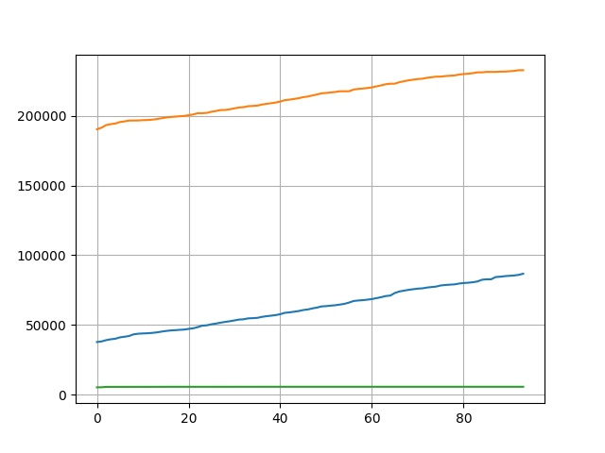
09
Update the .sh script
Show result in cumulative graph
Use no-pie to find the address range:
Seems that the addresses filtered by
pintool are all in the range

Slide 59
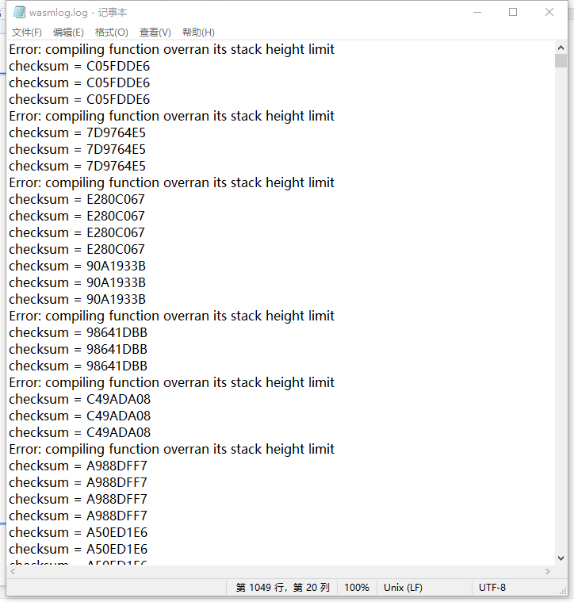
Record all the info in a summary.log:

Slide 60
Todo:
Connect BBL with source code
Update pintool

Slide 61

10
wasmer, wasmtime are multithreaded programs
Some errors:
Wasmtime once output a 40GB coverage log

Slide 62
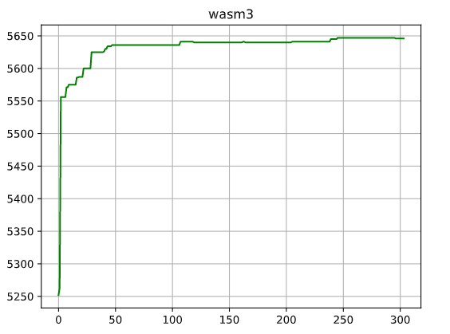
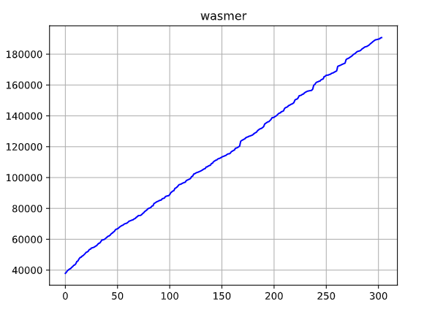
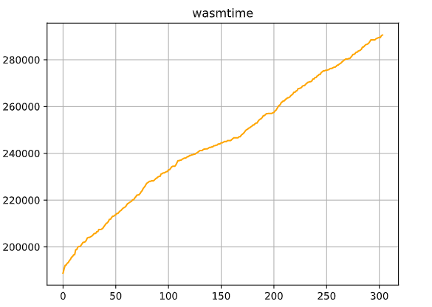

Slide 63
11
Update coverage script : add thread-safe structure
Add new coverage script : the old one could not identify dynamic created code?
Need more tests
Update baseline script

Slide 64
todo
Find interesting test case:
If a test case could cause more new basic blocks in one runtime than other test cases, or it could cause more new basic blocks in one runtime than in other runtimes, we think it is an “INTERESTING” test case. (just like what coverage-guide fuzzing does)
Need to update script:
The old pintool couldn’t collect correct basic blocks -- it couldn’t ignore dynamic created code. And that could explain why the former results are positively related (runtime created new JIT basic blocks for every test case)

Slide 65
12
Update pintool -- use new api other than RTN_isDynamic (watch the same question on StackOverflow)
Update statistic script, record the test case to find the one that create more bbls
Upload the baseline script on the server

Slide 66
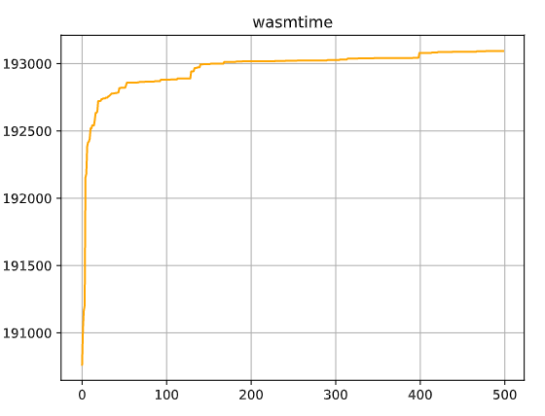
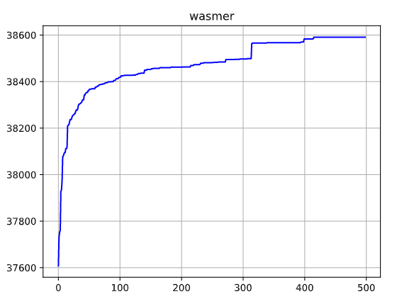
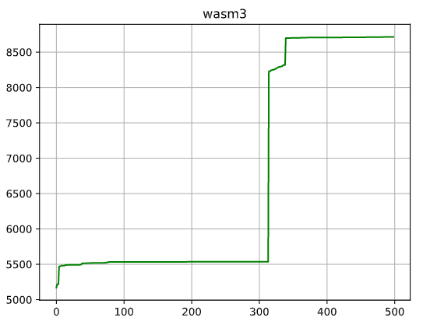
Using isValid():

Slide 67
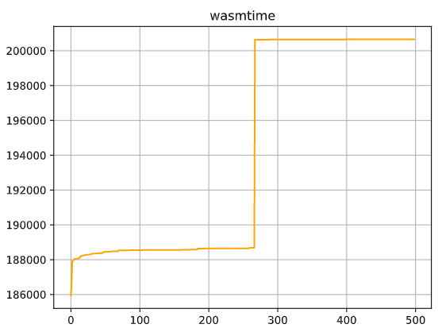
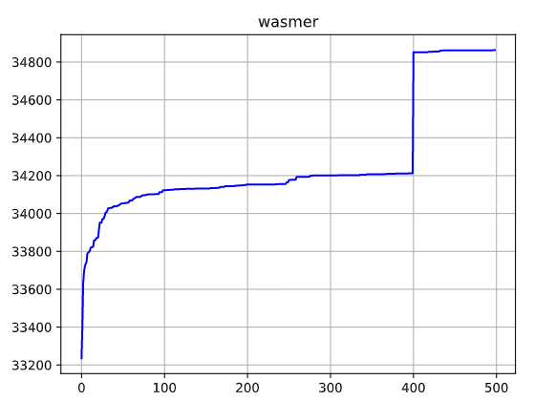
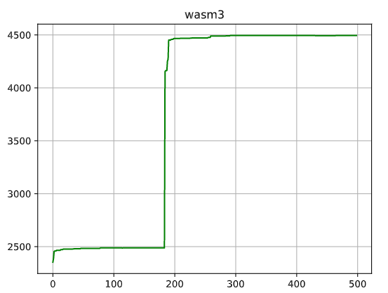
Using address boundary :

Slide 68
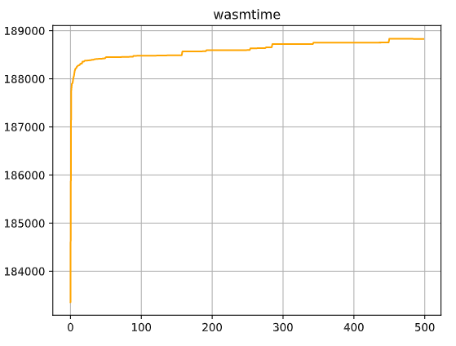
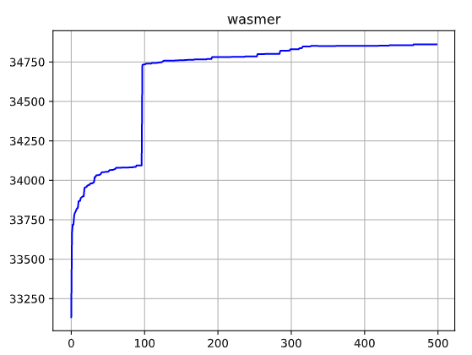
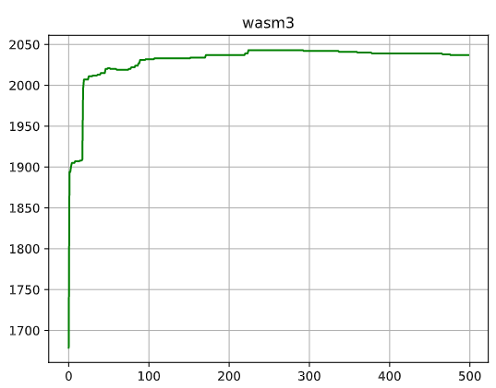
Using address boundary 2:

Slide 69
issues:
Why in address boundary 2, results in wasm3 decreases?
-- if there is no coverage data, the statistic script (calculate new bbls) will return -1, and wasm3 always has some issues like “overrun its stack height limit”
Run pintool on Wasmtime always need lots of time, and sometimes will output a very large record file, or just get stuck.
-- maybe pintool cause deadlock or endless loop when running on wasmtime.
-- why is timeout command useful?

Slide 70
todo:
Double check the “interesting” test cases.
Update script -- build a integrated tool to connect statistic data, bbls, results and test case source code.
The baseline running on the server is slow.

Slide 71
13
Compare source code:
Haven't find obvious differences

Slide 72
Csmith statistic info
Structure info: structure depth, number of union variables
Bitfield info: number of bit-field defined in structure(zero, non-zero, const, volatile), structures with bit-field
Address info: number of pointers, times of reference and dereference, depth of pointers, address compare
Volatile info: volatile & non-volatile operation times
Expression and block info: depth of expression and block, bit-field & reference on LHS/RHS

Slide 73
Source code generated by csmith
Define structures (with or without bit-field), or not
Define variables
Define functions: func_1 is the test function, others are subfunctions
Set values to variables and structures
Do reference and dereference operation on the variables and structures
Call functions nested
Calculate checksums of all values in all variables

Slide 74
Wasm runtime architecture
Wasmtime:
Compile a module:
First compilation walks over the WebAssembly module validating everything except function bodies.
all functions within a module are validated and compiled
Put the compilation information into a structure (module info, compiled jit code, and other info)
place all code into a form that's ready to get executed.(new memory mapping is allocated and the JIT code is copied into this memory mapping.)(jit code is executed at this point)

Slide 75
Wasm3:
Using a self-made interpreter, called M3.
Like "threaded code" http://www.complang.tuwien.ac.at/forth/threaded-code.html

Slide 76
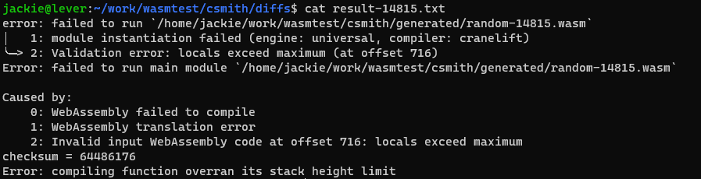
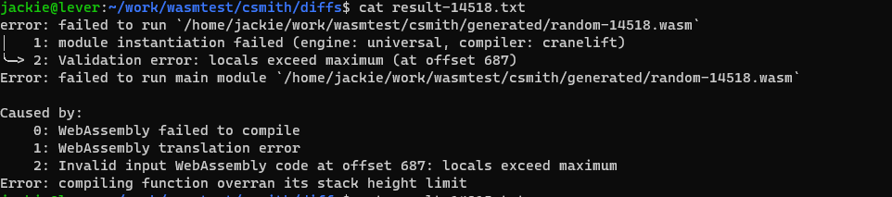
baseline

Slide 77
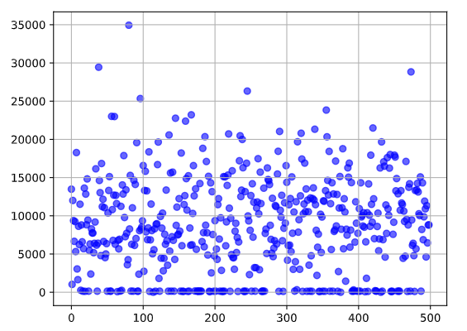
2021.08.12
Calculate the distance of csmith statistic info:
Didn’t find any relevant between
source code info and interesting
test case. (400, 268, 185)

Slide 78
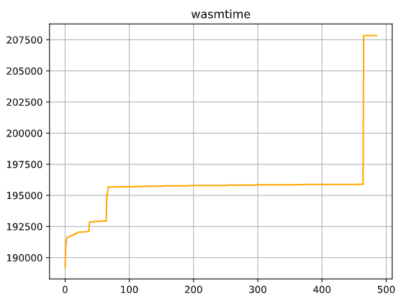
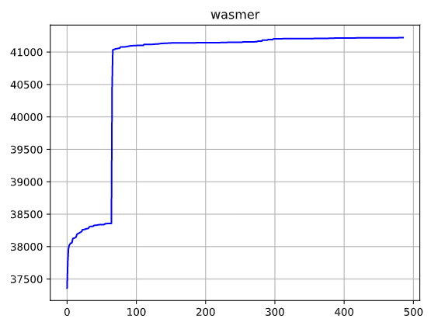
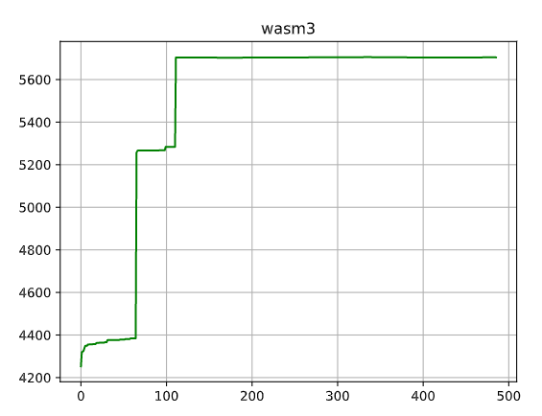
isValid()

Slide 79
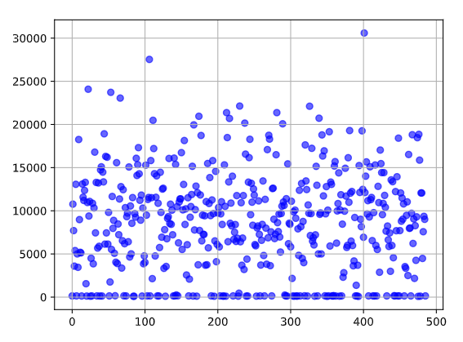

Slide 80
Interesting cases
random-14815.c
error: failed to run `/home/jackie/work/wasmtest/csmith/generated/random-14815.wasm`
│ 1: module instantiation failed (engine: universal, compiler: cranelift)
╰─> 2: Validation error: locals exceed maximum (at offset 716)
Error: failed to run main module `/home/jackie/work/wasmtest/csmith/generated/random-14815.wasm`
wasmer
Caused by:wasmtime
0: WebAssembly failed to compile
1: WebAssembly translation error
2: Invalid input WebAssembly code at offset 716: locals exceed maximum
checksum = 64486176 wavm
Error: compiling function overran its stack height limit wasm3
Gcc could execute successfully.
No runtime could execute in double-check.
But there is a result in the log -- wavm
About random-14518.c:
Seems that the source code is incorrect -- a.out generated by gcc cannot execute successfully.

Slide 81
Verify coverage data -- shared lib & multi-thread
Re-calculate distance -- random-14815
Debug information -- find related source code from coverage address
Find bug in 14815
Strength of differential testing (rather than normal fuzzing) -- find semantic error

Slide 82
14
Segment fault in wasm3: stack height limit -- should set stack height limit to a appropriate value, can’ t be too large
If you're generating artificial/pathological code, then it's probable you'll encounter a "function stack overflow" condition. But, there should be a constant large enough for d_m3MaxFunctionStackHeight that satisfies the Wasm code you're interpreting. Just keep doubling it. If there really isn't a solution, then this is probably a bug. Post the .wasm file for us.
Seems that the max value of stack height is 8000 -- a related value (stackheight * 2) is a unsigned short int type. Once the unsigned conversion from ‘int’ to ‘short unsigned int’ happens, there will be a segment fault.

Slide 83
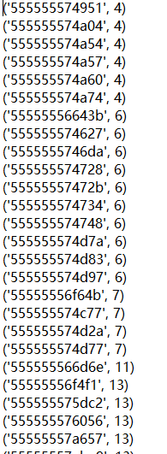
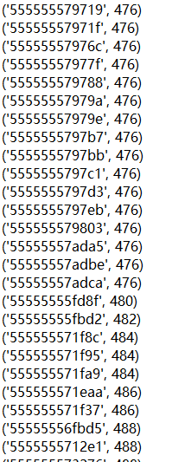
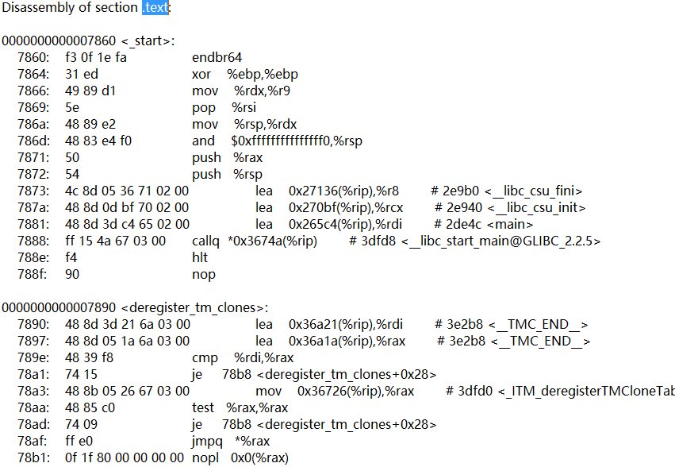
objdump
Collect the number of times the unique basic block occurs in 500 test cases with its address. Compared with objdump result.

Slide 84
Dynamo rio
Pintool -- debug, collect info
Verify coverage data -- shared lib & multi-thread
Re-calculate distance -- random-14815 (not work)
Debug information -- find related source code from coverage address -- using pintool (rtn)
Find bug in 14815
Strength of differential testing (rather than normal fuzzing) -- find semantic error
Add gcc to script -- verify result

Slide 85
todo
Has used pintool to collect each bbl’s corresponding function -- analyze which part or stage of the runtime is more unstable. And that means, we could generate test case in a targeted manner by adjust the strategy of csmith(random test case generator), to get “interesting test case” that could occur bugs in runtimes in a more efficient way.
Interesting test cases found -- random-61519, random-14815, random-78992
Strength of differential testing (rather than normal fuzzing) -- find semantic error, normal fuzzing focuses on crashes in one target rather than semantic error like producing wrong result. By using differential testing, we could find if there is semantic errors comparing results of different runtimes.

Slide 86
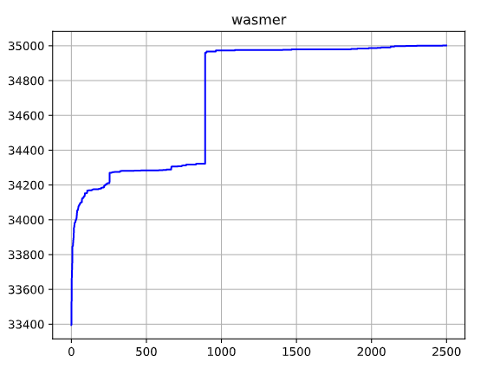
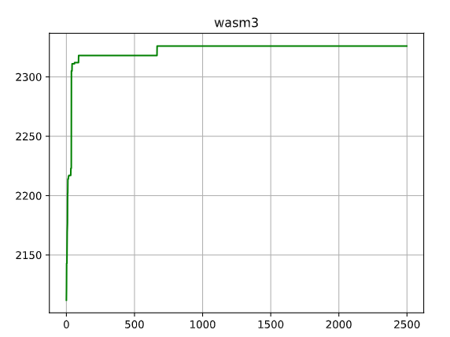
Wasmer: no.893 : 638 new bbls (case 256: 58 new bbls)(find similarity and difference between 2 cases -- to find individual feature or common feature)
wasm3: no. 667: 8 new bbls ， no.91:6
Find functions related to these new bbls -- change script
Double check interesting cases.

Slide 87

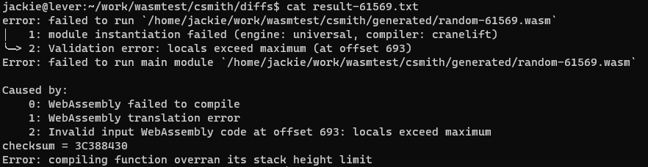
Interesting test case
Random-78992:
Random-61569:

Slide 88
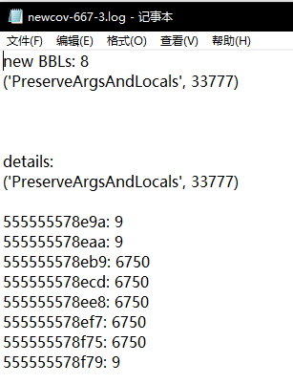
progress
Update statistic script -- could collect new bbls and related function names with their executed times in interesting test cases
Number of new bbl in this test case
The related function name of all new bbls
& sum of all executed times of bbls
Details : function name and its related new bbls
Check the related feature of these bbls
& if the rtn is executed in former test cases.

Slide 89
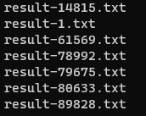
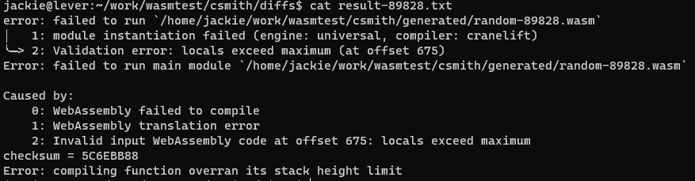
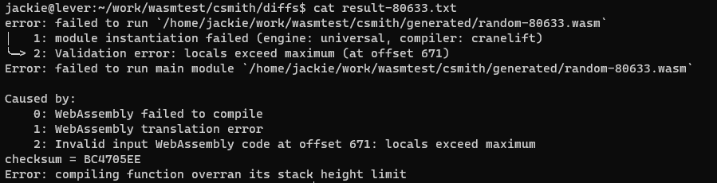
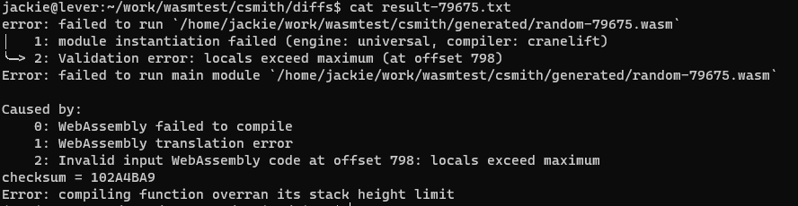
progress
Interesting cases:
Wavm is the most
stable runtime --
Implemented by c++
& llvm

Slide 90
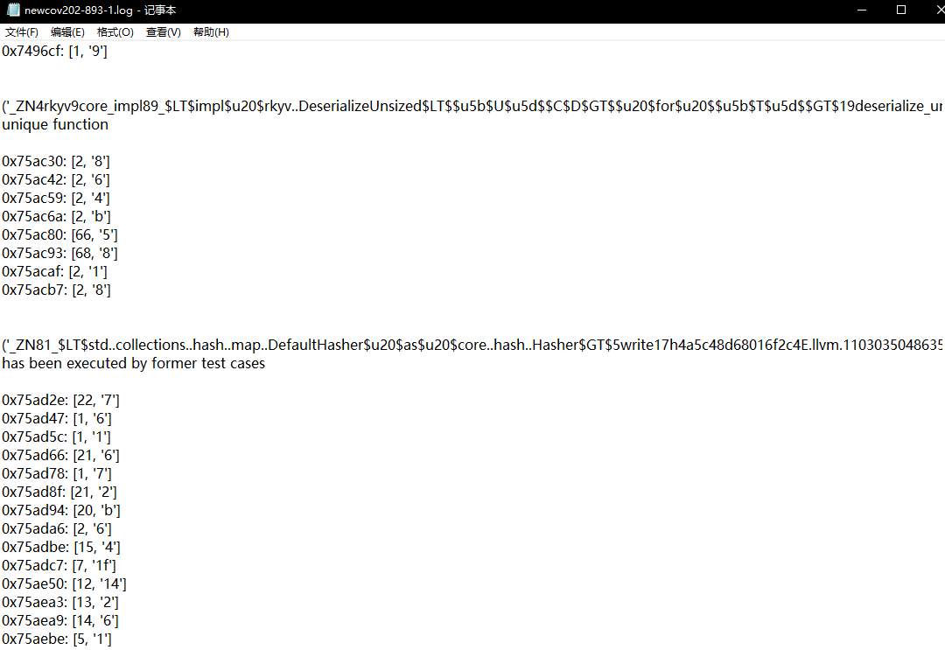
todo
The rtn name collected by pintool in runtimes written by rust has garbled characters -- how to fix it.

Slide 91
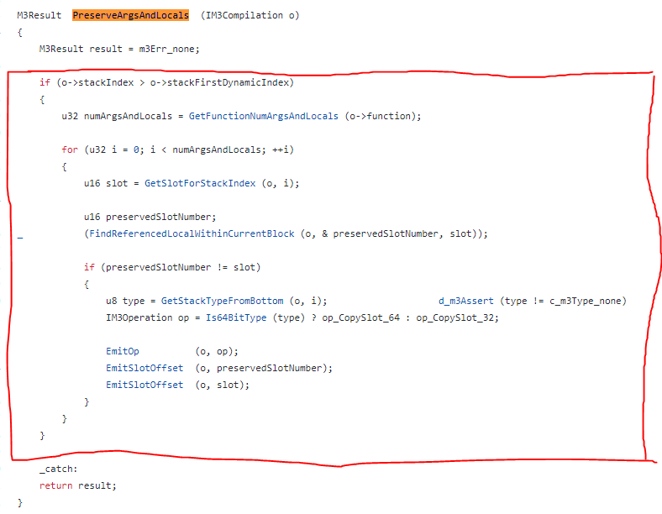
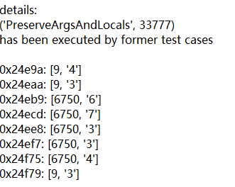
wasm3:no667

Slide 92
The source code of the new bbls in the interesting cases
Wams3: no667
There is a endless loop in the related source code. If we delete the loop, then there will be no “new bbls”.

Slide 93
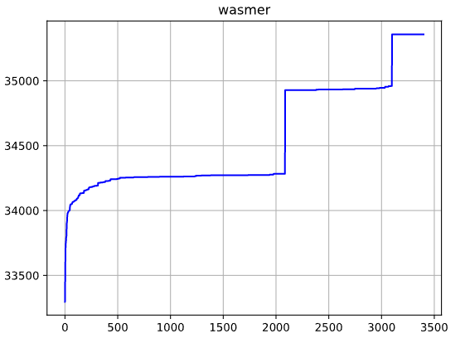
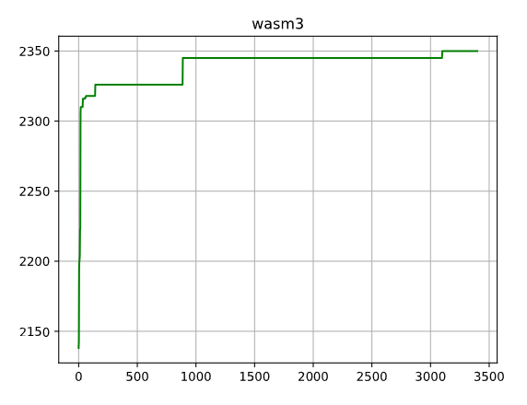
Some new interesting cases(generating new bbls)
Wasm3: no. 142, no. 888 (seems that they all have endless loop), no. 3100(throw error)
Wasmer: no. 2087(execute successfully) no. 3100(fail to execute and throw error)
Wasm3:

Slide 94
Try to find feature related to “preserveargsandlocals”
In test case 667: change loop condition
Const uint_64 65535: [761,760]
Const uint_32 65535: [759,758]
Const uint_16 65535: [759,758]
After changed type of loop condition, loop number, or whether it is const:
Times or type cannot influence number of “preserveargsandlocals”, the only reason is
whether it is const. ()

Slide 95
Try to find feature related to “preserveargsandlocals”
But “const” cannot cause “preserve” itself,
Try to make some simple loop structure with a const number as its condition,
Cannot cause “preserve”.
So there should be another reason.

Slide 96
Try to find feature related to “preserveargsandlocals”
Endless loop with a const as its loop condition
Nested function with bit operation?

Slide 97
Delta debugging
Clang plug-in
Llvm
--transformation

Slide 98
Todo list
One feature (code coverage) could be triggered by different type of test cases. A test cases will be considered as “interesting case” if it has a new code coverage. Follow-up test cases with the same coverage will not be considered as “interesting” even if the coverage might be triggered by different source code feature.
Therefore, we need to double check if a coverage is triggered be feature we have already analyzed and collect, to avoid missing new feature for further fuzzing.

Slide 99
Todo list
2. After analyzing and collecting features, we need to use these feature to reproduce new test cases for fuzzing (with higher code coverage). Theoretically, a reproduced test code block could trigger related coverage all the time.
However, in practice, some simple reproduced test code block could trigger coverage in a simple test cases. But it cannot trigger coverage in a more complicated test cases.
This issue needs further study.

Slide 100
Using AST to analyze and reproduce coverage-related feature
After using pintool to identify the location of test code which could trigger new coverage, we need to analyze and find the exact feature.
In summary, we need to recursively remove code from the identified code block to see if the rest code could still trigger the coverage, so we could locate the exact statement.
After that, simplify the statement to find the minimal structure. We need to do some mutation to check if a code node is redundant, and then remove the redundant node to reduce the statement or block.

Slide 101
Using AST to analyze and reproduce coverage-related feature
This progress will be easier to implement by using AST operation rather than directly modifying source code.
Clang is a front-end compiler, providing rich details of AST so that we could write our own plugin to do source-to-source transformation based on AST.

Slide 102
Pseudo algorithm -- analyzing coverage-related feature
Preparation: using pintool and wasm text file to identify the approximately location of the coverage-related code.
At this stage, we might get a statement or a code block containing the code we want.
If get a statement, start simplification.
If get a code block, need to remove redundant statements.
Recursively remove the sub-block or statements to check if the rest code could still trigger coverage.
Repeat (a) to get minimal block, this block contains feature that could trigger coverage
After get the exact block, we need to do simplification

Slide 103
Pseudo algorithm -- analyzing coverage-related feature
Simplification: the statement or block we find may contains lots of redundant structure irrelevant to the coverage. Remove them and get a minimal structure so that we could reproduce test cases.
This progress should base on AST.
Start at the innermost layer of ast, try to change the node（type, value）
If (1) could trigger coverage, move this layer while avoiding syntax error
If (2) the rest code could still trigger coverage, then the removed layer might be redundant.
If (1)(2) or (3) causing no coverage triggered, then the original node or layer might be the feature we want to find. Preserve it, and repeat (123) on the outer layer or other node on the same layer.

Slide 104
Pseudo algorithm -- analyzing coverage-related feature
Double check: after simplification, we should get a minimal structure that could trigger coverage. We need to double check if we miss some feature when simplifying.
Everytime we find a related layer or node in simplification, we could remove it and then add the removed redundant code back to the statement or block to see if coverage could be triggered. If the added-back statement cannot trigger the coverage, we could say that the removed code is actually redundant and the related layer or node is the key feature.
Or we can add redundant code to the minimal structure we have simplified to check if the feature we found could always trigger the coverage

Slide 105
Pseudo algorithm -- analyzing coverage-related feature
The thinking of simplification is like delta debugging (both need to pinpoint the issue).
If we could collect enough features related to new coverages, we could then feedback these feature to test case generator to produce higher code-coverage test cases, which could help us find error and bugs more efficient that just do brute force fuzzing without any guide. (actually this is very similar to coverage-guided fuzzing, but more targeted)

Slide 106
Source-to-source transformation (using clang AST)

Slide 107
Todo list
2-d feature-runtime map
Improve the algorithm
Combine clang plugin and pintool
Different from delta debugging
Missing features (multiple features)
How to feedback
Baseline -- use different compile option or runtime option

Slide 108
How to use clang libtools to do automated feature extraction
2 issues:
Recursively access Stmt node from outer layer to inner layer, and remove it. Record the accessed node and coverage result.
Possible issues: syntax error during remove
Try to locate stmt without remove -- instrument log stmt?
Will log insertion influence runtime behaviour?
Or directly use wasm text file to locate
Automated mutation strategy on AST node from the inner layer to the outer layer. Preserve potential features.

Slide 109
Coverage features feedback to code generator strategy
Make the code generator tendentiously produces test cases with certain structures(features).
The features are extracted from “interesting test cases” which have a significant increases in new coverage by clang plugin.

Slide 110
Combine pintool and clang plugin
To build a automated feature analysis tool:
Use pintool to identify the approximate location of stmt that have potential feature.
After located exact location of stmt, clang plugin will use pintool to verify whether the coverage is influenced by each mutation operation on the identified stmt.
A simple way is to just watch on whether there is coverage after mutation.
Or record the times of coverage to do a finer analysis.

