Slide 1
Forecasting for Inventory Optimization
under Long Replenishment Lead Times
Mid-term progress: probabilistic forecasting and reinforcement learning replenishment
Yizhe (Dorothy) Hu
BSc Data Science & Artificial Intelligence, LIACS
November 2026
Notes:
[20 seconds]
This thesis studies weekly inventory replenishment when every order takes about fifteen weeks to arrive. I have completed the first forecasting experiments. The next stage will use those probability forecasts to train and compare replenishment policies.

Slide 2
Company setting and current replenishment process
Physical supply chain
Overseas
factories
Ocean shipment
approximately 15 weeks
European central warehouse
The Netherlands
European
customers
Weekly replenishment decision
A Past monthly sales
dₜ₋₁, …, dₜ₋ₖ
B Weighted forecast
Fₜ = Σwₖdₜ₋ₖ / Σwₖ
C Target stock
Tₜ = Mₜ × Fₜ
D Weekly order
qₜ = max(0, Tₜ − IPₜ)
d = monthly demand • w = historical weight • M = fixed coverage multiplier
IPₜ = on-hand + in-transit + in-production inventory
Simple and stable—but future demand is represented by one deterministic value.
02
Notes:
[75 seconds]
The Dutch subsidiary has the European central warehouse but no factory. Goods are shipped from overseas factories and need about fifteen weeks to arrive. A replenishment decision is made every week. In the notation shown here, d is past monthly demand, w is the weight assigned to each past month, F is the weighted monthly forecast, M is the fixed stock-coverage multiplier, T is target inventory, IP is inventory position, and q is the weekly order quantity. Inventory position includes on-hand, in-transit and in-production inventory. The rule is easy to operate, but it represents future demand with one deterministic number.

Slide 3
Why the 15-week delay creates inventory risk
Week t
Order placed
Week t + 15
Shipment arrives
approximately 15-week lead time
Demand pattern visible at order time
Demand during the lead time can look different
Order too much
Order too little
Unsold inventory remains
Demand exceeds stock
Slow-moving stock + holding cost
Stockout + lost sales
+ customer risk
Stock
Demand
Stock
Demand
Research objective in plain language
Months of stock
= inventory ÷ average monthly sales
Backorder rate
= unfulfilled demand ÷ total demand
Keep backorders ≤ 5%, then minimize months of stock
03
Notes:
[80 seconds]
This timeline is the key distinction. The company places an order at week t, but the shipment only arrives around week t plus fifteen. We are not claiming that the model predicts every one of the next fifteen weeks here. The problem is that the demand pattern used when ordering may already be different by the time the goods arrive. If the order is too large, inventory remains after demand and creates slow-moving stock and holding cost. If it is too small, demand exceeds stock and creates backorders, lost sales and customer risk. Months of stock means inventory divided by average monthly sales. Backorder rate means unfulfilled demand divided by total demand. The research objective is therefore to keep backorders at or below five percent and then minimize months of stock.

Slide 4
Research approach
Forecasting module: completed
Demand grouping
Weekly
demand
Smooth
Erratic
Intermittent
Lumpy
Zero
No forecast
Empirical distribution + grouped LightGBM
Probability intervals: 70%, 80%, 90%
Replenishment module: planned
Sales matching
Forecast + inventory state
+ open orders
Common weekly
inventory simulator
Compare months of stock
and backorder rate
Classical order-up-to
Reinforcement learning
04
Notes:
[85 seconds]
The forecasting module is complete. Weekly demand is first assigned to one of five recognizable patterns. Smooth products sell regularly, erratic products fluctuate, intermittent products contain many zeros, lumpy products combine zeros with irregular spikes, and the Zero group contains mostly or entirely zero-sales weeks. The current Zero group is not forecast; it receives a zero forecast. The other groups enter the empirical and LightGBM models and produce probability intervals. The replenishment module is planned. It will combine the forecast with inventory and open orders, run three policies in the same simulator, and compare months of stock and backorder rate under identical conditions.

Slide 5
Forecasting experiment completed so far
Training period | Testing period
2025-W41 to 2026-W24 | 2026-W25 to 2026-W42
7,196
6,464
115,992
50–80%
merged materials
evaluated SKUs
SKU-week outcomes
Zero-threshold test
Method | Probability forecast
Historical empirical | Observed frequency of training sales
Grouped LightGBM | Quantile regression pooled within demand groups
Metrics: coverage, interval width and normalized outside distance
05
Notes:
[55 seconds]
I merged seven thousand one hundred and ninety-six materials. Six thousand four hundred and sixty-four have the required training history for the main experiment. I train on thirty-six weeks and test on the next eighteen weeks, without updating features using test outcomes. The main method comparison is historical empirical distribution versus grouped LightGBM quantile regression. I also vary the Zero threshold from fifty to eighty percent. The threshold means the share of zero-sales weeks required before a SKU receives a zero forecast. I evaluate interval coverage, interval width and the observations outside the interval. Returns remain negative sales and receive no special treatment in this version.

Slide 6
At 60% threshold, LightGBM gains little coverage by widening the interval
+1.0 pp
coverage
+20%
mean interval width
Empirical forecasting remains competitive and easier to explain.
All SKUs, 80% interval, Zero threshold 60%
06
Notes:
[70 seconds]
This comparison uses the eighty percent prediction interval and includes all evaluated SKUs. The historical empirical method covers ninety point two percent of observations with a mean width of seventeen point nine units. Grouped LightGBM covers ninety-one point three percent with a width of twenty-one point four. LightGBM therefore gains about one percentage point of coverage, but its interval is about twenty percent wider. Both methods exceed the nominal eighty percent coverage because the data contains many zeros. At this stage, the empirical distribution remains a strong and more transparent benchmark. Higher coverage alone does not show a better forecast.
Source: zero-threshold experiment, main W42 results, all-SKU population.

Slide 7
Lower Zero thresholds shorten intervals and increase outside points
Outside points
Empirical: 12,546 at 50% → 9,318 at 80%
LightGBM: 11,442 at 50% → 7,855 at 80%
Threshold choice must balance narrow intervals against missed demand.
07
Notes:
[80 seconds]
The Zero threshold changes which SKUs receive a zero forecast and which SKUs enter the non-Zero demand groups. For both the historical empirical method and LightGBM, raising the threshold from fifty to eighty percent widens the eighty percent interval and increases observed coverage. At fifty percent, more SKUs receive zero forecasts. The intervals are shorter, but the empirical method produces twelve thousand five hundred and forty-six outside points and LightGBM eleven thousand four hundred and forty-two. At eighty percent, those totals fall to nine thousand three hundred and eighteen and seven thousand eight hundred and fifty-five. The threshold therefore controls a real trade-off. A low threshold looks efficient because intervals are narrow, but it misses more renewed demand. Sixty percent remains a working setting, not a final choice.
Source: zero-threshold experiment, main W42 results, all-SKU population.

Slide 8
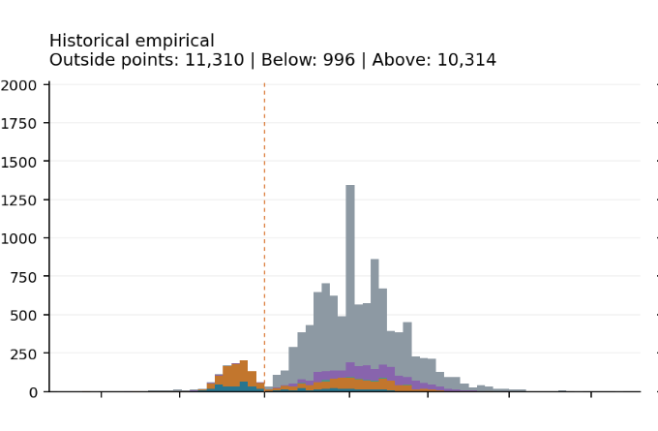
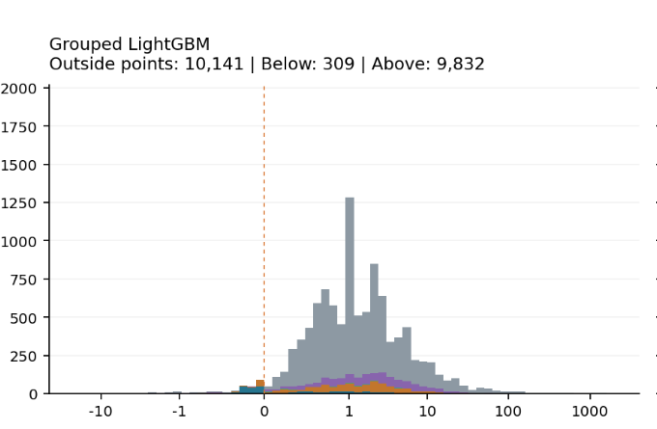
Outside-point histograms: most misses are high-demand surprises
← actual below lower bound
actual above upper bound →
Most misses are to the right of zero: occasional high-demand orders dominate.
08
Notes:
[60 seconds]
These histograms show the signed distance of every observation outside the eighty percent prediction interval at the sixty percent Zero threshold. Values left of zero are actual sales below the lower bound. Values right of zero are actual sales above the upper bound. For both the historical empirical forecast and grouped LightGBM, the large majority of misses sit on the positive side. This means the observed demand was higher than the upper forecast bound. The pattern is consistent with occasional large customer orders. These observations are therefore candidates for business investigation and replenishment design, not points to delete automatically.
Source: outside-point distribution, 80% interval, Zero threshold 60%.

Slide 9
TODO: turn forecast evidence into replenishment decisions
1 Validate data
stock, arrivals, open orders, backorders
2 Prepare inputs
convert weekly forecasts to 15-week demand
3 Build simulator
inventory dynamics + reward function
4 Compare policies
sales matching, classical, RL
Common evaluation
Same demand sequence
Same 15-week lead time
Same cost and service metrics
Fair policy comparison
Success condition: lowest months of stock with backorder rate ≤ 5%
09
Notes:
[55 seconds]
The next stage turns the forecasting evidence into an inventory experiment. First, I will validate the operational records for stock, arrivals, open orders and backorders. Second, I will convert the weekly probability forecasts into demand inputs that are consistent with the fifteen-week lead time. Third, I will build the common inventory simulator and define a reward that penalizes both stock and backorders. Finally, I will compare sales matching, a classical policy and reinforcement learning under identical conditions. The success condition remains the lowest months of stock among policies that keep the backorder rate at or below five percent.

Slide 10
Questions?
Forecasting and replenishment under long lead times
Notes:
Invite questions. Backup slides contain method definitions, the full Zero-threshold comparison, the complete outside-point figure, and limitations.

Slide 11
Thank you
Yizhe (Dorothy) Hu
Notes:
Thank the audience and close the presentation.

Slide 12
Backup: forecasting methods and evaluation
Method | Forecast construction
Historical empirical | SKU-level distribution from all training observations
Recent 13-week empirical | SKU-level distribution from the latest 13 weeks
Damped trend + residuals | Recent trend with empirical residual uncertainty
Grouped LightGBM | Quantile regression pooled within demand groups
Poisson / negative binomial | Additional count-data benchmarks
Prediction intervals
Evaluation
70%, 80% and 90%
Coverage, mean width and outside distance
Returns remain negative sales. The current Zero-group rule outputs zero forecasts.
12
Notes:
Use this slide if asked about model definitions or evaluation. Historical empirical uses the complete training history for each SKU. LightGBM pools lag and demand-pattern features within groups and fits separate quantile models. Recent empirical and damped trend remain secondary baselines. Poisson and negative binomial appear only where their count assumptions apply.

Slide 13
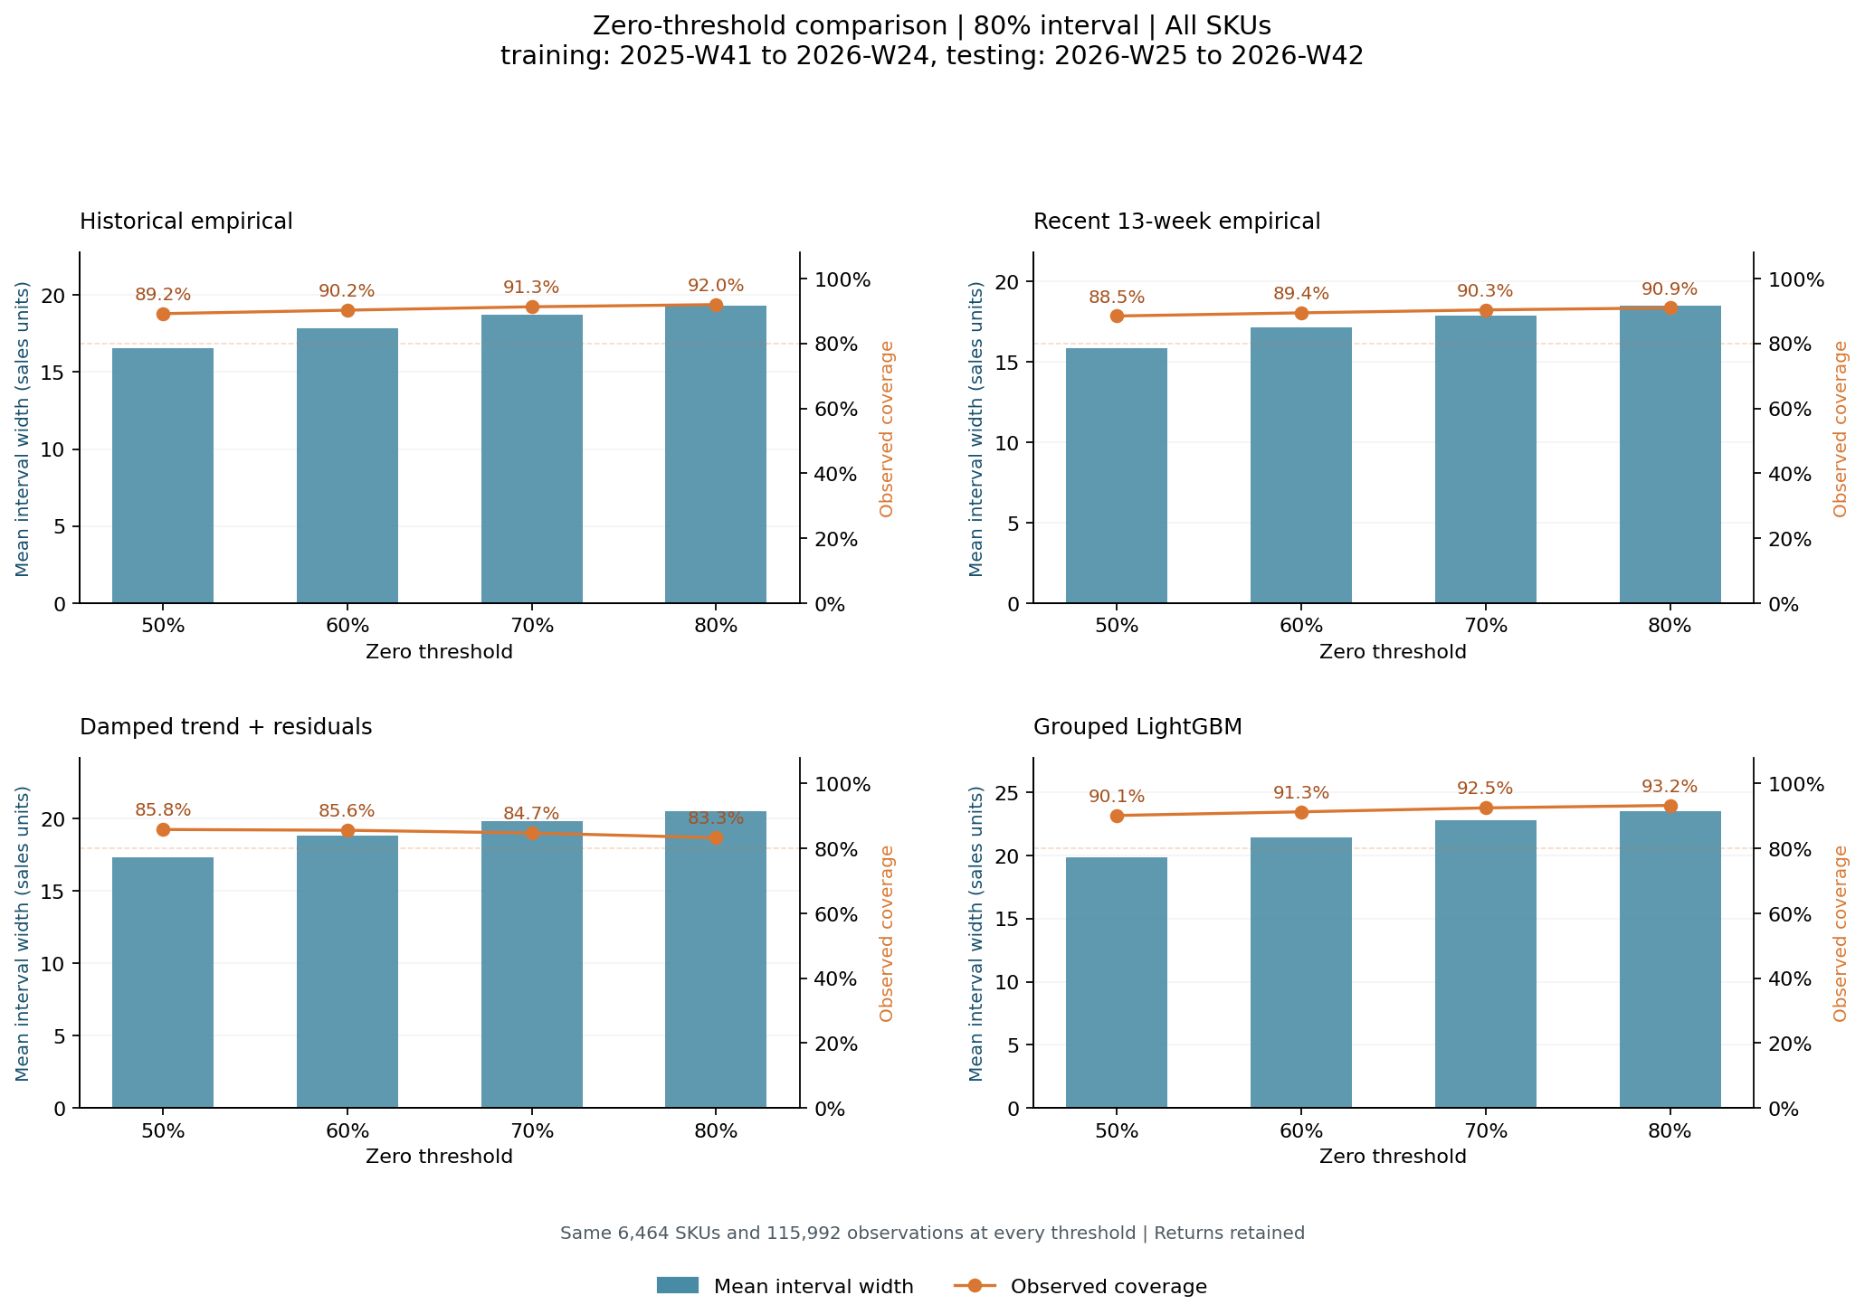
Backup: full Zero-threshold comparison
13
Notes:
Original result figure from the threshold experiment. Blue bars show mean width for the 80% interval. Orange points show observed coverage. The main experiment trains on 2025-W41 to 2026-W24 and tests on 2026-W25 to 2026-W42. All 6,464 SKUs and 115,992 observations remain in each threshold comparison.

Slide 14
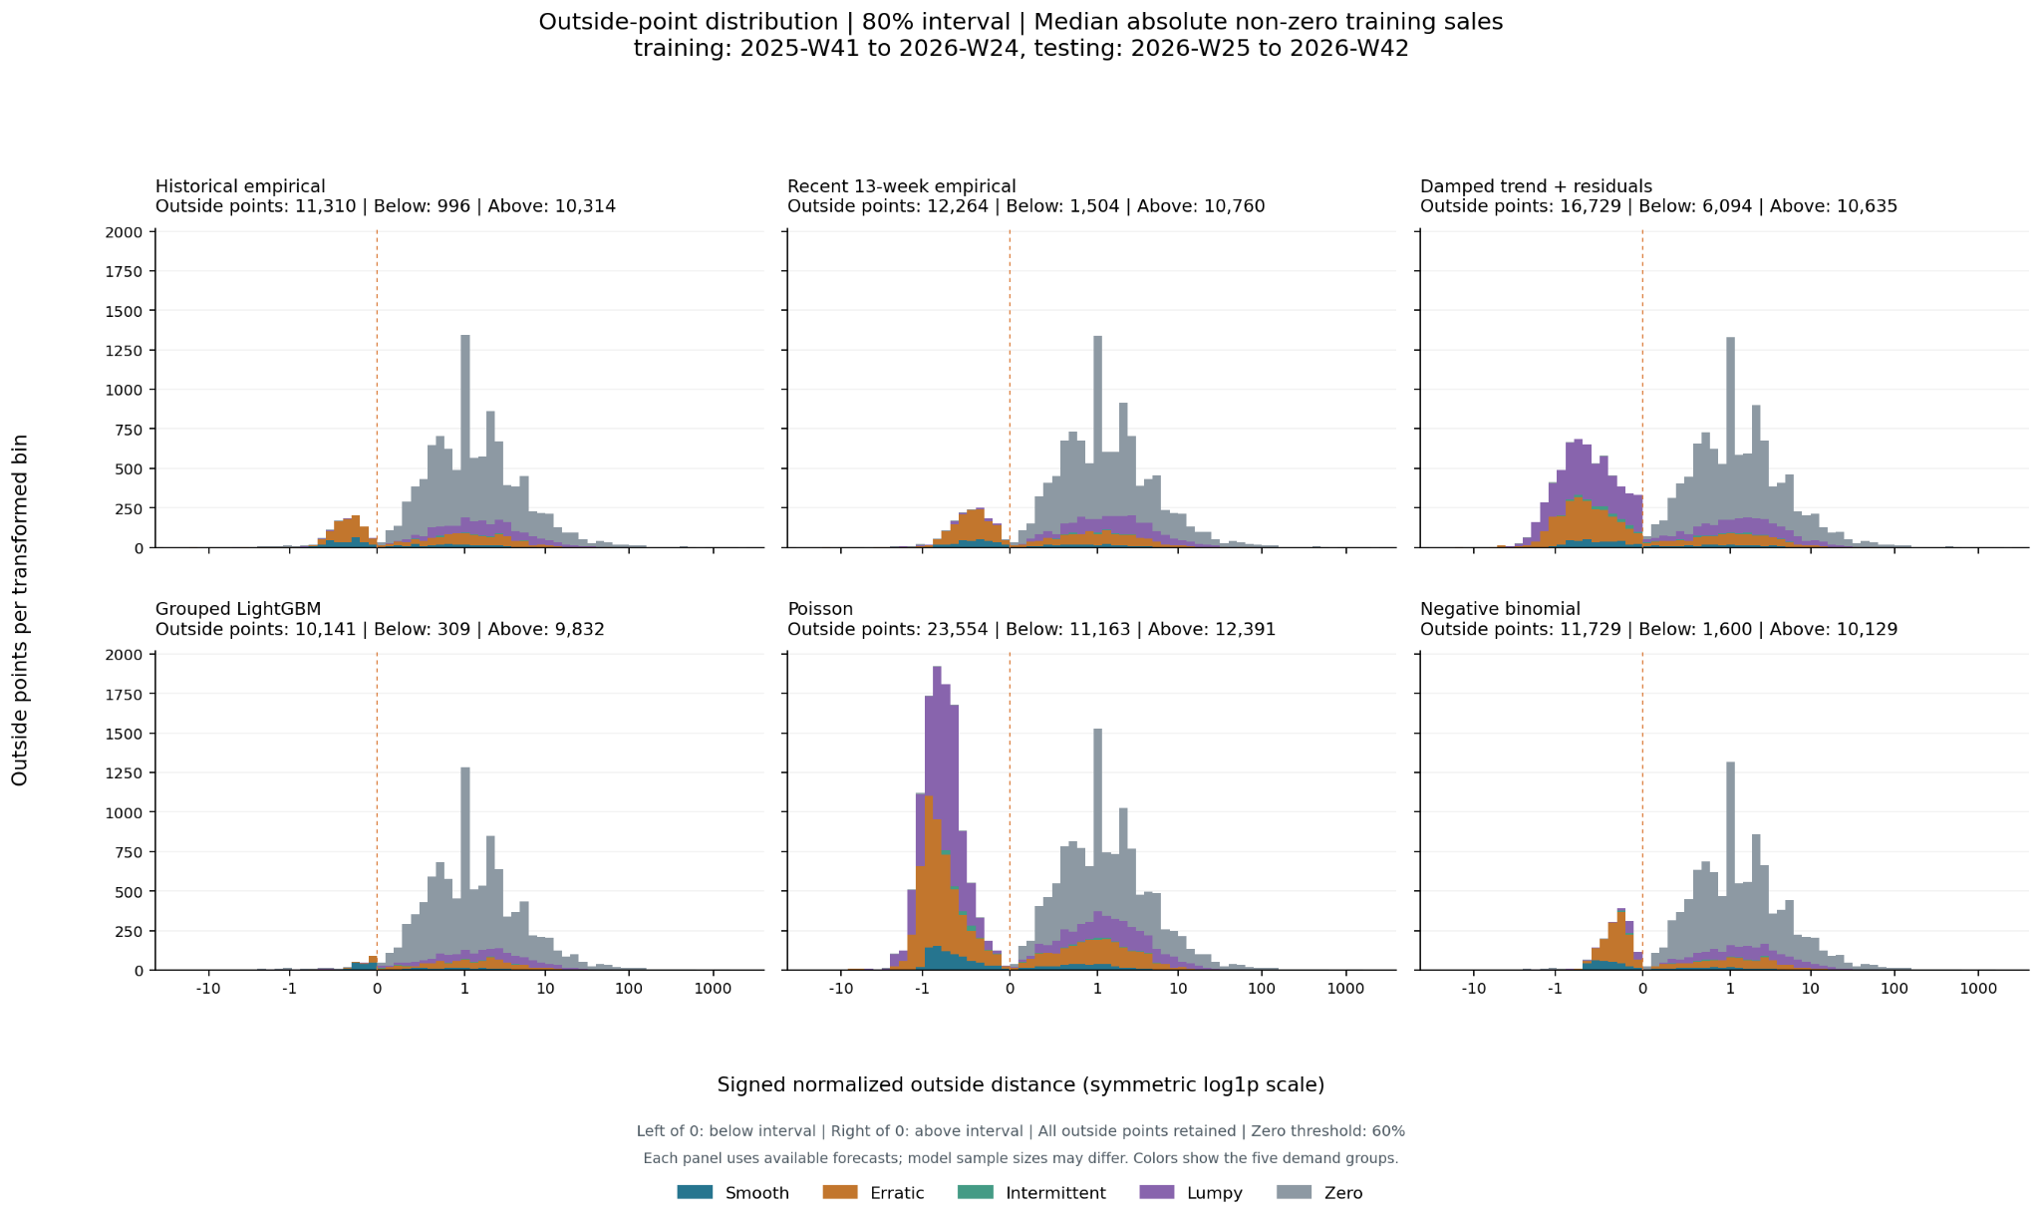
Backup: outside-point distribution
14
Notes:
Original outside-point figure at the 80% interval and 60% Zero threshold. Negative values fall below the lower prediction bound. Positive values exceed the upper bound. Distance is normalized by the SKU median absolute non-zero training sale, with a minimum denominator of one. The horizontal axis uses a symmetric log1p transformation.

Slide 15
Backup: limitations and research basis
Current limitations
Research basis
Observed sales can differ from unconstrained demand during stockouts.
The Zero threshold changes group assignment and forecast behavior.
Weekly interval coverage does not establish inventory performance.
The simulator and reinforcement learning results are not yet available.
Syntetos, Boylan & Croston (2005). Demand-pattern classification.
Wang, Kang & Petropoulos (2024). Probabilistic intermittent-demand forecasts.
Prak & Teunter (2019). Forecast uncertainty in inventory models.
Babai et al. (2022). Lead-time demand variance and safety stock.
Boute et al. (2022). Deep reinforcement learning for inventory control.
Project sources: research proposal, merged weekly-sales experiment and Zero-threshold sensitivity results.
15
Notes:
References follow the supplied research proposal and experiment files. The forecasting experiment uses observed sales, which may understate unconstrained demand during stockouts. The replenishment experiment requires historical stock, arrivals, open orders and backorder validation.

