Slide 1
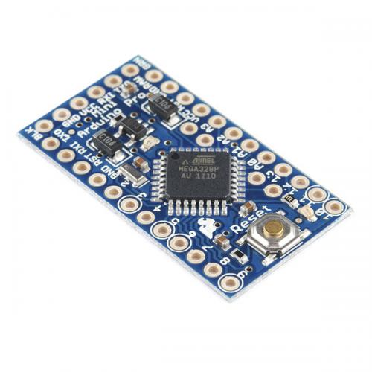
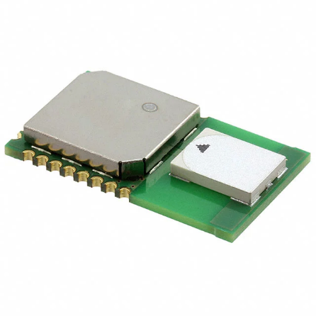
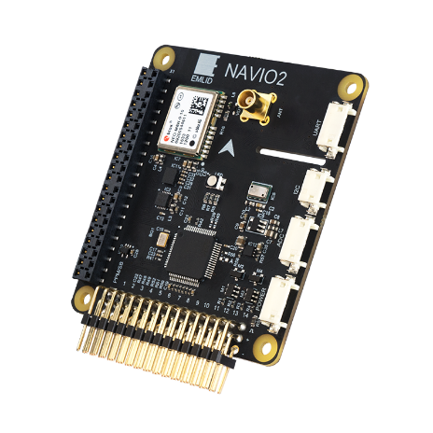
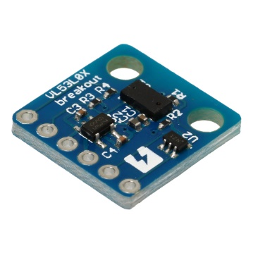
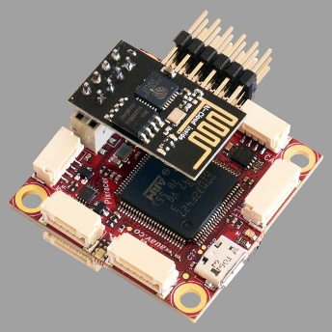

SPI
Arduino Pro Mini
DWM1000
Micro controller
UART
UWB antenna
I2C
VL53L0X
Distance sensor
Sensor board
NAVIO2
USB
Raspberry Pi
Pixracer
Main computer
Fright controller

Slide 2
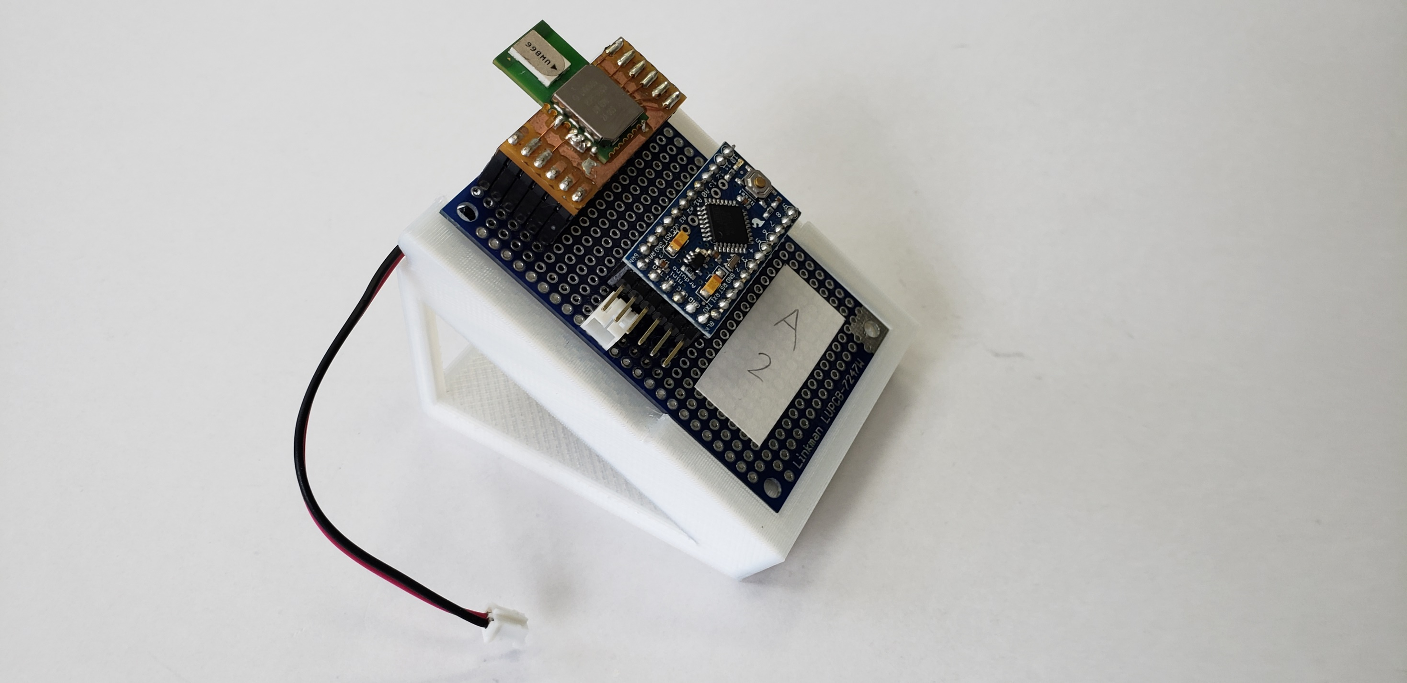
30°

Slide 3


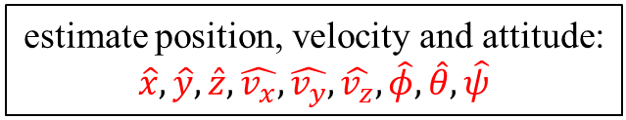
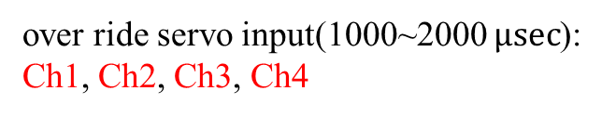

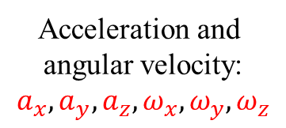
UWB Modules
distance between Anchors and Tag:
$$d_{1},d_{2},d_{3},d_{4}$$
Raspberry Pi
estimate position, velocity and attitude:
$$\hat{x},\hat{y},\hat{z},\hat{v_{x}},\hat{v_{y}},\hat{v_{z}},\hat{φ},\hat{θ},\hat{ψ}$$
NAVIO2
Distance Sensor
Acceleration and
angular velocity:
$$a_{x},a_{y},a_{z},ω_{x},ω_{y},ω_{z}$$
altitude: h
position PID controller
set position: $x_{d},y_{d},z_{d}$
calculate desired angle
$$φ_{d},θ_{d},ψ_{d}$$
change angle to servo signal
over ride servo input(1000~2000 $μsec$):
Ch1, Ch2, Ch3, Ch4
Pixracer
Attitude controller

Slide 4


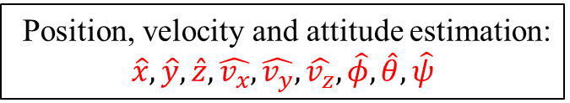

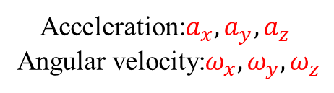
Distance Sensor
UWB Modules
Altitude: h
Distances between Anchors and Tag:
$$d_{1},d_{2},d_{3},d_{4}$$
Position, velocity and attitude estimation:
$$\hat{x},\hat{y},\hat{z},\hat{v_{x}},\hat{v_{y}},\hat{v_{z}},\hat{φ},\hat{θ},\hat{ψ}$$
NAVIO2
Acceleration:$a_{x},a_{y},a_{z}$
Angular velocity:$ω_{x},ω_{y},ω_{z}$
Position PID controller
Set position: $x_{d},y_{d},z_{d}$
Desired angle calcuration
$$φ_{d},θ_{d},ψ_{d}$$
Change angles to servo signal
Raspberry Pi
over ride servo input(1000~2000 $μsec$):
Ch1, Ch2, Ch3, Ch4
Pixracer
Attitude controller

Slide 5
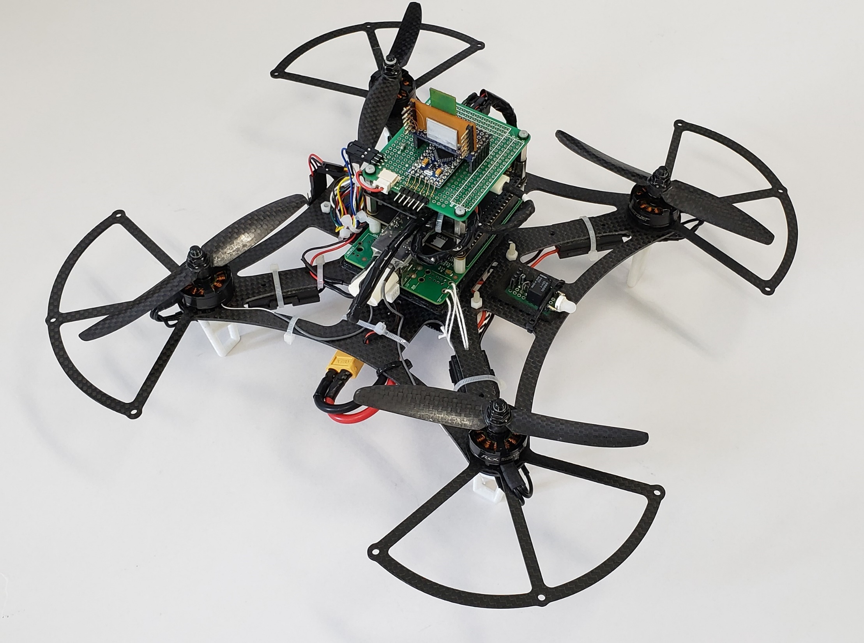
UWB module
Distance sensor
IMU
165mm
650g, 2633KV
Propeller(Inch):
5(diameter) × 3(pitch)
LiPo (3Cell 1800mAh)

Slide 6

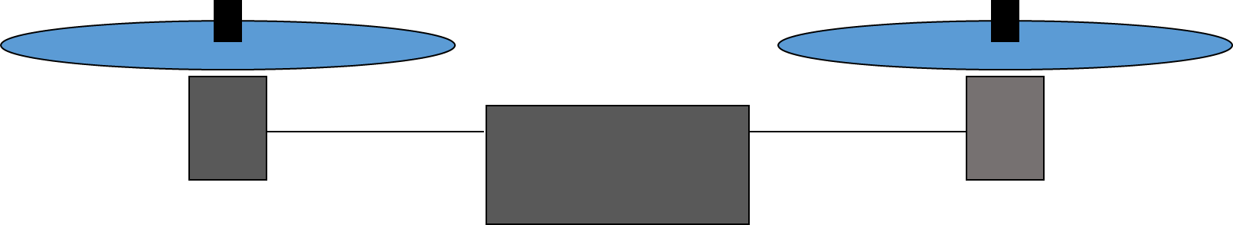
: Fixed station
: Mobile station
Quad-rotor

Slide 8
GPS
Bluetooth
Wi-Fi
Power spectral density
UWB
1.6
2.4
3.1
5.0
10.6
Frequency [GHz]

Slide 9
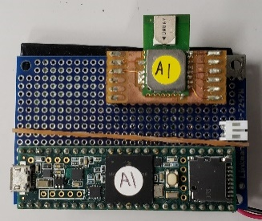






Anchor2
(x₂, y₂, z₂)
Anchor3
(x₃, y₃, z₃)
$$d_{2}$$
Tag
($\hat{x}$, $\hat{y}$, $\hat{z}$)
$$d_{3}$$
$$d_{1}$$
$$d_{4}$$
Anchor4
(x₄, y₄, z₄)
Anchor1
(x₁, y₁, z₁)

Slide 10

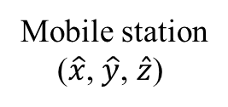



Fixed station2
(x₂, y₂, z₂)
Fixed station3
(x₃, y₃, z₃)
$$d_{2}$$
Mobile station
($\hat{x}$, $\hat{y}$, $\hat{z}$)
$$d_{3}$$
$$d_{1}$$
$$d_{4}$$
Fixed station1
(x₁, y₁, z₁)
Fixed station4
(x₄, y₄, z₄)

Slide 11
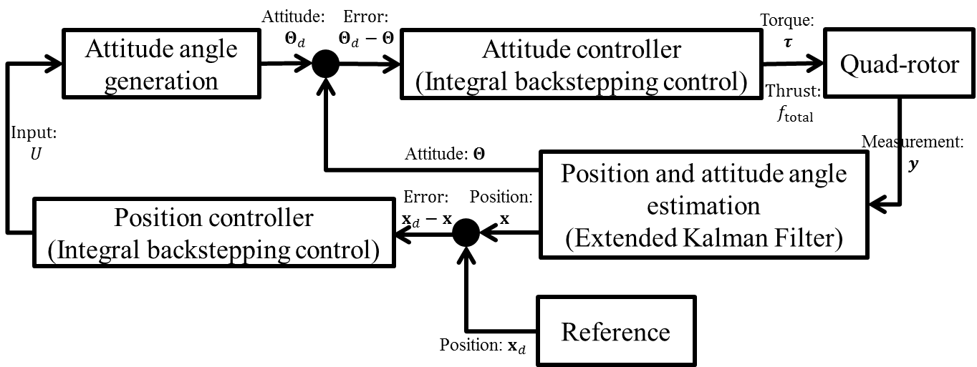

Slide 12
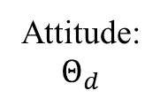
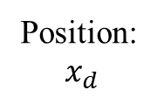
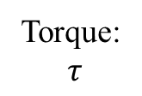
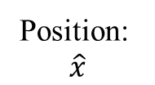


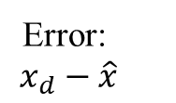
Attitude:
$$Θ_{d}$$
Torque:
$$τ$$
Attitude angle
generation
Attitude controller
Quad-rotor
Input: U
Error:
$$x_{d}−\hat{x}$$
Position:
$$\hat{x}$$
Position and
attitude angle estimation
(Extended Kalman Filter)
PID position controller
$$−$$
$$+$$
Position:
$${ x}_{d}$$
Reference

Slide 13




$$z_{b}$$
$$x_{b}$$
$$y_{b}$$
650g, 2633KV
Propeller(Inch):
5(diameter) × 3(pitch)
LiPo (3Cell 1800mAh)

Slide 14

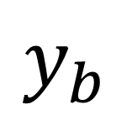

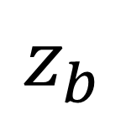
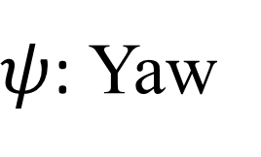
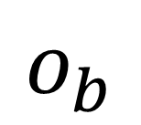
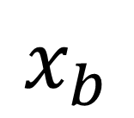
$$z_{b}$$
$ψ$: Yaw
$$y_{b}$$
$$o_{b}$$
$θ$: Roll
$$x_{b}$$
$φ$: Pitch

Slide 16
z
y
x

