Slide 1
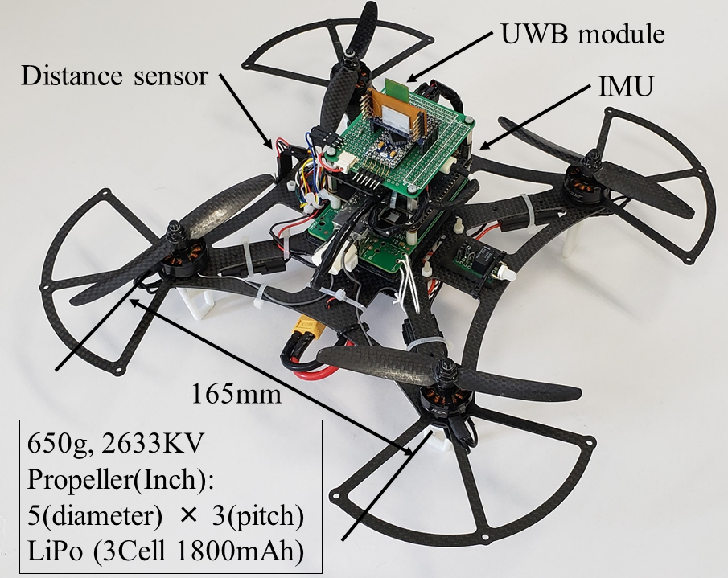
A Positioning System and Position Control System of a Quad-Rotor Applying Kalman Filter to a UWB Module and an IMU
Shota Nakamura
Division of Mechanodesign, Kyoto Institute of Technology, Japan
Yoshiyuki Higashi, Arata Masuda and Nanako Miura
Faculty of Mechanical Engineering, Kyoto Institute of Technology, Japan
Position estimation methods of
a quad-rotor applying data from an IMU and a UWB module to Kalman filter
Position holding control experiment
using the proposed position estimator
Position moving control experiment through three target points in sequence
Developed quad-rotor mounted
a UWB module and an IMU

